Slide 1
Viva Amplify 101
Get started with Viva Amplify

Slide 2
What is Viva Amplify

Slide 3
Microsoft Viva Amplify empowers leaders and communicators to elevate their message and energize their people by meeting employees where they are
Communicate easier
Centralize communication processes in a single space, so you can save time and focus on what matters
Communicate better
Write messages that stick with writing guidance and reporting from your organization
Be heard
Drive engagement with your message by meeting employees where they are
Notes:
Viva Amplify helps leaders and communicators elevate their message and reach employees where they are, across email, intranet, communities and teams, so that they can inform and motivate their audience. Because Amplify is founded on SharePoint, the same content management policies apply to Amplify. We want people to communicate easier, communicate better, and be heard.
Whether you are an individual project manager ​or a team of comms professionals, you can spend less time re-creating messages and more time empowering others to scale & reuse what you have created. With campaign creation, management, publishing, and reporting in one place, Amplify saves you time and makes it easy to improve your messages. Writing guidance, reporting, and best practices from your organization help evolve communications so that you can be heard and drive engagement with your people.

Slide 4





Who is Viva Amplify for?
Corporate
Communicators and HR
Business Leadership
And Support
Functional or Role
Communications
Communication
creators
Specialized needs
Professional comms roles
HR, talent, benefits
Internal corp comms
Employee advocacy connection
Workforce communications
Execs & chief of staff roles
Liaisons, branch, site, franchise managers
Administrative professionals
Vertical communications
Internal campaigns, stimulus
Facilities and services
Sales and marketing managers
Change and IT managers
Scenario-based needs
Project managers
Line of business operations
Team leads
Notes:
There are four main groups we think would benefit from Amplify:
Corporate communicators or HR. An example of a campaign that HR would send with Amplify is “Open Enrollment for Benefits” – this might have multiple emails where they are requesting action from employees. They can create, manage, and publish this campaign straight from the hub.
Business leaders and support roles could also simplify their communications with Amplify. Leaders or their staff could create campaigns around culture initiatives, strategic updates for their teams, necessary trainings that need to be completed, and much more to keep their employees in the loop and engaged
Another place we see Amplify is in functional roles that send high volumes of communications. For example, marketing managers sending weekly newsletters or IT managers sending periodic updates on compliance and security can see if their messages are being read and acted on
Another example is in certain scenarios, like for project managers, whose role it is to keep everyone up to date on a project or task – Amplify can help them create campaigns that track readership to see who’s been informed

Slide 5





Summary:
What can you do with
Viva Amplify?
Plan & Manage
Orchestrate & Automate
Design & Create Content
Publish Universally
Measure Effectiveness
Notes:
Viva Amplify enables communicators to:
1. Plan and manage: You have the ability to manage a series of communications as a campaign. Campaign Management becomes a new Microsoft 365 capability
2. Orchestrate and automate: Defining, creating, automating and managing campaigns simplifies the process
3. Design & Create Content: Author a communication once and get guidance from your organization on how to make your communication better
4. Publish Universally: Post and amplify your communication in multiple apps simultaneously
5. Measure effectiveness: Amplify will have reporting on how effective your communications were at reaching people and depth of engagement.

Slide 6
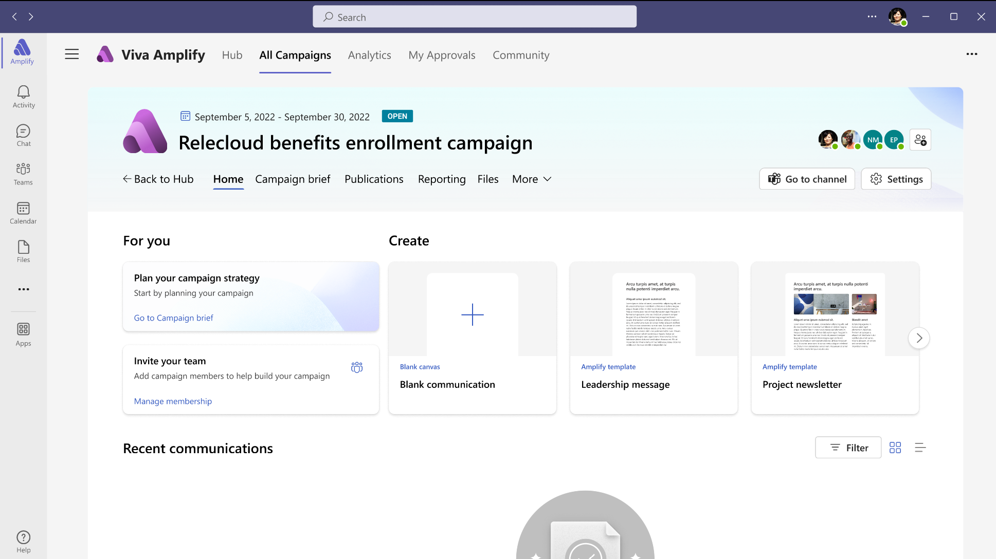
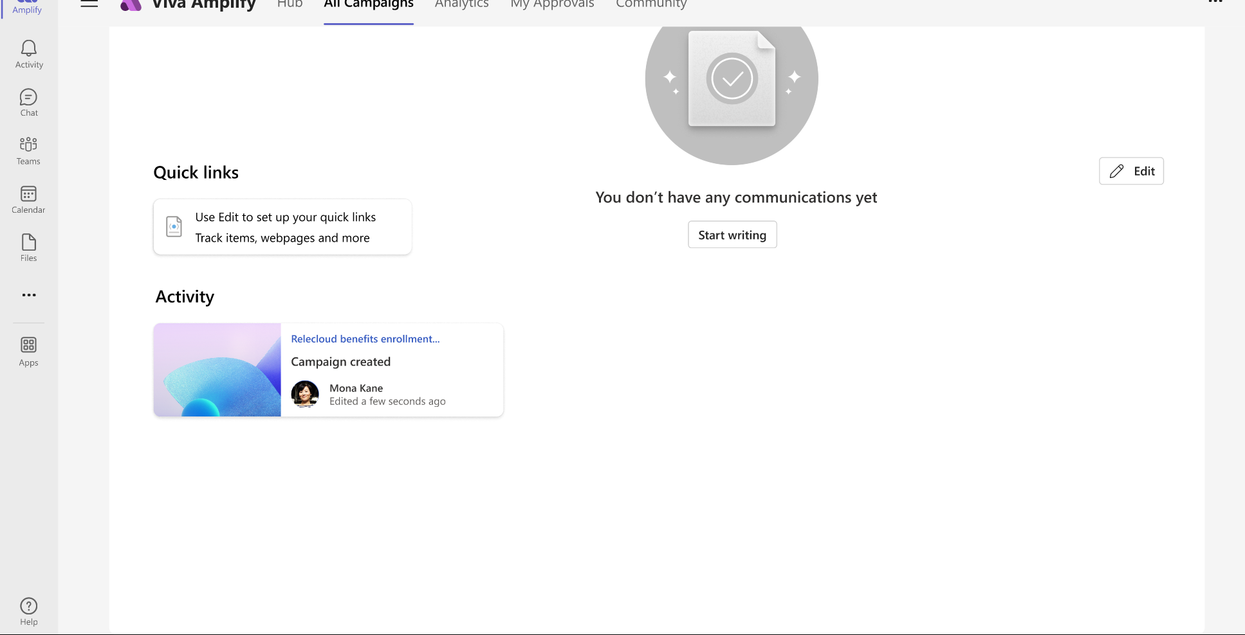

Communicate easier
Provides communicators with a centralized view to create, manage, publish, and evaluate their campaigns in one place
Create campaigns that include multiple communications
Separate message writing from distribution channels by creating comm once
Track reviewers and approvers
Manage multiple campaigns at once
Built as an app on top of SharePoint and can use MIP, permissions, content management features
Notes:
Viva Amplify helps you communicate easier:
Reduce clutter by planning, analyzing, writing, and publishing communications in a single hub
Write messages faster and more effectively with writing guidance and best practices from your organization (companies can upload brand guidelines and authors can get tips from experts in their organization through the community feature).
Save time on publishing by automating campaigns with an editorial calendar – no need to do this manually. [The Forrester TEI study showed a case with a CEO who said Viva Topics freed up 15% of HR and corporate communications teams’ time – this same team is developing Viva Amplify.]
Seamlessly manage approvals with workflows that show who is reviewing messages at which time
Stay focused by managing the lifecycle of various campaigns from one place

Slide 7
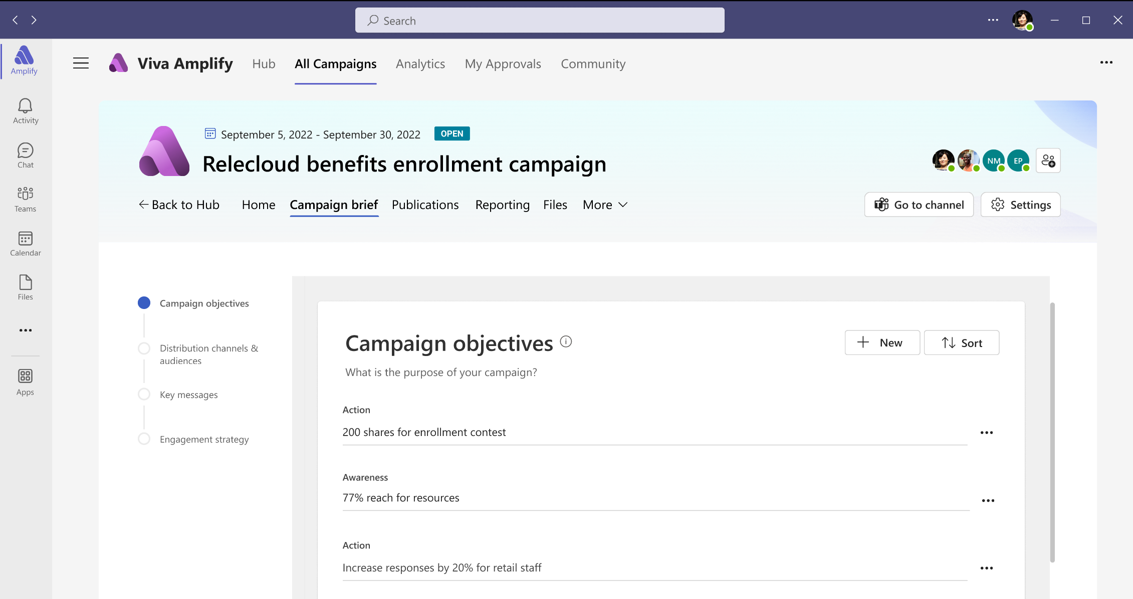


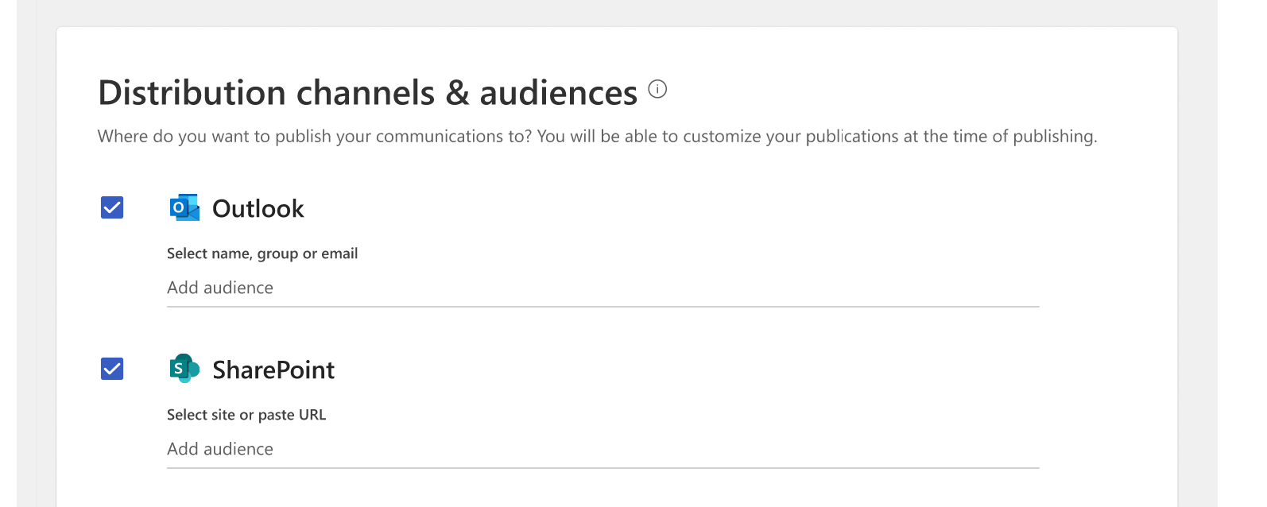

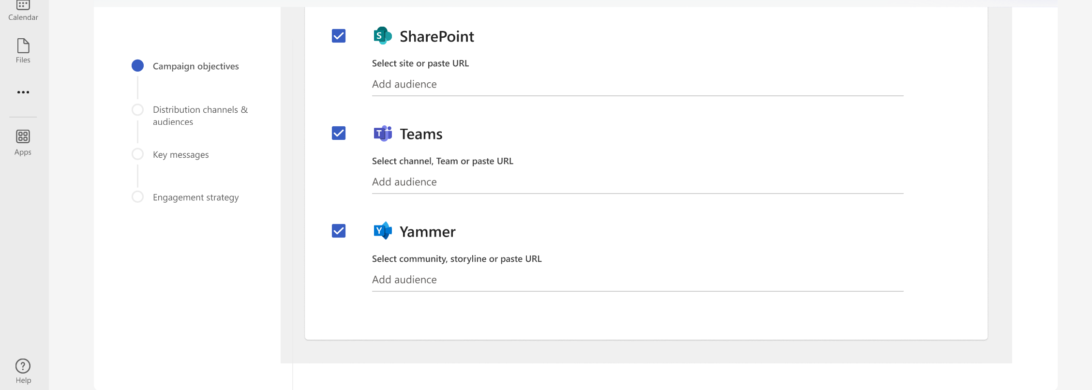

Communicate better
Guides campaign communicators
to write messages that stick, with writing guidance and reporting
Write quality messages that resonate
Get best practices from guidance
Align stakeholders
Set goals and measure success
Use reporting to improve your message
Notes:
Write a message that sticks with writing guidance, reporting, and experts from your organization:
Write quality messages with guidance on tone, style, accessibility, and key points that resonate with your audience
Grow as a communicator by incorporating best practices from experts
Use Campaign Objectives to set goals and measure outcomes so you can make your message a success
Understand how people are interacting with your message and adjust accordingly so that your communications get better and better each time

Slide 8
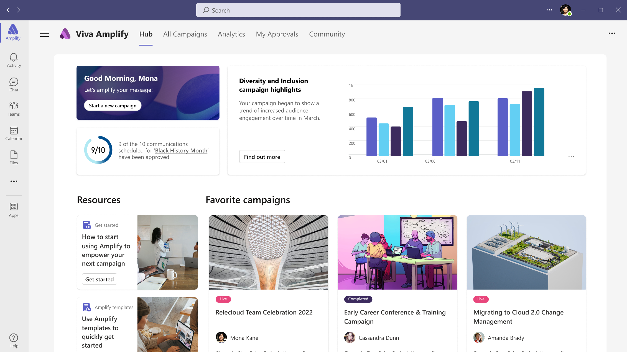
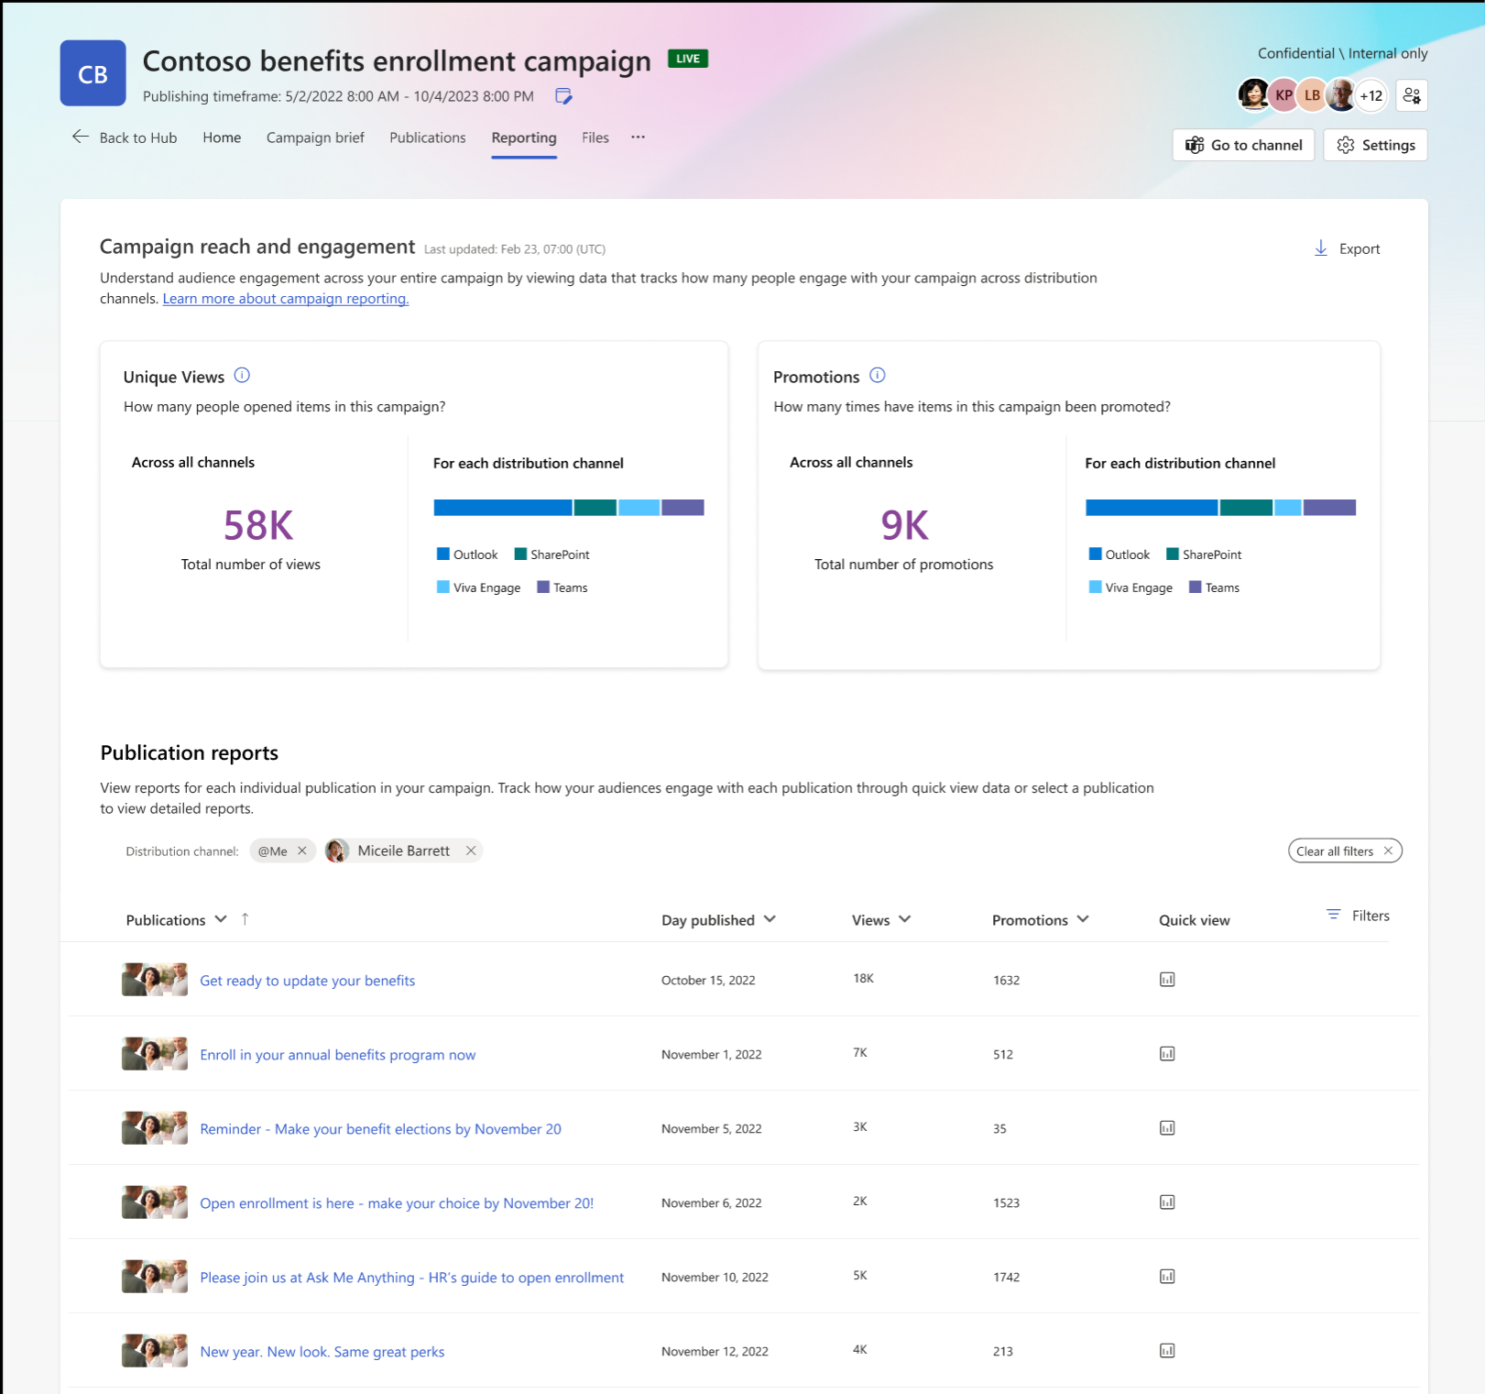
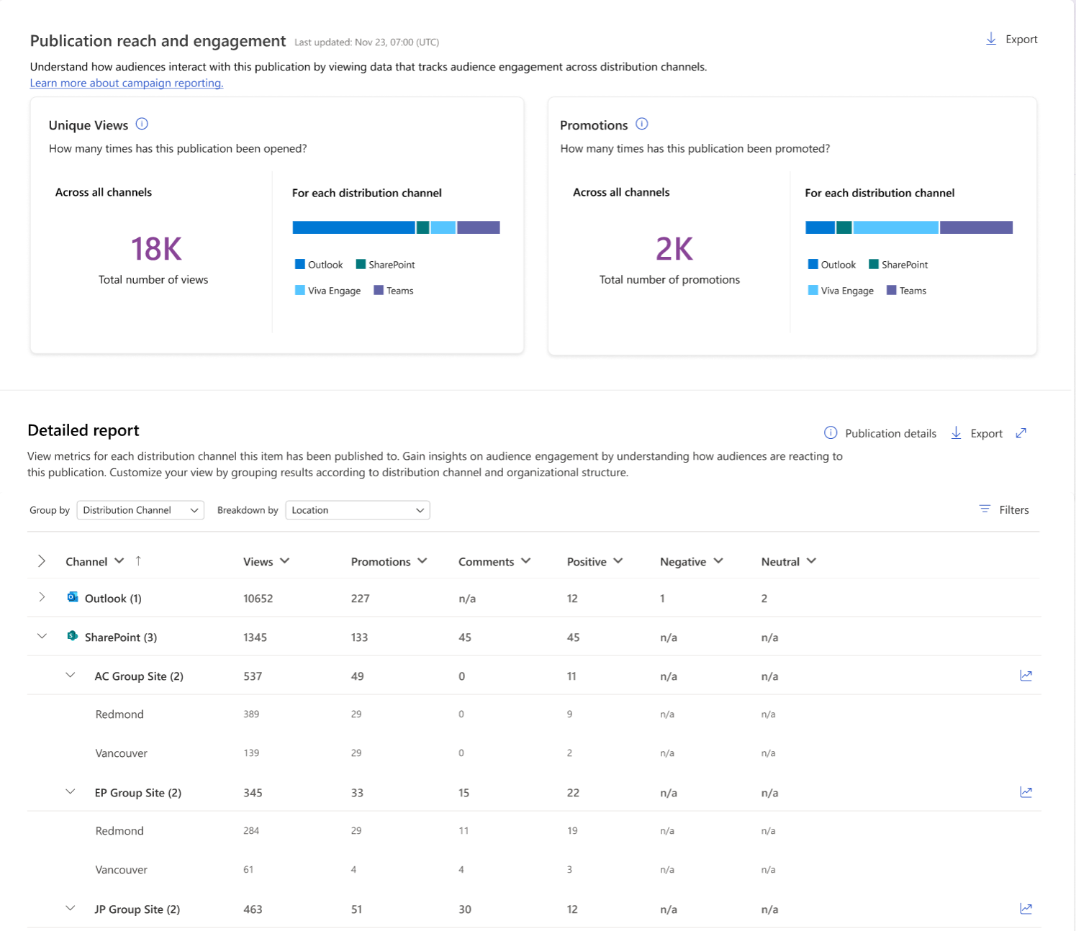
Be heard
Drives engagement with internal audiences by better understanding reach and impact
View aggregate results across campaigns, specific publications, or audiences.
A single dashboard to measure reach across Teams, SharePoint, Mail, Viva Engage
Overlay HR and Org data to create reports that measure critical business impact for your organization
Understand which campaigns and publications are most effective in order to replicate success
Notes:
Drive engagement with your message by meeting employees where they are:
Maximize reach to boost critical news, using reporting to understand the optimal channels for publishing
Be heard by easily tailoring communications to specific distribution channels and groups
Grow readership by automatically publishing to multiple apps at the same time
Specific metrics that are measured include % read, # of times promoted (shares, forwards, mentions), and # of interactions (Like + comment). We do not have dwell time in v1 though it may be a consideration for the future.

Slide 9
Scenarios

Slide 10

Creating Scenarios
…description or an outline of a series of events that could possibly happen or that are imagined
• “Cover” tells the BIG story of their success.
• “Headlines” convey the substance of the cover story.
• “Sidebars” reveal interesting facets of the cover story.
• “Quotes” can be from anyone as long as they’re related to the story.
• “Brainstorm” is for documenting initial ideas for the cover story.
• “Images” are for supporting the content with illustrations.
Notes:
Before starting with the technology tools, think about what types of campaigns you want to produce.
The innovation game Cover Story can help in thinking about campaigns. If you already have ideas of your own for campaigns done in the past, that’s ok and you can always come back to this section for ideas.

Slide 11
Creating Scenarios– Benefits Campaign
Benefits Campaign is on the cover
Big Headlines are the campaign Brief:
  What is the goal of the campaign-Objectives
  Who is the audience for this campaign
  What key messages will you deliver
  What are the distribution channels
Sidebars:
  What are some messages that people will read?
Quote:
  What you hope or heard end users say about your campaign
Notes:
It’s important to break down the elements into different sections. You can use this layout or other layouts in creating your campaign ideas before you even start using Viva Amplify.

Slide 12
Brainstorm your first campaign!
Headline
Date
Sub headline
Customer Quote
Sub headline
Did you know...
Interesting fact
Interesting fact
Interesting fact
....
Leadership Quote
Notes:
Get started brainstorming your first campaign with a few easy areas.

Slide 13
Campaign of the Year cover story
Notes:
Use this blank template to get started by simply drawing a few areas to brainstorm information.

Slide 14
‘Campaign of the year’ cover story Template
Cover | Tells the big story | In Viva Amplify this relates to the overall Campaign brief. What Goals or Objectives do you have for your campaign to accomplish. This might be to make people aware or take action over time.
Audience | Who is this message for? | Thinking about the audience helps to set a target of people in which to share the message. This might be broken down into sectors of the business, by role, by location or other unique identifier. It could also be for everyone across the company as many campaigns are.
Headlines | Conveys the cover story to the right audience | Headlines are those key messages that are outlined in the Campaign brief. These would typically be titles of the publication. For instance, in doing a benefits campaign, you might have several headlines or titles for your publications... “Announcing Benefits Weeks”, “Review your Benefits Now”, “One week left for benefits” are all starting points for titles that capture attention from your audience.
Sidebars | Reveal interesting facts that this audience would want to know | Facts and figures can be important information for your audience. Include those in this area.
Quotes | Can be from anyone, related to the story (leaders, customers, partners) | What do you hope your audience says or is saying about your campaign. You can also include quotes from previous campaigns or highlight key quotes from leaders.
Brainstorm | Initial ideas | Have an idea, but not sure where to put it. Might be a subject area you need a little more brainstorming on. Use this as a parking lot area to include those ideas that aren’t fully aligned yet.
Images | Supporting content | Pictures tell the story of 1000 words. What images will you include?
Goals | Objectives, impact, or call to action | Did we meet our objectives? Did people take action? Did your campaign create the right impact? Write them here to be able to think about how to frame those messages.
Notes:
Or you can use this grid type layout.
The participants must pretend as though this campaign has already taken place and has been reported by the mainstream media. Tell the story of the “campaign of the year” as if it was on the cover of a magazine. Be creative and have fun brainstorming the elements of this campaign.

Slide 15
How to think about campaigns
Campaign I only do 1X per year, but go to all employees throughout the company with multiple messages
Examples:
Benefits Campaign
Giving Campaign/United Way
Health/Wellness
International Days/Months – Womens day, Mens Health, Cancer Awareness, etc
For these types of campaigns, the recommended practice is to set these up as separate campaigns and separate groups as you may have different resources working in the Teams instance.
Campaign that I do several times in a week or month to communicate to different groups of employees or all employees.
Examples:
Training/Learning available
Daily updates
Project Updates
New tech updates
Changes to org/staff
For these types of campaigns, you can choose to set up a separate campaign for each, but it may work best to bundle for less Teams instances.
Notes:
How you should think about campaigns starts with thinking about the overall architecture of the Viva Amplify product.
Each campaign creates a M365 Group, which also creates a corresponding SharePoint site and Teams instance. In order to minimize the group creation of campaigns, you will want to group together like campaigns for purposes of doing your communications.
There are two scenarios here, one where you have a campaign that you do 1X per year, but have multiple publications associated with that campaign. Ideas like Benefits, Wellness, Charitable Giving, all fit this type of scenario. For this, you create a campaign and are likely working with additional people and even outside vendors to create the communication and resources associated with the campaign. For this, you would set up separate groups to be able to track the metrics associated with the entire campaign for each of the communications/publications that go out across the company.
The other scenario is where communications are done several times per week or month but are all associated with a topic. Topics like project updates, training that is available, C-suite communications or any type of change management. Instead of creating these as all separate campaigns, it’s a little easier to create them as one campaign and do all the corresponding communications under that campaign. The tracking that is available then allows you to compare which messages landed with your audience over time.

Slide 16
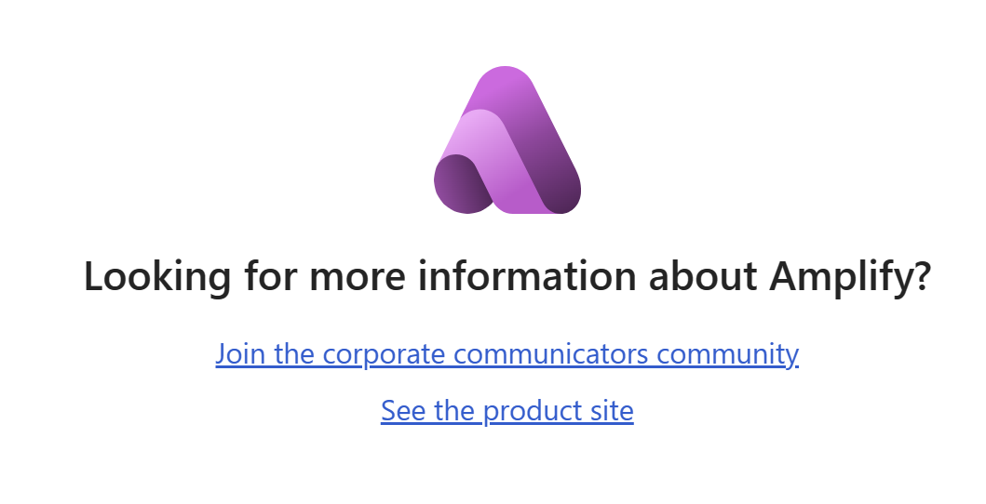
Resources for Campaigns
Notes:
As part of the product on the Get Started page, you will find more information about Viva Amplify.
If you are looking to join a community or just read some additional information on your own, there are resources to help you get started.

Slide 17
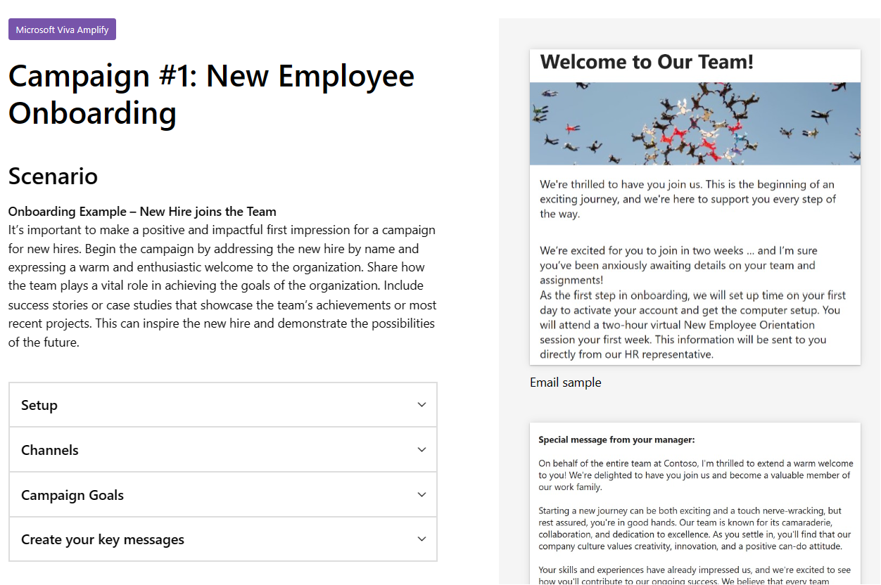
Campaign Catalog Resources
Need some ideas to get started with creating campaigns? Check out the Campaign Catalog located on adoption.Microsoft.com under Viva Amplify.
Campaigns include:
New Employee Onboarding
Benefits
Project Updates
Charitable Giving
Training
New Technology Changes
Letters from Executives
Notes:
Still stuck on how to start a campaign, the Campaign catalog is a great resource that already has some of these ideas outlined.
The Campaign catalog is intended to be used as an idea generator, rather than fully operational campaigns for your company.

Slide 18
Licensing and sign In

Slide 19
Product Limitations (Sept 2023)
Vanity URLs
The product will have limitations when used with vanity URL’s. If you company has a vanity URL please reach out to your account representatives for the best approach on using the product within your organization.
Localization
At launch, the product will be available exclusively in English. We are working to expand to other languages.

Slide 20
Set up Licensing for Viva Amplify
The following service plans are enabled for licensed users for the following products:
Microsoft Viva Employee Communities & Communications
Microsoft Viva - Learn more: Set up Microsoft Viva | Microsoft Learn
Microsoft Viva for Faculty
Microsoft Viva with Glint add-on
Microsoft Viva with Glint add-on for Faculty

Slide 21
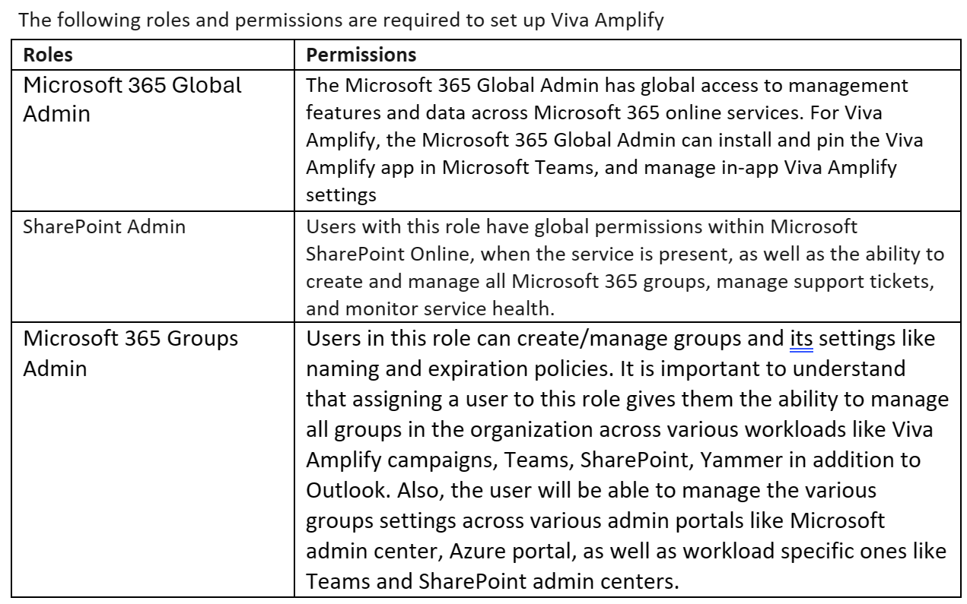
Admin Roles
Notes:
Learn more about Microsoft 365 roles here: Azure AD built-in roles - Microsoft Entra | Microsoft Learn

Slide 22
Steps to Assign Admin Roles
Assign Admin Roles
Sign in to the Microsoft 365 admin center and go to Microsoft Viva and select ‘Viva Amplify’
Choose Assign SharePoint Administrator Role settings
Search for the user by entering the user name or email.
Select the user(s) for whom you want to assign the SharePoint Administrator role.
Choose Assign Groups Administrator Role settings
Search for the user by entering the user name or email.
Select the user(s) for whom you want to assign the Groups Administrator role.
Select Add.
Important:
A user must be assigned both Admin roles to manage settings in Viva Amplify
Alternately, you can also assign roles by going to ‘Roles’ and then Role assignment in the Microsoft Admin Center.

Slide 23
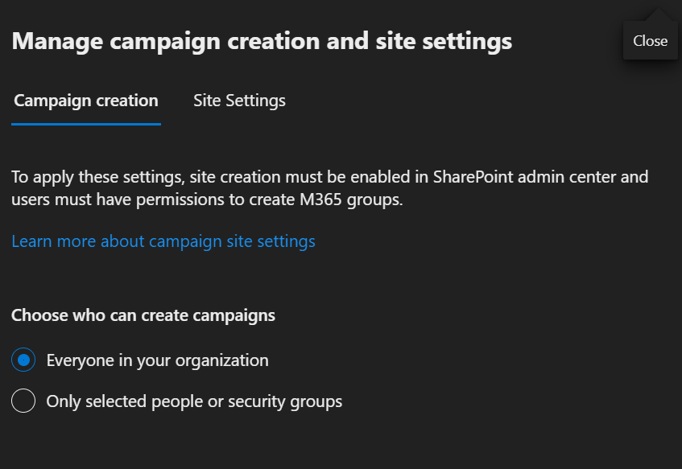
Who can create campaigns?
Viva Amplify is designed so that users with a wide range of roles, such as project managers who do regular status reports for stakeholders, can benefit from using campaigns. You can use the admin controls in Amplify to restrict who can create campaigns:
Keep the default selection that enables everyone in the organization to create campaigns with Amplify.
Choose to indicate specific people or security groups only to allow only select users to create campaigns.
Important Consideration. Both Site creation and group creation permissions need to be enabled and provided to a user in the SharePoint admin center before adding them as a campaign creator. To learn more: https://learn.microsoft.com/en-US/sharepoint/manage-site-creation?WT.mc_id=365AdminCSH_spo
Notes:
Viva Amplify is designed so that users with a wide range of roles, such as project managers who do regular status reports for stakeholders, can benefit from using campaigns. You can use the admin controls in Amplify to restrict who can create campaigns:
Keep the default selection that enables everyone in the organization to create campaigns with Amplify.
Choose to indicate specific people or security groups only to allow only select users to create campaigns.
Important: First, make sure both site creation and group creation permissions have been enabled and provided to a user in the SharePoint admin center before adding them as a campaign creator. Learn more: https://learn.microsoft.com/en-US/sharepoint/manage-site-creation?WT.mc_id=365AdminCSH_spo

Slide 24
Create a campaign

Slide 25
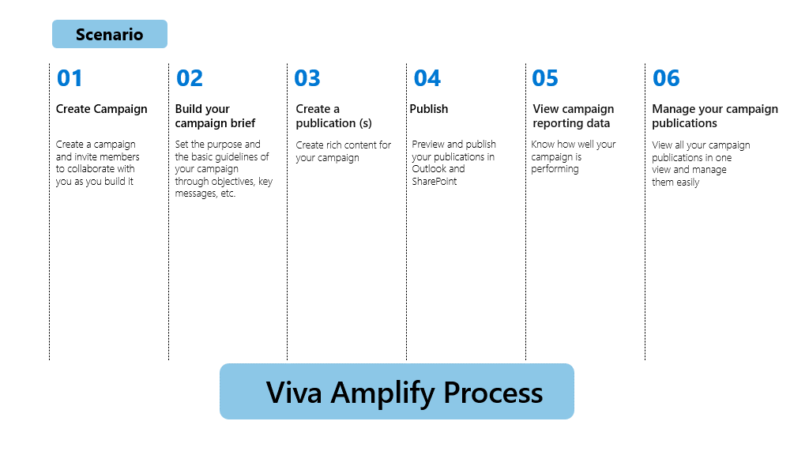
Viva Amplify Process Flow

Slide 26
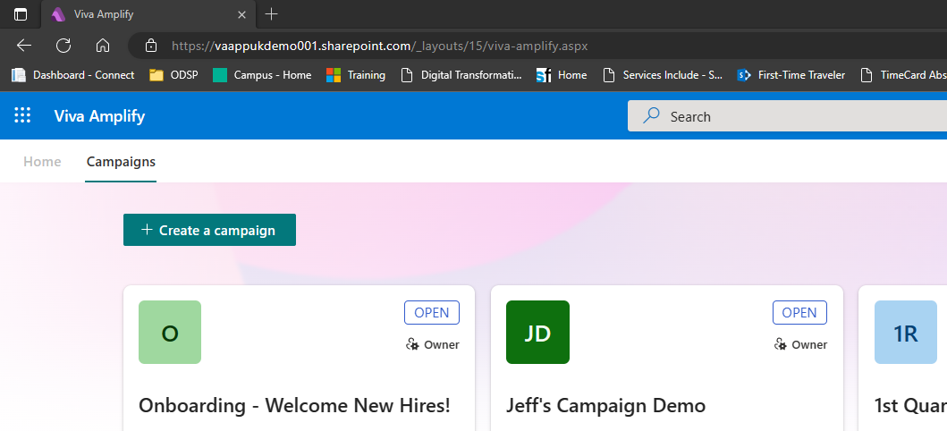
Create Campaign
Notes:
To get started at the HUB. The appended URL needs to include /_layouts/15/viva-amplify.aspx to get to the Viva Amplify product.
This will show only your campaigns that you are a member or owner of. This works against your One Drive User profile to populate the campaigns in this section. If other campaigns are created by co-workers, you will not see them here unless they include you in the campaign as an editor or owner.
To get started creating a campaign, click the +Create a campaign button

Slide 27
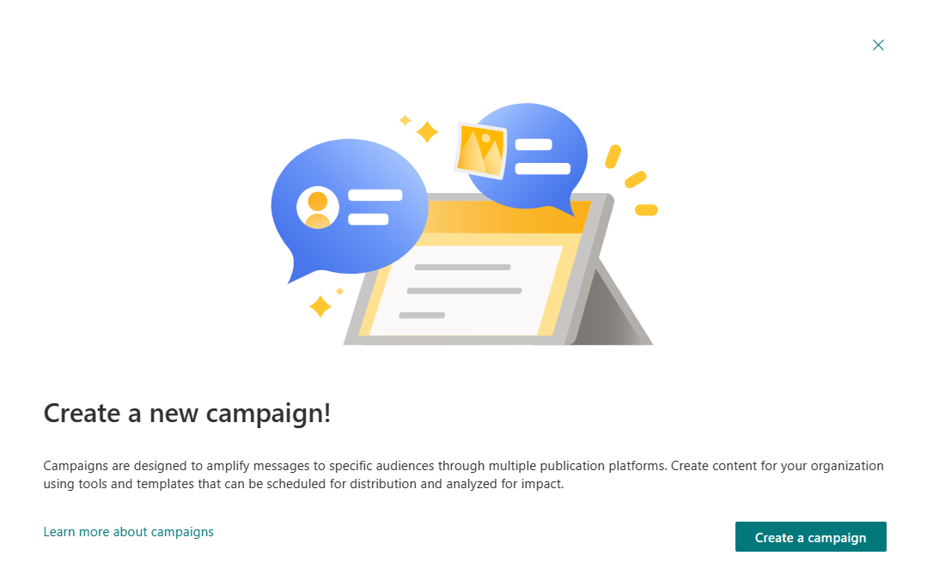
Click Create a New Campaign
Notes:
Another look at a blank screen that is from a user that doesn’t have any campaigns they have as owners or editors. To get started, click Create a campaign button.

Slide 28
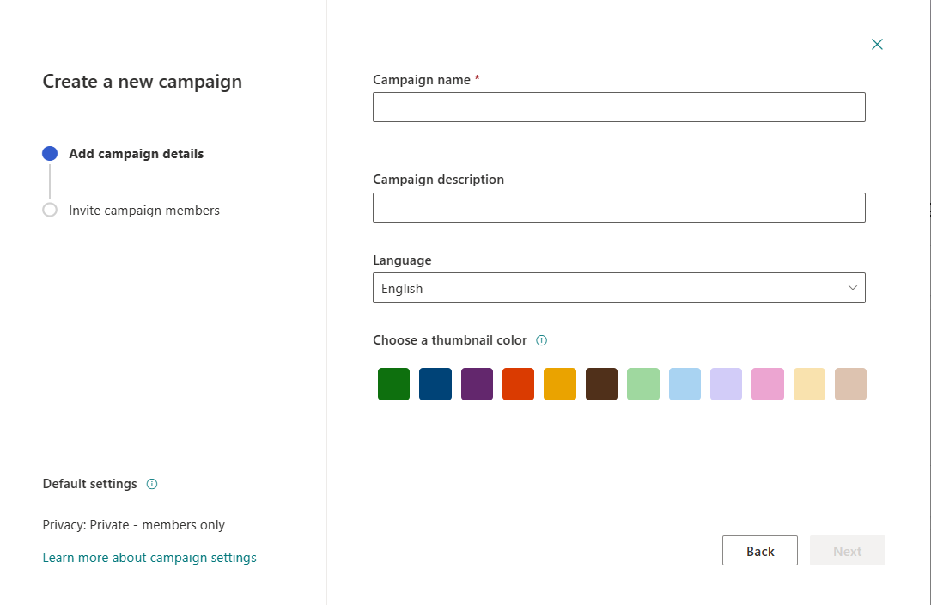
Create a New Campaign
Create a Campaign Name. Name must be unique
Enter description
Language = English only (GA)
Choose a color
Click Next
Notes:
Campaign details include:
Campaign name: This must be unique to M365 Group. If you have a group with the same name as your campaign, it will not let you create the campaign as the group already exists. This must be unique.
Campaign Description: A freeform description of your campaign.
Language = English only for now.
Color: This is just a unique identifier that will show against the campaign hub (the main page where all your campaigns are listed. You can color code for quick reference or just chose the color you like each time.
Click Next when finished.

Slide 29
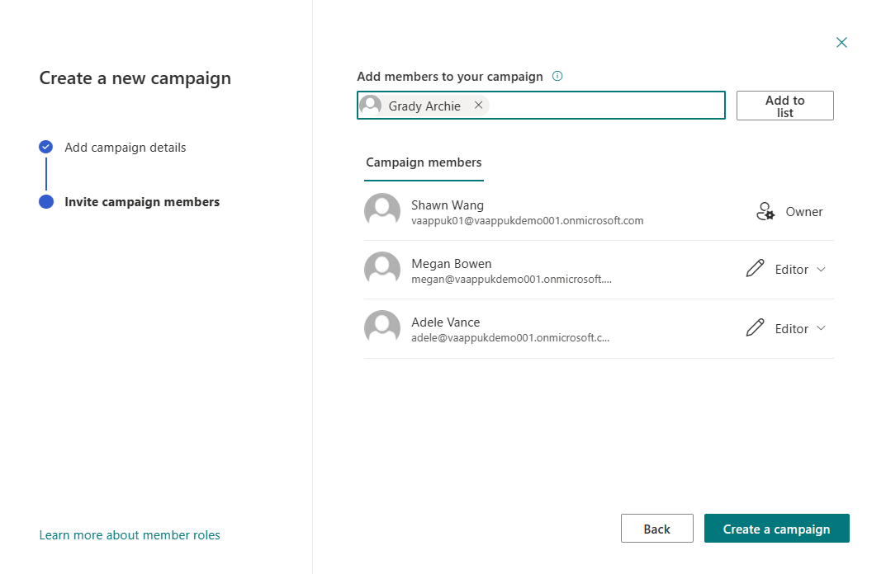
Add Members
Those users who would be part of the campaign and author publications should be added.
This creates a M365 Group. You will need to have Group creation rights turned on.
Notes:
Member roles:
Owner (Full control)
Enables users to have full control of the campaign
Approver (Contributor & approver)
Edit and approve Viva Amplify content, list items and documents
Editor (Contributor)
Edit and manage lists, campaigns, and publications
Learn more about User permissions and permission levels in SharePoint Server

Slide 30
Create a campaign brief

Slide 31
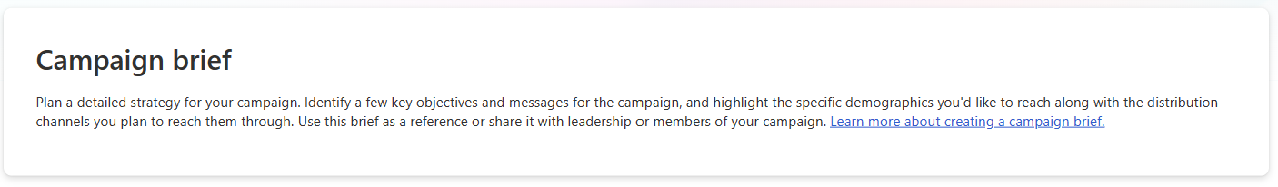
Campaign Brief
Use the campaign brief to establish basic guidelines of your campaign
This can be used as a reference for anyone to get up to speed quickly on what the campaign is all about.
This is where you set campaign objectives and key messages.
Use the campaign brief when you get a new idea for a campaign and take the time to map out what your campaign will look like, who it will be for and what success should look like.
Notes:
Build a Microsoft Viva Amplify campaign brief (Private preview) - Microsoft Support

Slide 32
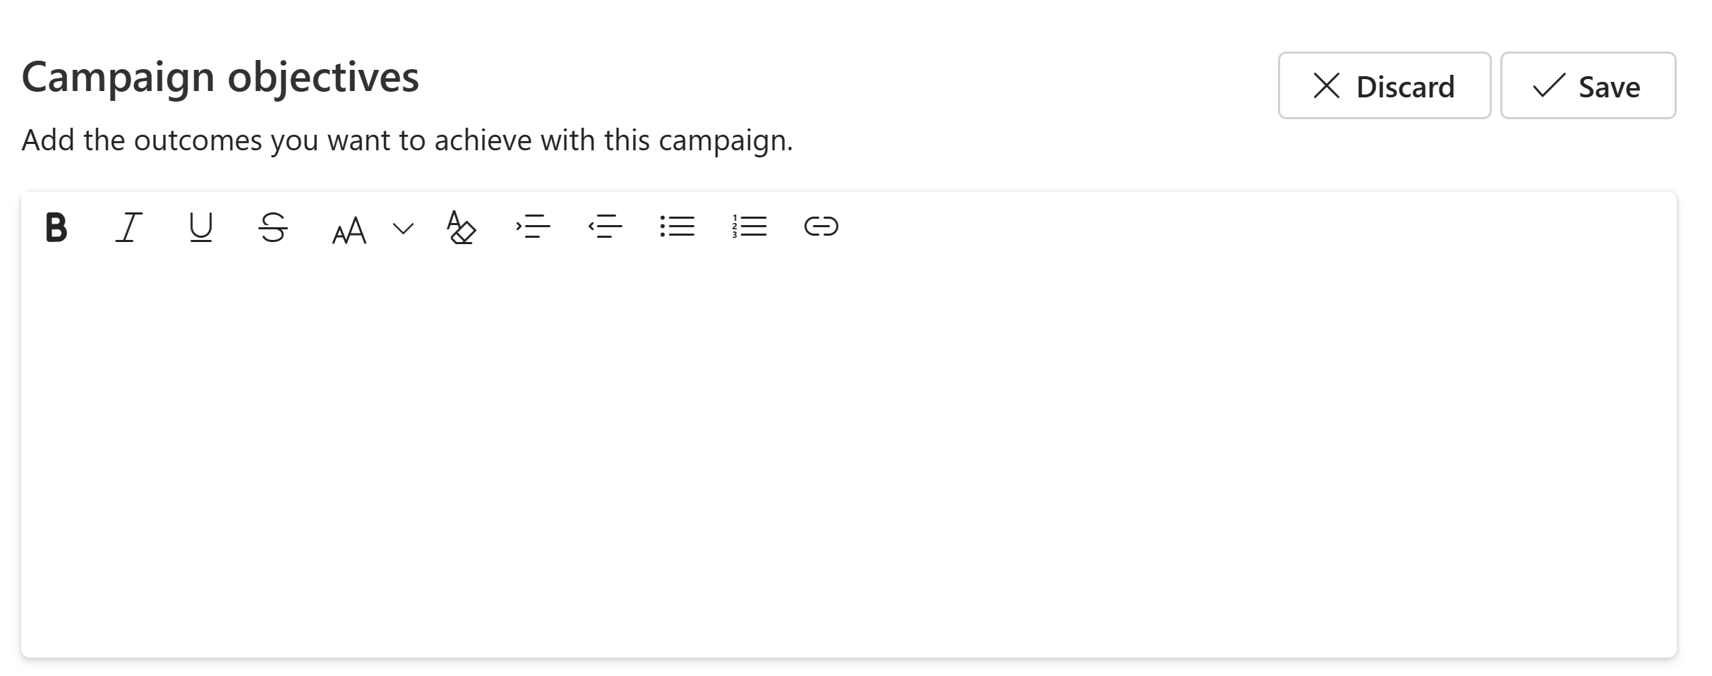
Campaign Objectives
First start by creating 1 or several campaign objectives. These are goals that will be associated to your messages.
Objective Details:
Title of the objective
Description
Examples of campaign objectives
Raise 100,000 $ for the Breast Cancer Awareness month
Increase employee participation by 30% for a specific volunteering event
Build awareness for an upcoming product launch
Notes:
Add one or more campaign objectives by selecting +New and filling out the details below. Objectives are the first components of a campaign strategy and describe the main outcome (s) you want your campaign to achieve for your organization.

Slide 33
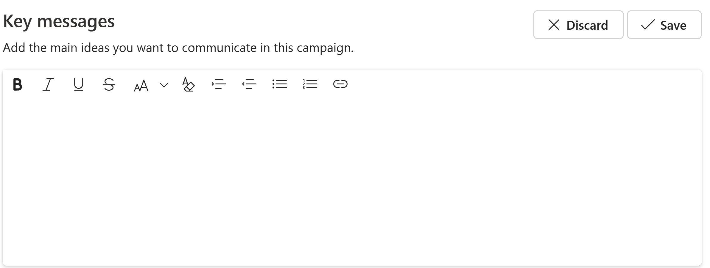
Key Messages
Next is to plan your key messages. This is a high-level plan of what you will communicate over time.
Examples include:
It’s almost time for Benefits. Benefit selection starts in November so be sure to get your benefits reviewed for you and your family
Open Enrollment begins next month. Review your family benefits at <link> to make informed decisions in November
Benefits enrollment is now open. Make your selections before November 15 for you and your dependents.

Slide 34
Create a publication

Slide 35
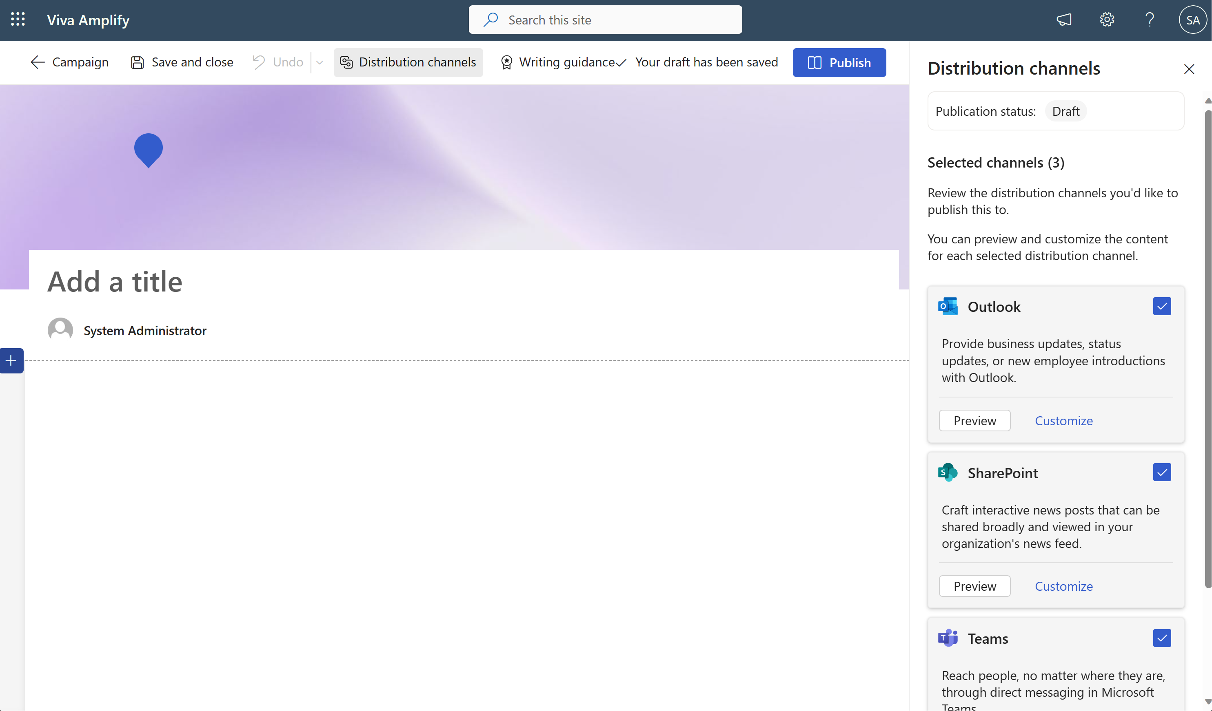
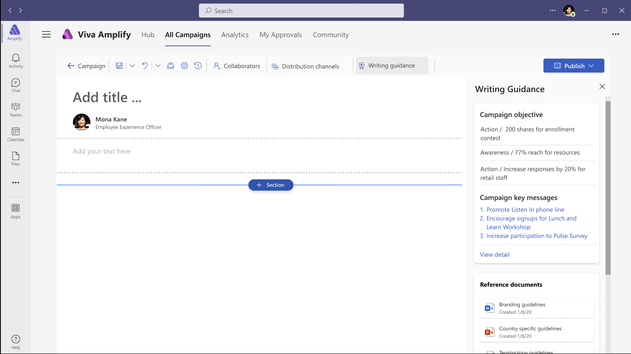
Viva Amplify Create Publication
Notes:
Creating a publication starts with creating a SharePoint newspost. The information in the newspost is then transpiled into different formatting options for outlook, Teams, SharePoint and Viva Engage.
Colors and branding will take on the look and feel of the SharePoint site it’s being posted to.

Slide 36
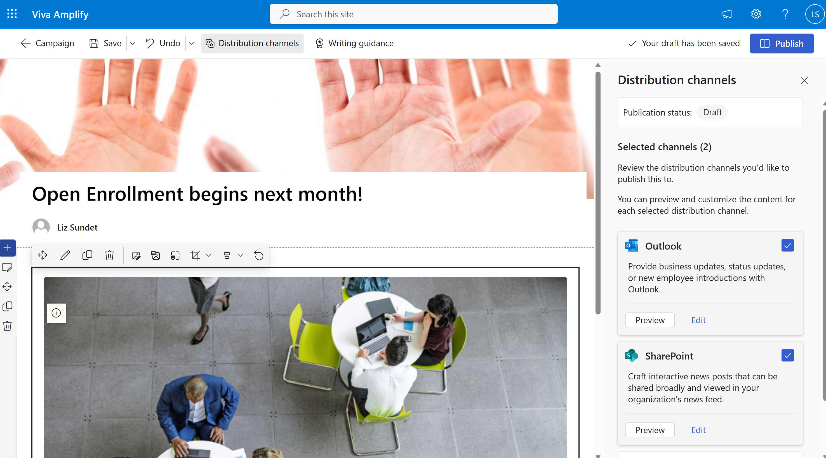
Create Publication content
Notes:
The publication should look familiar if you have ever created a SharePoint page from a site. In fact, it’s a scaled down version of a SharePoint page.

Slide 37
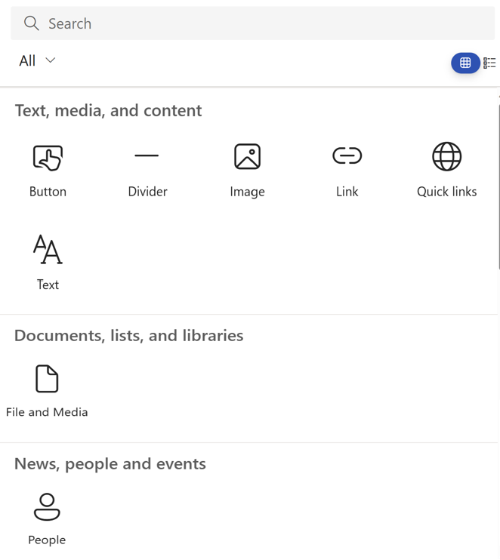
Publication webparts
Notes:
The publication should look familiar if you have ever created a SharePoint page from a site. In fact, it’s a scaled down version of a SharePoint page.
When searching for webparts, you will find Image, Text, Buttons, Dividers, Links, Quick Links, File and Media (Video or documents) and People within Viva Amplify. This is so that the publication can scale across all distribution channels when compiling the pages for all the channels.

Slide 38
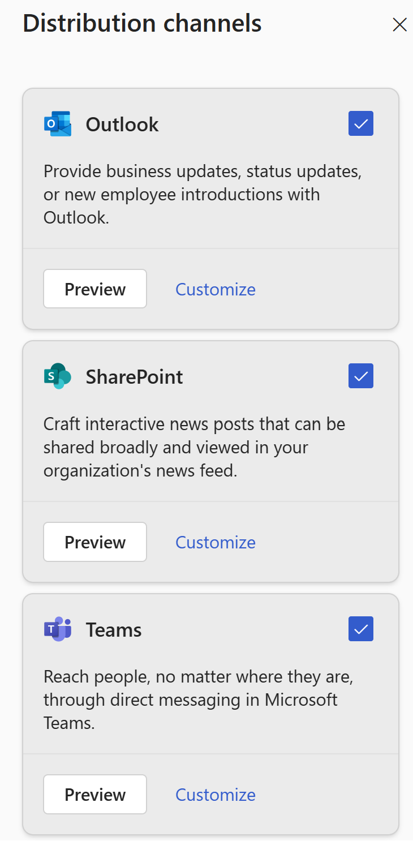
Distribution Channels
Select which distribution channels you want to publish this message to. You can select or de-select from here. The pre-selections are based on what you selected when creating the campaign brief.
You can also see the publication status. This is in draft as we haven’t published anywhere yet. Once this has been published, the status will change to published.
You can also select preview to see an example of what the page looks like against the different channels.
Notes:
Next let's take a look at the Distribution Channels.
We can select or deselect which channels we want this message to be sent. This is also where we will select our audiences. In outlook, this could be a distribution list or M365 Group. This uses the same functionality that is part of SharePoint today to send out the email using the sender's user profile along with SMTP in Exchange online. This will also use all of the security and compliance and policies you have in place to prevent people from sending messages if you have those in place. For instance, the use of All Company is typically restricted in many organizations. If you can’t send an All Company email today, you won’t be able to do it with the Amplify product either.
For posting to the SharePoint channels, we can select 1-Many SharePoint sites. It will only show the sites you as an author have access to be able to edit to. For instance, if you want to post to your corporate intranet, but you don’t have the rights to do that, the SharePoint site will not show up to be able to post to.

Slide 39
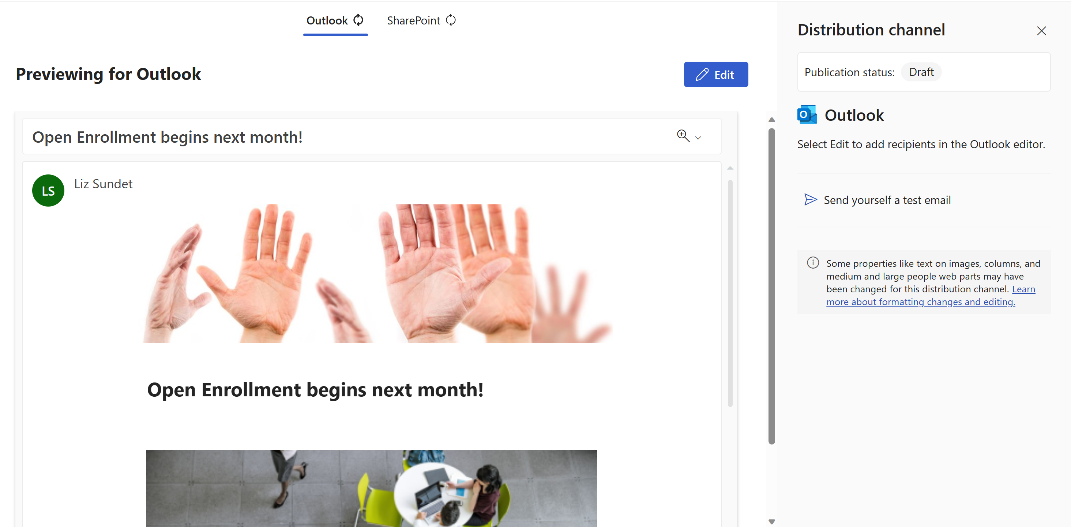
Preview for Outlook
Notes:
Here we can see a preview of what the layout for our message will look like in Outlook.
From here you can also send yourself a test email. The processing time for this is typically just a couple of minutes.
Next we will click on the edit button

Slide 40
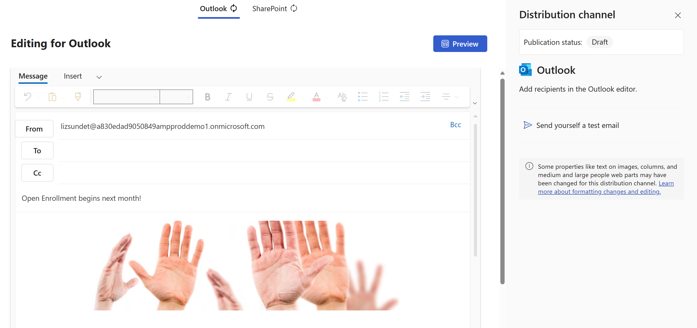
Add recipients to your email message
Notes:
(These next two slides should be presented together)
When selecting the edit button we can see that we can add users to the email message.
Our title of our publication is the title of the email message.
Our pictures are showing in line in the body of the email, along with any text.
At this time we can add additional text or make changes. (Click to morph) Any changes made at this point will result in a change from the main canvas and the sync circle at the top of the page will indicate this as not in sync. There will also be

Slide 41
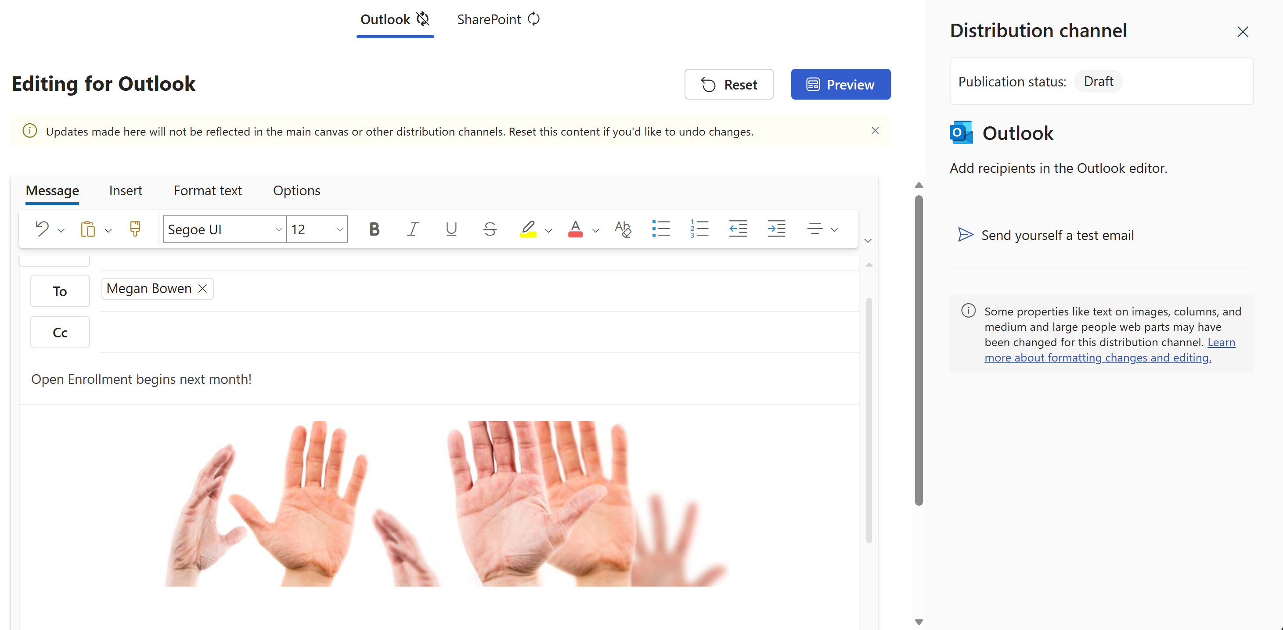
Outlook experience in Viva Amplify
Notes:
When selecting the edit button we can see that we can add users to the email message.
Our title of our publication is the title of the email message.
Our pictures are showing in line in the body of the email, along with any text.
At this time we can add additional text or make changes. Any changes made at this point will result in a change from the main canvas and the sync circle at the top of the page will indicate this as not in sync.
There is also the capability to send yourself a test email so you can see exactly what your audience will see when receiving the emai.

Slide 42
Other email capabilities
Ability to send on someone else’s behalf as a delegate
Ability to send from a shared mailbox – CorporateCommsTeam
Ability to select DL’s, Groups, individuals
Transport rules applicable to sending emails work through Amplify, same rules that apply in Outlook
Colors can be changed in the preview.
Notes:
You can choose to change the sender (To) if you have delegate access for someone else. This is set up in Exchange, but Amplify will pull in the same properties. Likewise, the ability to send from a shared mailbox (also set up in Exchange) will allow the sender to obfuscate the message coming from a group of people rather than an individual.
You can select Distribution Lists, M365 Groups, and individuals just as crafting the message in outlook. There is a limit on the number of addresses Message size and recipient limits in Exchange Server | Microsoft Learn outlined. Transport and other applicable rules apply when sending email messages from Amplify. All retention policies for any endpoint apply to which endpoint and are set up as part of the Security and Compliance features in M365.
Colors can be changed in the preview to match what colors/branding you have for the organization. This is not part of the templates in Amplify.

Slide 43
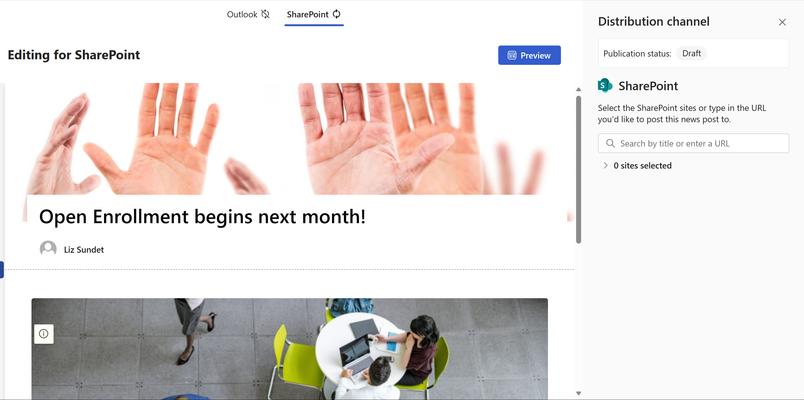
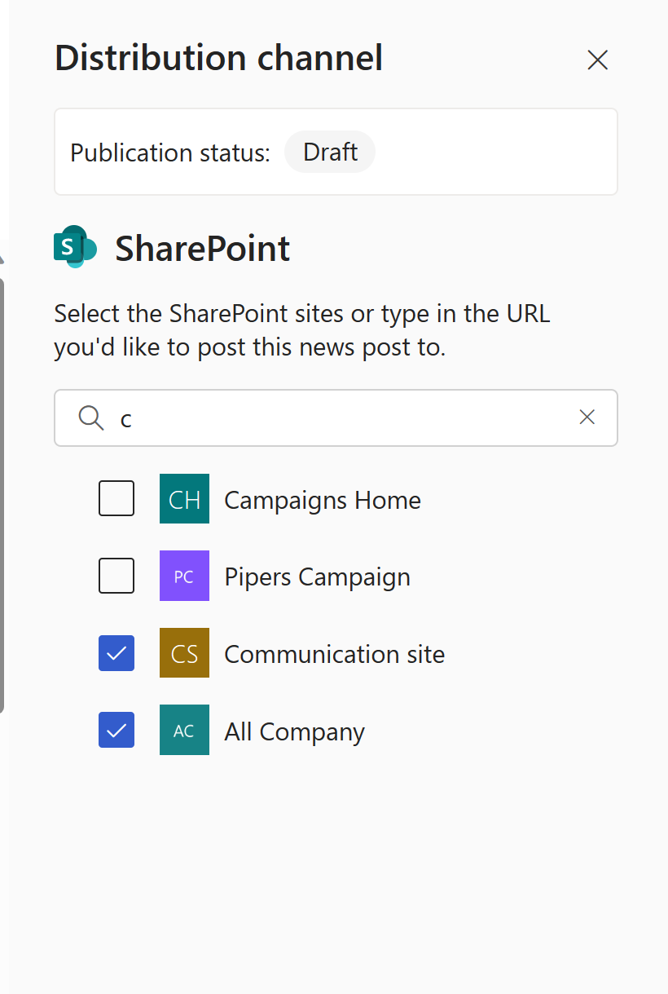
Preview in SharePoint
Notes:
We can also look at the preview in SharePoint.
If we open the distribution channel we can search for the sites that you can post to. This will show the sites you have access to as an owner/editor.
You can post to any SharePoint site, either a communications site or a team site.
When the page is published, the page is replicated to all sites and will appear as a newspost just as if it was created on that site to start. This will then appear in either the News webpart or Feed for Viva Connections depending on which webparts you have on the site.

Slide 44
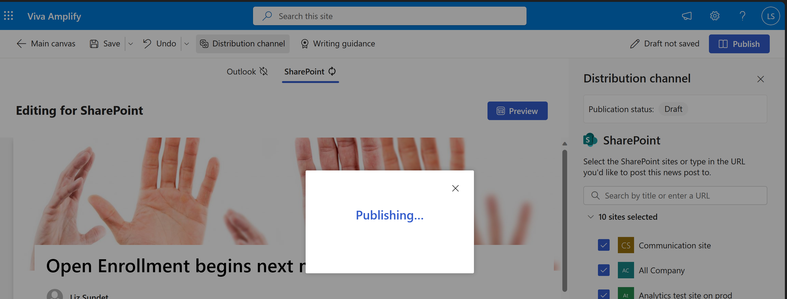
Publishing
Notes:
Once finished with selecting sites and channels and we are ready to send the communication, simply click publish in the upper right hand corner.
You will be shown that the work is being published.

Slide 45
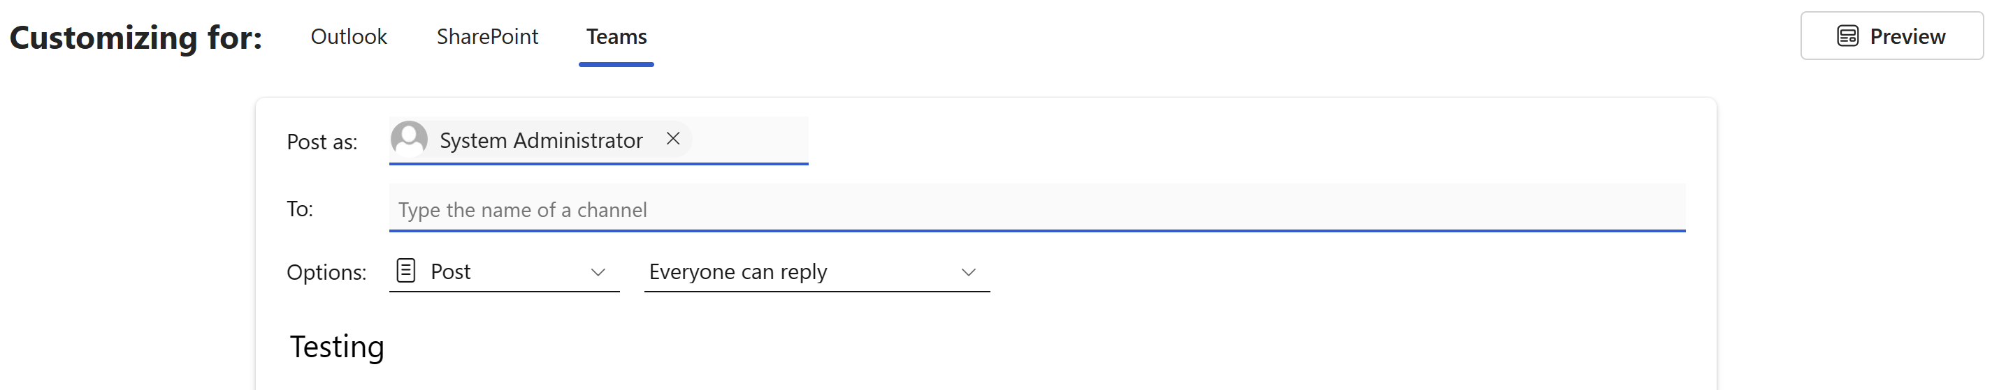
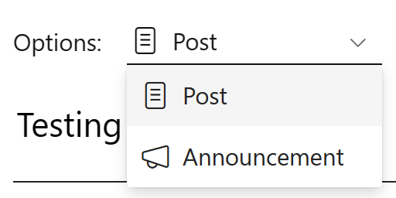
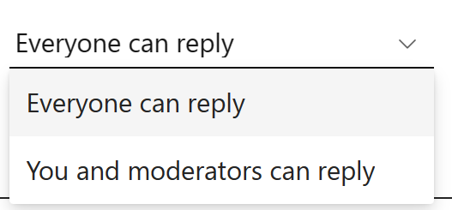
Teams publishing
Notes:
For a post in Teams, only channel messages are part of the Amplify product. You can chose to create either a post or announcement and it will change the way the post looks based on what type you select.
You can also chose who is able to reply to the channel message.

Slide 46
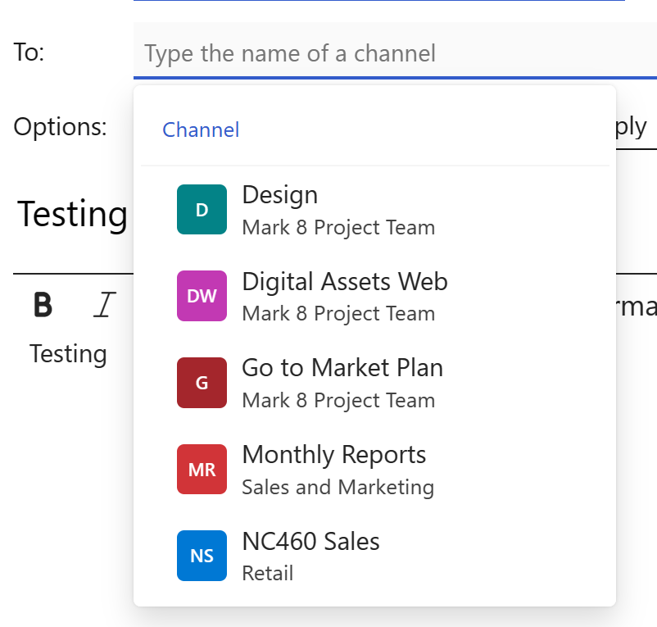
Post to Teams
The list of channels for teams that are available to you are listed when clicking on the To. Select the channel(s) for your messages.

Slide 47

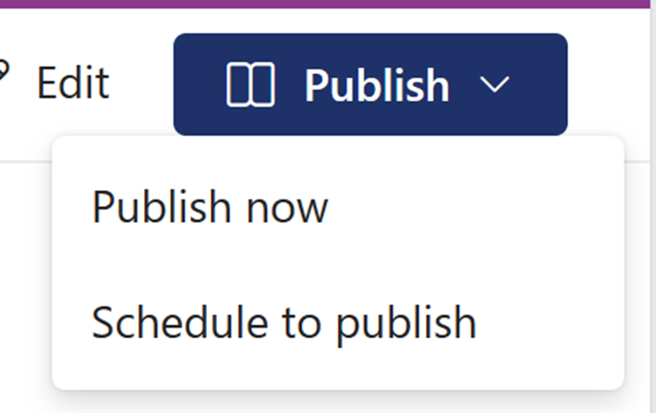
Publish or schedule
Notes:
When you’re ready to publish, click on the next.
You can either chose to send out your publication all at one time or you can schedule for a particular date and time.

Slide 48
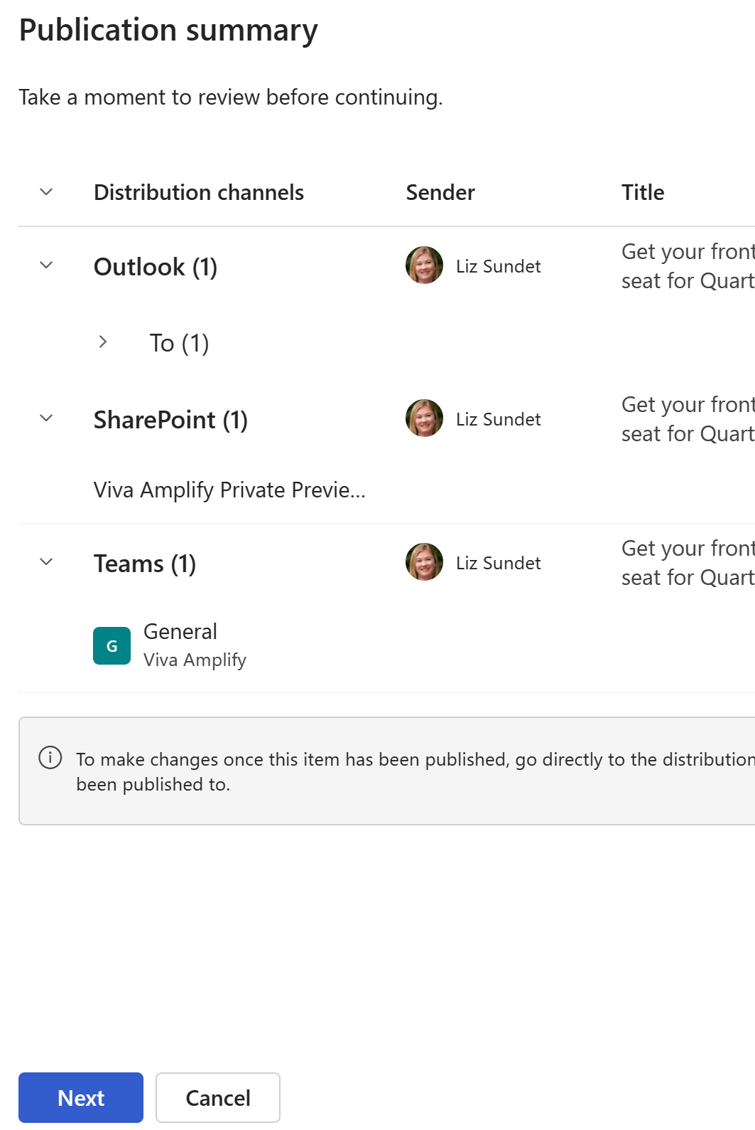
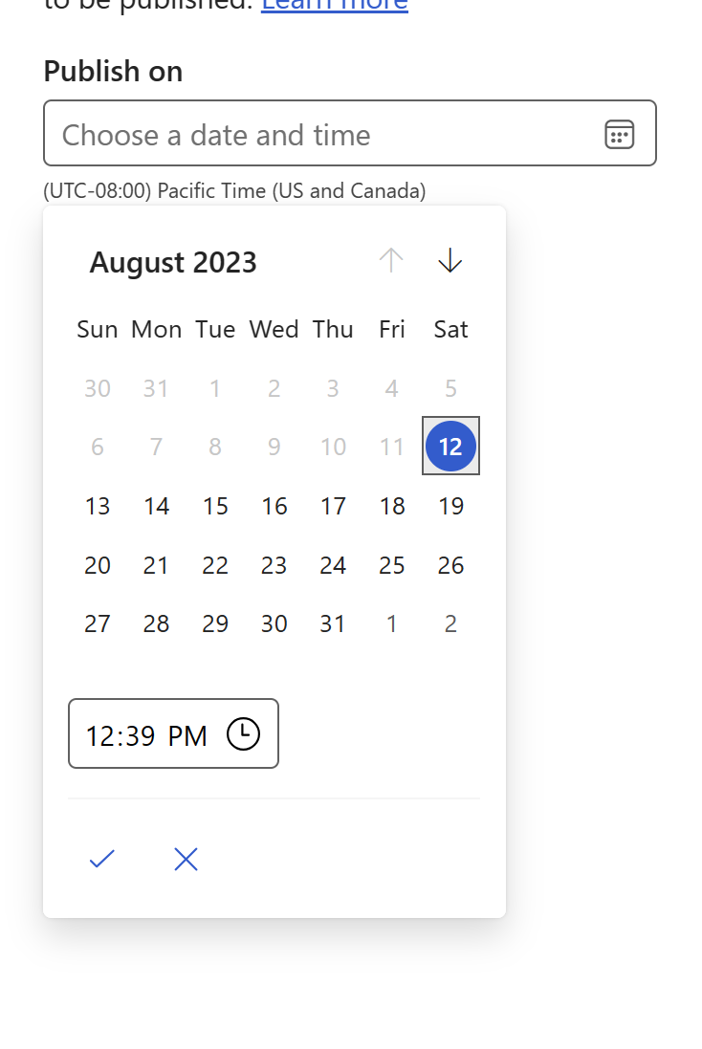
Schedule publication
Notes:
In order to schedule a publication you will see a publication summary. This is an overview of all the areas in which you will be posting your message.
Click next at the Publication Summary and you can select which date and time the message will go out This is based on the time zone set up.

Slide 49
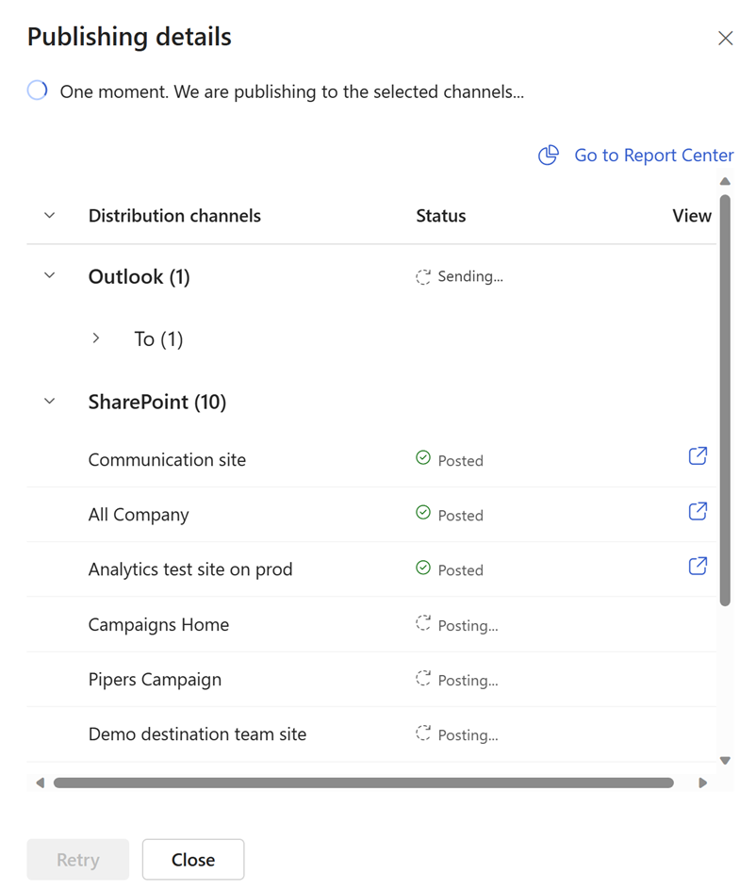
Publishing Details
Notes:
Once it’s completed the publishing to channels you will be shown the publishing details. This will show where it’s been posted and the details of who the Outlook message was sent.

Slide 50
Reporting

Slide 51
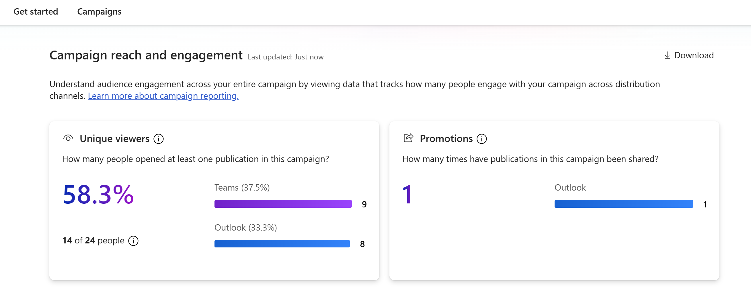
Campaign Metrics
Notes:
Reporting will show for each publication as well as the overall campaign. This is something that should be taken into consideration when setting up your campaigns to be able to see them grouped together for comparison purposes or not.
The Unique viewers will show the number of unique viewers as well as breaking them down into the channels they selected to view. If a single person views in two different places, they are counted in the channel where they viewed, but they are still one unique viewer. As you can see from the example, the number of people 14/24 does not equal the number of people across the channels. This is because a few people have looked at the publication in more than one place.
The Promotions is how many times a campaign has been shared with others. This could include an email that is forwarded to another group of people or a share in SharePoint to another area.

Slide 52
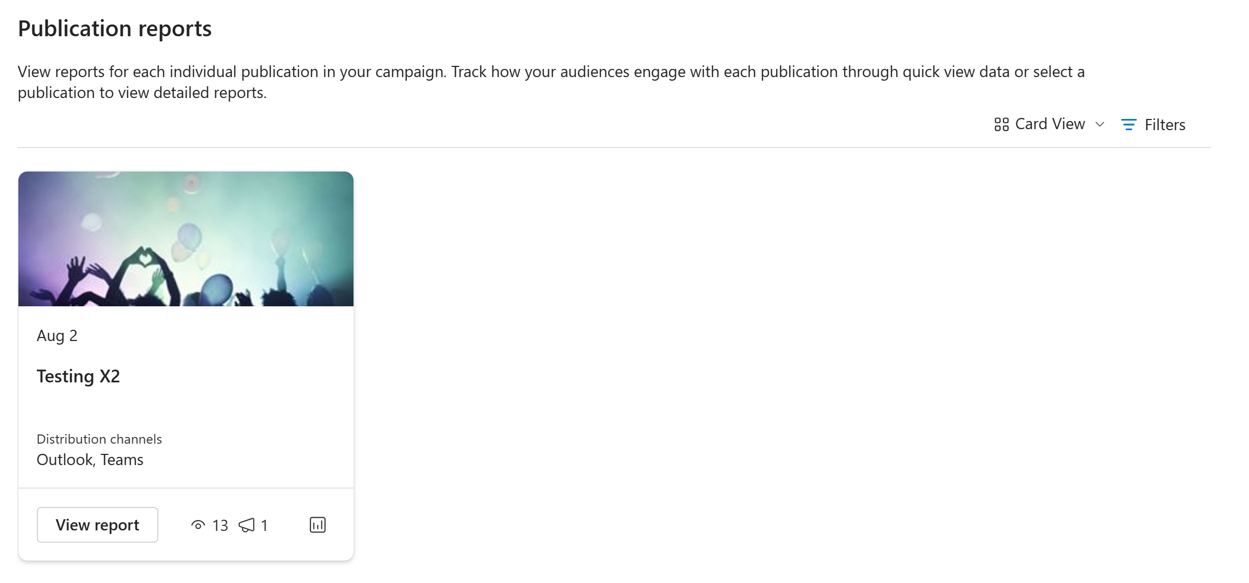
Publication Reporting
Notes:
In the lower area of the reporting section, it will show the publications that you have done for this campaign and how some metrics such as the number of times it was viewed and number of promotions.
(next slide)

Slide 53
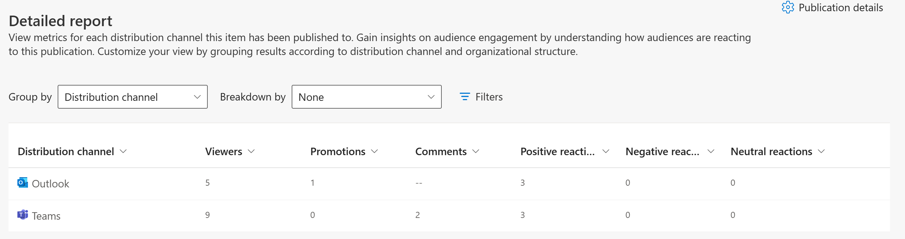
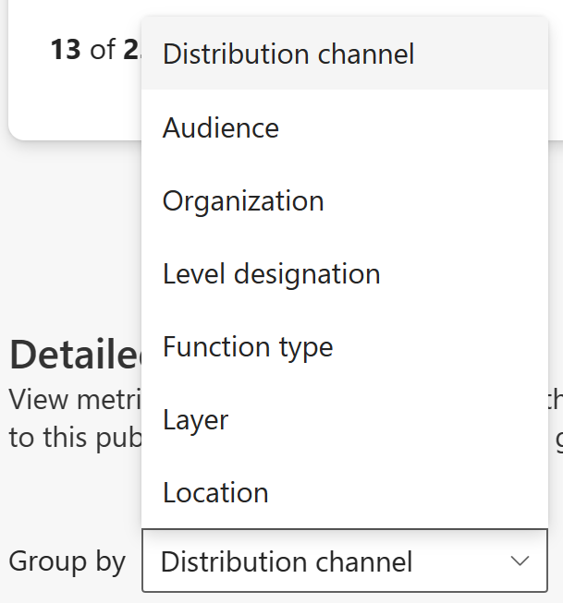
Detailed reporting
Notes:
For detailed reporting, you can click on the View report and see where your viewers are being reached.
You can also select the Group by or Breakdown by differences in your organization data. This requires either a .csv import from organizational data or from Viva Insights. This allows you to be able to see where your audience is being reached across the organization and break down by role or location.

Slide 54
Close

Slide 55
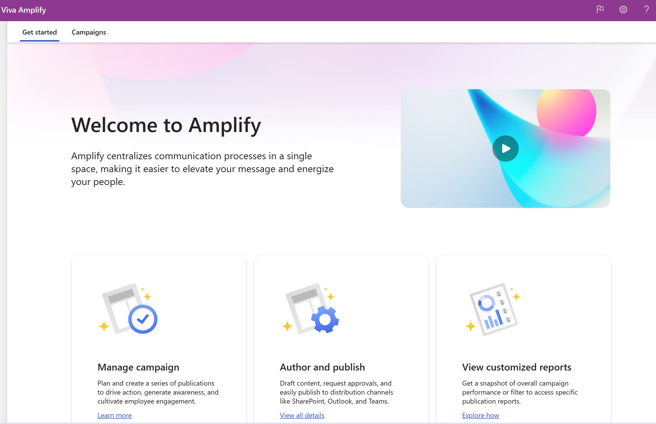
Get started using Viva Amplify
Notes:
You are now ready to get started using Viva Amplify today. Welcome to creating beautiful publications across your organization without the need to recreate across every channel.

