Slide 1
Dynamic Emergency Calling in Microsoft Teams

Slide 2
Agenda
General Emergency Calling Considerations
  What is Dynamic Emergency Calling?
  Federal - Kari’s Law and Ray Baum’s Act
  State and Local
  Country (outside of U.S.)
Dynamic Emergency Calling in Microsoft Teams
  Location Awareness
  Emergency Addresses and Places
  Network Topology and Identifiers
  Work From Home & Remote Scenarios
  Emergency Policies
  Dynamic Emergency Policy Assignment
  Supported Clients & Endpoints
  E911 with Shared Calling

Slide 3
What is Dynamic Emergency Calling?
Dynamic emergency calling for Microsoft Calling Plans, Operator Connect, Teams Phone Mobile, and Direct Routing provides the capability to configure and route emergency calls and notify security personnel based on the current location of the Teams client.

Slide 4
Emergency Calling Legal Considerations
Kari’s Law and RAY BAUM’s Act are federal laws that change 911 requirements for organizations like yours and will ultimately affect how you purchase, install, manage and operate 911 features and functions.
In addition to Kari’s Law and RAY BAUM’s act, your organization may be subject to local and state regulations related to how you provide emergency calling services.
Organizations with locations out of side of the United States should consult with their legal team to understand the requirements in those countries.
Does your organization have an organization policy to instruct employees what to do when working from home, remote, or outside of the organizations designated facilities? Example: If an employee is working from home, should they use their Teams client to call 911, or should they use their home phone or cell phone.
Disclaimer: It is critical for organizations to review all applicable laws with their own legal representation.
Multi-line Telephone Systems – Kari’s Law and RAY BAUM’S Act 911 Direct Dialing, Notification, and Dispatchable Location Requirements | Federal Communications Commission (fcc.gov)

Slide 5
Kari’s Law
Kari’s Law applies to phone systems manufactured, imported, offered for first sale or lease, first sold or leased, or installed on or after Feb. 16, 2020. An upgrade to an existing system or moving an existing system to a new location may be considered an implementation, depending on the circumstances.
  Must Have a No-Prefix Option: Locations with covered phone systems must allow end users to reach 911 without having to dial a prefix first. Businesses can implement a dialing pattern that includes a prefix, but there must always be an available no-prefix method as well.
  Must Send Onsite Notifications: When a 911 call is placed from a covered phone system, a notification must be sent to onsite personnel, alerting them to the emergency.
Multi-line Telephone Systems – Kari’s Law and RAY BAUM’S Act 911 Direct Dialing, Notification, and Dispatchable Location Requirements | Federal Communications Commission (fcc.gov)

Slide 6
Ray Baum’s Act
Section 506 of RAY BAUM’s Act requires that telephone systems automatically convey dispatchable locations to public safety when a 911 call is placed. Dispatchable location information includes the street address of the calling party and additional information such as room number, or similar information necessary to adequately identify the location of the caller. The compliance deadline for RAY BAUM’s Act will depend on the type of technology utilized.
  Jan 6, 2021 - On-premises, fixed devices associated with an MLTS must provide automated dispatchable location with 911 calls. (47 CFR § 9.16(b)(3)(i).)
  Jan 6, 2022 - On-premises, non-fixed devices associated with an MLTS must provide automated dispatchable location to the appropriate PSAP when technically feasible; otherwise, they must provide either dispatchable location based on end-user manual update, or alternative location information that meets the requirements below.
Multi-line Telephone Systems – Kari’s Law and RAY BAUM’S Act 911 Direct Dialing, Notification, and Dispatchable Location Requirements | Federal Communications Commission (fcc.gov)

Slide 7
National Suicide Prevention Hotline - 988
On November 18, 2021, the FCC adopted a Second Report and Order requiring covered text providers to support text messaging to 988 (the National Suicide Prevention Lifeline or Lifeline). In the Second Report and Order, the Commission recognizes that texting can be a preferred method of communications for at-risk populations, including individuals with disabilities.
The Second Report and Order follows up on the FCC designating 988 as the 3-digit number for voice calls to the Lifeline. Individuals can currently reach the Lifeline by calling 1-800-273-8255 (TALK) or through online chats. Service members, veterans, and their families may reach the Veterans Crisis Line by calling 1-800-273-8255 and pressing 1, texting 838255, or sending online chats through the Veterans Crisis Line’s website, https://www.veteranscrisisline.net/.
July 16, 2022 - In the Second Report and Order, the FCC sets July 16, 2022, as the implementation deadline to support text messaging to 988. That is the same date when voice calls must be able to reach 988.
FCC Adopts Rules for Text-to-988 | Federal Communications Commission

Slide 8
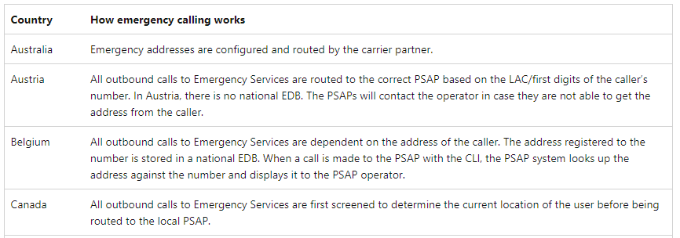
Outside of the United States for Microsoft Calling Plans
  Emergency call routing for Calling Plans - Microsoft Teams | Microsoft Learn
Disclaimer: It is critical for organizations to review all applicable emergency call routing laws for global locations with their own legal representation.

Slide 9

Dynamic Location Awareness

Slide 10
What is location awareness?
Using Location Information Service (LIS)
Identify and populate the user location in the client
Affects the routing of emergency calls

Slide 11






Location Awareness in Microsoft Teams
Teams clients are location aware.
On startup (or if the network status changes) the client will query the LIS for location data.
The Teams LIS configuration is the customer/tenant responsibility
LIS returns ‘dispatchable location’ data to the client.
LIS is embedded into the SIP signal with emergency calls using PIDF-LO.
Where Am I?
PIDF-LO
192.168.1.20
184.55.138.211
PSTN Connectivity
(CP, DR, OC, TPM)
Emergency Call Routing Service Provider
Public Safety Answering Point (PSAP)
Teams Location Information Service (LIS)
184.55.138.211 = Trusted IP = Matched
192.168.1.0 = 100 Main Street. 1st Floor NW. New York, NY 10044 = Matched

Slide 12
Tenant Configuration Components
Trusted IP’s
Identify Corporate Network Connected Clients
Emergency Addresses and Places
LIS Network Identifiers
Teams Emergency Policies
User or Site Assignment
Emergency Calling Policy
(Security Desk Notification)
Emergency Call Routing Policy
Routing of Calls for Direct Routing
Network Configuration: Dynamically Assign Emergency Policies
Region
Site
Subnet
Subnet
Port
Switch
Wireless Access Point
Location Information Service (LIS)
Dynamically Determine Emergency Address
Requests based on Ethernet/Switch (PortID or ChassisID) and Wireless AccessPoint (BSSID) will be done regardless of whether the external IP address matches an IP address in the trusted IP addresses.
Notes:
Left side – identifying where the user is
Right side – applying a policy
Configure dynamic emergency calling - Microsoft Teams | Microsoft Learn
“Requests based on Ethernet/Switch (PortID or ChassisID) and Wireless AccessPoint (BSSID) will be done regardless of whether the external IP address matches an IP address in the trusted IP addresses.”

Slide 13
Trusted IP
Internet external IP address (IPv4/IPv6) of the enterprise network
Used to determine if the Teams client is inside the corporate network
Checked before looking for specific match with the LIS elements (Civic Address, Location, Subnet) or Network Configuration Service (Region, Sites, Subnets). Match is made regardless when matching Switch/Port, WAP presented.
Must match the clients advertised (Public) IP address
Typically (but not always), IPv6 is preferred over IPv4 – be sure to enter both
New-CsTenantTrustedIPAddress cmdlet
All public IP addresses that will be presented by clients when connected to the corporate network, e.g. their public NAT IP, must be defined in the Tenant Trusted IP Address List
Create in Teams Powershell or Teams Admin Center
These are also used with Location Based Routing (LBR) configurations
New-CsTenantTrustedIPAddress
IPv4: use –MaskBits 32 for single address (default)
IPv6: use –MaskBits 128 for single address (default)
Network Configuration Service (NCS) has a 2-hour cache
Newly created Tenant Network configuration settings (such as Trusted IPs) won’t be available for ~2 hours after creation
Notes:
You can use http://www.whatismyip.com to see both IPv4 and IPv6 addresses.
Without a match:
Network Configuration Service lookup stops
Teams client will not display Emergency Location

Slide 14
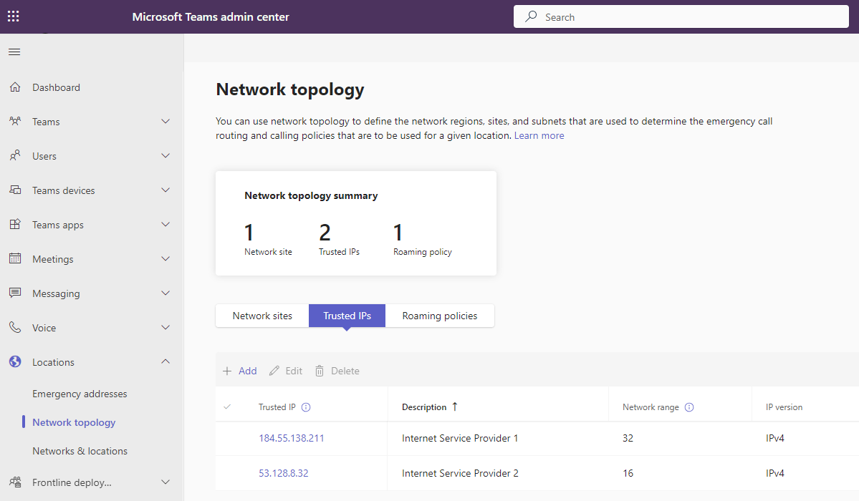
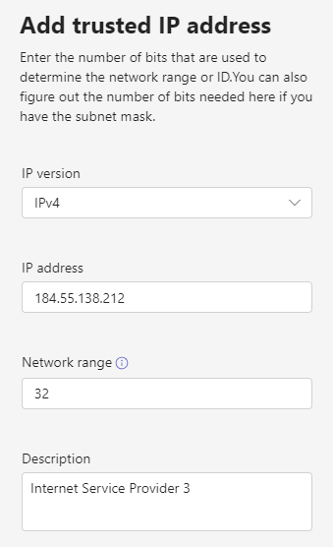
Network Topology – Trusted IP’s
10.1.0.43
184.55.138.211
Notes:
Trusted IP addresses contain a collection of the internet external IP addresses of the enterprise network and are used to determine if the user's endpoint is inside the corporate network.
Network configuration setting lookups are not supported with cloud proxy service deployments that modify the source IP addresses from Teams clients.
Microsoft does not recommend putting end-users home IP Address in Teams.

Slide 15
Defining your environment
Hierarchy and information should be detailed enough to allow emergency responders to easily locate a person.
Civic Address -> specific building
Location (also called Places) -> for example, a floor in the building
In each location -> one (or more) network elements {Subnet, Wireless Access Point, Switch/Port}
Civic Address
Location
Subnet
Switch
Location
Subnet
Subnet
Port
WAP
WAP
Port
Subnet
Switch
Port
WAP
WAP

Slide 16
Civic Addresses
Civic address and geographic coordinates are used to provide user’s location
When assigning a number with Calling Plans or Operator Connect, an emergency location is required
Default location is assigned to the user
Use the LIS network components to dynamically assign a location
New-CsOnlineLisCivicAddress cmdlet Use the –Latitude and –Longitude parameters (optionally also –Elin)
Notes:
Must contain geographic coordinates
Cannot be added to existing addresses
New addresses must be added with geo codes
Users must be assigned new locations
Must be assigned to a LIS network identifier

Slide 17

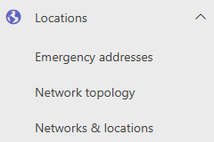



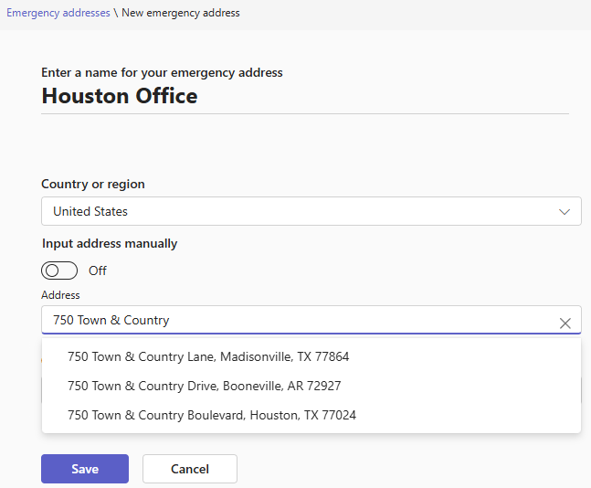
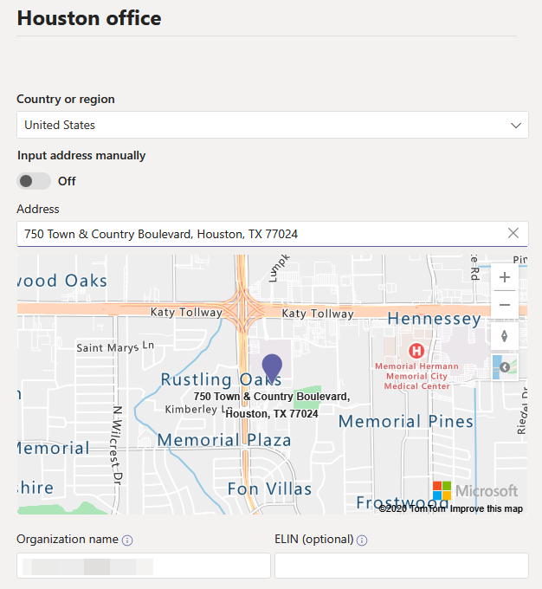
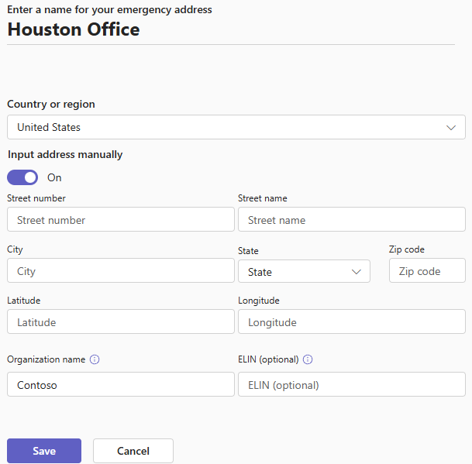
Civic address creation [Teams Admin Center]
Select Locations – Emergency Addresses
Define location details (Name, Country or Region, Address, etc) and check for validation
If address is validated by Microsoft, Azure Maps will display verified location
If location details cannot be validated, select Input address manually
Notes:
Note: You can change the address information for a location only if the address isn't validated. If the address is already validated, and you need to change the address, delete the location, and then create a new location with the correct address.
Add, change, remove emergency locations – Microsoft Teams | Microsoft Docs
Teams PowerShell
New-CsOnlineLisCivicAddress cmdlet
Use the –Latitude and –Longitude parameters (optionally also –Elin)
Obtain geo coordinates (example use Bing Maps)

Slide 18
Locations (Places)
When a Civic Address is created, a corresponding location is automatically created
Admin can create additional locations
Common example -> create multiple Places to map to floors in a building
Teams Admin Center
Locations -> Emergency addresses -> [CivicAddress] -> Places
Once voice users are assigned to a location, associated location/civic address
Teams Powershell
New-CsOnlineLisLocation cmdlet -> must reference the associated CivicAddressID
Use Get-CsOnlineLisCivicAddress cmdlet to find the CivicAddressID
Notes:
The main Civic Address and each location associated with it, will have unique Location ID’s.
It's these Location ID's that are used when associating and address with a Lis network entry.
If a location does not have geo codes associated to it, then the location cannot be used with Lis network configuration.

Slide 19
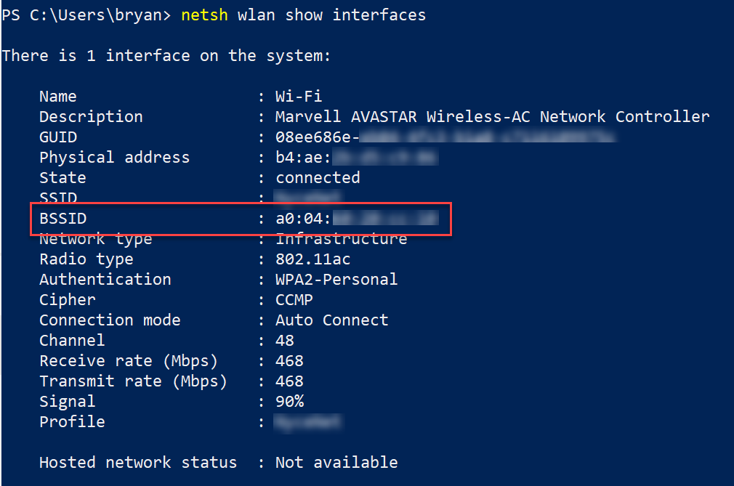
Dynamically Assigning Locations
Use LIS network elements to dynamically assign
locations
Subnet
  Configure Network Subnet ID
    Must match client computed root network ID based on client IP/CIDR
  Set-CsOnlineLisSubnet cmdlet (associate to location with LocationID)
  Must be unique within the tenant
Wireless Access Point (WAP) BSSID
  BSSID is entered in the form of a MAC address (##-##-##-##-##-##, or as ##:##:##:##:##) – should match what the client sees when connected
  Verify on PC: netsh wlan show interfaces
  Set-CsOnlineLisWirelessAccessPoint cmdlet (associate to location with LocationID)
Network Switch/Port
  Client/Switches must be configured to support LLDP
  Set-CsOnlineLisSwitch cmdlet -> MAC address used for the chassis ID (##-##-##-##-##-##)
  Set-CsOnlineLisPort -> Associate with a specific port (ID string ex. ge/0/8) on a given switch chassis ID (##-##-##-##-##-##)
Notes:
Subnet Calculator example: https://mxtoolbox.com/SubnetCalculator.aspx
Example LLDP Config (Cisco): https://www.cisco.com/c/en/us/td/docs/switches/lan/catalyst4500/12-2/46sg/configuration/guide/Wrapper-46SG/swlldp.html#wp1084239
LLDP Viewer: https://polarclouds.co.uk/ldwin-link-discovery-for-windows/ (https://github.com/chall32/LDWin)

Slide 20
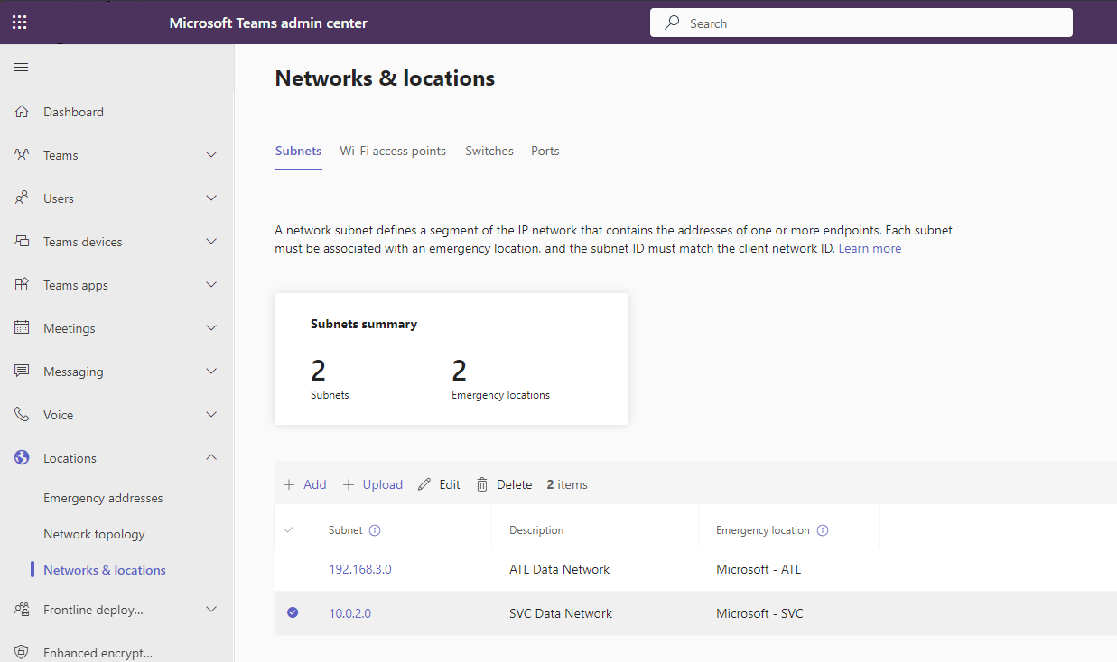

Network Identifiers (1/2)
The match is performed in the following order with the first match result being returned.
WAP
Ethernet switch/port
Ethernet switch
Subnet

Slide 21
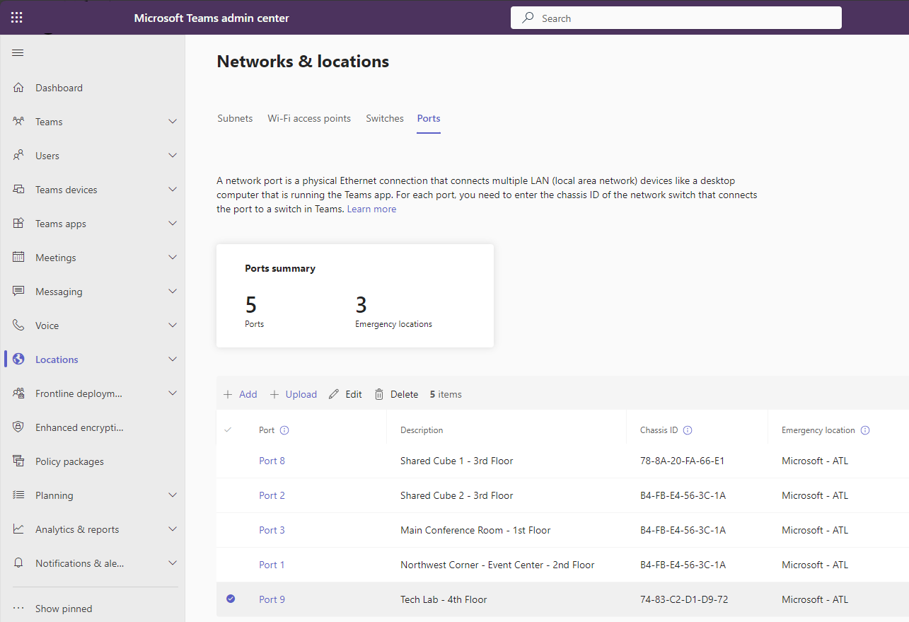
Network Identifiers (2/2)
The match is performed in the following order with the first match result being returned.
WAP
Ethernet switch/port
Ethernet switch
Subnet

Slide 22

When do Teams clients query LIS?
Desktop Client:
Upon Sign In / Authentication
Whenever the client detects network change. The poll is every 5 minutes.
Mobile Client:
As soon as the user goes to the calls tab, Teams fetches the emergency location information. (iOS)
If the user switches networks with the calls tab opened.
If the user stays with the calls tab opened for 5 minutes.

Slide 23

Work From Home & Remote Scenarios
When users are working from a non-corporate network location, it is still critical to identify where the user is located in order to present accurate location information to Emergency Routing Service Providers.

Slide 24
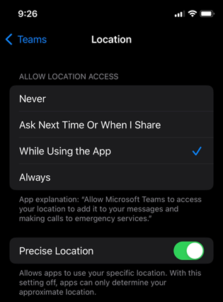
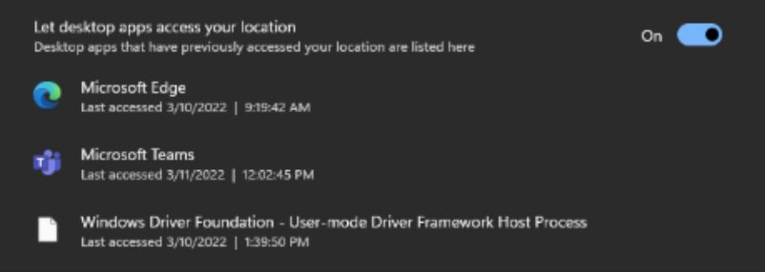
Work From Home an Remote Scenarios
If the Teams client determines there is not a match to the corporate network identifiers, it will attempt to discover it’s geocoordinates provided by the Operating System of the device to determine the user’s location.
The Operating System will use whatever supported methods of location detection available.
Due to privacy settings on each Operating System, it is required that the Teams app be granted permissions to access location services to successfully obtain any geocoordinates determined by the Operating System.
Privacy settings can conflict with automatic location detection – Mobile Device Management systems can be used.
Work from Home Emergency 911: enable location services - Microsoft Support

Slide 25
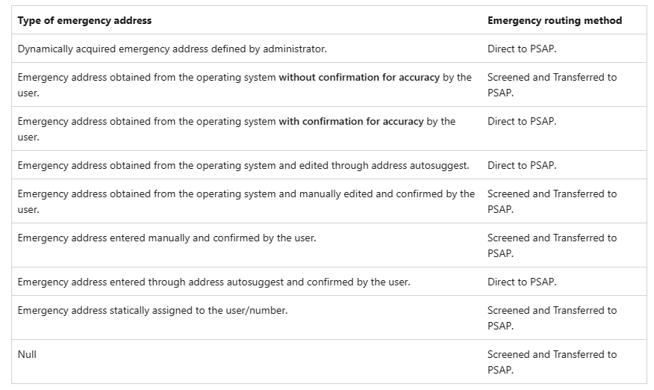
Emergency Address Classification and Routing
Emergency addresses for remote locations - Microsoft Teams | Microsoft Learn
Notes:
Emergency addresses for remote locations - Microsoft Teams | Microsoft Learn

Slide 26
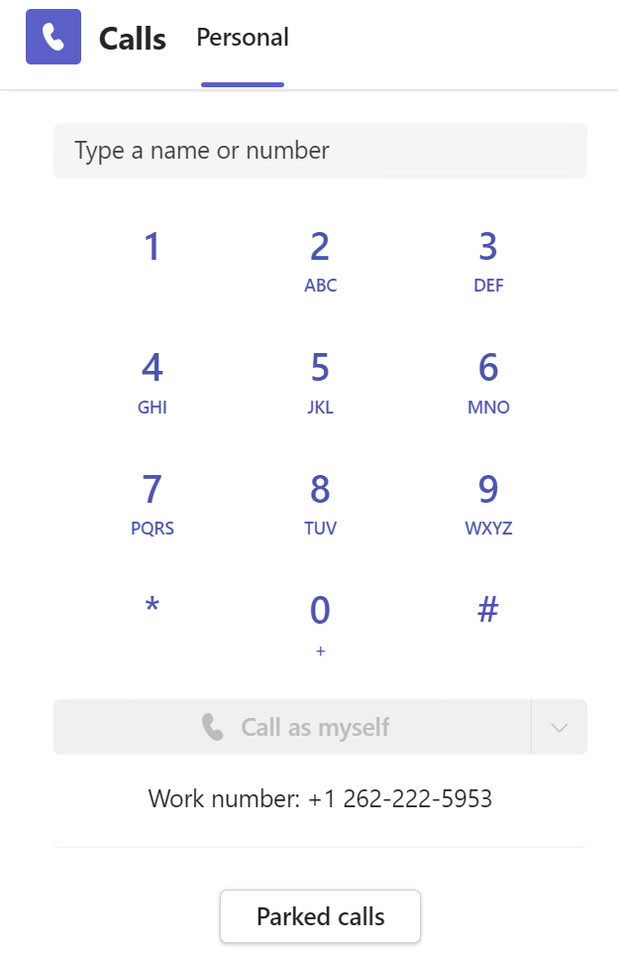
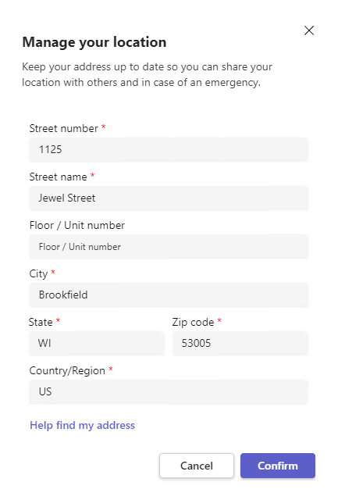
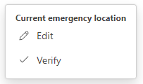
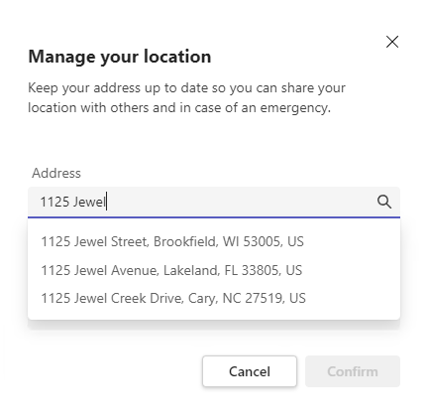
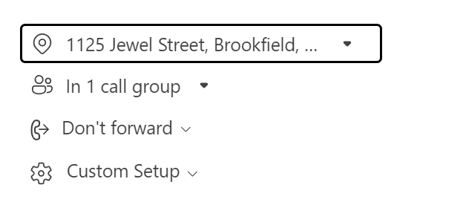
Remote Client Location Discovery (Desktop Client)
Notes:
External Location Lookup Mode must be enabled in the emergency calling policy and that policy must be assigned to the user for this feature to be visible in the Teams Client.

Slide 27
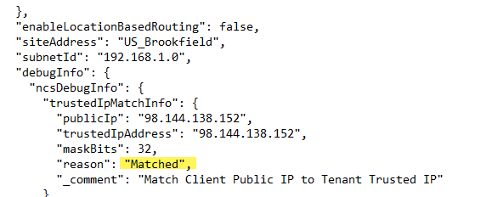
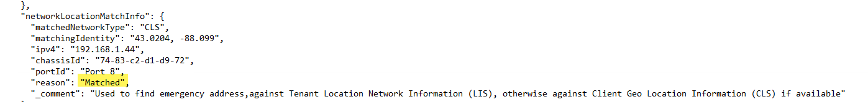
Dynamically acquired emergency address defined by administrator (tenant)
Emergency Routing Method
Direct to PSAP

Slide 28
Notes and Restrictions
Keep the following in mind:
The work-from-home experience described is for Teams desktop on Windows and Mac.
Teams Phones do not support the work-from-home experience.
Teams mobile supports automatic location detection but not the user entered experience as described.
Privacy settings can conflict with automatic location detection – Mobile Device Management systems can be used.
Emergency addresses for remote locations - Microsoft Teams | Microsoft Learn

Slide 29

Teams Emergency Policies

Slide 30
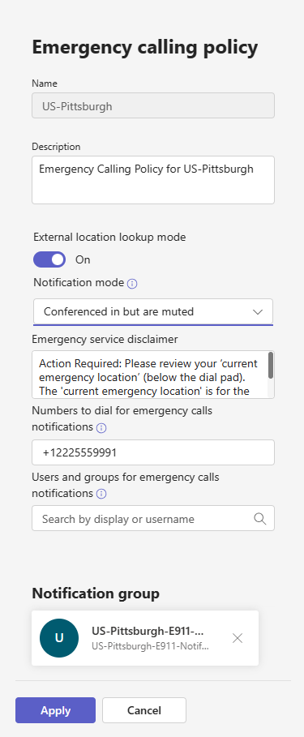
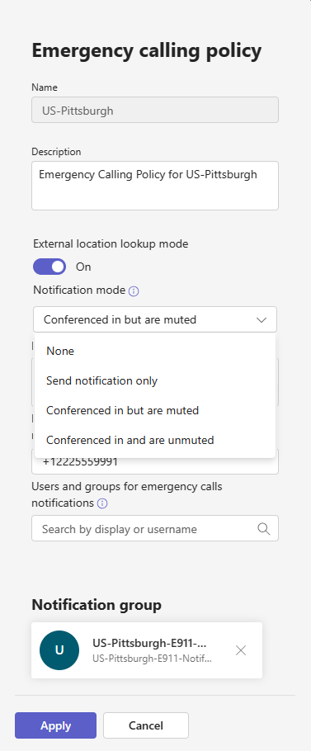
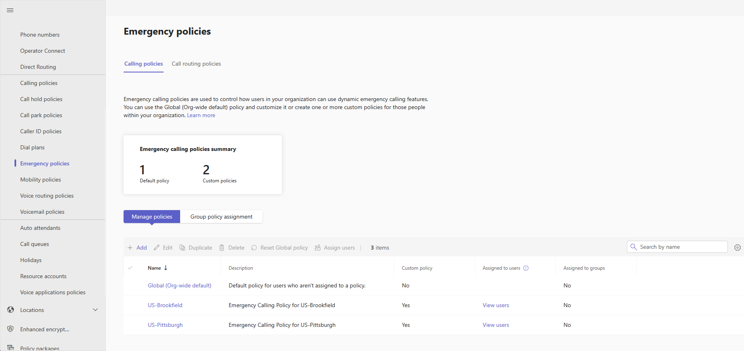
Emergency Calling Policies
Notes:
Teams Emergency Calling Policies define what happens when a Teams user in your organization makes an emergency call.
Set the External location lookup mode to on to allow your end users to configure their emergency address when they are working from a network location outside the corporate network.
Send notification only: A Teams chat message is sent to the users and groups that you specify.
Conferenced in but are muted: A Teams chat message is sent to the users and groups that you specify and they can listen (but not participate) in the conversation between the caller and the PSAP operator.
Conferenced in and are unmuted: A Teams chat message is sent to the users and groups that you specify and they can unmute to listen and participate in the conversation between the caller and the PSAP operator.
If you selected either of the Conference in muted notification modes, in the Number to dial for emergency calls notifications box, you can enter a PSTN phone number of a user or group to call and join the emergency call. For example, enter the number of your organization's security desk, who will receive a call when an emergency call is made and can then listen in on the call. The PSTN phone cannot be unmuted even when the mode is set to Conferenced in muted but are able to unmute
You can define a list of users, distribution groups, or security groups. A maximum of 50 users can be notified.

Slide 31
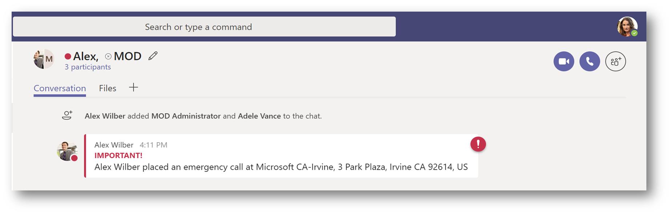
Notifications
Who should get notified in your organization?
Kari’s Law - Must Send Onsite Notifications: When a 911 call is placed from a covered phone system, a notification must be sent to onsite personnel, alerting them to the emergency.

Slide 32
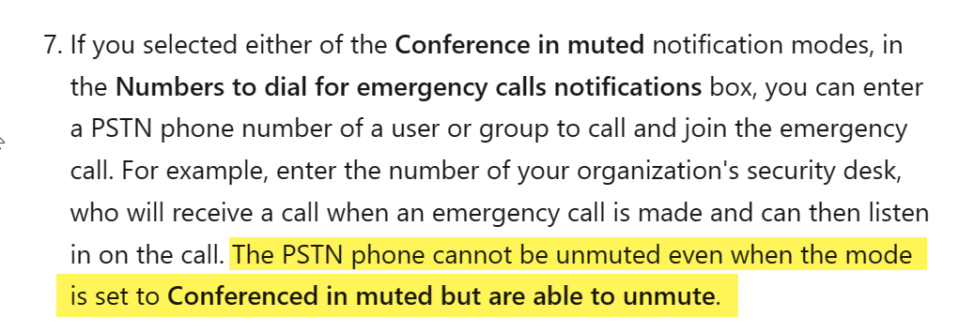
Emergency Notifications
Teams does not provide email notifications.
Manage emergency calling policies in Microsoft Teams - Microsoft Teams | Microsoft Learn
Notes:
Note: only a single number is supported even though the disclaimer says you can use multiple. This is a bug in TAC that does match how the feature is implemented.

Slide 33
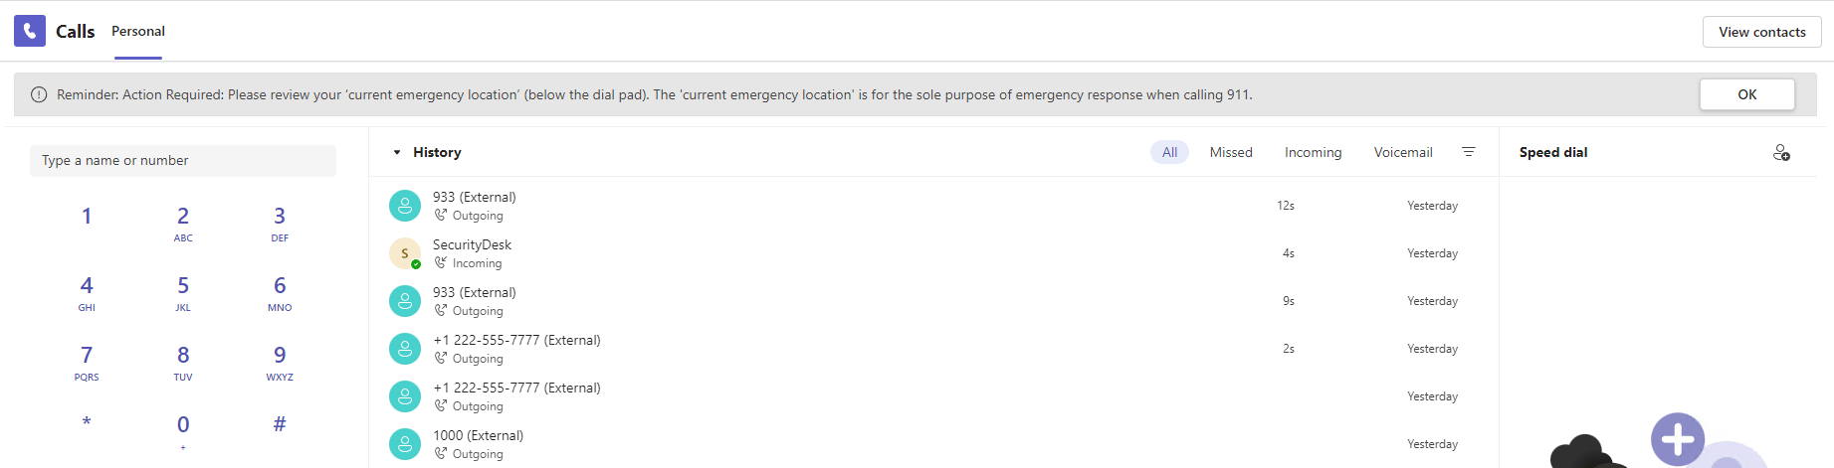
Emergency Disclaimer

Slide 34
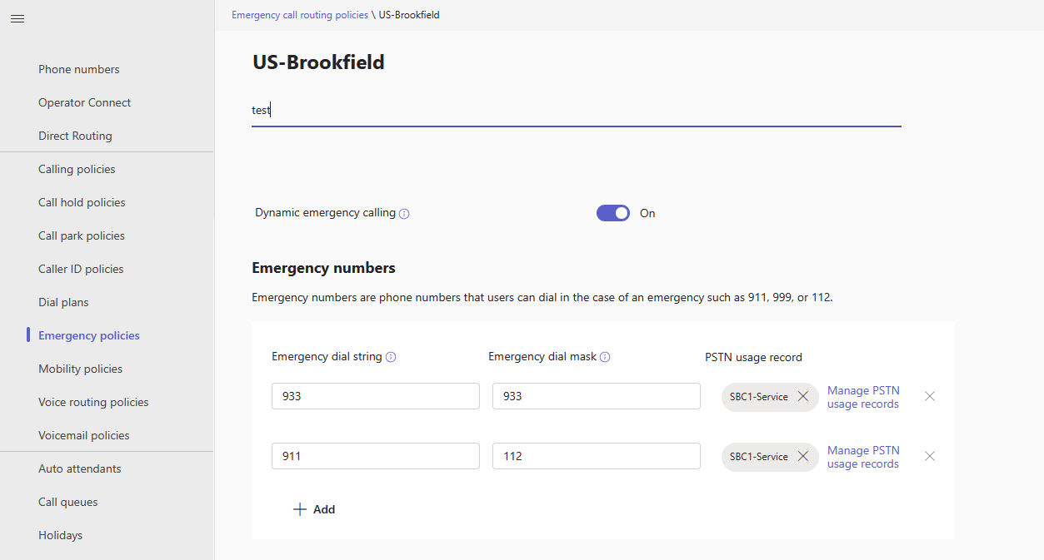
Emergency Call Routing Policy
Notes:
Teams Emergency Call Routing Policies allow organizations using Direct Routing to enable dynamic emergency calling, define what numbers (dial strings) are emergency numbers and how (where) they are routed.
When dynamic emergency calling is enabled, Teams retrieves policy and location information from the service and includes that information as part of the emergency call.
Emergency dial string: Enter the emergency dial string. This dial string indicates that a call is an emergency call and the route pattern must match this dial string exactly.
For Direct Routing, Teams clients no longer send emergency calls with a "+" in front of the emergency dial string. Be sure the voice route pattern to match an emergency dial string reflects this change.
Emergency dial mask: For each emergency number, you can specify zero or more emergency dial masks. A dial mask is the number that you want to translate into the value of the emergency dial string. A dial mask allows for alternate emergency numbers to be dialed and still have the call reach emergency services.
For example, you add 112 as the emergency dial mask, which is the emergency service number for most of Europe, and 911 as the emergency dial string. A Teams user from Europe who is visiting may not know that 911 is the emergency number in the United States, and when they dial 112, the call is made to 911. To define multiple dial masks, separate each value by a semicolon. For example, 112;212.

Slide 35
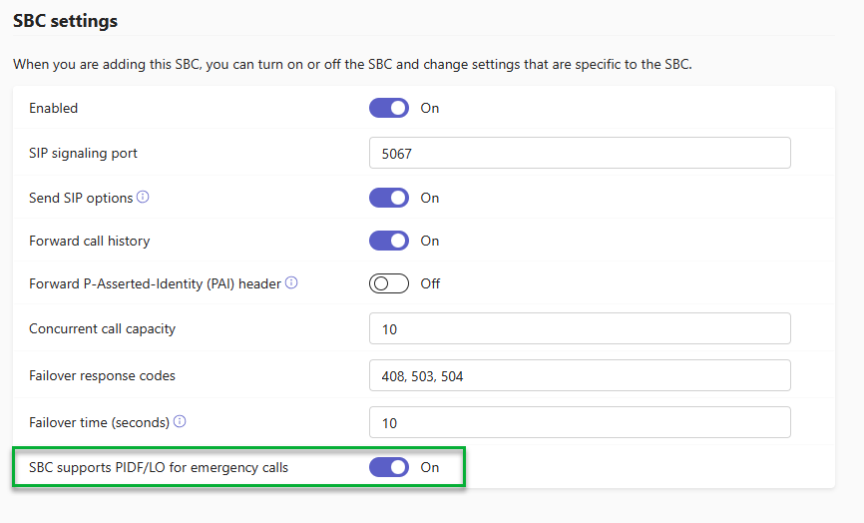
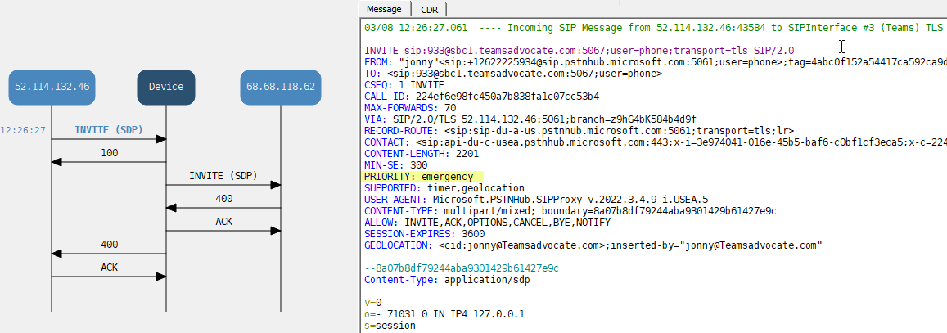
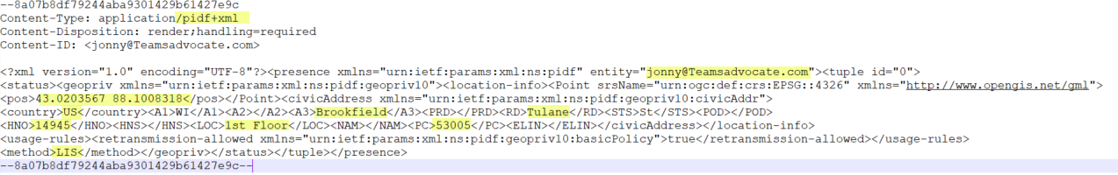
What is PIDF-LO?
PIDF-LO (Presence Information Data Format Location Object) is an HTTP, XML tag format that includes a location object. PIDF-LO takes those location objects and sends them natively with a 911 call across the internet, allowing for instant provisioning with hyper-targeted accuracy, as a caller moves about a campus or high-rise environment.

Slide 36

Emergency Calling Providers
Operator Example:
Verify Certified Session Border Controllers (link)
  AudioCodes
  Ribbon Communications
  Thinktel
  Oracle
  TE-SYSTEMS
  Metaswitch
  Cisco
  Nokia
  Sansay Inc.
Verify Certified 911 Service Providers (link)
  Bandwidth Dynamic Location Routing
  Intrado Emergency Routing Service (ERS)
  Intrado Emergency Gateway (EGW)
  Inteliquent
  Many operators now support PIDF-LO natively by using the above services on their backend. Ask your operator if they support this capability and if additional service charges are required.
Lumen for example uses Intrado “Every voice complete phone number has an Emergency Services (ES) flag assigned. Lync/Teams 911 is an optional flag that can be enabled to allow PIDF-LO support. The ES flag change may be requested via the Lumen Control Center portal.”

Slide 37
Direct Routing specific settings

Slide 38
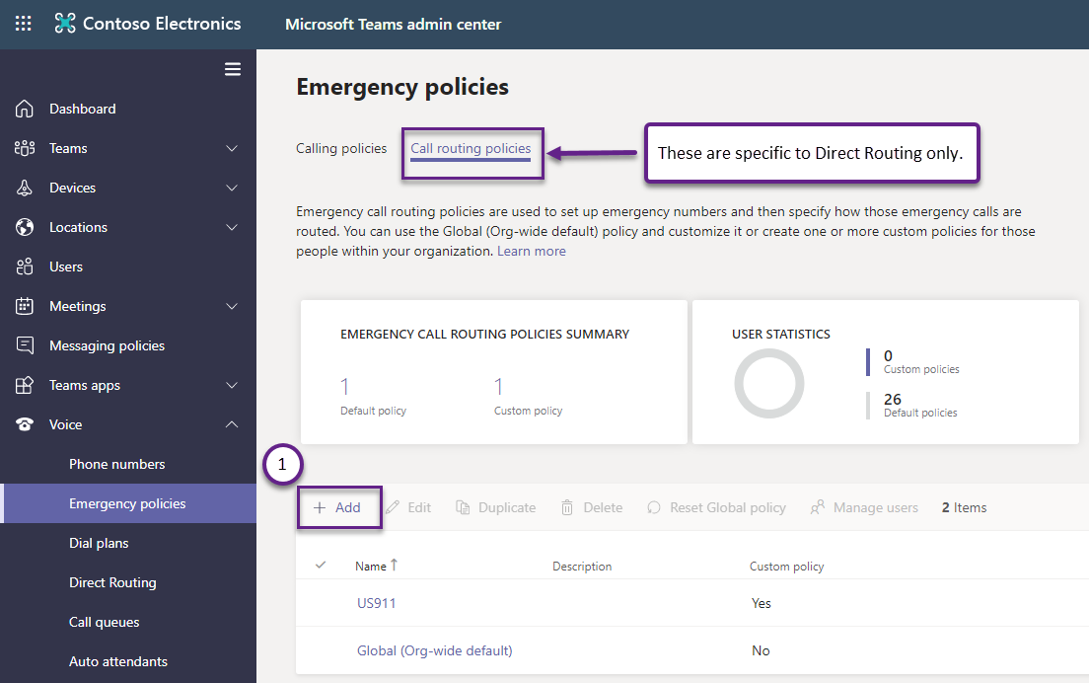
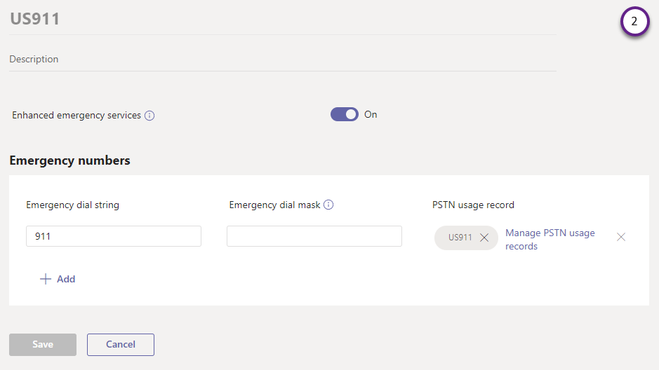
Online Voice Routing for DR Users
Build the PSTN Usage
  Set-CsOnlinePstnUsage -Usage @{add="US911"}
Define the Emergency Number (store in a variable for later use)
  $en = New-CsTeamsEmergencyNumber -EmergencyDialString “911” -OnlinePSTNUsage US911
Define the Emergency Call Routing Policy
  New-CsTeamsEmergencyCallRoutingPolicy -Identity US911 -EmergencyNumbers @{add=$en} -AllowEnhancedEmergencyServices $true

Slide 39
Online Voice Routing for Direct Routing Users
Add Voice Route (MicrosoftTeams PowerShell only)
  New-CsOnlineVoiceRoute -Identity US911 -Description "US E911 Dialing" -Name "US911" -OnlinePstnGatewayList sbc1.contoso.com -NumberPattern "^\+?911“ –OnlinePstnUsages “US911”
    Note: The DR user does not need to have an Online Voice Routing Policy that includes the OnlinePSTNUsage from the TeamsEmergencyCallRoutingPolicy; the emergency call will be routed using the OnlinePSTNUsage directly.
  Any external PSTN call used in the security desk notification will use the user’s Online Voice Routing Policy for routing.
Notes:
Previous guidance is no longer applicable - “When defining the route, be sure to account for calls with and without the leading + [-NumberPattern "^\+?911“]”

Slide 40
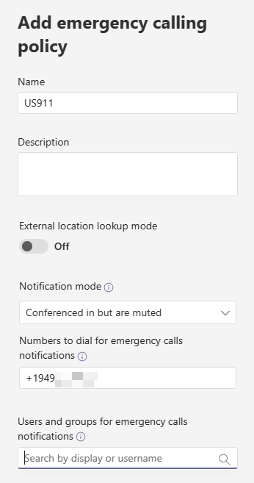
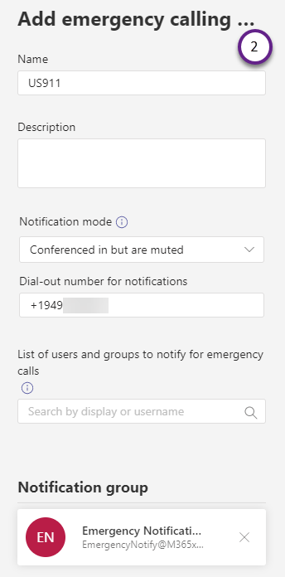
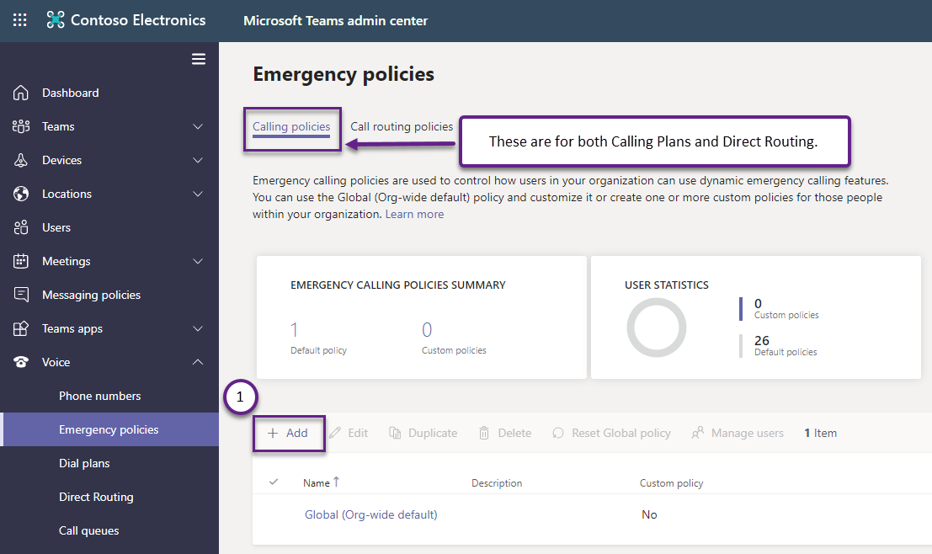
Security Desk Notification (optional)
Can use Global if dynamic assignment is not required
MicrosoftTeams PowerShell
  New-CsTeamsEmergencyCallingPolicy -Identity US911 -NotificationGroup GroupEmail@contoso.com -NotificationMode ConferenceUnMuted

Slide 41
Emergency Policies Assignment (1/2)
Global
  Get/Set-CsTeamsEmergencyCallingPolicy
  Get/Set-CsTeamsEmergencyCallRoutingPolicy
Static (Per User)
    Grant-CsTeamsEmergencyCallRoutingPolicy -PolicyName US911 -Identity <user>
    Grant-CsTeamsEmergencyCallingPolicy -PolicyName US911 –Identity <user>
  Teams Admin Center [Voice -> Emergency policies -> Calling policies tab]
Dynamic (By Site)
    Set-CsTenantNetworkSite -Identity $nsite1.Identity -EmergencyCallRoutingPolicy US911 -EmergencyCallingPolicy US911
  Teams Admin Center [Locations -> Network topology -> Network sites tab]
  Takes precedence over user-assigned policy (if matching user network location)

Slide 42
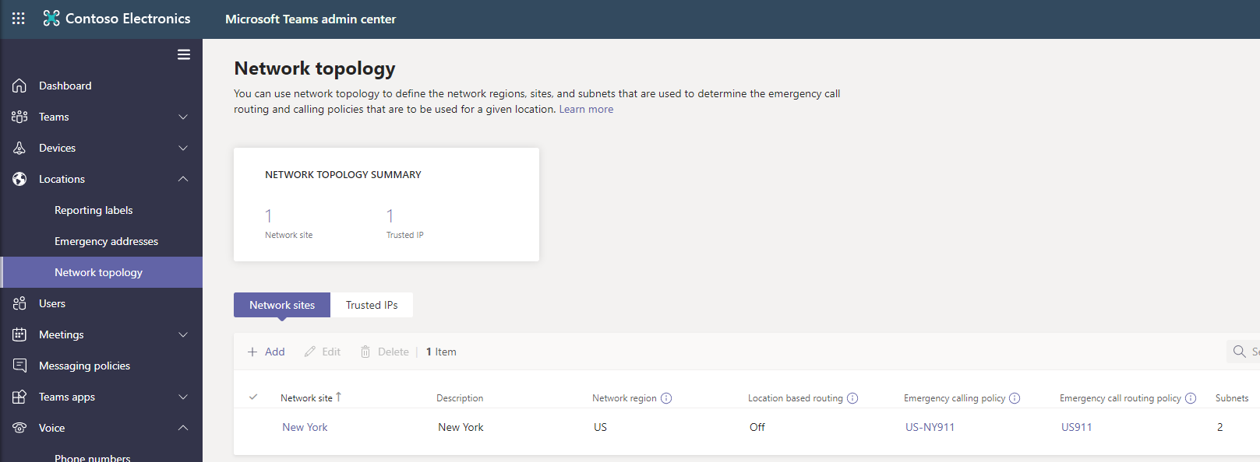
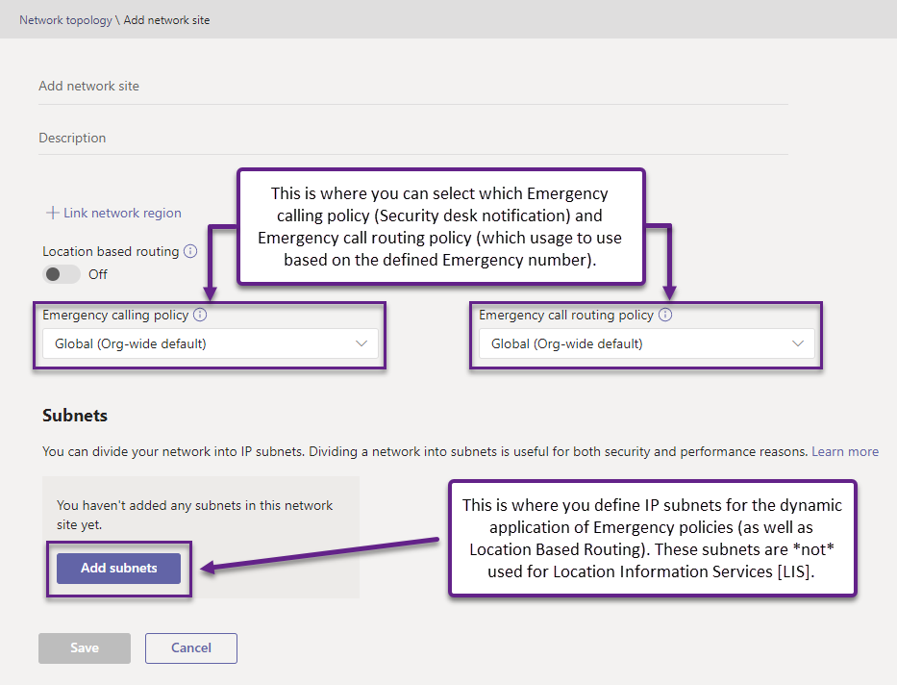
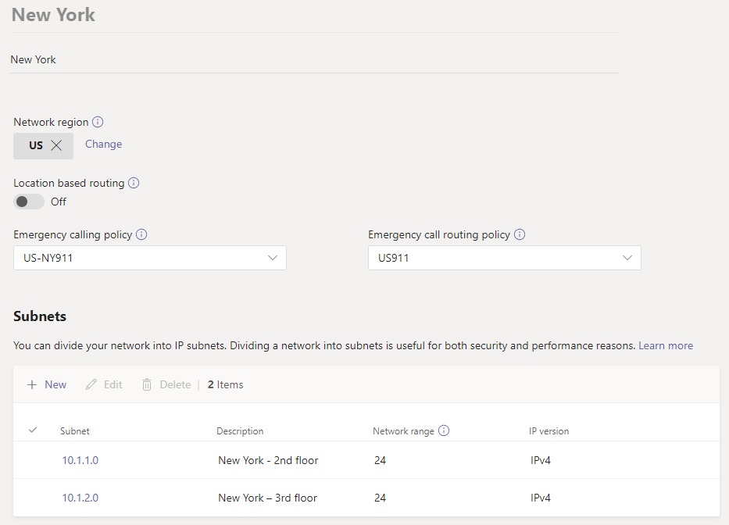
Emergency Policies Assignment (2/2)
Tenant Network Elements

Slide 43

Dynamic Assignment of Emergency Policies
This Photo by Unknown Author is licensed under CC BY

Slide 44
Scenario
Contoso has corporate offices in New York, NY and Los Angeles, CA
Each office has its own respective Security/Service Desk
Alice is based in the New York office
When in NY, dialing emergency services causes the New York Service Desk to be notified
Alice travels to the Los Angeles, CA office and needs to dial emergency services
The Los Angeles, CA Service Desk should be notified (since she has now traveled to LA)

Slide 45
Dynamic Assignment: Emergency Policies
To support the previous scenario, the tenant admin needs to configure the appropriate network elements and assign a policy to a Site.
Dynamic assignment is based on Tenant Network Configuration
Network Region
Network Site
Network Subnet
The Tenant Network components are not used for mapping emergency address for users; only for dynamic assignment of emergency policies, emergency routing, Location Based Routing [LBR] and DR Media Optimization.
Site policies take precedence over user policies.
No match found would revert to Global (unless there is an explicit assignment to user)
Notes:
If the customer is already using LBR (for example) we can simply re-use that existing configuration.

Slide 46
Regions, Sites, and Subnets
Network Region
  Interconnects various parts of a network across multiple geographic areas
  Collection of Network Sites
Network Site
  Represents a location where the organization has a physical location
  Collection of unique IP subnets
Network Subnets
  Internal IPv4/IPv6 subnets assigned to Network Sites; IPv4 takes precedence
  Multiple subnets may be associated with the same network site, but multiple sites may not be associated with a same subnet
Network Configuration Service (NCS) has a 2-hour cache; newly created Tenant Network configuration items won’t be available for ~2 hours post creation

Slide 47

Direct Routing: Dynamic Emergency Policy Assignment
US (Network Region)
CSOnlinePSTNGateway
-FQDN:sbc1.contoso.com
-PidfloSupported $true
New York (Network Site)
Los Angeles (Network Site)
NumberPattern “^\+?911”
Priority 1
Online gateway list:
sbc1.contoso.com
Voice Route (USRegion)
10.1.1.0/24 (Network Subnet)
10.1.2.0/24 (Network Subnet)
10.20.1.0/24 (Network Subnet)
10.20.2.0/24 (Network Subnet)
EmergencyCallRoutingPolicy: US911
EmergencyCallingPolicy: US-LA911
PSTN Usage (US911)
EmergencyCallRoutingPolicy: US911
EmergencyCallingPolicy: US-NY911
Emergency Call Routing Policy (US911)
EmergencyNumber=911

Slide 48

Tenant Network Configuration
Optional for Dynamic 911
Used for Dynamically Assigning Policies based on users Network Site
NOT used for Emergency Address lookup
Subnet maps client IP address to a Site
Subnets must be unique

Slide 49
User Experience
This Photo by Unknown Author is licensed under CC BY

Slide 50
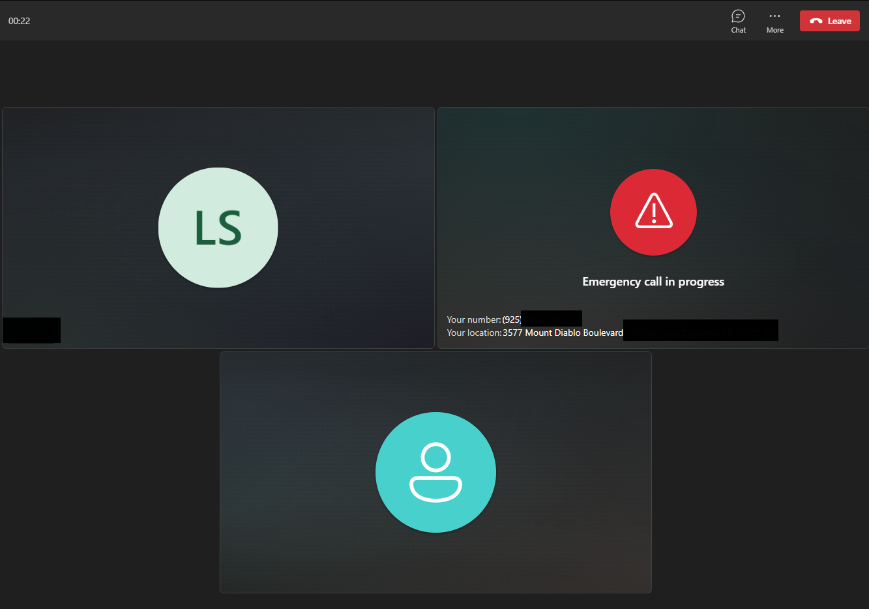
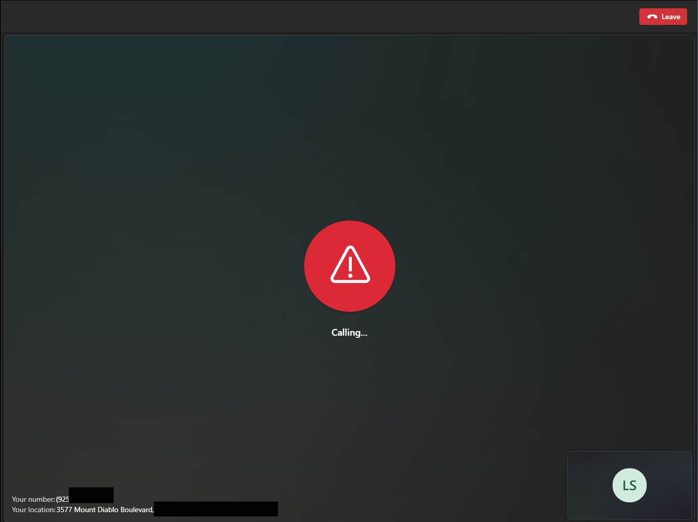
User Experience (desktop client)
Security officer conferenced in the call
Single user dials emergency services

Slide 51
Caller ID Policy and E911
Question: What happens when a user who has a Caller ID Policy that masks their phone number (DID) from being displayed places a 911 call. Which number is displayed?
Answer 1: The Caller ID Mask number is not applied during emergency (911) calls – the users DID is displayed for proper call back in the event the call is displayed.
Answer 2: In the event the user is using Shared Calling, next free emergency call back number in the emergency number list will be used as the caller ID. This number will be reserved for the next 60 minutes. If there are no free numbers available in the list, Teams will reuse a phone number from the list.

Slide 52
Supported Clients
The following clients are currently supported. Check back often to see updates to this list.
  Teams desktop client for Microsoft Windows
  Teams desktop client for Apple macOS
  Teams mobile client for Apple iOS client version 1.0.92.2019121004 and App Store version 1.0.92 and greater
  Teams mobile client for Android client and Google Play store version 1416/1.0.0.2019121201 and greater
  Teams phone version 1449/1.0.94.2019110802 and greater
  Teams Rooms on Windows
  Teams Rooms on Android
Subnet locations are supported on all Teams clients. WiFi-based locations are supported on all Teams clients except Teams phone.
Ethernet/Switch (LLDP) is supported on:
  Windows versions 10.0 and later at this time.
  Mac OS, which requires LLDP enablement software.
  Teams phone with Teams app version 1449/1.0.94.2021110101 and later.
  Teams Rooms on Windows
  Teams Rooms on Android (OEM specific configuration may be required)

Slide 53
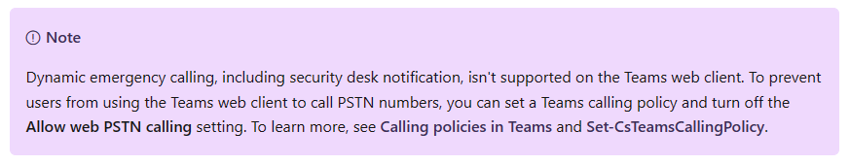
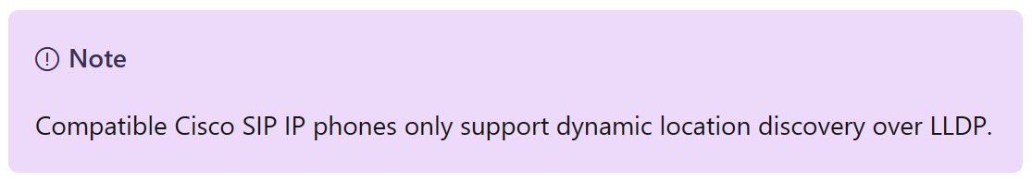
Other Clients and Endpoints
The following clients are currently supported. Check back often to see updates to this list.
  Teams on VDI (VMWare)
  Teams on VDI (Citrix and Citrix)
  Teams SIP Gateway (Reference)
  Teams Web Client does not perform dynamic discovery; user must manually add their location.
Notes:
SIP Gateway supports dynamic emergency calling (dynamic E911) for compatible SIP devices that share network attributes over the wire. These attributes are provisioned in the Teams admin center and can be a combination of local IP and subnet length, or chassis ID and network port number. For devices that do not share location attributes, or if the location is not resolved dynamically for any reason, SIP Gateway will continue to support emergency calling based on registered addresses. Currently, registered addresses are not supported for Direct Routing scenarios. For more information about emergency calling, see Plan and manage emergency calling.
Skype for Business Client / Skype for Business Mobile App is not supported.

Slide 54
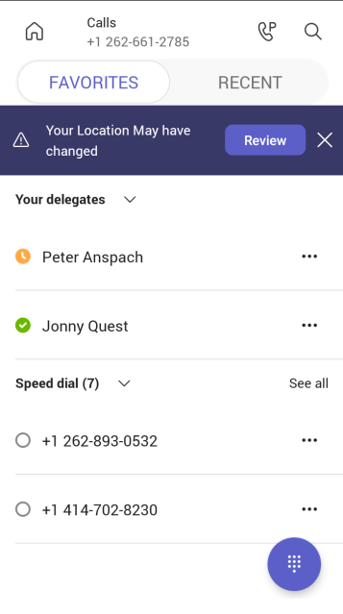
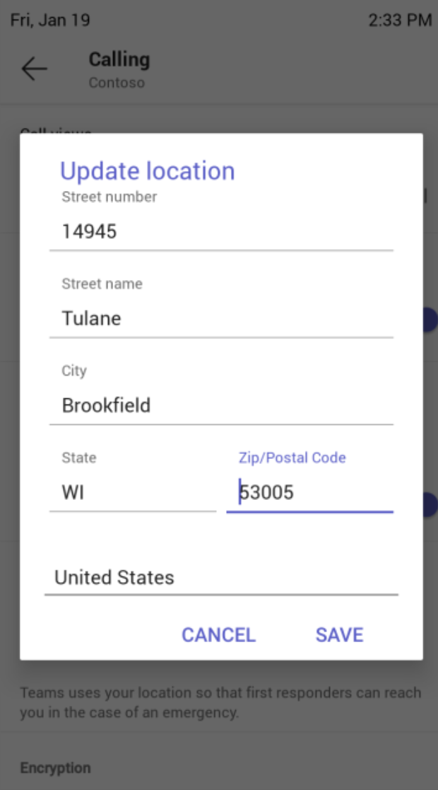
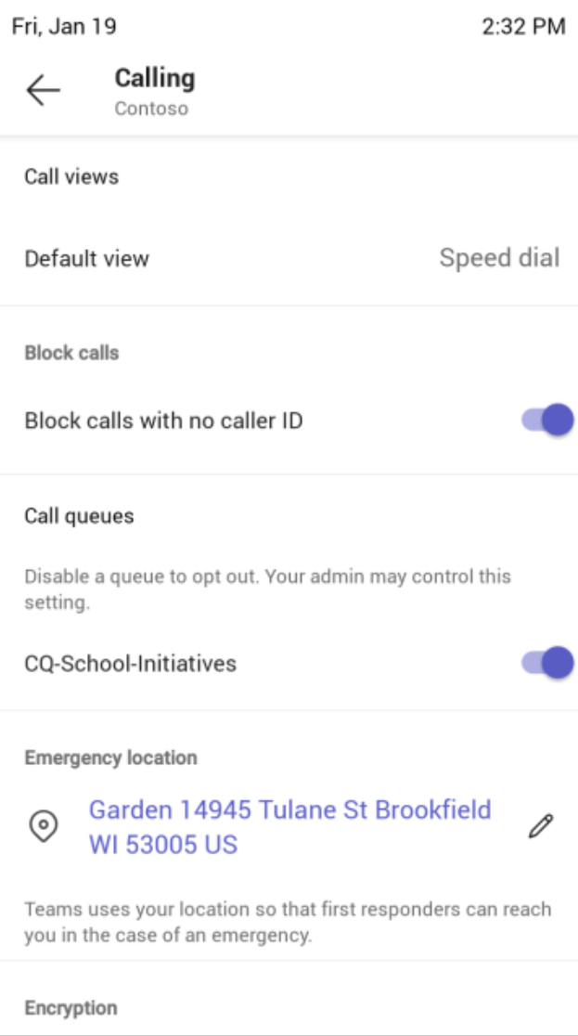
Desk Phones
Notes:
Teams desktop phones can detect a location change and prompt the end user but they do not have location services.

Slide 55
Teams Mobile App (iOS)
Custom disclaimer is not supported for mobile since mobile has GPS coordinates, which is the best and most accurate location.
There is no way to verify (WFH) experience in mobile for the same reason.
Teams mobile supports automatic location detection but not the user entered experience described with the desktop client.
On iOS as soon as the user goes to the calls tab, Teams will fetch the emergency call information. Teams will also update that information if the user switches networks with the calls tab opened. If the user stays with the calls tab opened for 5 minutes, Teams will also update the emergency information.
Privacy settings can conflict with automatic location detection – Mobile Device Management systems can be used.

Slide 56
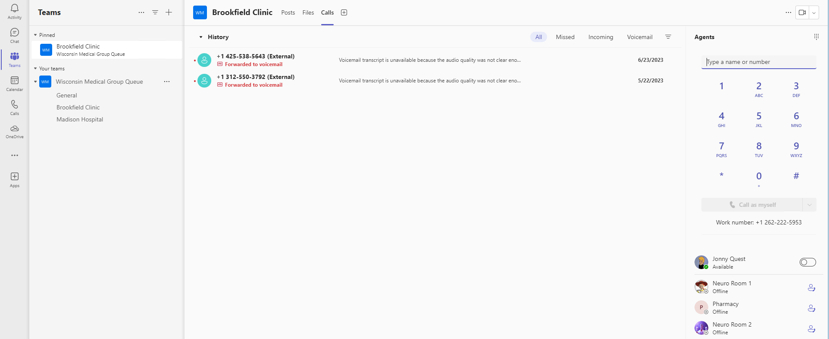
Voice Channels
The voice channel supports emergency calling where agents can dial in the emergency number in case of a crisis. Any omnichannel voice agent with a capacity profile associated with a voice outbound profile can make an emergency call. The emergency responders can call the agent back over a temporary callback number if the call is dropped (even if the agent had called via a shared outbound number).
Reference: Voice channel in Omnichannel for Customer Service | Microsoft Docs
Notes:
*Agent Experience - Dial the emergency number during crisis (currently supported in the United States and Puerto Rico only).

Slide 57
Shared Calling and E911
This Photo by Unknown Author is licensed under CC BY

Slide 58
Shared Calling for Teams Phone
This feature enables faster PSTN deployment to users who do not need a dedicated phone number.
One phone number for multiple users
Group users and provide the ability to receive incoming calls and make outgoing calls via a single company phone number.
Simplify deployment and reduce administrative overhead
Simple policy definition allows groups of users to be quickly enabled reducing time to value.
Multiple PSTN enablement options
Supports Pay-As-You-Go Calling Plan, Operator Connect, and Direct Routing.
Full functionality including Emergency Calling support
Teams Phone features including dynamic locations and callback are fully supported.
Notes:
[PRESENTER TALK TRACK]
We recently announced the shared calling capability in Teams Phone.
Shared calling allows you to enable groups of users to make and receive PSTN calls using a shared phone number and calling plan – enabling you to quickly deploy calling across groups or your entire organization, as well as pooling calling plan minutes across users.
With shared calling, a single phone number and calling plan can be shared across a users licensed for Teams Phone, either through E5 or Teams Phone Standard.
Whether supporting 10 people in a small office or 10,000 users in an enterprise, you can easily enable shared calling in the Teams admin center by creating a custom shared calling policy, assigning a resource and phone number to the custom policy, and then assigning users to this policy.
How it works
Inbound calling
External caller places a call to a shared number
Call is routed through name to desired call recipient
Call recipient answers call in the Teams app
Outbound calling
User dials a phone number from the Teams app
Call is routed through the resource account to the call recipient
Call is billed against calling plan associated with the resource account used for shared calling (can be Microsoft or 3rd party)

Slide 59



How Emergency Calling works with Shared Calling
Emergency Call
Emergency Call Back
Emergency callback number
Caller ID Mask:
(425) 882-0911
PSTN connectivity
PSTN connectivity
Emergency callback number
Caller ID Mask:
(425) 882-0911
Shared Calling User 1
Public Safety
Answering Point
Public Safety
Answering Point
Shared Calling Policy
Resource Account Number
(425) 882-08080
Emergency Callback Numbers
(425) 882-0911
(425) 882-0933
Shared Calling User 1
Shared Calling Policy
Resource Account Number
(425) 882-08080
Emergency Callback Numbers
(425) 882-0911
(425) 882-0933
Shared Calling User 2
Shared Calling User 2
Shared Calling User 3
Shared Calling User 3
User 2 signs into Teams. Location Services initiates.
User 2 dials Emergency Number (911).
Security desk notification is sent.
Emergency Callback Number is allocated from shared calling policy. This number is used as Caller ID Mask.
Location information (PIDF-LO) information is sent to PSAP.
If the emergency call is disconnected, the emergency callback number is reserved for 60 minutes.
PSAP calls the allocated emergency callback number (presented as Caller ID Mask)
Teams connects the inbound call from PSAP to User 2.
1
1
2
2
3
4
3
5
Notes:
Emergency services must be able to call back the originator of an emergency call through the emergency callback number. The callback number serves as the caller ID or calling number used when an emergency call is made.
You define a list of emergency callback numbers in the Shared Calling policy by using the -EmergencyNumbers parameter. Each Shared Calling policy must have a unique emergency calling number. That is, you can't use the same emergency number in more than one Shared Calling policy.
When an emergency call is made, the next free number in the emergency number list will be used as the caller ID. This number will be reserved for the next 60 minutes.
If there are no free numbers available in the list, we'll reuse a phone number from the list.
If this list is empty, the phone number of the resource account is used as the emergency callback number--however, this process isn't supported if your resource account is assigned a Calling Plan toll free service number.
When emergency numbers are added to a policy:
The emergency numbers must be routable for inbound PSTN calls. For Calling Plan & Operator Connect, the emergency numbers must be available within the tenant.
The emergency numbers specified must all be of the same phone number type as the phone number assigned to the specified resource account--that's Calling Plan, Operator Connect, or Direct Routing.
The emergency numbers can’t be assigned to any user or resource account.
You can't delete or reassign an emergency number used in any Shared Calling policy. You must first remove the number from the Shared Calling policy before you delete or reassign the number.
You can view all Calling Plan and Operator Connect numbers by country, number sequence, or policy group by using the Teams admin center. For assigned Direct Routing numbers, you can use Get-CsPhoneNumberAssignment -NumberType DirectRouting.
Calling Plan service numbers
If the resource account has assigned a Calling Plan service number, then the emergency callback number must be a Calling Plan subscriber number--not a Calling Plan service number.
If your resource account is assigned a Calling Plan toll-free service number, you need to add Calling Plan subscriber numbers to emergency numbers in the Shared Calling policy.

Slide 60
Basic E911 Deployment Plan – United States
Engage with your legal team to identify and understand your organizational requirements around E911.
Engage with your carrier to ask if they support PIDF-LO.
Engage your endpoint management team to enable location services on all endpoints.
Configure Teams Emergency Calling Policies.
  Enable External Location Lookup Mode
  Enable Notifications
Configure Teams Emergency Call Routing Policies and your SBC if needed.
Configure Emergency Addresses, Network Topology, Networks & Locations as needed.

Slide 61
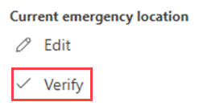
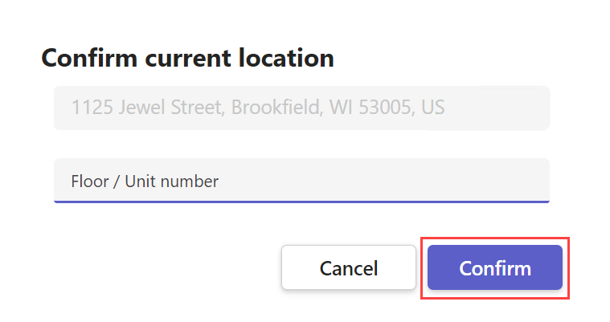
Emergency address obtained from the operating system without confirmation for accuracy by the user
Emergency Routing Method
Screened and Transferred to PSAP

Slide 62
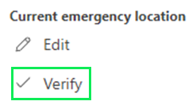
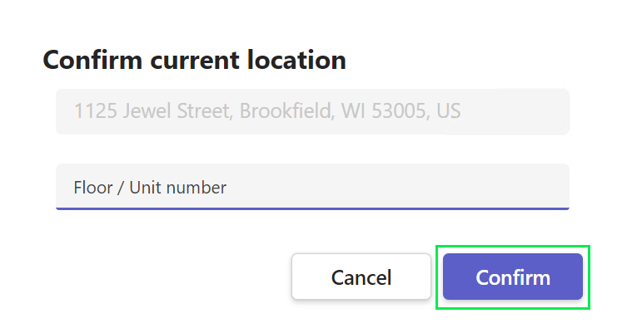
Emergency address obtained from the operating system with confirmation for accuracy by the user.
Emergency Routing Method
Direct to PSAP

Slide 63


Emergency address obtained from operating system and edited through address autosuggest.
Emergency Routing Method
Direct to PSAP

Slide 64


Emergency address obtained from the operating system and manually edited and confirmed by the user.
Emergency Routing Method
Screened and Transferred to PSAP

Slide 65



Emergency address entered manually and confirmed by the user.
Emergency Routing Method
Screened and Transferred to PSAP

Slide 66



Emergency address entered through address autosuggest and confirmed by the user. Direct to PSAP
Emergency Routing Method
Direct to PSAP

Slide 67

Emergency address statically assigned to the user / number.
Emergency Routing Method
Screened and Transferred to PSAP

Slide 68
Null – Screened and Transferred to PSAP.
Emergency Routing Method
Screened and Transferred to PSAP

