Slide 1
Accessible events guide
Notes:
Updated 2/23/24
Thank you to our content reviewers:
Julia Binger
Toby Fitch
Kevin Wolfe
Crystal Jones
Phillip Profitt
Laura Luethe
Carly Nelson

Slide 2


What to expect
This guide provides Microsoft's recommendation and best practices for planning and executing an accessible event. This guide is intended for event planners, organizers, and presenters.
These recommendations are provided to help you plan and launch an inclusive event with accessibility and disability in mind. After reviewing this guide, you will be able to answer the following questions:
How can you make your communications accessible to people before, during, and after the event?
What should you consider when selecting a venue for virtual, in person, and hybrid events?
What accessibility accommodations should be provided to all event attendees?
What should you consider when preparing and presenting content for your event?
FEBRUARY 2024
CLASSIFIED AS MICROSOFT CONFIDENTIAL

Slide 3
What’s in this guide
FOR EVENT PLANNERS, ORGANIZERS, AND PRESENTERS
Event Planning 04
Preparing your communications to be accessible to everyone before, during, and after the event.
  Communications 4
  Marketing 7
  Social media 9
  Platform 12
  Registration 15
  Accommodations 18
  Travel 21
Venue 24
Best practices to employ when selecting a venue for in person, hybrid or virtual events.
  In person 25
  Event staff training 31
  Hybrid and virtual 33
Content 35
Strategies for creating, presenting and sharing accessible content to your audience.
  Presenting 36
  Resources 37
  Live or recorded content 38
  Captions 39
Etiquette 41
Disability language and etiquette are important aspects of creating an inclusive environment for people with disabilities.
  Social decorum 42
  Sign language 43
Check list 45
Appendix 50
Here you will find considerations for in person, virtual, and hybrid events. Accessibility must be considered at all stages of an event: Before the event, during the event, and after the event. Any slides in this deck that are relevant to presenters will be indicated.
FEBRUARY 2024

Slide 4
1 | Communications
Effective communication forms the cornerstone of your event, serving as an introduction to your attendees. Prior to dispatching any communications, it is necessary to prioritize accessibility and integrate measures to foster an inclusive experience for all participants.
Crafting a communication strategy that proactively addresses accessibility requirements is essential. Here are some recommended practices for cultivating an inclusive communication experience for both event attendees and followers.
Ask yourself: How can I make my communications accessible to people before, during, and after the event?

Slide 5
event Communications
Crafting a communication strategy that proactively addresses accessibility requirements is essential. Here are some recommended practices for cultivating an inclusive communication experience for both event attendees and followers.
1
Make it accessible.
Use Microsoft Outlook’s accessibility checker to verify email accessibility. Learn more about improving email accessibility in Microsoft Outlook.
2
Mindful messaging.
Consider the sensitivity around words and phrases that are related to culture, race, gender, and disability.
For more information review the Diversity Style Guide.
3
Imagery.
When using images to communicate information about the event add alternative text (alt text) and verify auto-generated alt text for all images.
Attendees using a screen reader will be able to understand the images.
4
Communicating.
Choose a communication and registration platform that will support ongoing communication with attendees and meets accessibility criteria.
Learn more at Accessibility Resources & Training | Microsoft Accessibility.
5
Seek feedback.
Seek feedback and leverage to enhance future events.
FEBRUARY 2024
CLASSIFIED AS MICROSOFT CONFIDENTIAL

Slide 6
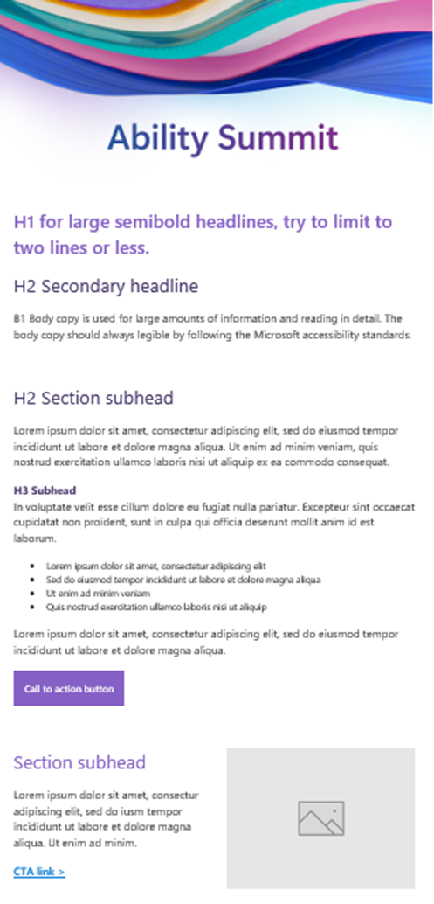
Email template
Image showing an email layout with specified font types for headlines and subhead sections to use for event communications.
Remember to use alt text for your imagery.

Slide 7
Marketing
FOR EVENT PLANNERS, ORGANIZERS, AND PRESENTERS

Slide 8
event marketing
Posters and signage play integral roles in any event. By ensuring inclusivity in signage, all attendees, including those with disabilities, can confidently navigate the event space.
1
Make it accessible.
Event materials such as menus, maps, and agendas, should be made available in electronic formats in advance of the event.
Provide tactile maps and wayfinding tools for people who are blind or have low vision. Learn more at Tactile Maps and Wayfinding Tools.
2
Accommodations.
Attendees may specifically request additional alternative formats, such as Braille and Large Print.
Engage with your Braille supplier early in order to fulfill Braille requests in time for your big day.
3
Fonts.
Comic Sans is favored due to its technical attributes that cater to readers across different proficiency levels. Avoid decorative fonts. Choose typefaces with clear letterforms and distinguishable characters
Learn more about inclusive type at Accessibility Resources & Training | Microsoft Accessibility.
4
Contrast.
Ensure a high contrast between the text and background to enhance readability.
Black text on a white background or vice versa is a classic choice, but other high-contrast combinations can also be effective.
5
Testing.
Before finalizing your design, evaluate the legibility of your chosen fonts and color combinations using accessibility tools or by soliciting feedback from individuals with diverse visual abilities.

Slide 9
Social media content
FOR EVENT PLANNERS, ORGANIZERS, AND PRESENTERS

Slide 10
Social media
Social media is a powerful and expansive platform to share information about your event; it is important to acknowledge accessibility standards may vary among different social media platforms.
1
Make it accessible.
Provide alternative text and review generated text for accuracy for all images. Include captions for all multimedia.
2
Mindful messaging.
Consider the sensitivity around words and phrases that are related to culture, race, gender, and disability. For more information review the Diversity Style Guide.
3
Audio.
Provide audio description when necessary to announce the resource contents for someone who is blind or has low vision.
Learn more at Accessibility Resources & Training | Microsoft Accessibility.
4
Platform guidelines.
LinkedIn accessibility
Facebook accessibility
Google accessibility
5
Platform guidelines cont.
YouTube accessibility
  Instagram accessibility
  X (formerly Twitter) accessibility
FEBRUARY 2024
CLASSIFIED AS MICROSOFT CONFIDENTIAL

Slide 11
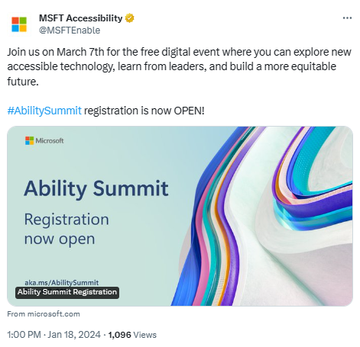
Twitter
Example of a Twitter announcement for the Microsoft Ability Summit.
Remember to use alt text for your imagery.

Slide 12
2 | Platform
FOR EVENT PLANNERS, ORGANIZERS, AND PRESENTERS

Slide 13
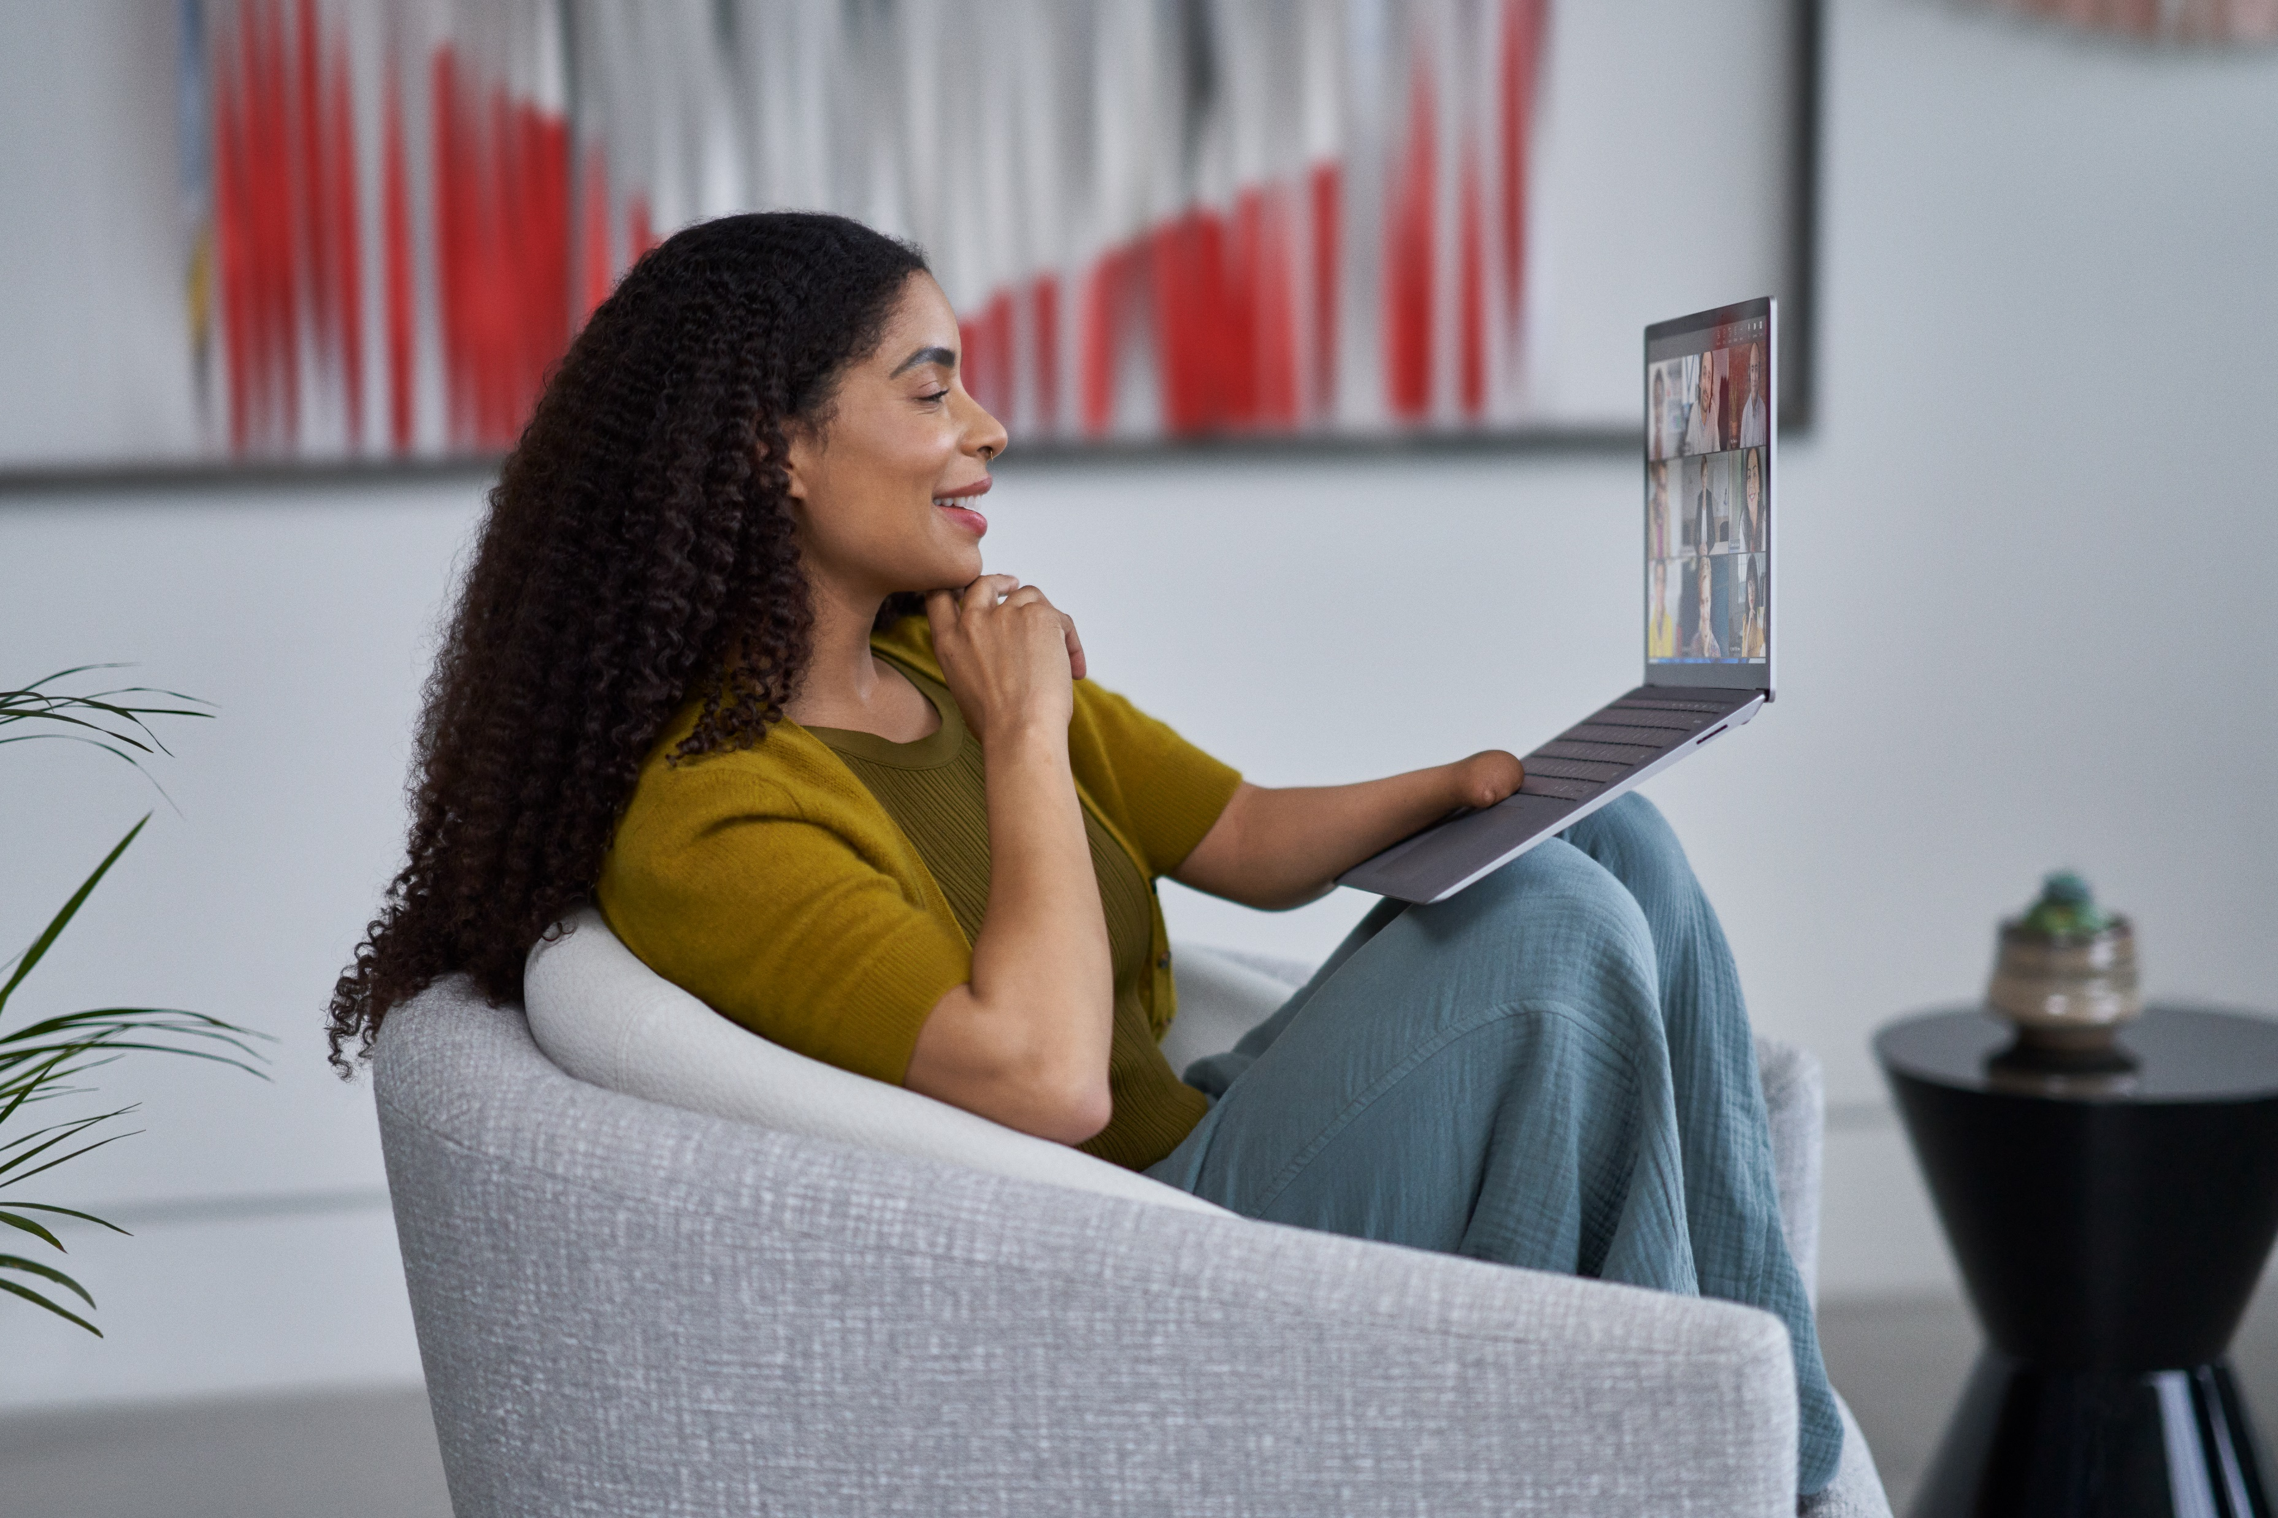

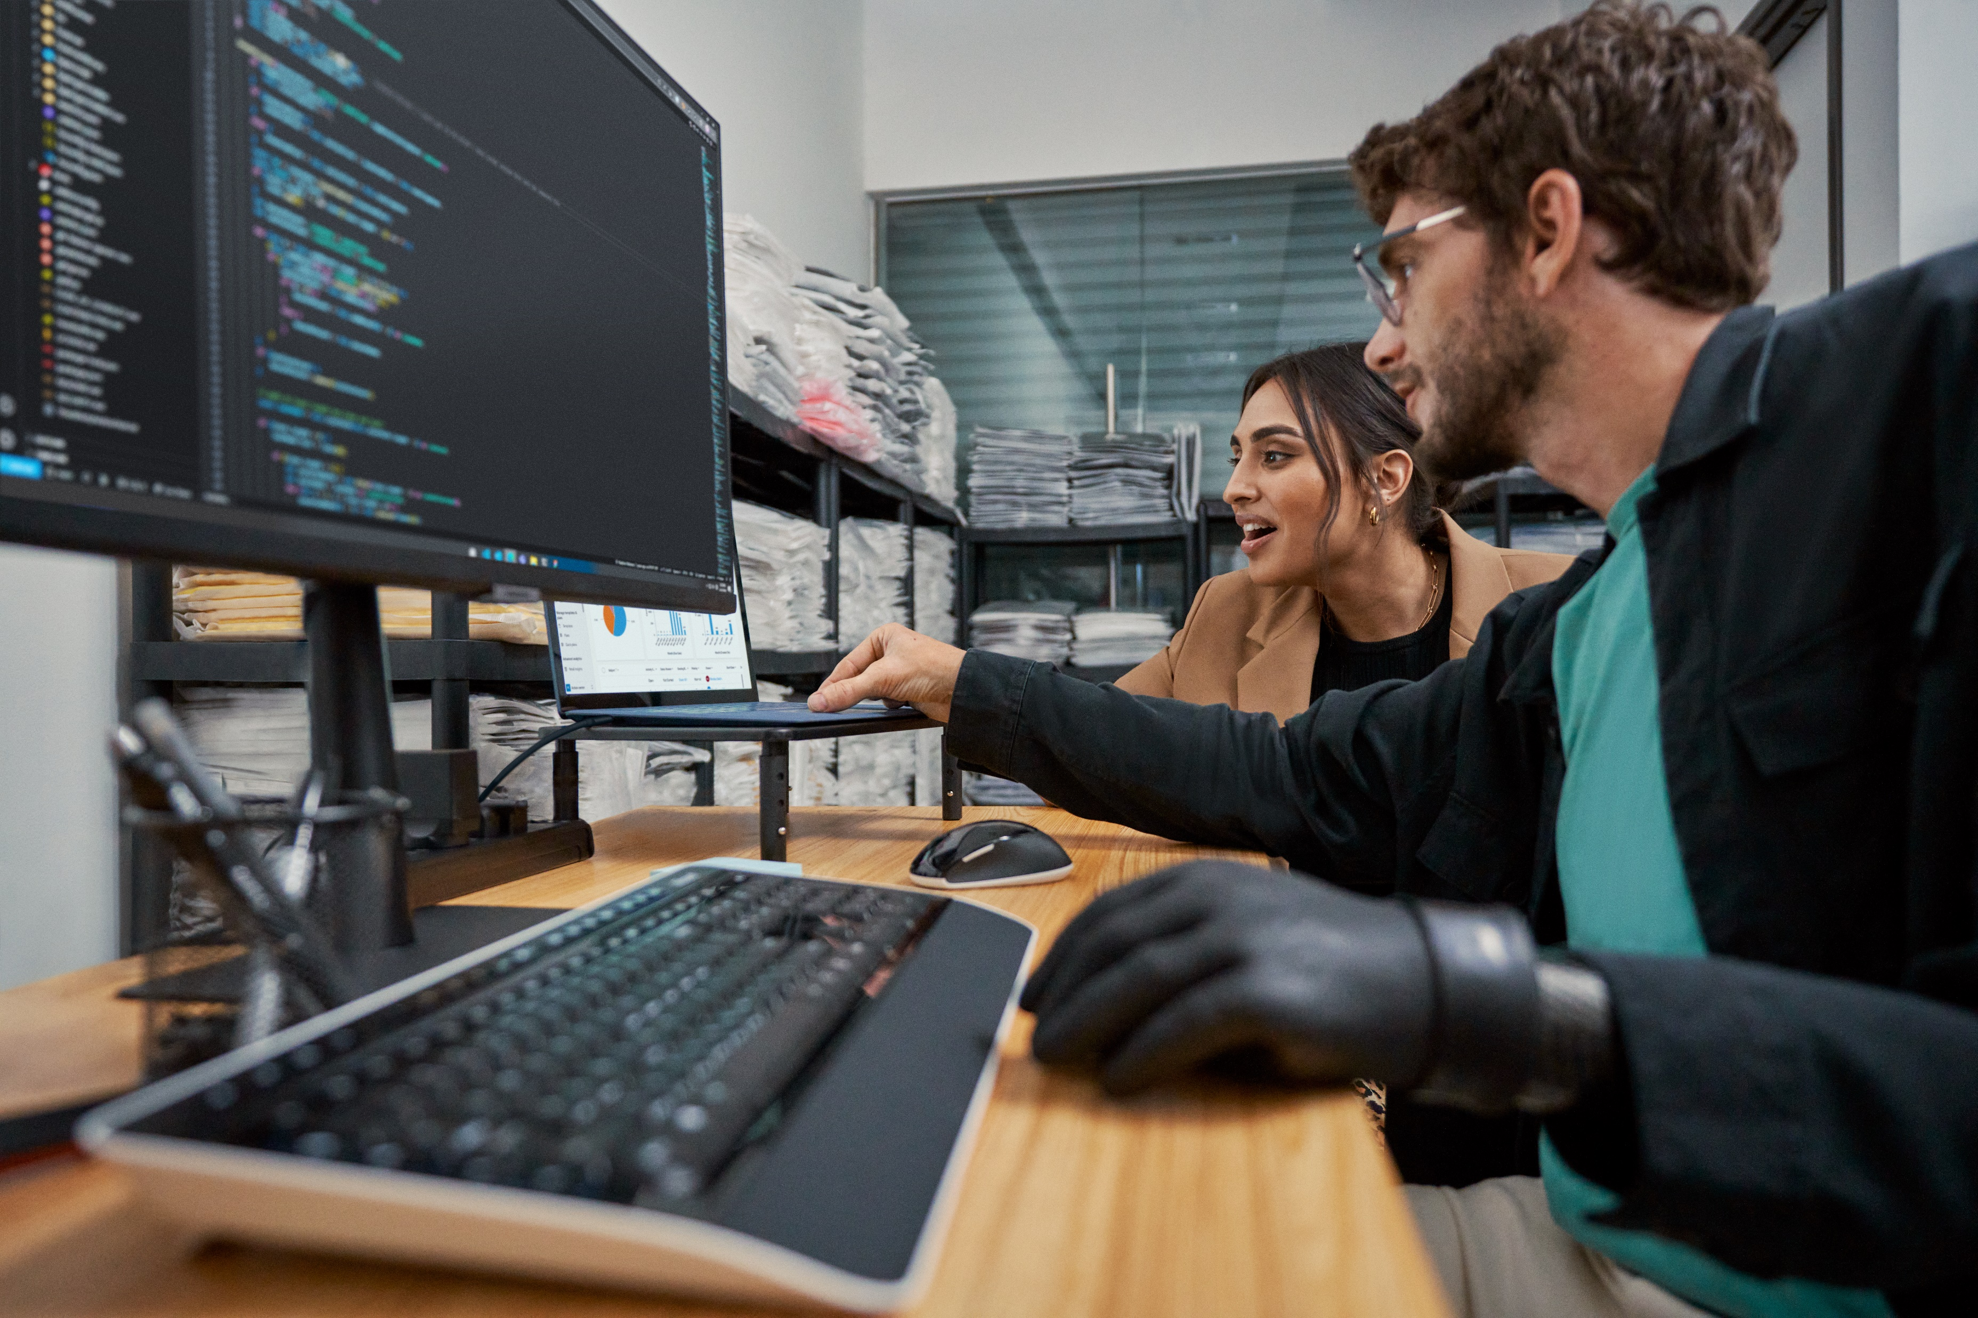



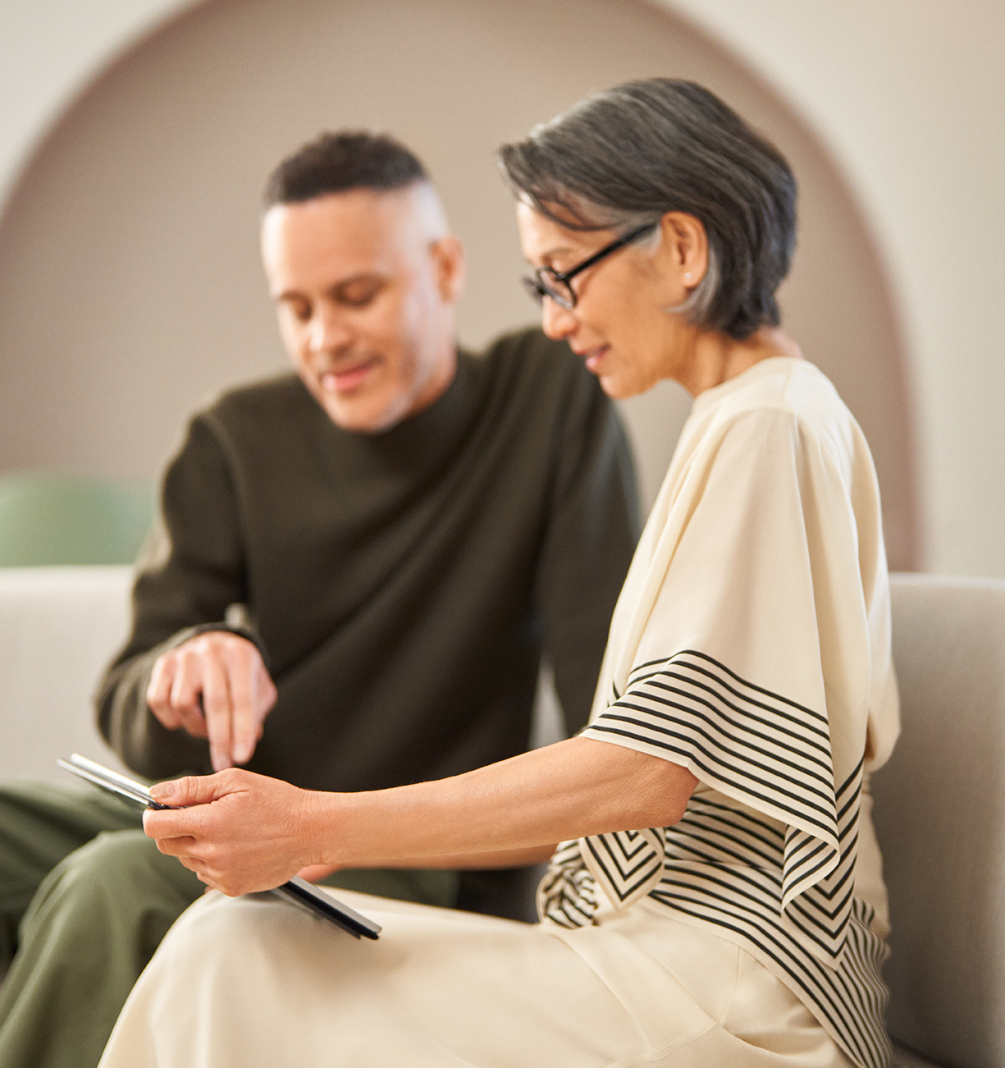

DIGITAL PLATFORM
FOR EVENT PLANNERS, ORGANIZERS, AND PRESENTERS
Here are some tips to help make your in-person, hybrid or virtual events more accessible.
Consider the platform
Choose an accessible platform that allows people using assistive technology to present and participate. The platform should provide accessibility features such as blurred background and captioning features.
Content
All materials must be accessible. Consider pre-recorded content, especially for complicated technology demonstrations. Share content with the moderator prior to the event for support in the event of technical issues.
Provide support
Provide technical and accessibility assistance as well as breaks and check-ins. Your technical support team should be trained on disability language and etiquette, assistive technology, and the digital platform.

Slide 14
platform
Choose a registration platform that will support ongoing communication with attendees and meets accessibility criteria.
1
Functionality.
Ensure that all functions and interactive elements on the registration page can be accessed and operated using keyboard-only navigation, without relying on a mouse.
Use semantic HTML markup to properly structure the content of the page to aid in navigation for screen reader users. Include heading tags, lists and landmarks.
2
Forms.
Design forms with accessibility in mind by providing clear labels for form fields, using proper field grouping with field set and legend elements, and ensuring that form controls have accessible names and roles.
3
Design.
Design the registration page to be responsive and adaptable to different screen sizes and devices, including cell phones and tablets.
Learn more at Developing for Web Accessibility.
4
Contrast.
Ensure sufficient color contrast between text and background elements to make content readable for users with low vision or color blindness.
Aim for a minimum contrast ratio of 4.5:1 for normal text and 3:1 for large text.
5
Testing.
Conduct usability testing with individuals with disabilities to gather feedback on the accessibility of the registration page and identify any potential barriers or issues that need to be addressed.
Test the page's functionality and layout across various devices and screen resolutions.

Slide 15
3 | Registration
FOR EVENT PLANNERS, ORGANIZERS, AND PRESENTERS

Slide 16
online Registration
Providing accessible registration options not only enhances the overall attendee experience but also demonstrates a commitment to inclusivity and diversity, fostering a positive atmosphere for all participants.
1
Make it accessible.
Provide an accessible registration form. Whether you’re using Microsoft Forms, Eventify, or another format, your registration form must be accessible.
Test your form before sending it to your audience to make sure you meet accessibility standards.
2
Accommodations.
Provide a list of accommodations you will offer at your event and allow participants and presenters to request additional accommodations such as hearing or visual assistance.
Accessible hotel rooms with rooms with roll in showers, doorbells with flashing lights, adjoining rooms for PCA’s.
.
3
Meals.
If food will be provided at your event, ask participants to identify any dietary requirements including options such as vegetarian, vegan, halal, Kosher, Diabetic options (low carb, low sugar, low fat), and/or food allergies.
Do not include calorie counts on menus.
4
Assistants.
Provide a field for attendees to input personal care attendant’s (PCA), and sighted guides names for badge purposes at the event.
If badges are required for all attendees to access the event, PCAs and sighted attendants must be given the same access to support the attendees appropriately.
5
Walkthroughs (optional).
Provide dates and times for attendees to sign up for a walkthrough of the event space.
Be sure to request whether accommodations will be needed for the event space walkthrough.

Slide 17
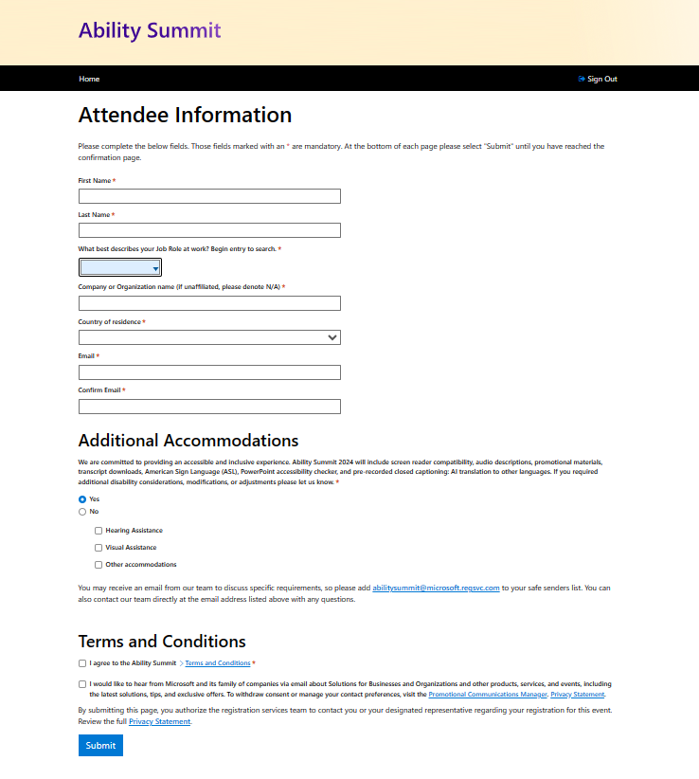
REGISTRATION FORM
Here is an example registration form and a list of fields to consider.
Attendee information can include:
  First name
  Last name
  Job role
  Company or organization (or unaffiliated)
  Country
  Email
  Additional accommodations:
    Hearing assistance, visual assistance Accessible hotel rooms with roll in showers or doorbells with flashing lights and adjoining rooms for PCA’s. )
  Field for personal care attendant registration
DO solicit requests for accommodations early and often.
DO follow up with attendees who request accommodations.

Slide 18
Accommodations/Adjustments
FOR EVENT PLANNERS, ORGANIZERS, AND PRESENTERS
Notes:
Accommodations or adjustments are services or tools provided for individuals with disabilities to give the attendee the opportunity to fully participate in the event. Some accommodations should always be provided as a best practice, while others are more individualized and should be provided when requested by an attendee. During the registration process and throughout all communications, solicit requests for accommodations and follow up with the people who requested accommodations to ensure you are meeting the attendee's needs.
Ask yourself: What accessibility accommodations should be provided to all event attendees?

Slide 19
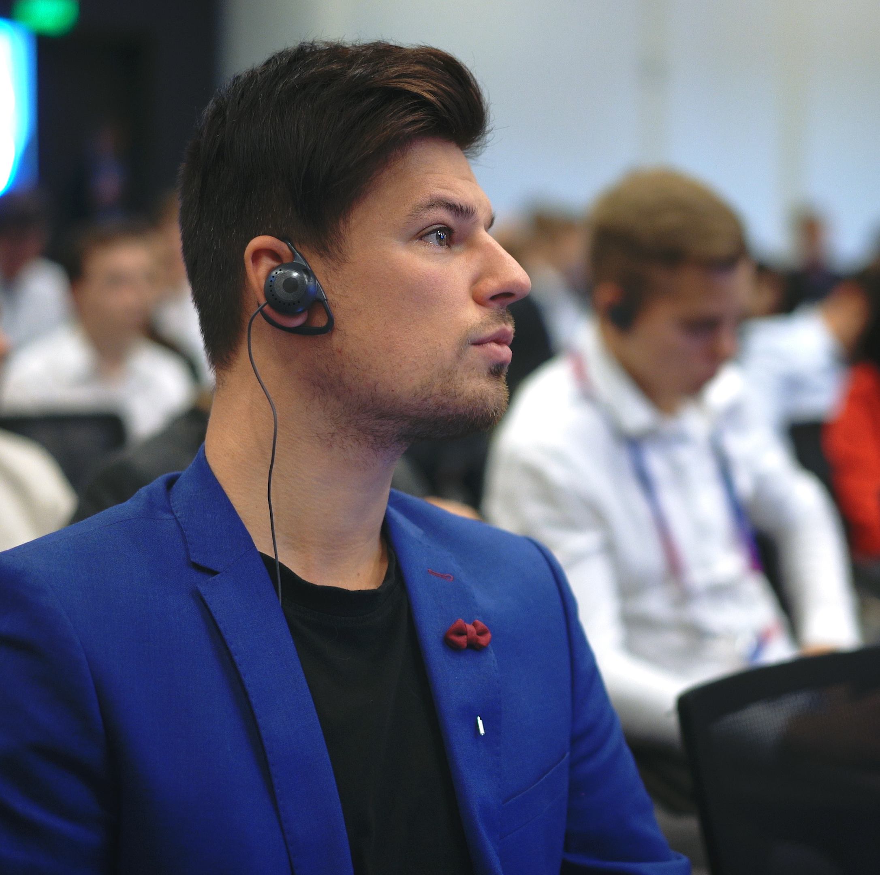



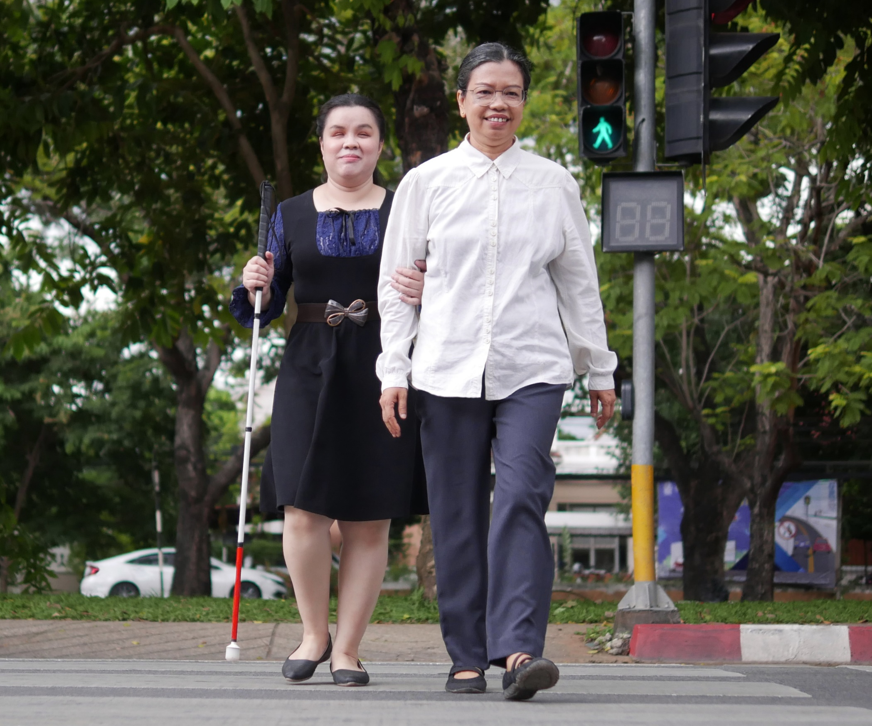
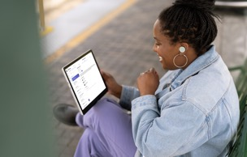
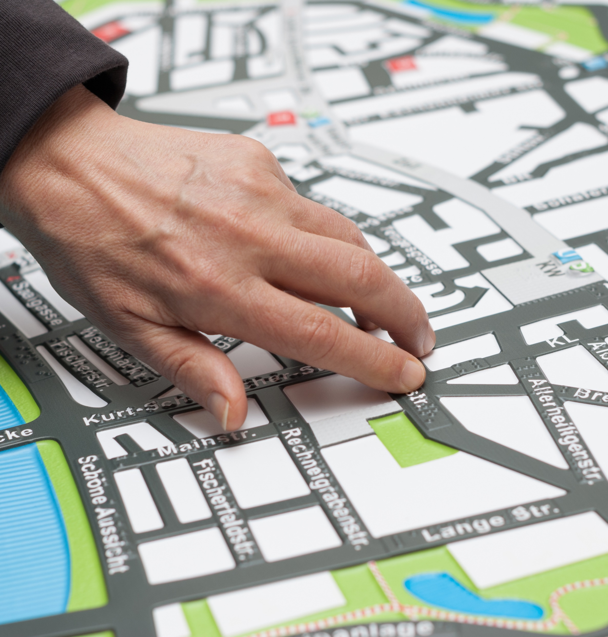
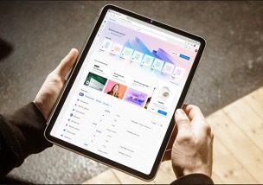
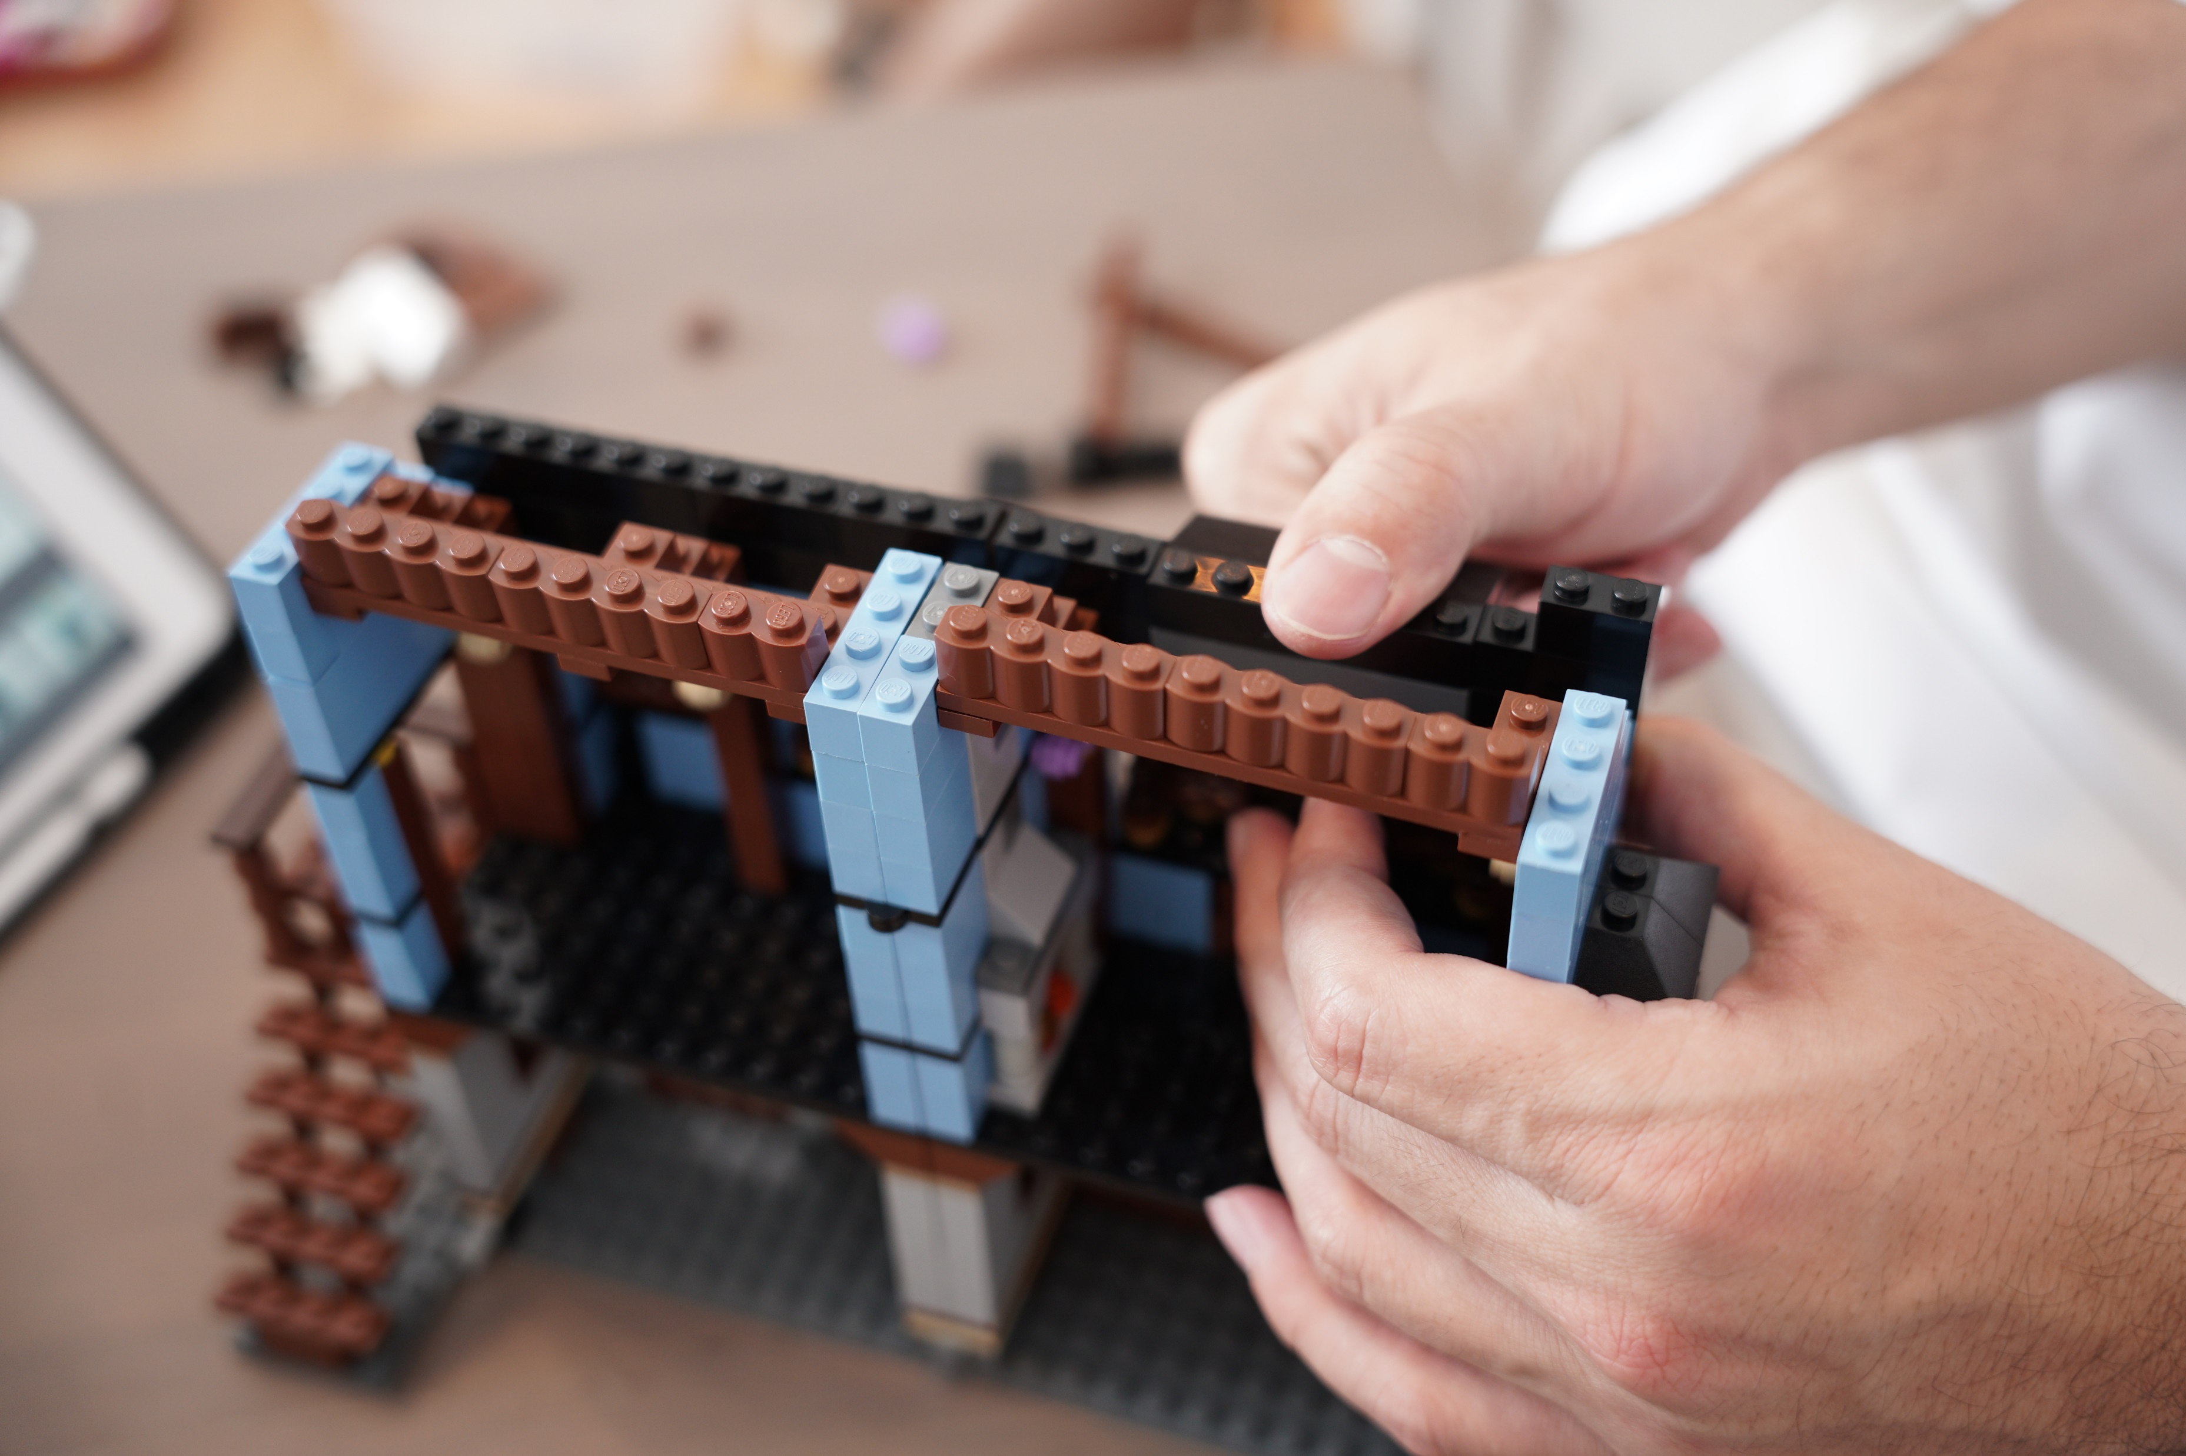

ACCOMMODATIONS
In addition to accommodations that are provided to all attendees, some attendees may request individual accommodations and must be provided upon request. Solicit requests for accommodations during registration and any communications thereafter. Here are some examples of accommodations but may not reflect all the options requested by attendees.
Live audio description
Audio description is narration of visual components of a video or performance for a person who is blind or has low vision. Live audio description is real time narration of a live performance, event, demonstration, or experience. Choose an experienced live audio description vendor. Provide material to live audio describers prior to the event.
Sensory experiences
Sensory experiences are activities, objects, or spaces at the event that provide a calm environment. Sensory experiences can help to lower anxiety and stress levels. Some examples include quiet spaces, silent discos, mask only areas, and sensory objects such as building blocks. Provide space close to the main event. Include clear signage for quiet space locations.
Personal assistants
Some people with disabilities utilize assistants, such as Sighted Guides. Sighted guides are support professionals hired to guide people who are blind or have low vision to various locations at the event. Ask attendees to register assistants by name so they can acquire a badge at the event. Remember to take assistants into account for catering and space considerations.
Alternative formats
Provide event materials such as menus, maps, and agendas, in electronic formats in advance of the event. Attendees may specifically request additional alternative formats, such as Braille and Large Print. Order alternative formats early to allow for processing time of the documents. Consider the entire event experience such as social gatherings and meals and provide information in alternative formats as well.

Slide 20
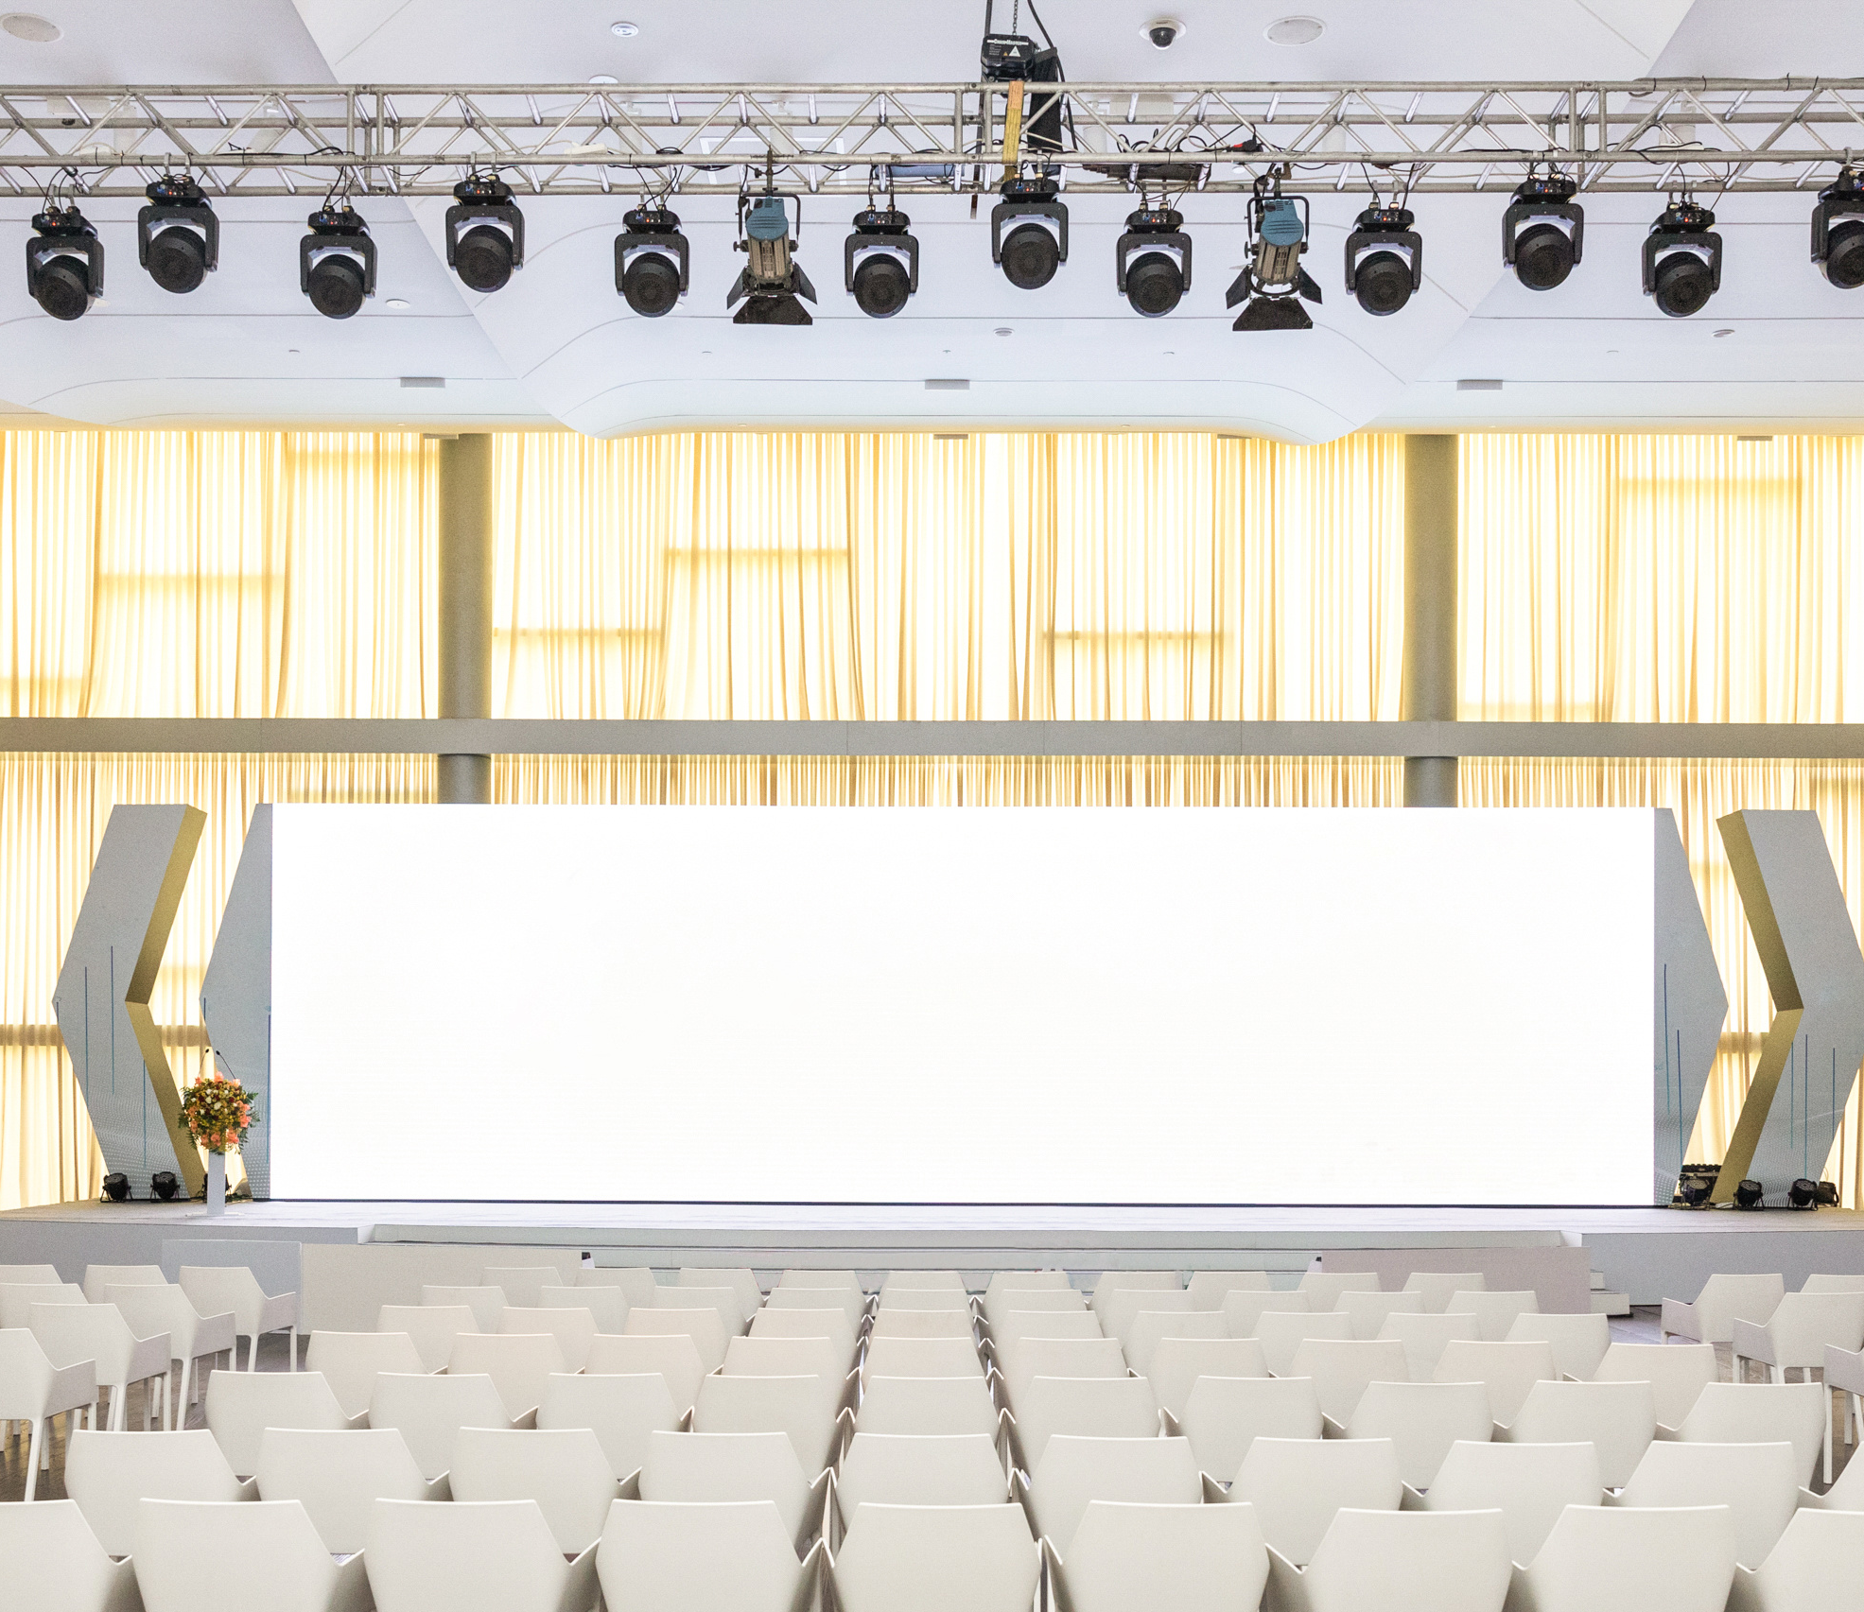
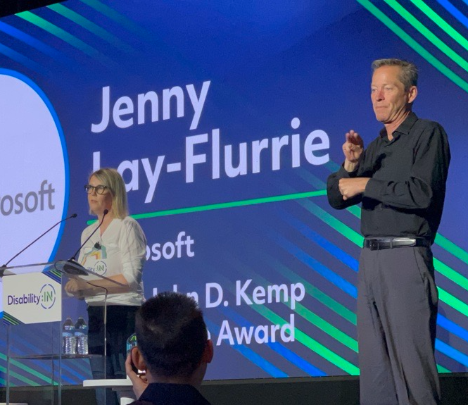



INTERPRETER PLACEMENT
When placing an interpreter on stage, the goal is to reduce the visual load for someone to view sign language, captions, presenter, and content all at the same time.
Well-lit room
Spotlight on interpreter
Captions in a visible location on the mainstage (and additional screens if in a large room)
Welcome to
Ability Summit
Interpreter on stage near presenter
Reserved seating for Deaf or Hard of Hearing attendees
Sample rendering: Sign language interpreter placement
Interpreter placement on the mainstage is near the presenter, not blocking content. Captions are on screen without obstruction, and the room is well lit. Reserved seating is placed in front of the interpreter.
In context: Presenter and interpreter
Jenny Lay-Flurrie presents to an audience at Disability:IN. A sign language interpreter interprets what Jenny says to the audience for any attendees who are Deaf or Hard of Hearing.

Slide 21
Accommodations TIPS
Some accommodations should always be provided as a best practice, while others are more individualized and should be provided when requested by an attendee.
1
Communicate.
During the registration process and throughout all communications, solicit requests for accommodations early and often. Share the list of accommodations provided at the event in all event communications.
2
Best practice.
Accessible online registration form.
Promotional materials in print and online.
Accessible event check in and meeting rooms.
Speaker training and content accessibility review.
Media subtitles, captioning.
3
Optional.
Materials in advance.
Site tours.
Assisted listening devices.
Labs/direct sessions.
CART
ASL
4
Upon request.
Large print materials.
Braille materials.
Pet relief area
Wheelchair
Mobility devices
5
Follow-up.
Follow up with the people who requested accommodations to ensure you are meeting the attendee's needs. Ensure staff is prepared to support requests upon arrival at the event.

Slide 22
Travel
FOR EVENT PLANNERS, ORGANIZERS, AND PRESENTERS

Slide 23
Travel TIPS
When planning travel and lodging for attendees of a conference with disabilities, it's crucial to prioritize accessibility at every stage. This includes ensuring transportation options are wheelchair-friendly and arranging accommodations that cater to specific needs, such as accessible rooms and amenities.
1
Registration.
During registration, solicit requests for travel and lodging accommodations for both presenters and attendees. Share what type of accommodations you are providing.
2
Hotel.
Accessible hotel rooms with roll in showers or doorbells with flashing lights. Offer adjoining rooms for personal care attendants if available.
3
Transportation.
Accessible shuttles and/or buses for travel between locations. Share the schedule with attendees at check-in and at the venue.
4
Rental equipment.
Bath safety
Mobility equipment
Oxygen & Respiratory Therapy Equipment
5
Follow-up.
Follow-up with attendees' requests.

Slide 24
4 | Venue
Ensuring accessibility is crucial to creating an inclusive environment for all participants.
By incorporating the following into your event space planning, you can help create an inclusive and accessible meeting environment where all participants feel welcome and valued.
Ask yourself: What should I consider when selecting a venue for in person, hybrid or virtual events?

Slide 25
In person
FOR EVENT PLANNERS, ORGANIZERS, AND PRESENTERS

Slide 26
IN PERSON events | 1
Creating an accessible event space for a meeting is paramount to fostering inclusivity and ensuring equal participation for all attendees, regardless of their abilities.
1
Registration.
Strategic placement of the registration desk in relation to the entrance and meeting space distance is crucial for supporting the accessibility needs of all attendees. Registration desks should offer high and low options. Materials provided adhere to accessibility requirements as discussed in this guide.
2
Disability answer desk.
A disability answer desk provides a place for attendees to ask questions before, during and after the event. It is an excellent opportunity to engage with your attendees one-on-one and learn more about their experience at the event.
3
General.
Ensuring your meeting space includes, ramps, elevators, automatic doors, accessible restrooms, and space to easily move throughout the rooms and presentations will help support an accessible and more enjoyable event.
4
Event space.
Consider your attendees accommodation requests and disabilities when planning your event space. Accommodations such as the width of the aisles, food service placement and planning, location of ASL interpreters and the use of captions and other audio descriptions will allow attendees to stay focused on your meeting content.
5
Training.
It's considered best practice to conduct training sessions for volunteers, hotel staff, event personnel, and presenters before the event. This ensures there is ample time for everyone to ask questions and absorb the information provided. More resources available on Slide 51.
.

Slide 27
In person EVENTS | 2
Catering
Provide menus to attendees during registration and prior to the event including nutrition information.
Ask attendees for dietary requirements at time of registration.
Provide menus in alternative formats (Braille, large print, electronic formats).
Use tactile signage to differentiate items.
Avoid calorie counts on food items.
Label food and drink with large print and Braille.
Provide individually wrapped snacks throughout the day.
Keep order and placement of items consistent throughout your event.
Provide mixed height seating areas and tables.
Ensure food vessels are on low tables.
Ensure there is an accessible path to get to the food-especially ordering windows. and counters.
Have straws available wherever there are beverages served.
Provide differing forms of glassware including wide mouth brims and non-stemware in various weights to accommodate for arm/hand mobility needs.
Provide servers or volunteers to assist event attendees during break time.
Disability help desk
Provide a Disability Help Desk with trained staff that is available through the entirety of the event.
Ensure staff is trained on the event agenda, restrooms, medical availability, emergency plan, and etiquette.
Training for all staff
Staff is empowered to provide and support for attendees with disabilities identified upon arrival.
Contact information for conference owners to assist with any issues as they arise.
Emergency preparedness
Select locations that have inclusive emergency notification systems such as lights in sync with auditory alarms that indicate an emergency.
It is recommended for event staff to have a list of numbers to call in case of an emergency (i.e., fire department, police, poison control, etc.), the address of the venue and best areas of the building for first responders to enter.
All event staff needs to be informed of the location of emergency equipment and evacuation policies.
Include building managers, building security, first responders, and the disability community in the event planning.
Determine when it is appropriate to use elevators in an emergency.
Prior to the event, consult with people with disabilities to determine the best course of action in an emergency related to stairwell movement. In some cases, it may not be safe to assist a person down the stairs.
Provide evacuation chairs to use when necessary and safe and identify event staff who will assist with evacuation chairs as many evacuation chairs require assisted control.
Determine a safe place for refuge per the building evacuation plan and communicate this place effectively to event attendees and staff.
For more information visit the Emergency Preparedness | U.S. Department of Labor (dol.gov)

Slide 28
In person EVENTS | 3
Exhibit hall
Ensure there is ample space in the aisles, path, walkways for wheelchair access, other mobility devices, and service dogs.
Include a ramp with railings if you have an elevated stage for presenters that meet slope requirements. Verify they meet The Americans with Disabilities Act | ADA.gov guidelines.
Consider placing demos or lab equipment on height adjustable tables.
Provide clear and sufficient contrast and accessible format signage;
  Braille, digital, large print, for exhibit hall maps and on amenities (bathrooms, break out rooms, quiet areas, etc.).
Reserved seating at the front of the room for those who requested captioning or ASL Interpretation.
Open, reserved spaces at tables or in rows for wheelchairs, scooters, and other mobility devices to avoid segregating to sides or back of room.
DO NOT exceed the maximum capacity of the venue space.
General
Ensure there is ample access to elevators or ramps if the venue is multi-level, stepless venues are preferred. Include directional signage as needed.
Check for automatic doors at entrances and exits. Verify they are in working condition and they meet The Americans with Disabilities Act (ADA) guidelines.
Consider room acoustics free from ambient noise or strong echoes which could interfere with people who are hard of hearing or other disabilities.
Provide ample accessible parking with enough space for large vehicles and ramps
When possible, avoid venues with noisy ventilation that can be distracting for people who are hard of hearing or other disabilities.
Portable air filters can be used in rooms with inadequate ventilation
Access to elevators or ramps if the venue is multi-level, stepless venues are preferred.
Restrooms
Wheelchair accessible bathrooms with ample clearance, grab bars, and sink height.
Consider gender neutral restrooms.
Determine number of single use restrooms for attendees with companion helpers.
Outdoor space
Provide easily readable and identifiable signage for event location and parking
Ensure ramps for entering and exiting the building
Check automatic doors at entrances and exits
Eliminate rocks, sand, or uneven surfaces
Provide mixed-height and size inclusive seating areas and tables
Ensure ample shade for people with light sensitivities
Provide indoor alternatives for individuals with allergies, and environmental or temperature sensitivities

Slide 29
In person EVENTS | 4
Personal assistants
Certain individuals with disabilities may rely on assistance from professionals, such as Personal Care Attendants (PCAs) and Sighted Guides, to navigate events effectively.
PCAs are trained professionals capable of providing medical assistance to individuals with disabilities.
Sighted Guides, on the other hand, are support professionals hired specifically to assist individuals who are blind or have low vision in navigating various locations within the event.
During registration, ask attendees to register their assistants by name.
Remember to take assistants into account for catering and space considerations.
Service animals
Provide water bowls and a designated animal relief area for service animals.
Remember service animals are doing a job and should not be approached, pet or talked to.
Personal care
Location for attendees who are diabetic to inject insulin and check sugar levels
Temporary refrigerator for storing insulin and other medication
Ensure all onsite medical equipment, needle disposal bins, AED, and first aid kits are available.
Provide a space for mothers if requested.
Provide earplugs, extra masks, medicine cabinet, water, and juice.
Registration desk
Include varied height tables (low and high top) for attendees to collect registration materials.
Provide a designated line or space for ASL, PCA’s and Sighted Guides.
Ensure any digital sign-in devices (tablets, laptops, kiosks) provide assistive technology options - i.e., screen readers, text to speech, speech to text.
If there is audio/video at the event registration, provide captions, audio description and headphones.
Provide braille printed or large font materials as requested during the online registration process.
Consider using QR codes for agendas.
Limit the use of table skirting.

Slide 30
In person EVENTS | 5
Seating and lighting
Reserved seating at the front of the room for those who requested captioning or ASL Interpretation.
Provide reserved spaces at tables or in rows for wheelchairs, scooters, and other mobility devices throughout the room to avoid segregating to sides or back of room.
Provide reasonable seating locations:
  Avoid beanbags, low and high-top stools with no back support, or other unsupported seating.
Provide high and low top tables (with appropriate supported seating)
Natural or adjustable lighting is recommended.
Avoid fluorescent lighting and low lights that make it difficult to see interpreters.
Consider using shadowing effects created by overhead stage lights and spotlights
Sensory experiences
Sensory experiences are activities, objects, or spaces at the event that provide a calm environment. Events can be overwhelming. Sensory experiences can help to lower anxiety and stress levels.
Cuddle corners are areas at the event where people can pet, play, or observe animals such as rabbits, cats, dogs, horses, and more. Animals can be a great tool for providing comfort to people when the environment is stressful or overwhelming.
If providing cuddle corners, ensure that clear signage is available to allow people with allergies to keep a safe distance.
Learn more about how Microsoft is providing stress reducing environments at large conferences.
Sensory objects such as slime, blocks or fidget spinners
Quiet Spaces
Ensure the space is close to the main event activities.
Provide signage for quiet space locations per suggested guidelines.
Provide clear rules on what can be brought into the quiet space.
Request headphones are used to listen to personal content.
Provide comfortable and reasonable seating areas (low and high top). Avoid office furniture, avoid bean bags or stools.
SWAG
Consider marketing and promotional merchandise options that prioritize inclusivity for individuals with disabilities.
This may involve considering items such as Braille keychains, glasses cleaners, fidget spinners, and carabiners.
Additionally, ensure that diversity is represented within images or graphics used in marketing materials.

Slide 31
Event staff training
FOR EVENT PLANNERS, ORGANIZERS, AND PRESENTERS

Slide 32

Training video on YouTube for event staff.
Training video
Disability Etiquette (askjan.org)
Disability etiquette (Microsoft)
Just-in-Time Training Module: Disability Awareness to Increase Your Comfort, Confidence & Competence (youtube.com)
AskEARN | Working Together: Ensuring People with Disabilities Feel Welcome and Included in the Workplace
Introduction to disability and accessibility - Training | Microsoft Learn
Accessibility fundamentals - Training | Microsoft Learn

Slide 33
Hybrid and virtual events
FOR EVENT PLANNERS, ORGANIZERS, AND PRESENTERS

Slide 34
Hybrid and virtual
Virtual and hybrid events are increasingly common, offering expanded opportunities for individuals worldwide to participate in your event.
Platform
Choose an accessible platform that allows people using assistive technology to present and participate.
The meeting tool should provide accessibility features such as blurred background and captioning features.
If the tool does not allow captioning, ensure that CART (Caption Assistance Real-time) services are provided.
Ensure videos have captions, audio descriptions.
Ensure all content is accessible and shared with the event moderator.
Consider pre-recorded content, especially for complicated technology demonstrations.
Assign a designated moderator to help facilitate the session, support for technical issues and to purposefully include the virtual audience into the overall content.
Hybrid and virtual
Consider the in-room volume and its impact on virtual joiners.
For small group meetings/events, each person in attendance should log in from their own device.
If using a conference room, audio should be set up from the conference room and all participants should mute their own devices.
If attending a hybrid meeting in-person in the conference room, keep side conversations to a minimum.
Review the location and set-up and confirm the location is well-lit, reduce background noise like fans and music, silence cellphones.
Explore insights on hybrid events in this blog post by the Microsoft Research team
Collaborate
Encourage various means of responding and interacting and ensure to make space and time in the conversation for all individuals regardless of live or virtual attendance.
Request all attendees introduce themselves each time they are speaking and request participants to mute themselves when they are not speaking-especially critical for the blind/low vision community.
Instruct attendees on using the Raise Hand feature
Instruct attendees on turning on captions
Turn on Transcription, if appropriate.
Instruct attendees on how to use the Spotlight feature

Slide 35
5 | Content
Crafting and shaping content while prioritizing accessibility guarantees readiness for a diverse audience.
In the realm of virtual or hybrid events, effective communication goes beyond spoken words—it encompasses thoughtful consideration of visual content, accessibility, and participant engagement.
By incorporating live audio descriptions, captions, or Communication Access Real-Time 'CART' accessibility features, as needed, content creators can ensure their messages are effectively communicated to all audiences.
Ask yourself: Is my content accessible?

Slide 36
inclusive presentations
In ensuring an inclusive meeting environment, it's crucial to actively engage both in-room and remote participants, valuing their input equally.
1
Make materials accessible.
Your PowerPoint presentation or any handouts provided must be accessible.
Use the Accessibility Checker in PowerPoint to make sure you meet the bar for accessibility.
Share content with attendees prior to the meeting.
2
Use a microphone.
Microphones help to create more accurate captions and transcripts..
Ask participants to mute themselves rather than muting everyone on the call.
3
Describe your content.
Clearly describe any images, charts, tables, etc. that are important for understanding the presentation content.
Describe visual description of non-verbal action in the meeting e.g. “There are several audience members who have raised their hands.”
4
Address the audience.
Assign a moderator role. If there is an interpreter, look at/address the participant, not the interpreter.
When addressing someone specifically, say their name to confirm you have that person’s attention.
Repeat questions from the audience into the microphone.
5
Provide visual descriptions (optional).
Visual descriptions are voluntary.
If presenters choose to include visual descriptions, we recommend giving short concise descriptions delivered at the start of the session.

Slide 37

Resources for creating accessible content
Accessibility at-a-glance (Video)
Creating accessible content toolkit
Creating an accessible PowerPoint
Accessibility video training - Microsoft Support (Video)
PDF Accessibility training (Video)
Inclusive presentation skills (Video)
Microsoft accessibility home page
Office accessibility
Windows accessibility
Ultimate guide to captioning and audio description (3PlayMedia)​
Improve email accessibility - Microsoft Support (Video)​
Create accessible PowerPoint presentations (Video)​

Slide 38
Live or Recorded Content
It's essential to streamline visual presentations, minimizing distractions and ensuring clarity for all attendees.
1
Sharing.
Reduce visual content or be prepared to discuss everything that is being shared on the screen.
Close unnecessary applications and hide desktop icons, use generic desktop wallpaper.
Ensure all content is accessible and shared with the event moderator.
2
Settings.
Encourage joiners to check their settings and familiarize themselves with the buttons.
Reduce your desktop resolution to make the content appear larger.
3
Roadmap.
Share the roadmap of the session which provides context and expectations.
Guide the viewer with relatable content through story-telling that is relevant to the audience.
Consider pre-recorded content, especially for complicated technology demonstrations
4
Technical support.
Provide technical and accessibility assistance as well as breaks and check-ins.
Ensure videos have captions, audio descriptions.
5
Have fun!
Add a tropical background image or share a fun fact about disability history.
Notes:
Ensure to seek input from those who are not physically present in the room equally to those in the room.
Wear solid colors, avoiding white, small prints, stripes, plaid, or intricate patterns.
Clearly describe any images, charts, tables, that are important for understanding the presentation content.
When addressing someone in the meeting specifically, say his/her name to confirm you have that person’s attention.
If there is an interpreter, look at/address the participant, not the interpreter.
Visual descriptions are voluntary. If presenters choose to include visual descriptions, we recommend giving short concise descriptions delivered at the start of the session.
Always use a microphone. Microphones help to create more accurate captions and transcripts. Repeat questions from the audience into the microphone.
Avoid acronyms and colloquialisms.
Repeat questions asked within the room to ensure audio and captioning is able to capture what was said or signed.
Identify yourself each time you speak or if multiple speakers have verbal hand-offs to provide context for someone who is blind or has low vision.
Identify yourself each time you speak to provide context for someone who is blind or has low vision.
Indicate when you are finished speaking.
Provide an opportunity for asynchronous follow-ups.

Slide 39
Captions
What are captions
On-screen text which display both speech and non-speech elements, such as music and sound effects, synchronized with the video playback
WHO BENEFITS FROM CAPTIONS
People who are Deaf or hard of hearing, as well as people who speak a language other than the one being presented may benefit from captions.
WHAT IS THE DIFFERENCE BETWEEN CLOSED AND OPEN CAPTIONS
Closed captions allow viewers to toggle captions on or off via the online video player.
Open captions are always and cannot be turned off by the viewer and used during presentations.
WHAT ARE SOME CAPTIONING TIPS
Provide sufficient color contrast and use a sans-serif font. Do not block captions. Additionally, captions should not block content. Provide presentation material to live captioners prior to the event. Reserve space at the front of the room.
WHAT ARE AI GENERATED CAPTIONS AND WHEN TO USE THEM
AI generated captions exist within Microsoft products such as Windows 11 and Microsoft Teams. Presenters should use a high-quality microphone for better accuracy. Use AI captions during small events of less than 300 people or breakout sessions.
WHAT IS COMMUNICATION ACCESS REAL-TIME TRANSLATION (CART) AND WHEN TO USE IT
CART captions are live captions created by a human captioner. Captioners can be in the event space or remote, and the captioning is presented in real time. Use CART at large events of 300 or more people and/or keynote sessions. For more information on captioning and CART Services, visit the Captioning and CART resource from the Hearing Loss Association of America.

Slide 40
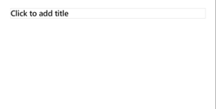
POWERPOINT ACCESSIBILITY
FOR PRESENTERS
Create compelling accessible PowerPoint presentations to allow all users to interact with your content.
Contrast
Use high contrast colors for maximum readability.
The recommended contrast ratio is at least 4.5:1.
Color Contrast Analyzer
Download this tool to determine the legibility of text and the contrast of visual elements.
Shape and color
Use different shapes with a legend to indicate statuses to accommodate for color blindness.
Example
Alt text
Alt text helps people using screen readers understand the images in slides.
You should create alternative text for shapes, pictures, charts, tables, SmartArt graphics, or other objects.
Here’s how:
Right click on item
Select Edit Alt Text
Enter a Description
If an object is meant to add visual styling and doesn’t contain meaning (e.g., stylistic borders), do not add alt text and instead check Mark as decorative
Slide layouts
Using a built-in slide layout that matches your content ensures a hierarchical reading order of text blocks.
Example
If a new slide will have a title, rather than starting with a blank layout and adding a text block for the title, choose one of the built-in layouts with a title placeholder.
Reading order
Screen readers describe content on the screen in the order it was created.
To ensure your content is read back in the order you prefer, arrange your objects in the Reading Order Pane appropriately.
Here’s how
Click the Review tab
Select the Accessibility drop-down menu
Click Reading Order Pane
Additional tips
Be sure to run the Accessibility Checker!
Go to File
Click the Check for Issues drop down menu
Click Check Accessibility
Videos need to be accessible
If your presentation includes a video, ensure it is captioned and audio described (if appropriate).
Visit the Office Accessibility Center to learn more about accessibility in PowerPoint.
Text
Text
Text
Subject 1
Subject 2
Subject 3
C1
C2
C3
Download

Slide 41
6 | Disability Etiquette and Inclusive Language
TBD

Slide 42
Disability etiquette and inclusive language
Disability language and etiquette are important aspects of creating an inclusive environment for people with disabilities.
Disability etiquette
Offer assistance but wait until the offer is accepted and do not assume a caregiving role.
Warn someone calmly and clearly if they are about to encounter a dangerous situation (this bullet seems out of place. Consider moving to the emergency section)
When introduced to a person with a disability, it is appropriate to shake hands. Handshakes may vary person to person dependent on their mobility.
Offer to guide a person who is blind or visually impaired. If your help is accepted, offer the person your arm.
To guide a person to a seat, place the hand of your guiding arm on the seat. The person you are guiding will find the seat by following along your arm. Never grab the person’s arm or try to direct him or her by pushing or pulling.
Never touch or interact with a guide dog without permission.
Do not rest or hang on to a person's wheelchair or push the person's chair without permission.
Inclusive language
Respect the descriptive language people choose to use to describe themselves.
Recognize preferences between people or identity first language. For example, “I am a person who is blind.” vs. “I am a blind person.”
Speak directly to a person with a disability rather focusing on their PCA or interpreter.
Identify yourself and others when meeting a person who is visually impaired and declare when the conversation (missing a word? example: has ended).
Address people who have disabilities by their first names only when extending the same familiarity to all others.
Listen attentively when speaking with a person who has difficulty speaking. Do not pretend to understand and dismiss them.
Ask clarifying questions and repeat what you understood asking for validation.
Conversation etiquette
To get the attention of a person who is deaf or hard of hearing, tap the person on the shoulder or wave your hand. Speak clearly, slowly, and expressively to determine if the person can read your lips. Keep hands, food, and other objects away from your mouth when speaking. Avoid raising the volume of your voice.
When describing people with disabilities, remember achievements, abilities, and individual qualities. It is not necessary to mention a person’s disability if it is not relevant to a story or conversation.
Don't be embarrassed if you use accepted, common expressions such as "See you later" or "Did you hear about that" that seem to relate to a person's disability.
Don't be afraid to ask questions if you're unsure what to do.

Slide 43

SIGN LANGUAGE
According to the National Association of the Deaf, sign language varies from country to country, with each having its own unique system and regional dialects, akin to spoken languages worldwide. Sign Language utilizes hand shape, placement, and movement, along with facial expressions and body positioning, to communicate information. American Sign Language is predominantly used in the United States and Canada, while International Sign serves as a pidgin sign language employed at global events like the Deaflympics and the World Federation of the Deaf congress.
Provide a well-lit space to ensure Sign Language communicators can easily see interpreters
Provide material to the Sign Language interpreters prior to the event.
If the presenter is speaking on a technical subject, ensure the Sign Language interpreters are technical interpreters or are familiar with the terminology and topic.
The International Association of Conference Interpreters (AIIC) suggests the active interpreter stands next to the panel or speaker on stage. If there are two signed languages, the interpreters should, if possible, not stand next to each other, but on either side of the stage facing the audience.

Slide 44
7 | Planning check lists
JANUARY 2024
CLASSIFIED AS MICROSOFT CONFIDENTIAL

Slide 45
ACCESSIBLE EVENTS CHECKLIST:
Event planning
Communications
Test and validate email communications templates for accessibility.
Test and validate social media templates.
Offer pre-event venue orientation for participants.
Request accommodations.
Send post event survey on inclusive experiences and to gather feedback.
Platform
Test and validate event websites for accessibility.
Test and validate digital platform for accessibility.
Registration
Build out registration tool to include accommodation requests and registration codes for ASL interpreters, PCA and other attendee categories as needed.
Test and validate registration tool for accessibility.
Venue (in person)
Schedule and complete venue walkthrough. See Site Inspection slide.
Meet with venue security to discuss emergency evacuation plan.
Conduct a catering walkthrough.
Conduct accessibility walkthrough after all areas are set up.
Travel and lodging
Secure accessible transportation from lodging to venue and between venue spaces.
Secure accessible lodging.
Confirm accessible parking at meeting location.
Event materials
Create signage templates. Recommend several weeks in advance to allow for review.
Order Braille materials (printed documents, signage, etc.). Upon request. Recommend several weeks in advance to allow for review.
Order large print documents. Upon request. Recommend several weeks in advance to allow for review.
Purchase material for sensory experiences as needed.
Pet relief supplies and water bowls if venue is not providing.
Presenter preparation
Train presenters and inclusive staff and volunteers on disability etiquette.
Gather materials from presenters and test and validate for accessibility.
Send materials to event participants prior to event.
Check all videos for accessibility (i.e. captions, audio description, appropriate representation).
Deliver material to ASL interpreters before event including presenter names, acronyms, and terminology.
Accommodations
Review accommodation requests.
Send communications to individuals who request accommodations.
Schedule ASL interpreters for keynote sessions and individual requests.
Schedule CART services for keynote and breakout sessions.
Schedule live audio description services.
Be prepared for additional individual accommodations.

Slide 46
ACCESSIBLE EVENTS CHECKLIST:
Site inspection
Meal service
Confirm there can be high/low tables for F&B.
Confirm seating includes supported chairs.
Confirm attendants can be available during meals to assist.
Emergency planning
Meet with venue security to discuss emergency evacuation plan.
Venue maps
Is there a map of the space digital and printed?
Conference reader boards
If electronic meeting boards, do they have audio?
Accommodations
Is there space for a quiet room?
Is there a designated pet relief area? Ask if synthetic grass and contained space can be added.
If no pet relief area inside, where is the closest location?
Is there a space designated for mothers? (Upon request)
Facilities
Determine the number and location of restrooms near the meeting space.
How many single restrooms?
How many companion use restrooms?
Are there any gender-neutral restrooms?
Do they have grab rails?
Do they accessible sinks?
Is there space for a mother’s room? (upon request)
Social spaces
Confirm availability of high/low seating and tables in social areas. Do not use bean bags or unsupported chairs.
Entrance
Are there accessible entrances with ramps that are wide enough for wheelchairs and mobility devices?
Do entrance doors have automatic openers? OPTION: If doors are manual consider adding a door attendant.
Where are designated shuttles/transportation drops located at the venue? Is there a map available to share during registration?
What is the distance from entry to registration? (Make a note of long distances for attendees with limited mobility to allow them time to move from each space.)
What is the distance from registration to the meeting space? (See above.)
Walkways
Are all walkways to meeting spaces open and easy to navigate?
What do the floor transitions look like from main walkways into meeting rooms? (Check for bumps or uneven surfaces.)
Elevator bays
Are elevators accessible for mobility devices and wheelchairs?
Any décor obstructing access?
Parking
Determine the number of disabled parking spaces. OPTION: If disabled spaces are limited, consider providing a parking attendant.
What is the location and distance from parking to the event/venue entrance?
Is there an elevator or ramp from parking to venue entrance?
Are parking maps available to share during online registration?

Slide 47
ACCESSIBLE EVENTS CHECKLIST:
In person meeting
Meeting space
Registration
Resources
Entrance
Is meeting room access stepless?
Are the doors automatic or manual? (Recommend an attendant be posted for assistance as needed)
What do the floor transitions look like from main walkways into meeting rooms? Check for bumps or uneven surfaces.
Confirm there is option to widen aisles for wheelchairs and mobility devices. (Recommend having an attendant to move chairs/tables as needed.)
Seating (theatre and rounds)
Reserved seating for accommodation requests, CART and AD services.
Stage
If using a ramp, ensure it meets ADA requirements.
Confirm where ASL will be located on the stage.
Confirm location of monitors and screens are visible to all.
ASL
Confirm there will be adequate sightline to screens, stage and ASL.
Captions
Confirm captioning, CART and audio descriptive services will be onsite and where they can be stationed.
Tech check
Test audio and visual requirements.
Ensure screens and monitors are visible when seated.
Presentation tools
Are whiteboards and easels available at adjustable heights?
Conference table
If using a conference table, where are the outlets and are they accessible?
Additional attendees
Where will companions, ASL and other supporting attendees' pick-up badges? (Recommend a separate line or location.)
Disability Answer Desk
Where can a Disability Answer Desk be located? (Recommend separate from main registration.)
Tables
Confirm lower tables for registration.
What are the skirting options? (Recommend mid-length skirting.)
Confirm there will be an accessible space for handouts on the tables. (Upon request, large format and Braille.)
More event planning resources are available on Slide 51.

Slide 48
ACCESSIBLE EVENTS CHECKLIST:
Virtual meeting
Communications
Platform
Presenting
Event materials
Accommodations
Create and validate presentation templates for accessibility.
Test and validate email communications templates for accessibility.
Providing and Requesting Accommodations (Video)
Choose an accessible event platform such as Microsoft Teams Live Events.
Test and verify accessibility of platform prior to event.
Provide training for event staff, volunteers, and presenters on platform configuration and accessibility features.
Provide platform training for attendees (optional).
Distribute documentation on keyboard shortcuts and navigation for accessible platform.
The meeting tool should provide accessibility features such as blurred background and captioning features.
If the tool does not allow captioning, ensure that CART (Caption Assistance Real-time) services are provided.
Pin ASL interpreters.
Test the presenter’ connection and setting prior to meeting.
Deliver material to ASL interpreters before event including names of presenters, acronyms, and terminology.
Check all videos for accessibility (i.e. captions, audio description, appropriate representation)
Present in PowerPoint LIVE for attendees using screen readers.
Assign a designated moderator to help facilitate the session, support for technical issues and to purposefully include the virtual audience into the overall content.
Inclusive Presentation Skills (Video)
Tips for Accessible Virtual Meetings (Video)
Create accessible presentations.
Distribute event materials to participants prior to event
Consider pre-recorded content, especially for complicated technology demonstrations.
Ensure videos have captions, audio descriptions.
Audio Descriptions At-a-Glance (Video)
Tips for Captioning for Events (Video)
Why Captions Matter (Video)
Text Alternatives At-a-Glance (Video)
Creating an accessible PowerPoint
Review and support accommodations requests.
Schedule ASL interpreters, CART and audio descriptions.
Encourage various means of responding and interacting and ensure to make space and time in the conversation for all individuals regardless of live or virtual attendance.
Request all attendees introduce themselves each time they are speaking and request participants to mute themselves when they are not speaking-especially critical for the blind/low vision community.
Instruct attendees on using the Raise Hand feature
Instruct attendees on turning on captions
Turn on Transcription, if appropriate.
Instruct attendees on how to use the Spotlight feature

Slide 49
8 | Appendix
JANUARY 2024
CLASSIFIED AS MICROSOFT CONFIDENTIAL

Slide 50
ADDITIONAL RESOURCES
American Sign Language interpreters
U.S. deaf and hard-of-hearing access services
Braille printing
Braille Works
Braille Access Center
Braille Plus
Sighted guides
Sighted guide techniques
Inclusive event planning
Providing and Requesting Accommodations (Video)
Tips for Captioning for Events (Video)
Tips for Accessible Virtual Meetings (Video)
Why Captions Matter (Video)
Text Alternatives At-a-Glance (Video)
Audio Descriptions At-a-Glance (Video)
Inclusive Presentation Skills (Video)
Accessibility at-a-glance (Video)
Creating accessible content toolkit
Creating an accessible PowerPoint
Accessibility video training - Microsoft Support (Video)
PDF Accessibility training (Video)
Microsoft accessibility home page
Office accessibility
Windows accessibility
Ultimate guide to captioning and audio description (3PlayMedia)​ (Video)
Improve email accessibility - Microsoft Support​ (Video)
Create accessible PowerPoint presentations (Video)

Slide 51
Thank you
We know applying this guidance takes time and effort, but the outcome will benefit everyone.
For more information on accessibility at Microsoft, visit Microsoft.com/accessibility.

