Slide 1
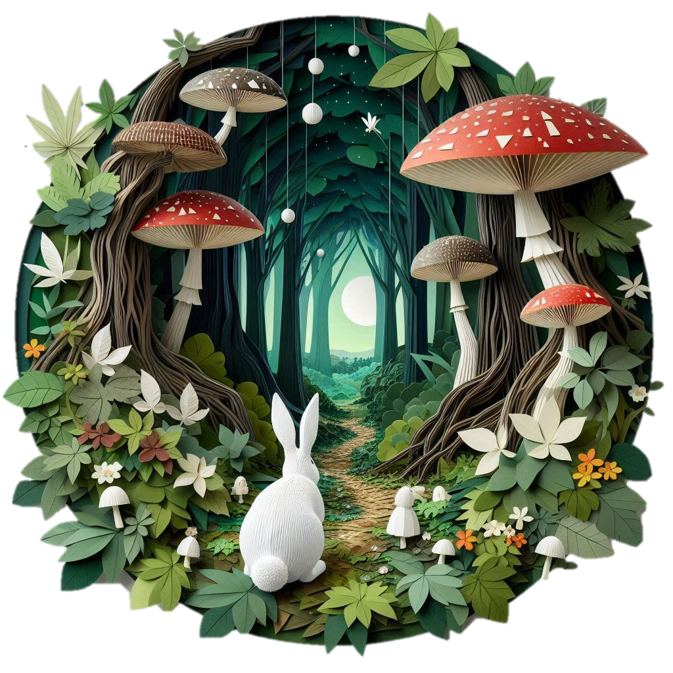







Our Copilot Adventure
…curiouser
and curiouser
A Communications Playbook from Microsoft Digital

Slide 2
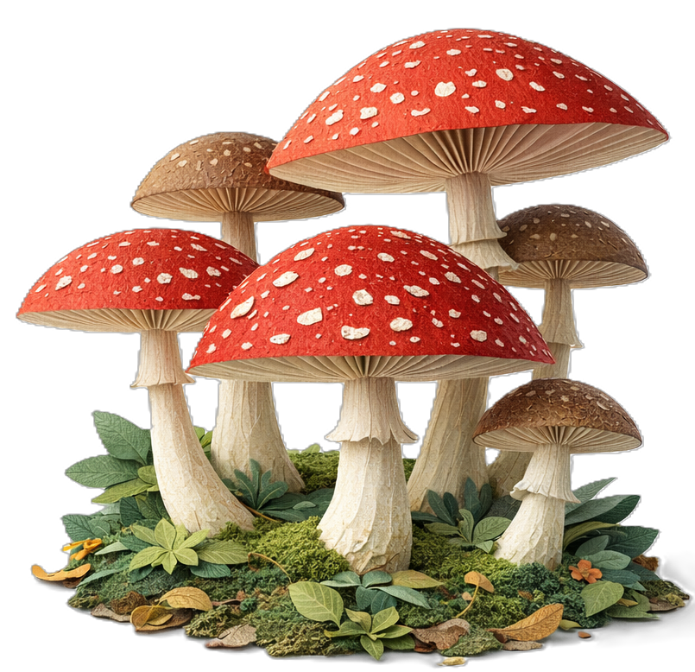
Inside
💡Steal this look!
Meeting people where they are
Who we are
Communications channels
Our philosophy
Campaign: The Copilot passport
Campaign: Fantastic 4 workstyles
Campaign: Prompt of the week
Campaign: Flex your Copilot habit
Campaign: Copilot + New Outlook
Campaign: Energy Vampires
Campaign: Copilot prompt kit
Campaign: How to coach Your agent
Newsletter: What’s Next in Copilot
Blog: What Copilot to use when
Blog: How to avoid workslop
Blog: Can you spot AI videos?
Steal these ideas
The real metric

Slide 3

Meeting people where they are
80% of the global workforce say they don't have enough time or energy to do their work — employees are already maxed out before AI enters the picture [microsoft.com]
Nearly half of employees (48%) say their work feels chaotic and fragmented with 60% of meetings being ad hoc — pings, meetings, and emails interrupt every 2 minutes during core hours, up to 275 interruptions a day [microsoft.com]
43% of employees fear AI will replace their jobs — compared to only 21% at companies already using AI well. Fear is a real barrier. [microsoft.com]
The fix? Meet people where they are. Small, consistent nudges. Real scenarios and practical tips that easily fit into their day. Make it feel personal. Bite-sized habits beat big launches every time. It’s not "here's a new thing," but "here’s something small that'll actually help you today. That's what our team did.

Slide 4


Our team
Make my life easy | Be there when (and where) I need you
Clear instructions. Automation. Simple processes. Whether I am an employee, an early adopter, or a communicator, my experiences should be as easy as possible. Give me one place to go for technology guidance, one place for early adoption, one place for campaign management, and make them easy. | Great, discoverable web content. A helpful response on Viva Engage. A message or reminder in email, Teams, or the app I’m using. Help me learn how to do my best work using our Microsoft technologies to great effect. Listen to my feedback and suggestions. Be a friend when I need help or answers.
Know who I am | Give me a reason to smile
I have a name. I have preferences for how I communicate or learn best. The tools and apps I use and how I use them are unique to me. I want you to know these things and respect them. | Clever campaigns. Games and prizes. Easter eggs and surprises. We might be at work but that doesn’t mean we can’t have fun. Inject a little sunshine into my day in unexpected ways. It’s worth the effort!
Microsoft Digital Content Communications
We create unique and distinguishable internal comms, breaking from the norm of formal and uninspiring.
100% happy customers

Slide 5
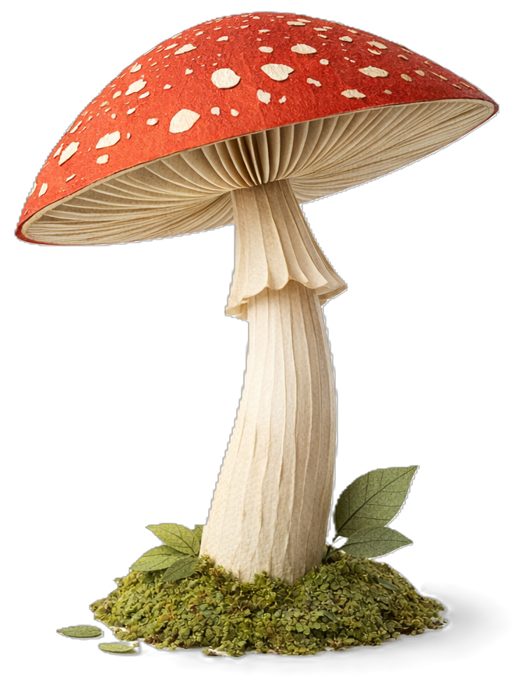
Our philosophy
We put people-first in all our communications
Turn Copilot from "just another tool" into something people genuinely want. One bite-sized, relatable, weirdly entertaining promo at a time.
We flipped the script
Real people, real scenarios, real chaos. Every campaign leads with how employees actually work, not a feature list or a product announcement.
We let employees be the story
Relatable videos, real submitted prompts, real faces. If someone can watch a promo and think "wait, that's literally my job“, that’s a win.
We made it personal
Interactive quizzes, community driven campaigns, employee showcases. Not one-size-fits-all.
We broke the Microsoft brand mold
All our visuals are created with Copilot and Microsoft tools. The creative is the proof. We don't just talk about what Copilot can do, we show it.
We ditched the corporate script
No sales pitch, no jargon, no "unlock your productivity potential" energy. Comms that people want to read. Dry, fun, occasionally a little snarky. You know the vibe.

Slide 6







Our communications channels
₌
Viva Engage
SharePoint
Outlook
Microsoft Teams
Viva Amplify
Promotional posts
Awareness
Engagement
Polls
Video
Feedback
Blogs
How-to articles
Newsletters
Targeted emails
Newsletters
Promotional posts
Feedback
Centralized hub for drafting and posting content
Metrics reporting
😍
Everything you are about to see on these pages was created with Microsoft products, in house.
We are magicians with PowerPoint waving a Copilot wand. 🪄
₊
₌

Slide 7

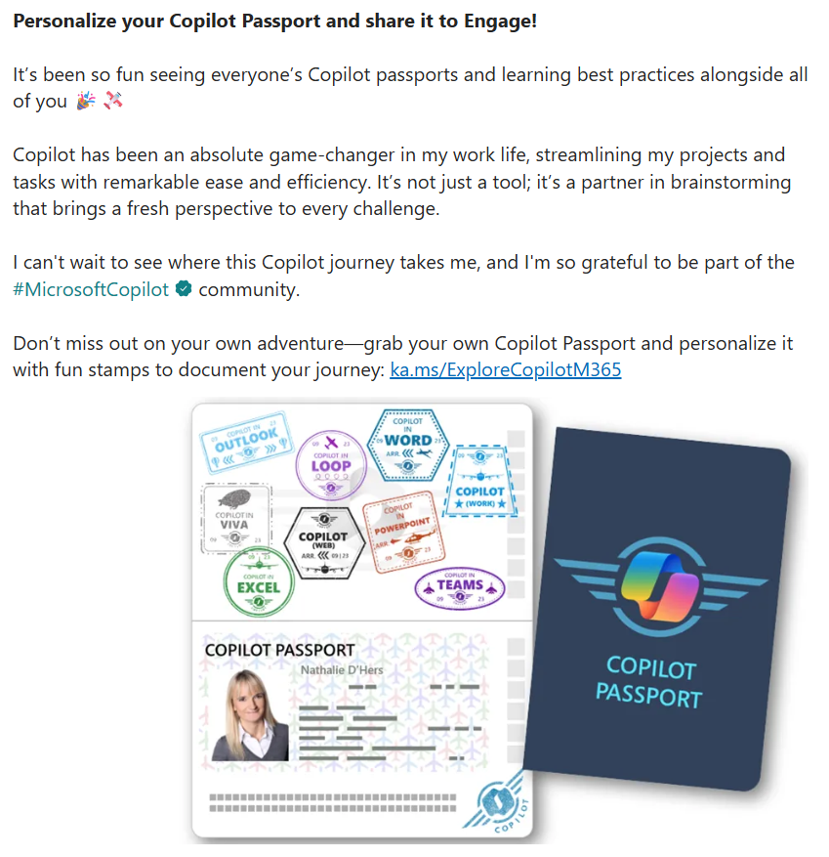


Campaign: The Copilot passport
The idea
What if trying Copilot felt like an adventure?
How it worked
Employees downloaded a digital passport and earned a stamp every time they tried a new Copilot experience. When done, they shared it on Viva Engage. A Teams background was created so employees could show off in meetings.
Leadership got involved
A special leadership version for executives to share their own completed passports on their Viva Engage storyline.
What people said
"Copilot has been an absolute game-changer in my work life... I can't wait to see where this journey takes me.“, "What Copilot stamps should we add next?,“ "Got my own passport now!“
💡Steal this idea!

Slide 8

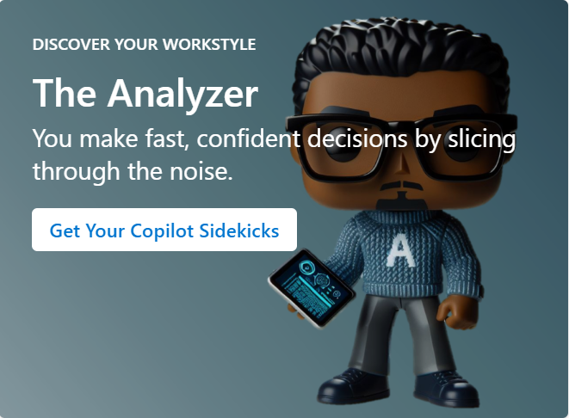
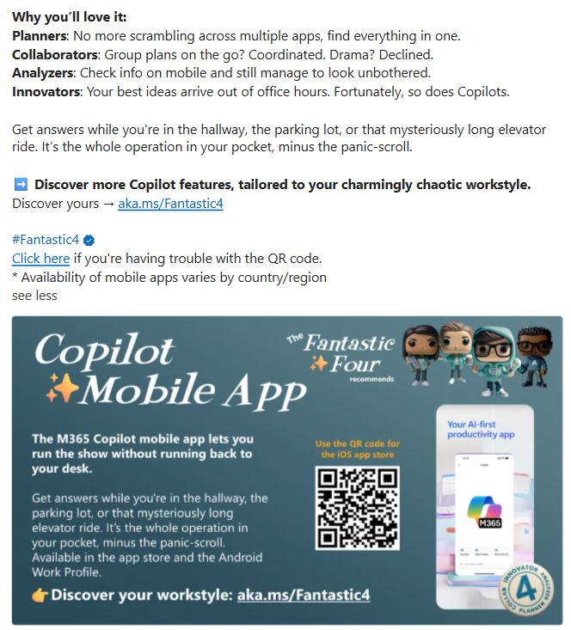
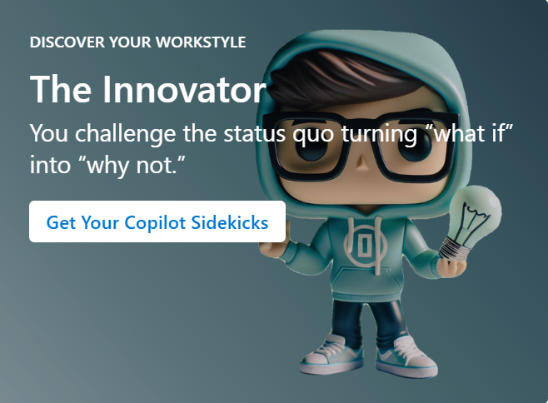
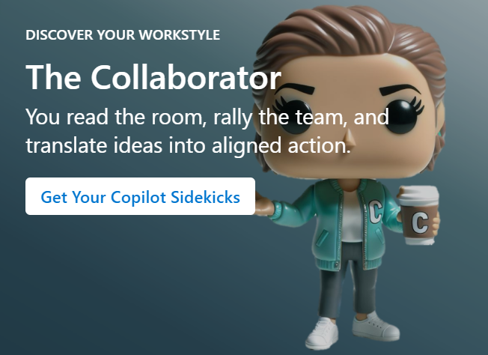
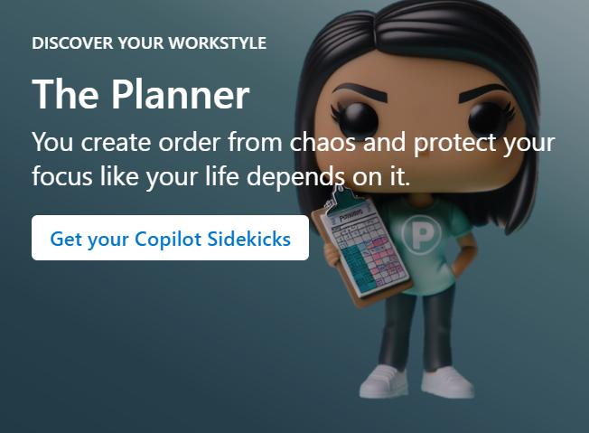
Campaign: The Fantastic Four workstyles
The idea
Everyone works differently, we kept pretending they didn’t.
BuzzFeed-style quizzes inside a Copilot prompt
Results provided you with a 1 of 4 workstyles (Planner, Collaborator, Analyzer, Innovator), each paired with Copilot features designed to match how you work.
The four workstyles aren't made up
They're grounded in patterns from Microsoft's Work Trend Index research.
Making it interactive and fun lowered the barrier to trying Copilot
Discovery replaced instruction, and curiosity did the rest.
What people said
"I was hoping to be an Analyzer, but it turned out I was a Planner!“, "This has been great fun, and a good introduction to things Copilot can do.“, "What a cool prompt!”
💡Steal this idea!

Slide 9
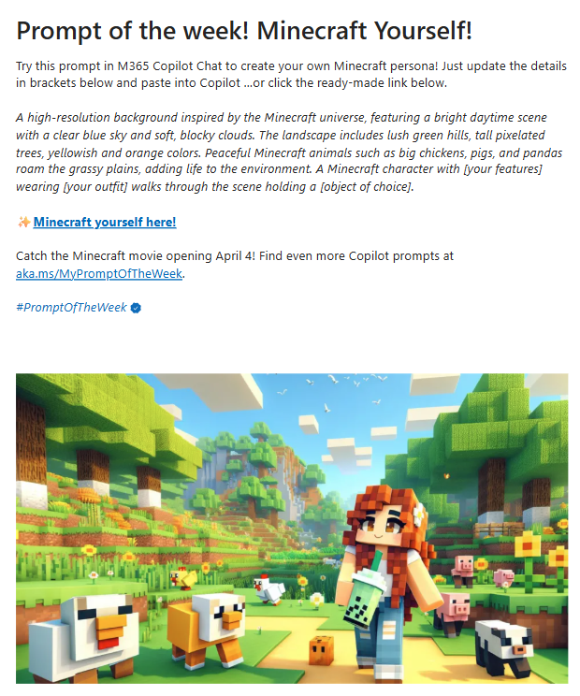
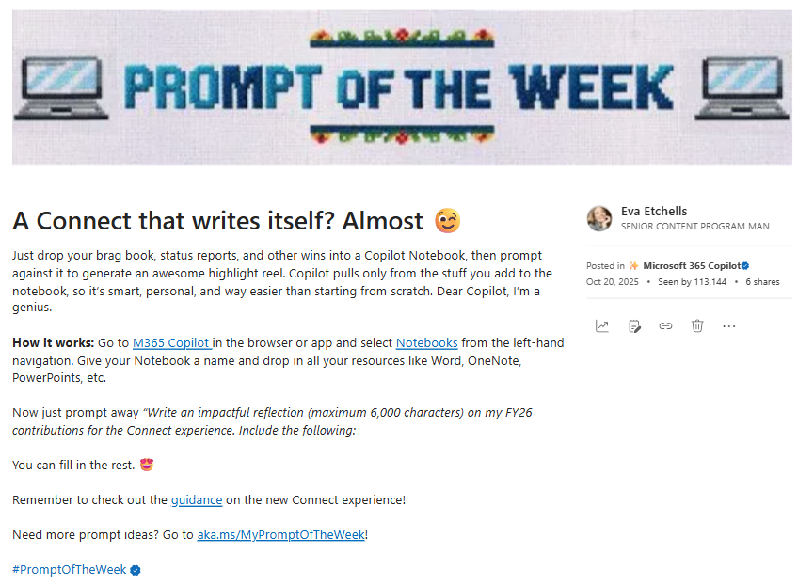
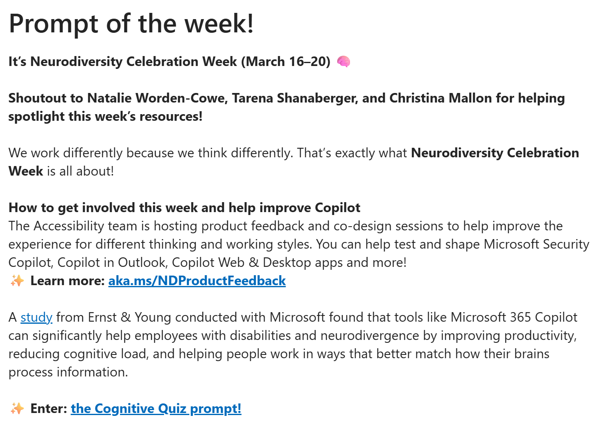

Campaign: Prompt of the week
The idea
A Monday prompt to start the week with a little Copilot.
100% community-driven
Employees submit their own prompts and see themselves featured. It stopped being our campaign a long time ago.
Follow the hashtag, get the archive
We set up a dedicated Viva Engage community so anyone can pull up every single past prompt.
Click to use
Every prompt opens directly in Copilot. Just click and go.
What people said
"Every time I see your posts, I learn something new that helps me grow as a Copilot seller.“ , “I can say that I've tested 90% of your prompts! They are very helpful, and we can adapt them to our daily work 😊.”, "This is the one thing I actually look forward to on Mondays."
💡Steal this idea!

Slide 10
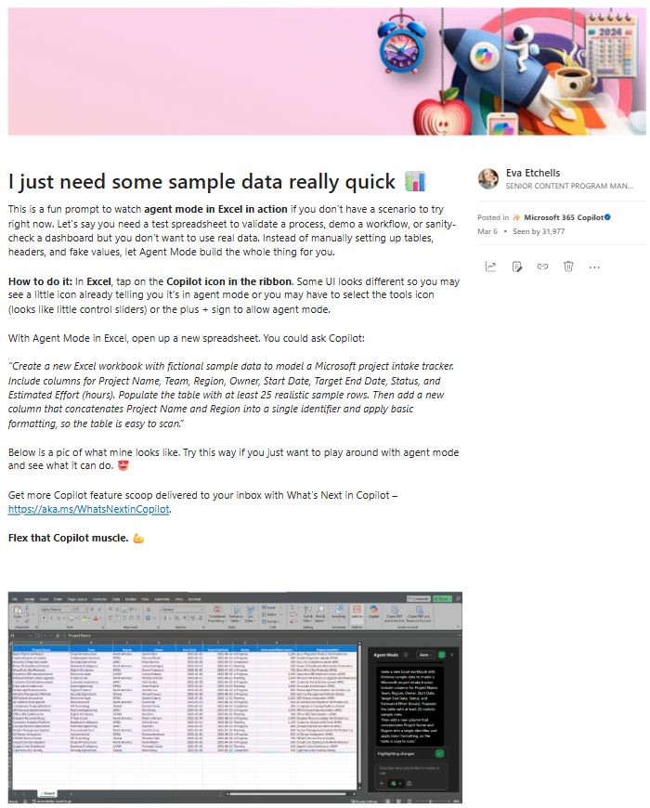

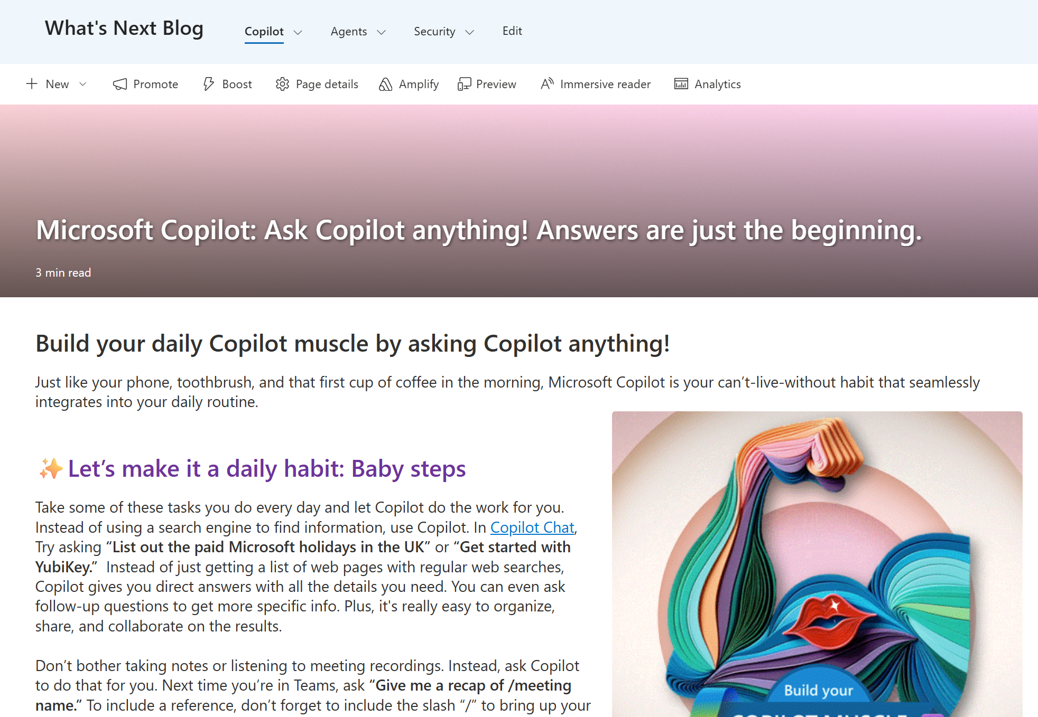
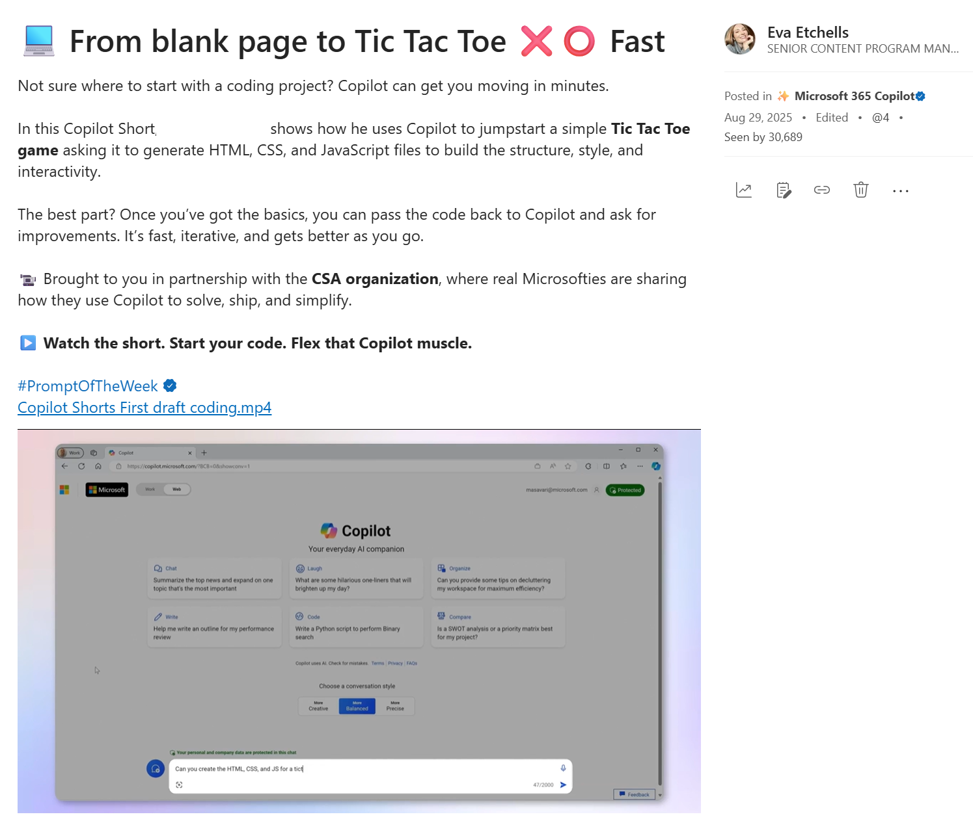
Campaign: Flex your Copilot habit
The idea
Adoption drops on Mondays and Fridays, so we bookend the week. Flex wraps it up with an AI tip they can use before they close their laptop.
"Did you know?" energy
Bite-sized, cute, and always current. We spotlight features people might have missed. No jargon, just: hey, did you know you could do this?
How-to GIFs and videos do the heavy lifting
Show don't tell. A 10-second GIF of a feature in action is worth more than three paragraphs explaining it.
What people said
"I had no idea Copilot could do that.“, "This is exactly the kind of tip I needed today.“, I'll definitely give it a try too!!!”, “I just tried this, and it works great.”

Slide 11
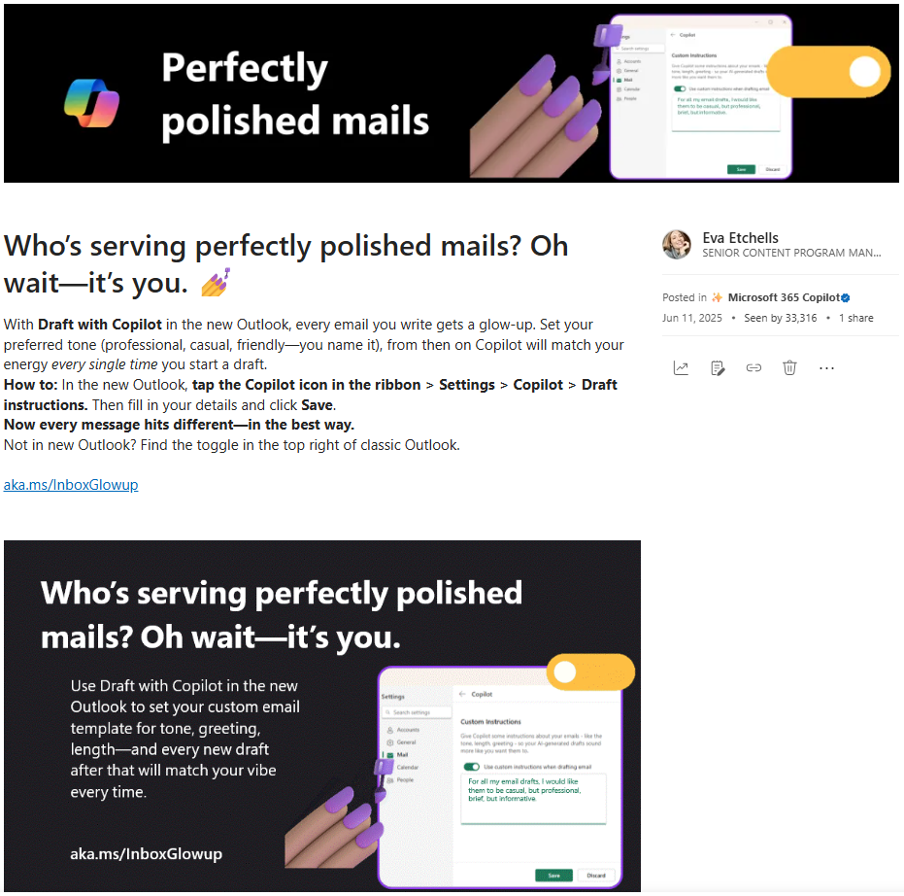

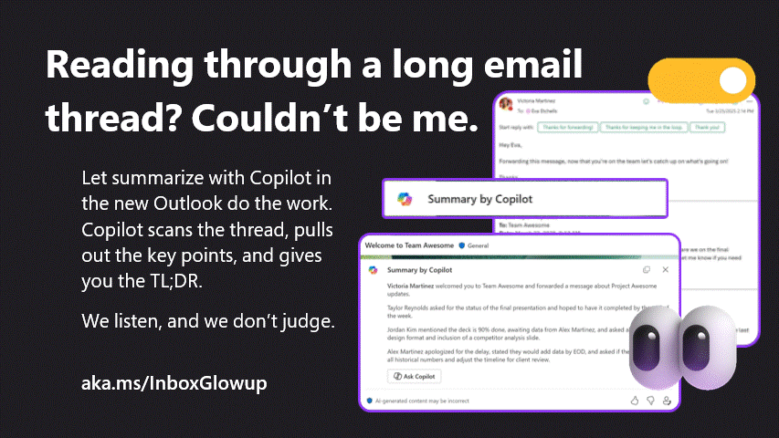
Campaign: Copilot + New Outlook
The idea
Instead of "hey, switch to New Outlook," we showed people what was in it for them, one Copilot feature at a time.
Every feature got its own moment
Each post one was a standalone tip, not a product tutorial.
Like a text from a friend, not a feature promo
Cute headlines, short how-tos, bold copy that made people stop scrolling.
We made every post a complete mini how-to — Since you can't deep-link directly into Outlook, we put everything right there in the post. Read it, try it, done. No clicking required.
What people said
"Outlook search just got a MILLION times better!!!!“, “This post wins for the day.”, “I have been serving copilot written emails for more than 8 months now ... love this feature :)”

Slide 12
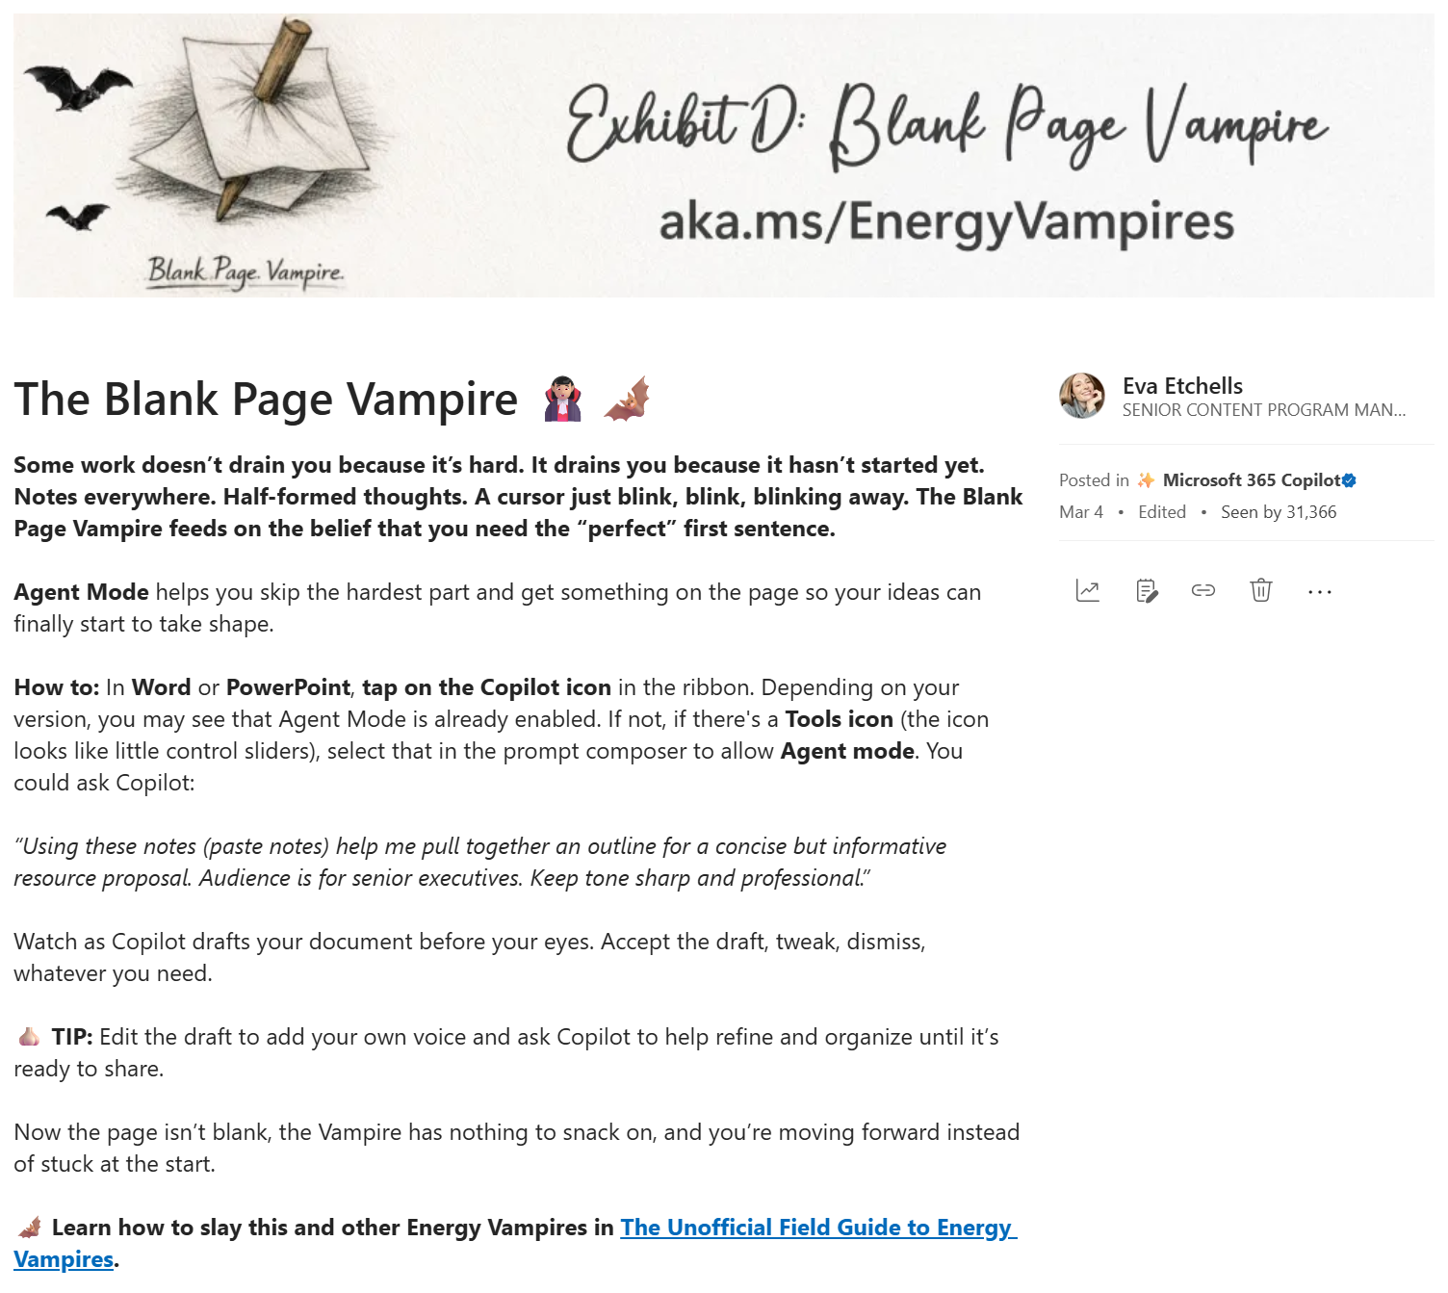

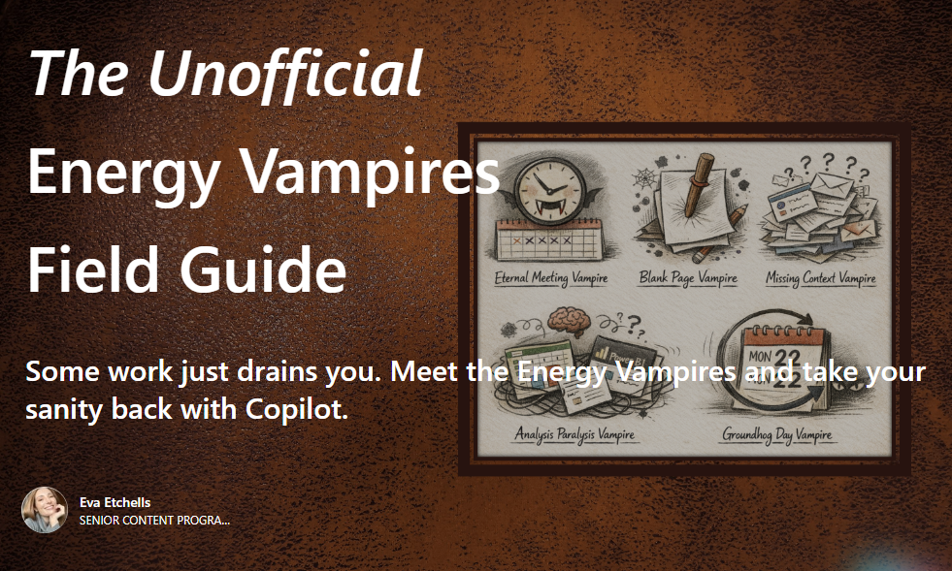
Campaign: The unofficial Energy Vampires field guide
The idea
Every job has tasks that quietly bleed you dry.
We introduced five notorious “Energy Vampires” Deja-vu tasks on repeat (think TPS reports).
Each vampire got a Copilot repellent
Not a feature announcement, a practical how-to guide. Garlic optional. Copilot recommended.
The tone was the whole point
We were acknowledging the pain. The blog reads like a friend who gets it. "Metrics reports are a special circle of work hell. That kind of honesty is what makes people click.
What people said
"Your Energy Vampires article is amazing, nice work!“, “I really loved how it was written in a fun and educational way.”, “I love the energy vampire promos, so good and relatable. Well done!"

Slide 13
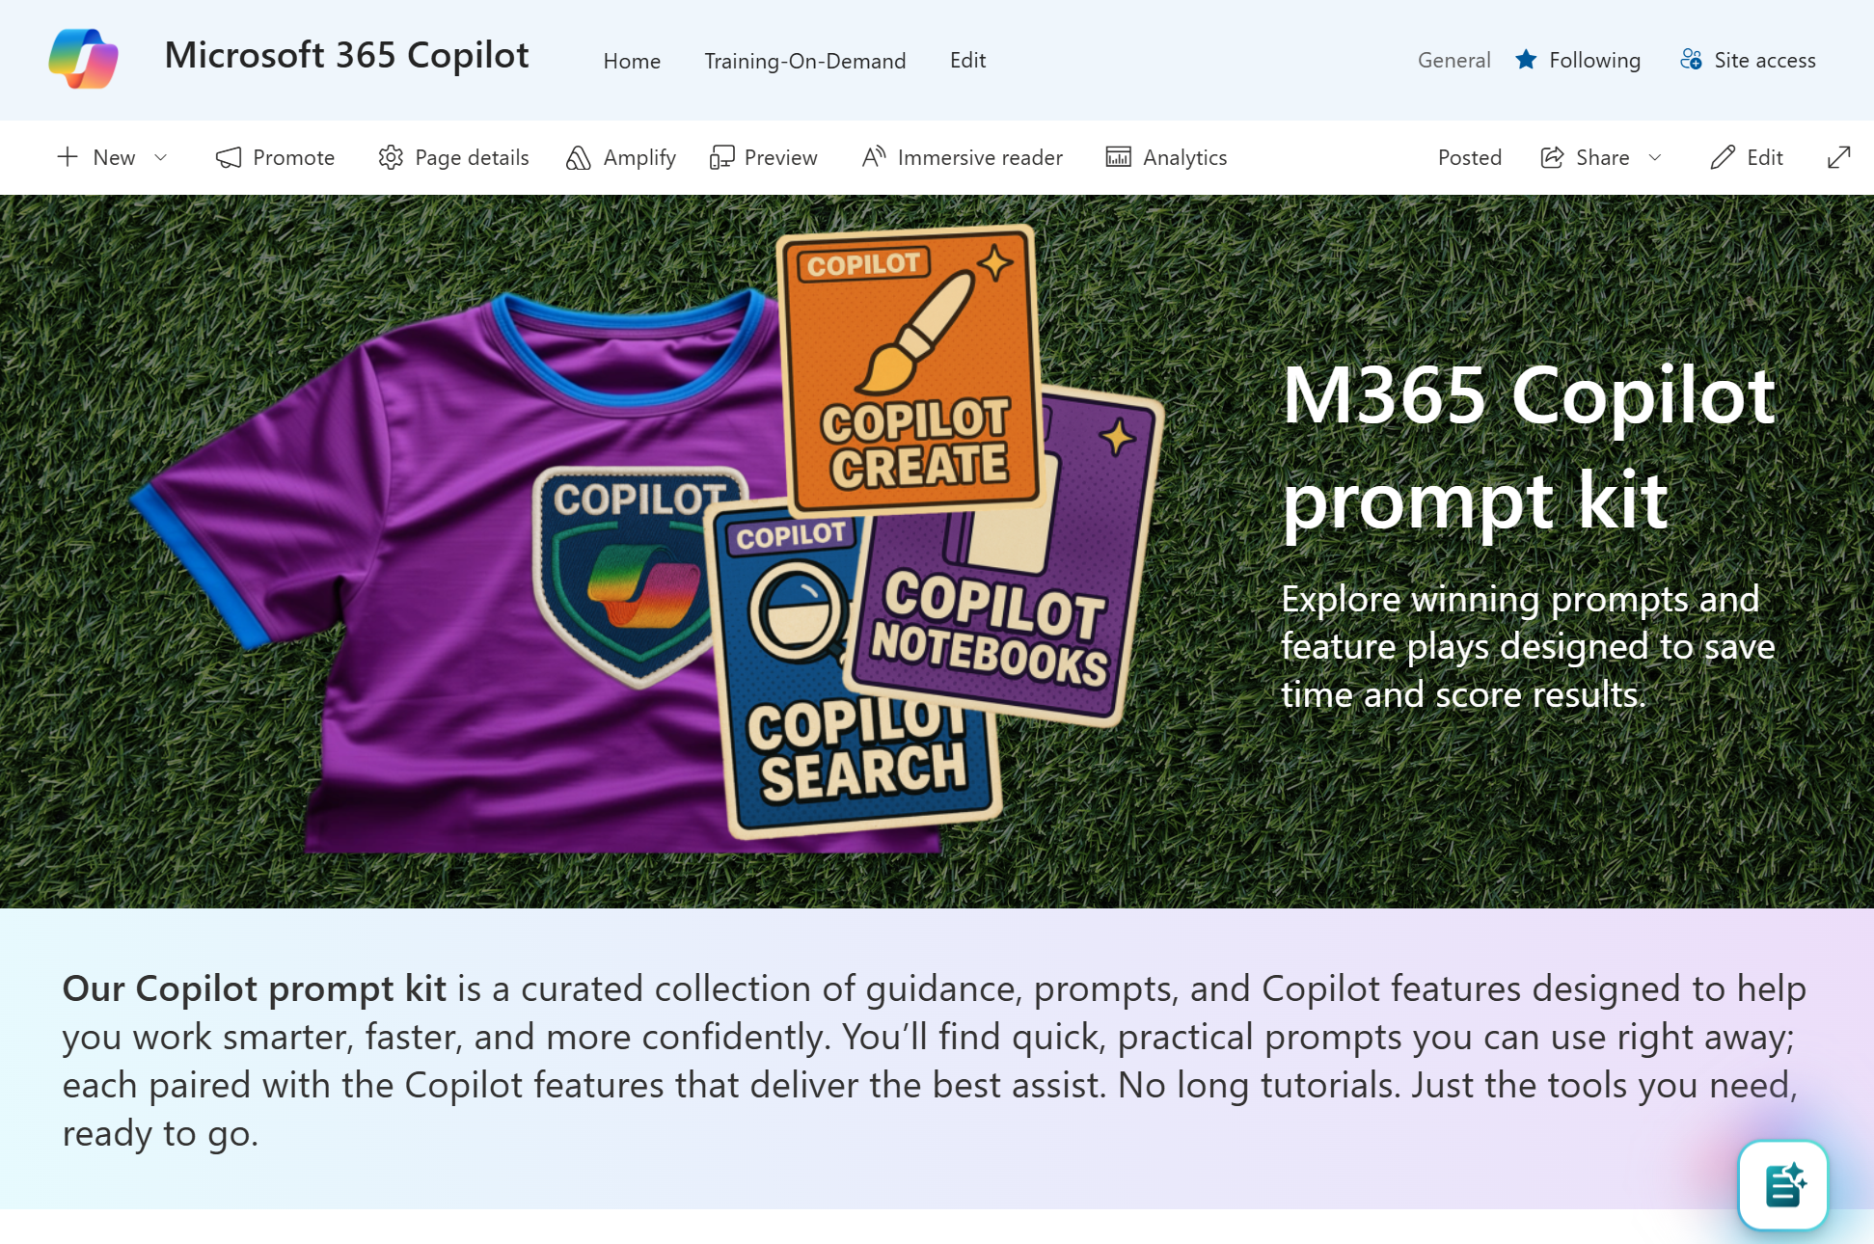
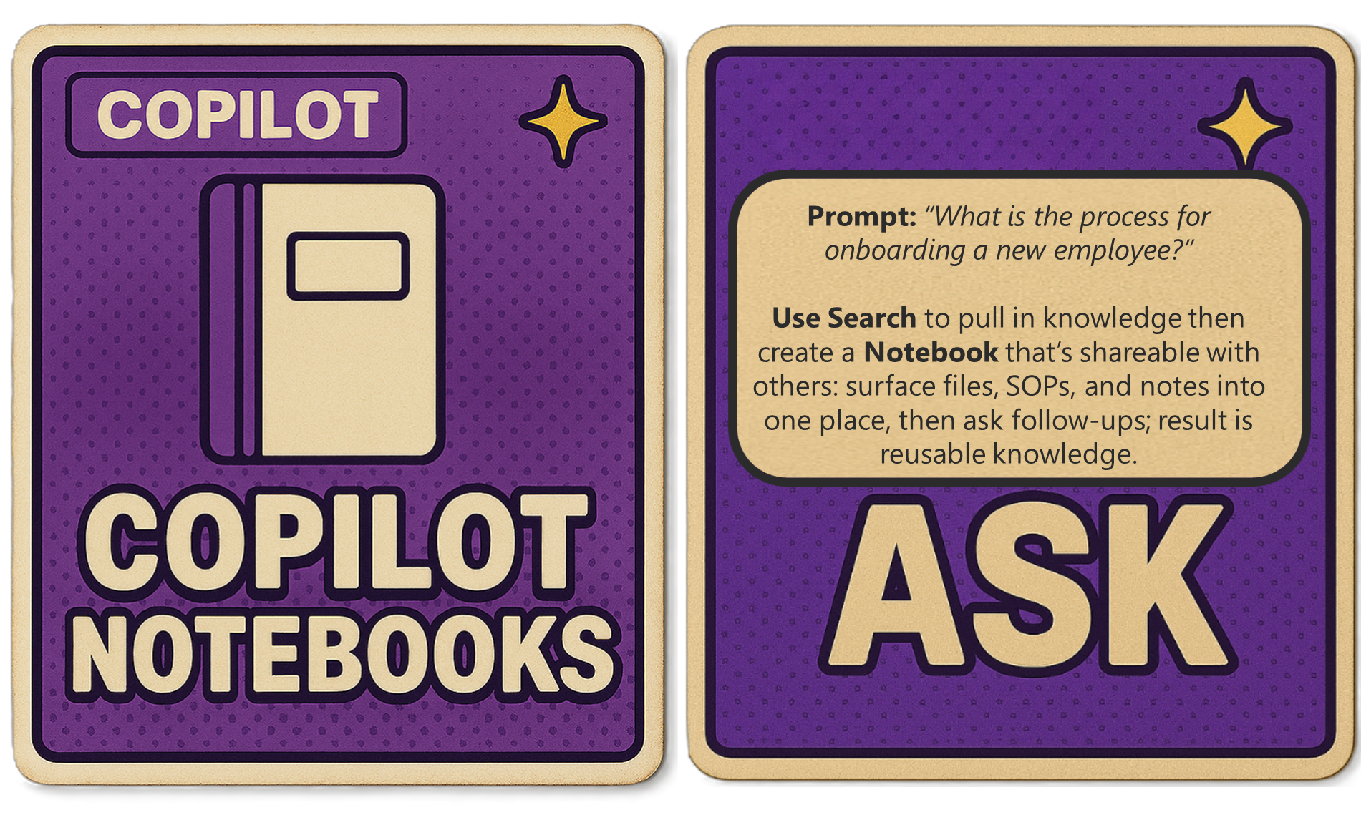
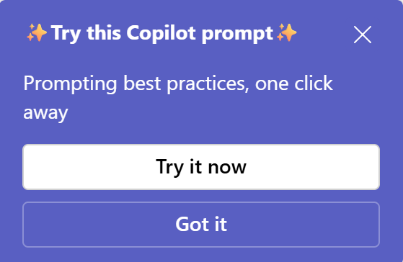
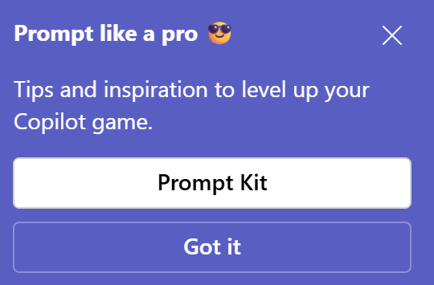
Campaign: Copilot prompt kit
The idea
Not everyone knows how to prompt well and that's the actual barrier to daily Copilot use. So, we built a practical kit: curated prompts, feature cards, and agent guidance organized by task type so anyone can pick it up and get a quick win.
The football ⚽ kit metaphor
A kit is everything a player needs to perform. Your Copilot Prompt Kit works the same way: the full set of prompts and tools you need to win at work, all in one place.
The content was organized by task, not by feature
Six categories (Ask, Create, Summarize, Command, Analyze, Brainstorm) each paired with the right Copilot feature for maximum impact. The kit lives on SharePoint — always on, always searchable.
Targeted, not broadcast
Sent to employees using email and pop-up messages in Microsoft Teams. Focused reach, meaningful impact.

Slide 14
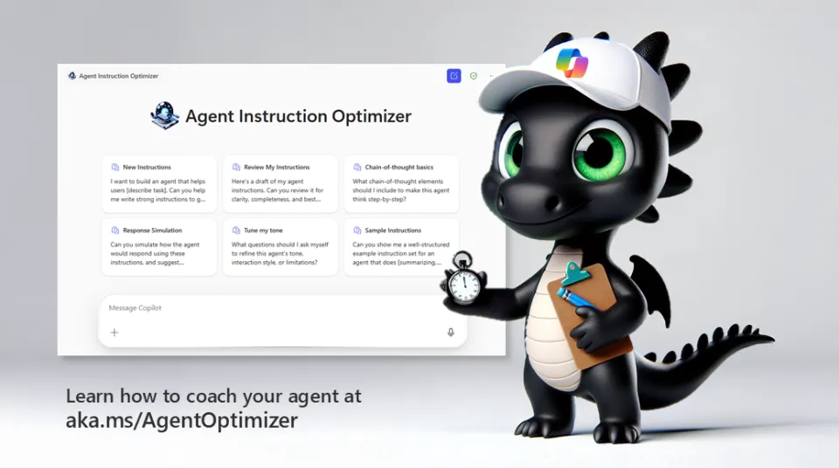
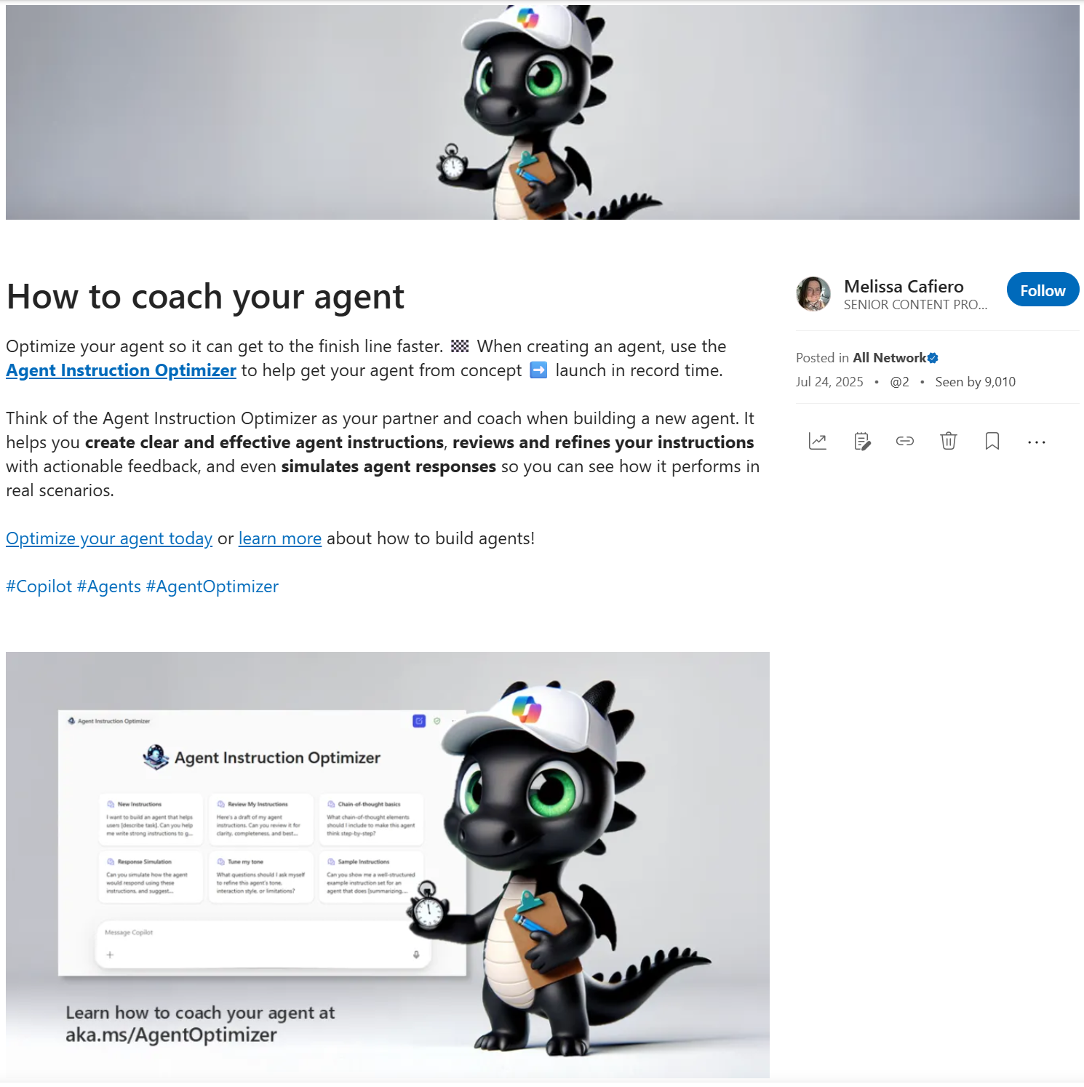
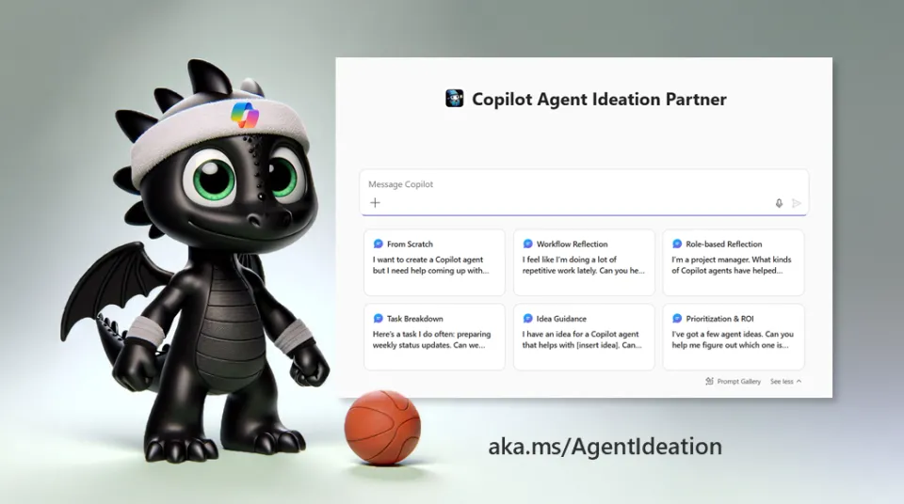
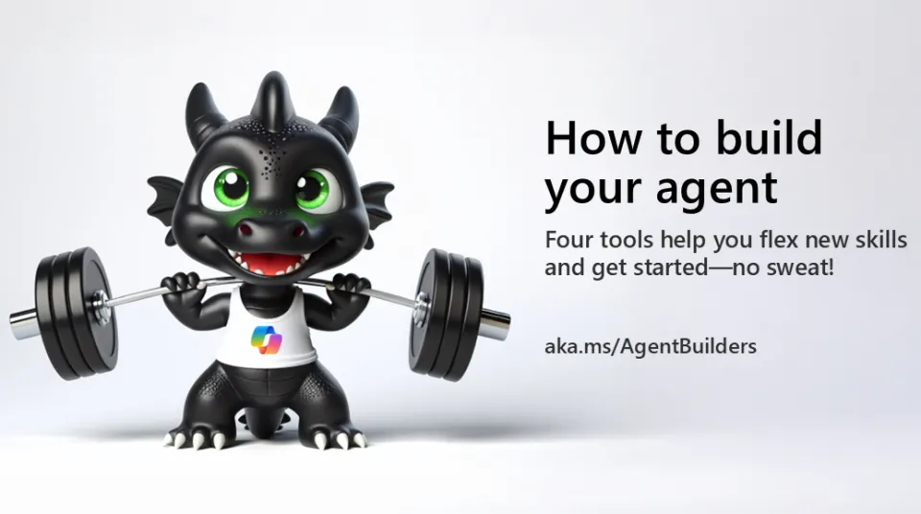
Campaign: How to coach your agent
The idea
Agents were having a moment but building one could feel intimidating. A multi-phase campaign was made to demystify agent-building and make it feel approachable, fun, and genuinely doable.
The campaign ran in phases, each one building on the last:
Ideation — Not sure what agent to build? Promos to introduce an agent that brainstorms with you.
Refining — Promos of an agent that acts as your partner and coach when building a new agent.
Building — Awareness of tools to help build and launch.
What people said
“Awesome!”, “Looking forward to putting these to use. Thank you!”, “Love the mascot, giving off "Toothless" vibes :)”.

Slide 15
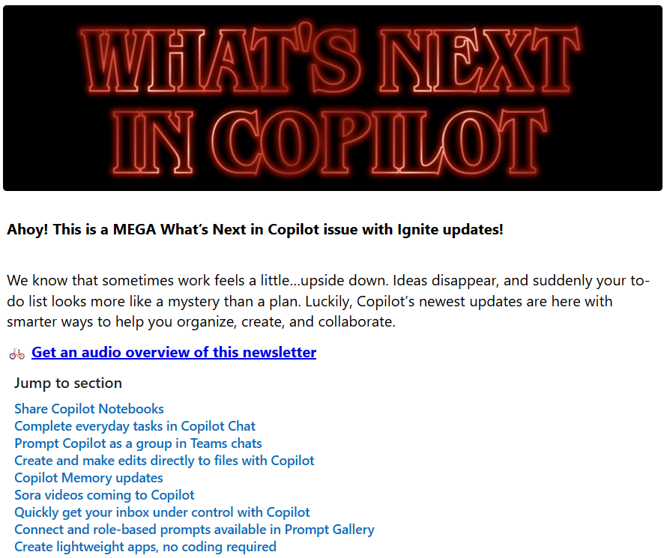
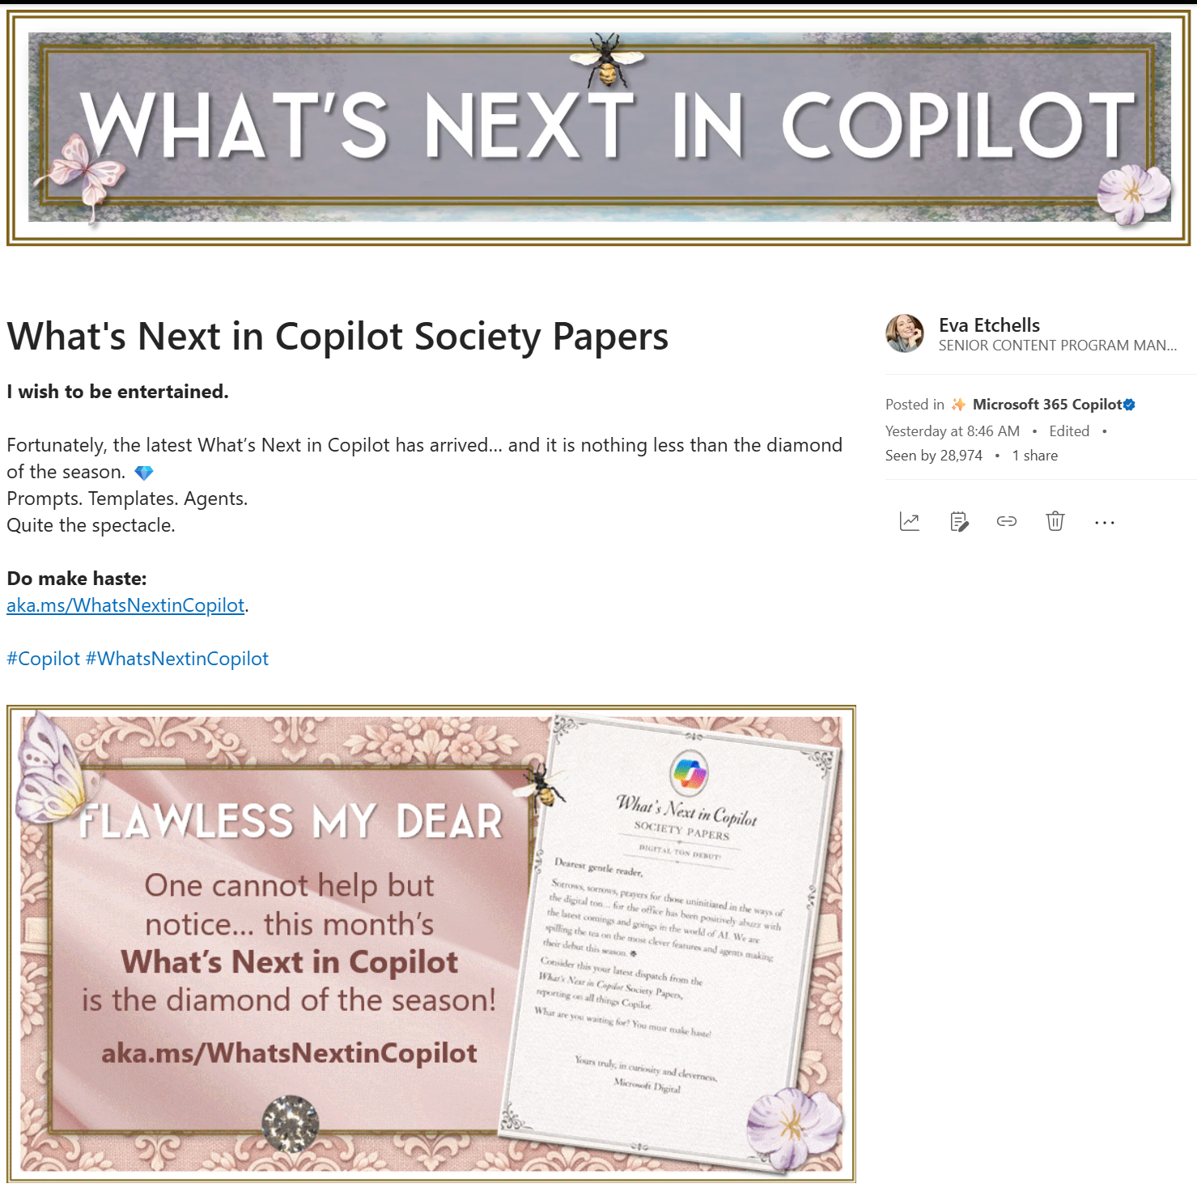
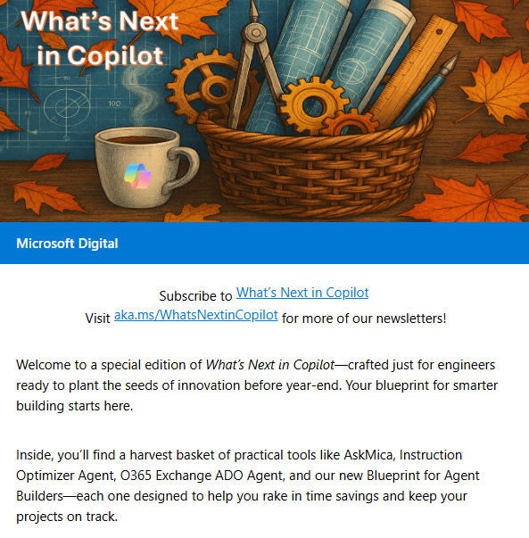
Newsletter: What’s Next in Copilot
The idea
A monthly newsletter that covers everything new in Copilot
Every edition has a theme, and every theme is a whole moment
One edition went full Bridgerton. Others leaned into Stranger Things. The theme isn’t the point. Getting people to open it is.
We even built a version just for engineers
Same people-first philosophy, different lens. We curated an edition around the tools and workflows engineers actually use,
Discovery is built in
Outlook newsletters allow subscription and organic discovery. If you're not subscribed, you can still find it.
What people said
"Great update!“, "Awesome update with lots of exciting announcements!“, "Super good summary! Thank you for the inspiration“, “I continue to be so impressed by your creativity and amazing ability to land content so beautifully.”

Slide 16
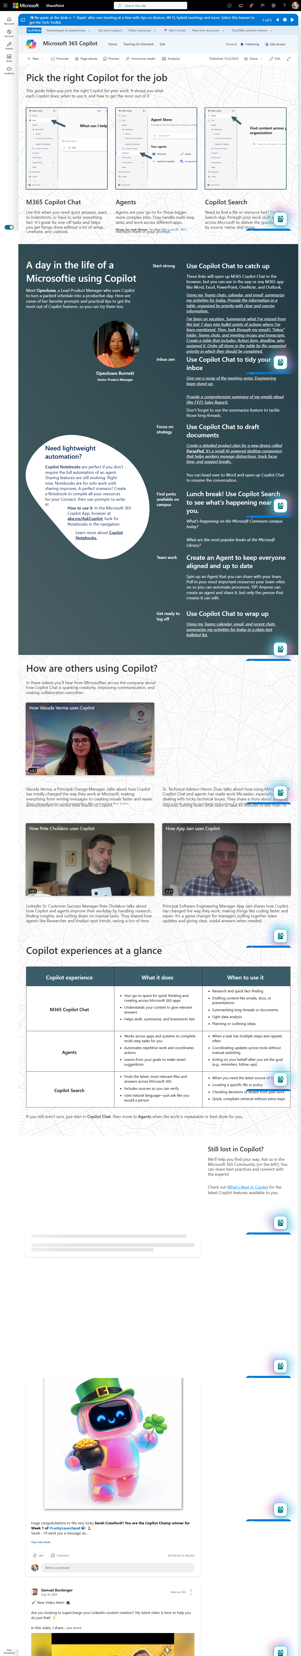
Blog: Which Copilot to use and when
The idea
One of the biggest blockers to any tech adoption isn't resistance, it's confusion. People don't know where to start so they don't start at all.
We broke it down
A guide to cut through the noise with a simple, human voice to guide decisions on M365 Copilot Chat, Agents, and Copilot Search
A real employee's real day made it land; the article features an actual workday with real prompts and clickable links that open directly in Copilot.
Inside Track picked it up
Microsoft's Inside Track amplified it to IT leaders globally:
Picking the right Copilot for the job: Tips from our experience at Microsoft - Inside Track Blog
A day in the life of a Microsoft employee using Copilot - Inside Track Blog

Slide 17
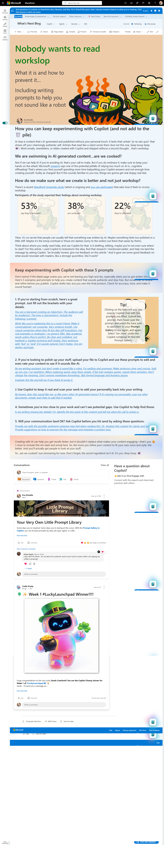
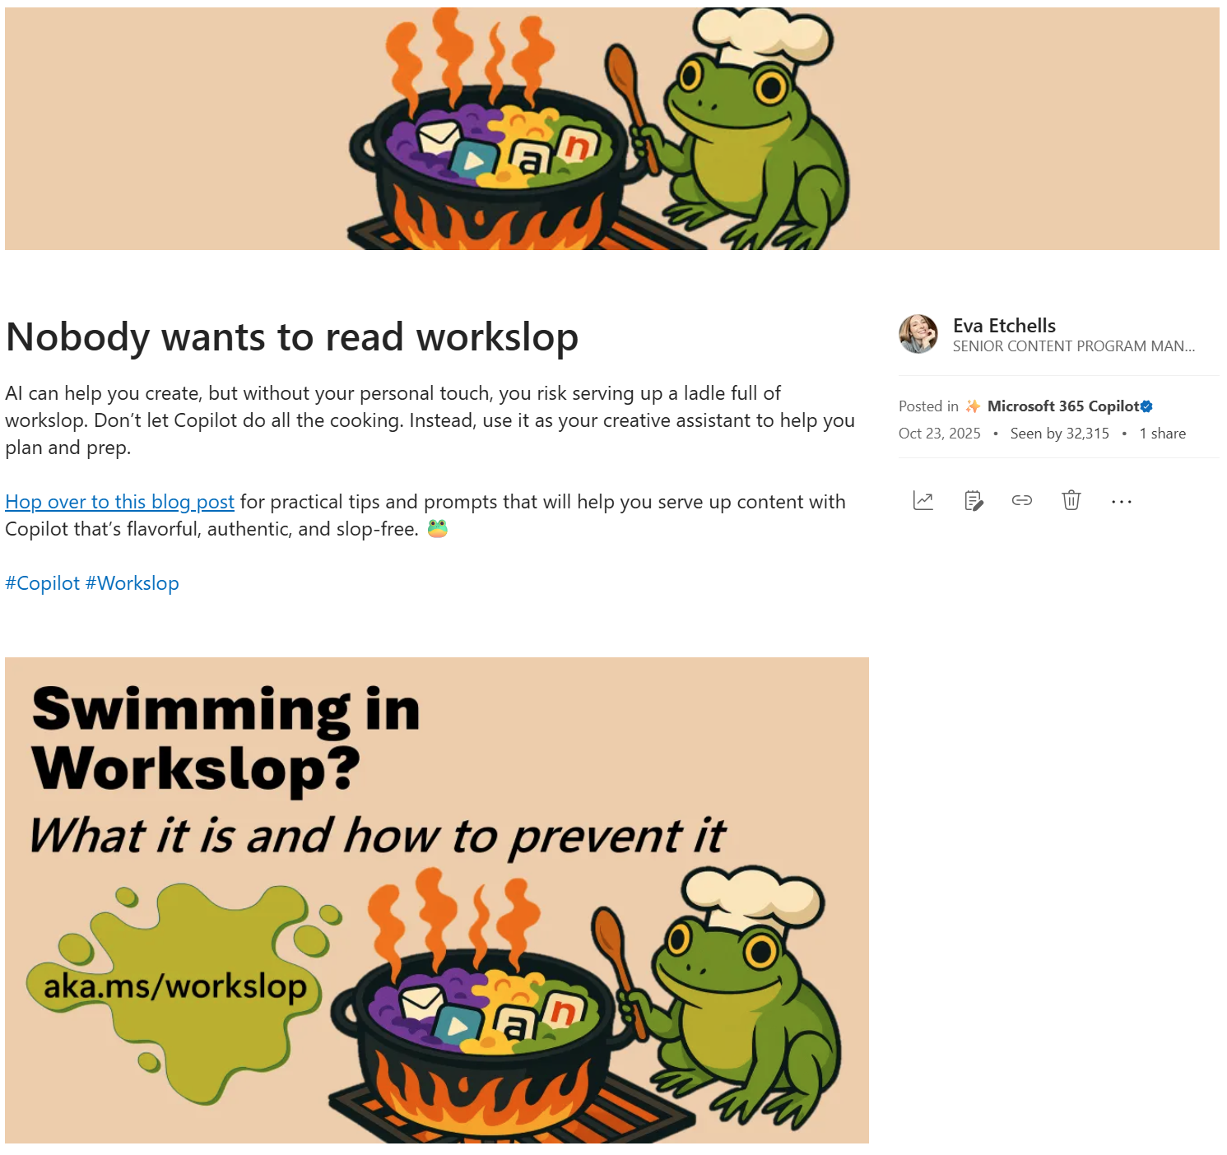
Blog: How to avoid workslop
The idea
This one named a growing concern. Workslop. We called it out, defined it, and then gave people the tools to avoid it.
What made it work
It validated shared frustration without shaming. It didn't say "stop using AI." It said, "keep using it, just keep your hands on the wheel." It came with five clickable prompts to fix it
Each one opening up right in Copilot.
It was backed by real research
Microsoft's own research flagged cognitive offloading as a real risk, spending more time babysitting Copilot outputs than actually thinking.
What people said
"I've seen a LOT of this lately.”, "An article with useful tips and concrete examples. You continue to deliver, Thank you!“, "AI slop has been my most recent soap box. Thank you for calling attention to this."

Slide 18
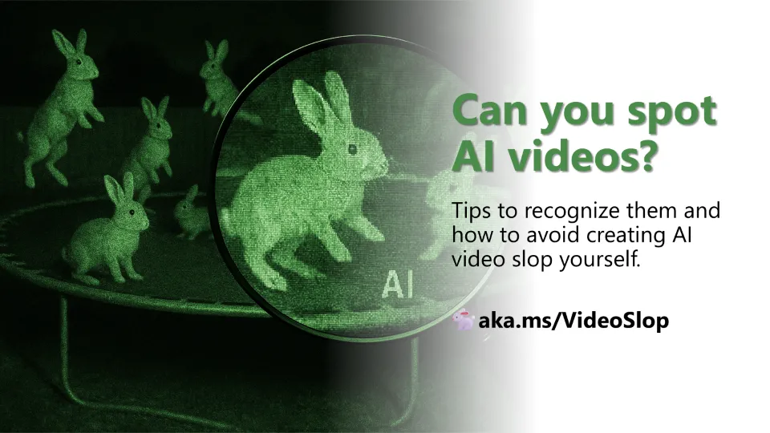
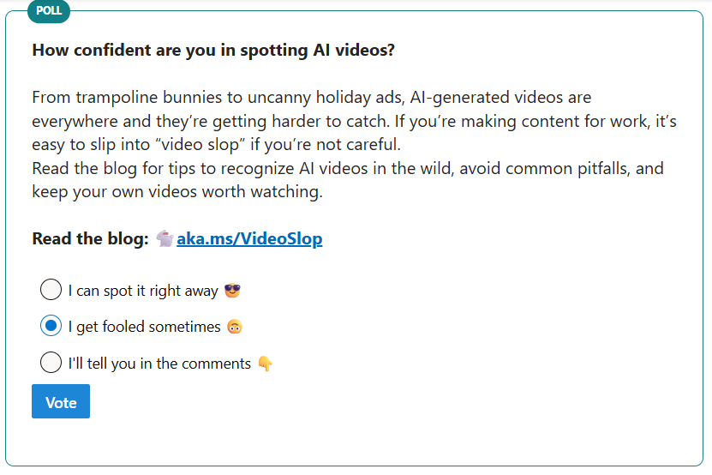
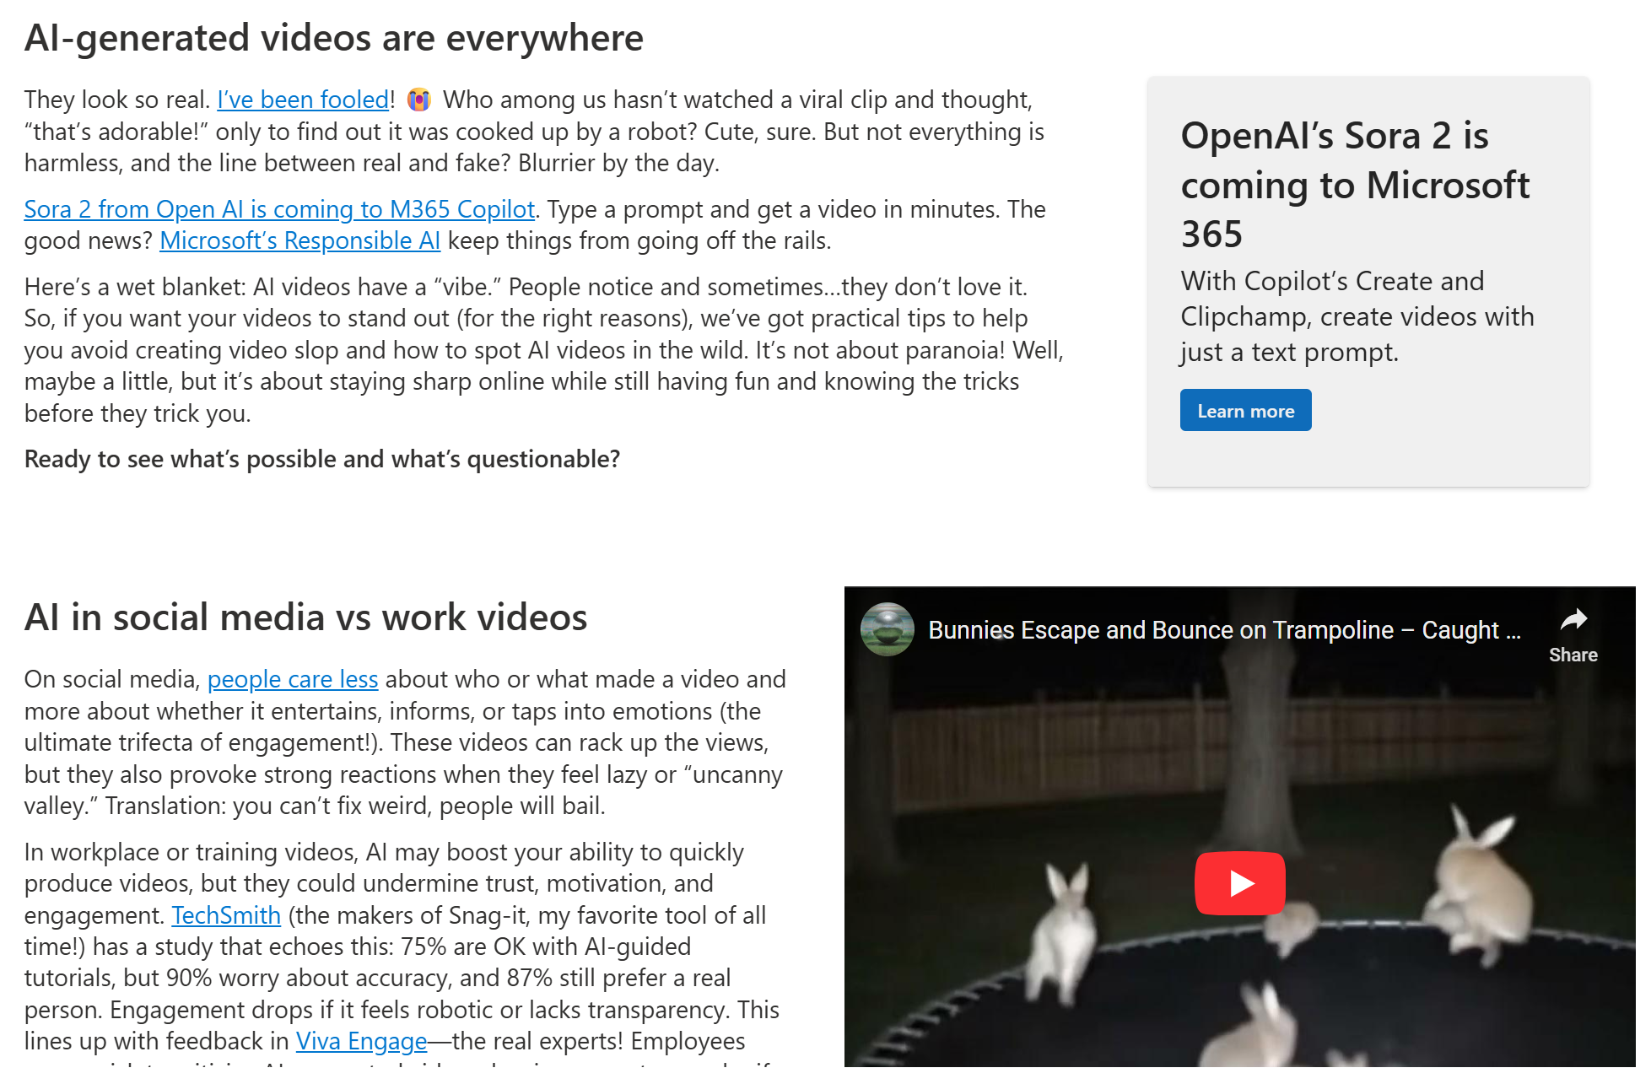
Blog: Can You spot AI videos?
The idea
A companion piece to the Workslop blog, same energy, different medium: AI generated video.
It was honest about the tension
The data backed it up: engagement drops when videos feels robotic or lacks transparency. The blog just gave the receipts.
It made AI literacy fun
A cheat sheet for spotting AI video in the wild: Poor resolution hiding imperfections, disappearing or mutating subjects, and more.
A Viva Engage poll increased engagement
Alongside the blog, a poll ran asking employees if they could spot AI videos. Nearly 40x more participation than likes or comments on any other post.
What people said
“GREAT poll!!!”, “I thought I could tell the difference, but I don't know what's real anymore?!”, “It’s getting harder and harder”.

Slide 19
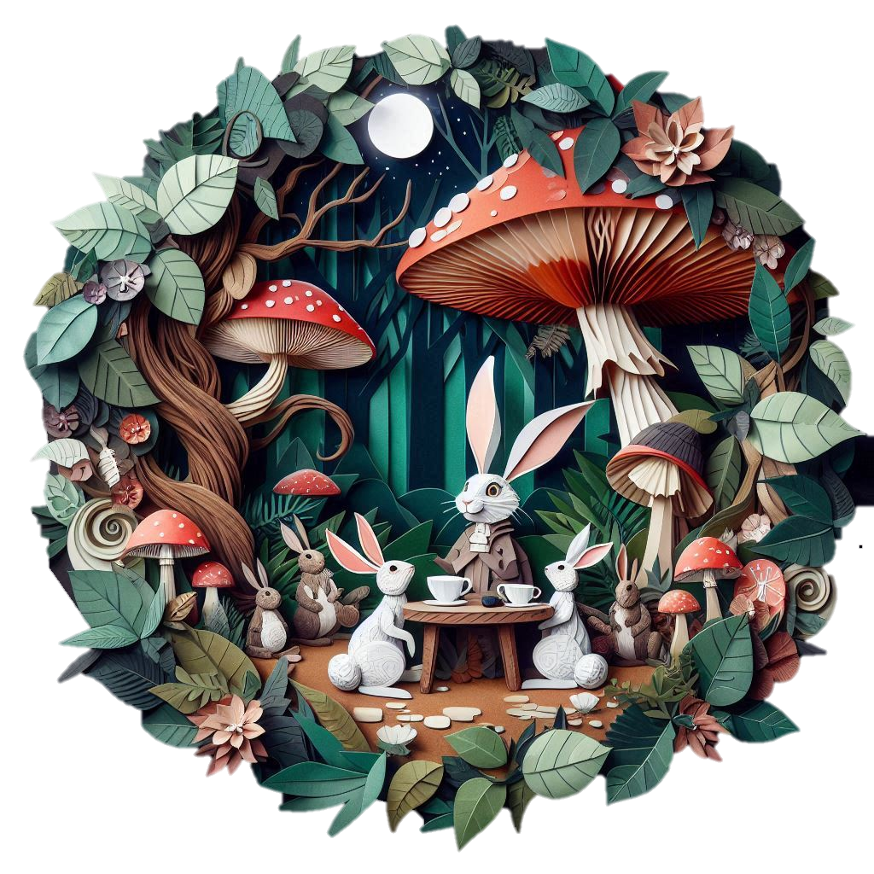

Steal this idea: Prompt of the week
The short version
Post a prompt every Monday on Viva Engage. Let the community take over. Repeat
The honest truth
The hardest part is showing up the first few Mondays before it takes on a life of its own. One Monday. Once the flywheel starts spinning, and it will, your job is just to keep the cadence and let the community do the rest.
A simple recipe for choosing prompts
Don’t make it complicated. What becomes a hit can vary: Is it fun? Is it practical? Would people find it interesting? Is it a complex prompt that really shows off what Copilot can do? Is it relevant to what's happening right now like a product launch, a company moment? Timely prompts can perform better, like a prompt about catching up after a long break hits differently when it goes out on a Monday in January after the holidays. A timely post about our company performance review process was our highest viewed post.

Slide 20

Steal this idea: Prompt of the week – Step by step
Choose your community in Viva Engage
Set up your Viva Engage campaign
Build your archive on SharePoint
Start it yourself
We post Prompt of the Week as an announcement in one of the largest communities. Posting this way lets people choose how they receive it — email, Teams, or Engage. You write it once. It finds people where they are..
Create a dedicated campaign in Viva Engage and give it a hashtag — ours is #PromptOfTheWeek. Invite people to follow the campaign so they can easily access the archives whenever you post. This also gives you a simple way of getting your metrics for reporting.
Don't wait for submissions Pick a prompt you've actually used and found value in. Test it and make sure it works. Post it on a Monday. That's your launch. No fanfare required. People loved our “Minecraft yourself” prompt. Get the prompt in the notes. 👇
Every prompt lives on a SharePoint page as well as Engage — a running collection that's always accessible, always searchable. New team members find it. People share it in onboarding. Managers send it to their orgs. Ours has 62K views and counting.
Start asking people to send prompts in
Add a simple callout in your post: "Got a prompt you’d like to share? Send it my way in Teams." That's it. People love being featured. Within a few months, the submissions start coming in on their own. Ours became 100% community-driven in just a few months, we barely had to ask.
Test every prompt before you post it
Before anything goes live, run it yourself. Does it work?
Keeping track — We use Excel to track what people send in. You could use Microsoft Forms. Keep it simple.
Credit the person who sent it in — Every promo includes the name of the employee who submitted the prompt. That's the whole secret sauce.
Notes:
Minecraft Yourself prompt
A high-resolution background inspired by the Minecraft universe, featuring a bright daytime scene with a clear blue sky and soft, blocky clouds. The landscape includes lush green hills, tall pixelated trees, yellowish and orange colors. Peaceful Minecraft animals such as big chickens, pigs, and pandas roam the grassy plains, adding life to the environment. A Minecraft character with [your features] wearing [your outfit] walks through the scene holding a [object of choice].

Slide 21
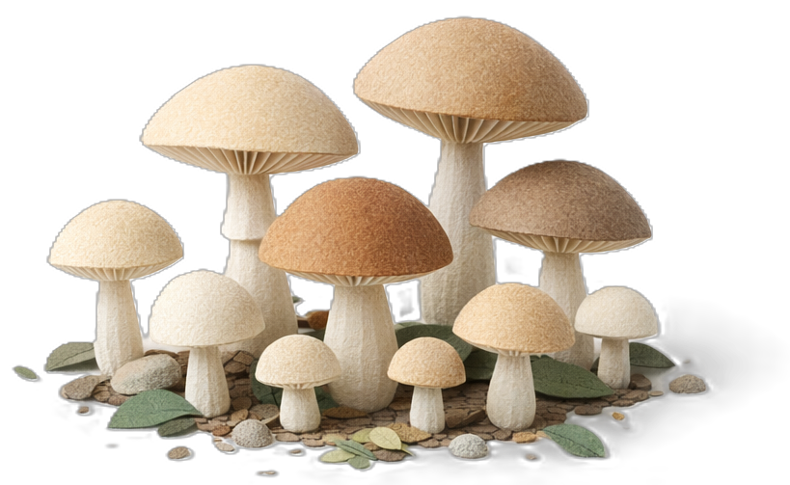
Steal this idea: Prompt of the week – Template
Prompt of the week announcement and cheeky headline.
Prompt of the week!
Happy New Year! Time to LOCK IN
Shout out to Eva Etchells for sending in this week’s prompt. Have one you want to share? Contact me on Teams.
Let’s start off 2026 with an Energy Audit! We’re mapping how you actually work: when you’re firing on all cylinders, when you’re creating, and when you’re handling the reactive stuff. Copilot turns your patterns into a plan that keeps energy high and burnout low.
Clicking on the prompt will pop you over to Copilot Chat with the prompt pre-loaded:
Look across recent documents, emails, chat activity, and file edits to identify times of day when I do my most focused work, creative work, and reactive work. Create a profile of my natural work rhythm and give suggestions for structuring my days that support energy, boundaries, and recovery. Consider optional guidance if it exists—such as early creative bursts, mid-morning focus, and late-afternoon wrap-up—but frame this as flexible, not prescriptive, so people can adapt principles to their own energy patterns. Emphasize autonomy and recovery between peaks. Provide me with a list of M365 Copilot features that would support me at different times of my day.
Need more prompt ideas? Go to aka.ms/MyPromptOfTheWeek! #PromptOfTheWeek
Call out who sent in the prompt and encourage participation
What the prompt does and the benefit to the employee
Clickable prompt
Viva Engage campaign and link to the SharePoint archives

Slide 22

Steal this idea: Prompt of the week – 12 months of metrics
  Our most popular prompts from the past year
  Most dependable: Catch up after vacation
  Cutest couple: Find your Fantastic 4 workstyle and cognitive thinking style
  Teacher’s pet: Analyze your week
  Most talented: Evaluate communication styles
  Most inquisitive: Ask clarifying questions
  Best glow-up: How not to sound like a robot
  Most artistic: Create custom badge images
  Most likely to succeed: Get the most out of AI
  Most likely to go viral: Create a weekly status report
  Life of the party: Minecraft yourself!
660K
views
300K
reached
7K
reactions

Slide 23
Steal this idea: Sample prompts for images
  Start with this adorable adventures in wonderland prompt in Create with Copilot and tweak until just right.
  Create an image of layered paper art, circular layout, zoomed out, dense forest scene at night filled with various shades of green foliage. Include large leaves with visible veins in the foreground and an assortment of smaller leaves and flowers in the background. Add yellow flowers, and other small white blooms on dark stems to enhance the depth. Very rich detail. 8K, hyper realistic. White background, show element of leaves and flowers poking outside of the composition.
  Find more prompts in the notes 👇
Notes:
IMAGE 1 – Get curious. Create an image of layered paper art with clear separation and realism, circular layout, zoomed out, of the back of a small white rabbit on a forest path in a dense forest scene at night filled with various shades of green foliage, huge twisted tree roots, and giant red, brown and white mushrooms that tower over it. Include a large white rabbit, and large leaves with visible veins in the foreground with an assortment of smaller leaves and flowers in the background. Add yellow flowers and other small white blooms on dark stems to enhance the depth. Very rich detail. 8K, hyper realistic. Contrasting background, show element of leaves and flowers poking outside of the composition.
IMAGE 2 – Join the party. Create an image of layered paper art with layered separation, circular layout, zoomed out, of an Alice in Wonderland tea party scene in a dense forest at night filled with various shades of green foliage, huge twisted tree roots, giant heavily veined leaves, and giant red, brown and white mushrooms that tower over head. A large white rabbit wearing a fancy top hat is at the head of a table with pretty teacups and tea pots, and other woodland creatures are sitting around the table raising teacups in a toast. Around them are large leaves with visible veins in the foreground with an assortment of smaller leaves and flowers in the background. Add yellow flowers and other small white blooms on dark stems to enhance the depth. Very rich detail. 8K, hyper realistic. Contrasting background. Show element of leaves and flowers poking outside of the composition.
IMAGE 3 – Learn what’s possible. Create an image of layered paper art with layered separation, circular layout, zoomed out, of the back of a white rabbit sitting under a huge gnarled tree in a dense forest scene at night filled looking up at the moon in the distance. Around it is foliage in various shades of green, huge twisted tree roots, and giant red, brown and white mushrooms that tower over her. Include large leaves with visible veins in the foreground with an assortment of smaller leaves and flowers in the background. Add yellow flowers and other small white blooms on dark stems to enhance the depth. Very rich detail. 8K, hyper realistic. Contrasting background, show element of leaves and flowers poking outside of the composition.
IMAGE 4 – Unlock the possibilities. Create an image of layered paper art with layered separation, circular layout, zoomed out, of the back of a small A bit white rabbit facing a fancy keyhole in a gnarled tree in a dense forest scene at night filled with various shades of green foliage, huge twisted tree roots, and giant red, brown and white mushrooms that tower over her. Include a large white rabbit, and large leaves with visible veins in the foreground with an assortment of smaller leaves and flowers in the background. Add yellow flowers and other small white blooms on dark stems to enhance the depth. Very rich detail. 8K, hyper realistic. White background, show element of leaves and flowers poking outside of the composition.
IMAGE 4 – What others are saying. Create an image of layered paper art with layered separation, circular layout, zoomed out, of a big white rabbit wearing a mad hatter hat and other woodland creatures sitting around a table with teacups, talking to each other. They are in a dense forest scene at night filled with various shades of green foliage, huge twisted tree roots, and giant red, brown and white mushrooms that tower over them. Feature large leaves with visible veins in the foreground with an assortment of smaller leaves and flowers in the background. Add yellow flowers and other small white blooms on dark stems to enhance the depth. Very rich detail. 8K, hyper realistic. White background, show element of leaves and flowers poking outside of the composition.

Slide 24
Steal this idea: Fantastic Four workstyles – Step by step
Choose your community in Viva Engage
Set up your Viva Engage campaign
Post your promo + your own results
Track how many people use it
We post our promos as an announcement in one of the largest communities. Posting this way lets people choose how they receive it — email, Teams, or Engage. You write it once. It finds people where they are.
Create a dedicated campaign in Viva Engage and give it a hashtag — ours is #Fantastic4. People will be posting their results with the #. This also gives you a simple way of getting your metrics for reporting.
Post your promotion and in the first response, share your own results. This gets people curious and feel inspired to post their own.
Sure, you can see if people are using it if they post their results using the campaign hashtag, but if you have a way to create a friendly short URL where you can see metrics, do that!
Employees use a customized Copilot Chat prompt
to analyze their work-related emails, chats, documents, and meetings to identify which persona best reflects their style. The prompt guides Copilot to highlight specific behavioral cues, making the response clear, confident, and engaging.
The prompt is a bit of a doozie but if you share it as a hyperlink (in Copilot chat hover over the prompt and select the link icon) will be a clickable hyperlink, so employees won’t need to do anything other than click and play.
See prompt in the notes 👇
Remove all references to our SharePoint sites, and URLs.
Notes:
✨ What’s My Work Style? Let’s Find Out. Analyze my full work patterns across all channels—emails, Teams chats, documents, and meetings, and match me to one of these Fantastic Four workstyles. Choose the dominant workstyle that shows up most clearly in my patterns, tone, and behavior: • Analyzer – Data-driven, focused on insights and logic, makes decisions based on facts. • Planner – Structured, detail-oriented, thrives on process and minimizing chaos. • Collaborator – Empathetic, people-focused, team-oriented, facilitates communication. • Innovator – Visionary, idea-oriented, brings bold energy to innovation and content creation. 🧠 [Insert Workstyle Name] Replace this with the best-fit workstyle. Write a short paragraph explaining why. Highlight 2–3 specific habits, tones, or patterns in how I work that support your choice. Use the section headers below exactly as written. Do not change or rephrase them. 1. 🚀 Copilot Scenarios That Fit Me Create a table with two columns: • Scenario • Why It Works for Me Include 3–5 Microsoft Copilot scenarios that align with my workstyle and explain the fit. 2. 🎯 Next Steps: Share on Viva Engage at https://aka.ms/ShareFantastic4 Write a ready-to-post paragraph that includes: • My workstyle name • A short, fun description • The hashtag #Fantastic4 • This link: https://aka.ms/Fantastic4 Example: I just discovered my Fantastic Four workstyle—and I’m a [Workstyle Name]! 💥 [Short description]. #Fantastic4 Curious what your workstyle is? Find out here: https://aka.ms/Fantastic4 3. 📘 Learn More Link to the full Fantastic Four page: https://microsoft.sharepoint.com/teams/WhatsNext/SitePages/Fantastic-Four-Workstyles.aspx Keep the tone confident, clear, and a little fun. Let’s go!

Slide 25
The real metric
Your posts help me know more... can't thank you enough for posting them!
I love reading the "Prompt of the Day. Please keep the Copilot tips coming!
Yes, adoption numbers are great. DAU is great. Impressions are great. We love a good stat. But here's what actually drove all of it:
We stopped talking about technology and started talking to people.
We made it fun. We made it personal. We made it feel like something worth showing up for on a Monday morning — or a Friday afternoon, or the week you came back from vacation, or the week everyone was dreading their performance review.
We met employees where they actually were. Not where we wished they were. Not where the product roadmap assumed they were. Where they actually were; skeptical, busy, overwhelmed, occasionally delighted by a dragon in a baseball cap. And they noticed.
That's the playbook.
Make the technology work for people. Make it human. Make it worth their time.
The adoption follows.
Copilot and its impact for me is directly correlated to the ingenuity and effort I afford it. The more I invest, the better it is. Always.
Your insights on Copilot features and tips have greatly improved my understanding and usage. It's making a real difference! Thank you very much.
Your posts have inspired me so many times! I’ve even added your tips to my demos at the last minute on a few occasions. Great job—keep shining!
Your posts not only help me learn more about Copilot for my personal use, they also help me with ideas on scenarios or use cases that could wow customers, like for example the prompts of the week.

Slide 26
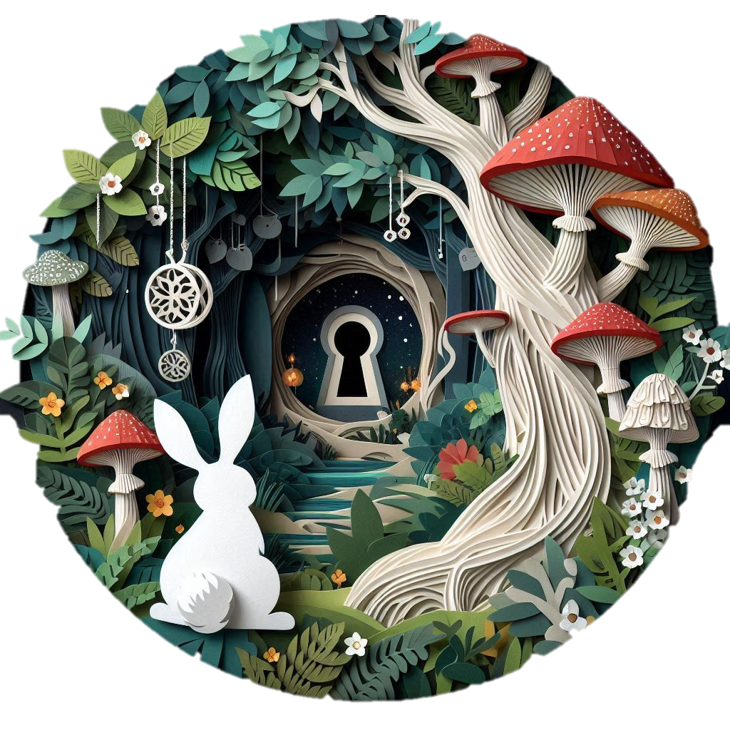

Unlock the benefits of Copilot
I love Prompt of the Week. It’s been a true game changer for me. It has helped me understand Copilot better, improve the quality of my prompts, and I’ve felt guided throughout the process. Thank you!
These prompts are absolutely fantastic! They’re exactly what we need to spark fresh ideas and make Copilot adoption even more exciting. Thanks so much for sharing them—I can’t wait to try them out!
Appreciate that the posts are usually giggle worthy.
They show a down-to-earth way of using Copilot new features to make our work easier, faster, and more efficient. They also help promote and foster collaboration across different people that comment on the prompt.

