Slide 1
Build communities in Viva Engage
Connect employees and accelerate knowledge sharing

Slide 2
Table of contents
Types of communities
Getting started
Driving engagement
Building knowledge
Learn more

Slide 3
Types of communities

Slide 4





Viva Engage
Connect people across the organization
with leaders, coworkers, news and knowledge
Build effective communities to support business objectives and employee experience
Empower leaders and communicators to reach, engage and listen at scale
Find knowledge, experts and answers faster so that employees can be more productive
Activate employees to contribute their energies, expertise and ideas
Across Outlook & Teams • Across tenants • Trusted platform • Powered by Copilot & AI
Notes:
Communities help connect employees across silos, to support business objectives, enhance the employee experience and build a sense of belonging.
There are three “pillars” of Engage that enable you activate employees.
If there’s only one thing I hope you leave with, today, it’s that you can achieve these outcomes without having to first drive users to adopt Viva Engage. That’s right—you don’t have to start by changing user behavior. Because what happens in Viva Engage reaches people across Outlook and Teams, and engages them in the flow of their work. They do not have to “go to Engage” to see your communications, for example… your communications reach them in Outlook and Teams. Likewise, they can participate in community discussions and answer questions right from Outlook and Teams.
Engage also is the only tool that lets you achieve these outcomes across organizations. More than 90% of our large customers have more than one production tenant, due to mergers, acquisitions, or governance requirements. Engage embraces all employees, across organizations.
And of course, Engage is part of Microsoft 365, which gives you the security, compliance and privacy you need for an org-wide communications platform; as well as powerful new AI tools to amplify your effectiveness across all three of these outcomes.
Many of you have already been using Yammer, and now Viva Engage, to support communities such as employee resource groups and communities of practice where people can share knowledge. We’ll touch on these pillars later, and you’ll see just how much we’ve invested to increase the value of these pillars for your organization.
But we’re going to start with leaders and communicators, where we made the most investments over the last year or so.

Slide 5
Build effective communities to support business objectives and employee experience
Organizational communities mirror your organization, divisions, departments, and regions
Support and shared services teams can inform, engage, and respond to stakeholders across the organization
Communities of practice enable people to ask and find answers, connect with experts, and share best practices
Foster diversity & inclusion with communities that bring employees & allies together
Employee interest groups connect employees around shared passions and hobbies
Notes:
Communities can be created in both a ‘bottoms-up’, crowdsourced manner or intentionally, in a top-down manner. The most effective organizations have a clear strategy on the types of communities they want to intentionally foster while enabling employees to build communities that help further their own professional and personal interests. Let me share with you some of the community types that both Microsoft and our customers have found well-suited to Engage.
I think of support and shared services both as a place for sharing info and for employees to come and ask questions. Things like Tech Connect and MSTravel in Microsoft are good examples. Are you ok with me changing this to focus on getting help and support from experts across the company?
Frame communities of practice around specific practices, not just asking questions. Communities of practice help employees learn from one another and connect across silos for innovation and process improvement

Slide 6

Organizational communities
Organizational communities mirror your organization, divisions, departments, workforce (FLW), and locations
Membership is assigned using dynamic membership rules (Entra ID), Group Membership Management, or third-party group management tools
Often configured as private communities, to scope reach of communications and support psychological safety
Start as communications channels that define an audience for sharing targeted news & information
Evolve into communities where people share knowledge, join events, and engage with each other
Community management starts with communications and leadership

Slide 7

Support and shared services
Support and shared services teams can inform, engage, and respond to employees across the organization
Service team are members and team leads are community admins
Configured as official, public communities, to allow anyone in the organization to visit on-demand
If the service is scoped—regional HR, for example—then configure as private community with assigned members
Consider muting in feeds as conversations tend to be very specific to the individuals involved
Answers in Viva uses AI to help people find answers to questions, faster

Slide 8

Communities of practice
Communities of practice enable people to ask and find answers, connect with experts, and share best practices
For authoritative forums, configure as official
Public or private based on the topic and people involved
Membership might be assigned for role-based communities, or opt-in for general knowledge sharing
Managed by subject matter experts or designated leads
Answers in Viva uses AI to help people find answers to questions, faster
Ask-me-anything events (AMAs) hosted by experts answer questions and harness knowledge

Slide 9

Diversity and inclusion
Foster diversity & inclusion with communities that bring employees & allies together
Configure organizationally-sanctioned ERGs as official
Public or private based on the topic and people involved
Membership is opt-in
Managed by community leaders
Live events bring community members together to share experience and foster a sense of belonging
Ask-me-anything events (AMAs) hosted by community leads create a safe space to ask and answer questions
Social campaigns drive awareness and participation

Slide 10
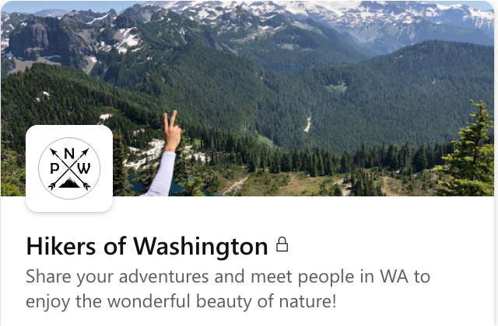
Employee interest groups
Employee interest groups connect employees around shared passions and hobbies
Generally public and open to anyone
Membership is opt-in
Managed by passionate volunteers
Live events bring community members together to share experience and foster a sense of belonging
Community campaigns spark contribution
Personalized, highly-visual content—from animal lovers or photo enthusiasts—makes feeds more engaging

Slide 11
Build effective communities to support business objectives and employee experience
Organizational communities mirror your organization, divisions, departments, and regions
Support and shared services teams can inform, engage, and respond to stakeholders across the organization
Communities of practice enable people to ask and find answers, connect with experts, and share best practices
Foster diversity & inclusion with communities that bring employees & allies together
Employee interest groups connect employees around shared passions and hobbies

Slide 12


Core digital communications channel
Location
Benefits
Performance
Flexible working
Segment
Job function
Inclusion
Allyship
Organization
Interests
Wellbeing
Culture
Leader
Hobbies
Employee resource groups
Leadership
announcements
Department
Morale
Notes:
Performance
Inclusion
Culture
Leadership announcements
Morale
Employee resource groups
Wellbeing
Allyship
Flexible working
Benefits
Connect employees with signifiers such as location, job function, interests, hobbies, department, leader, organization, and segment.
Viva Engage is Microsoft’s core digital communications channel for employees
Historically, we had a mix of comms platforms, senders and topics
What we have now moved to is now a better organized selection of meaningful communities with two-way interaction.
Our core principle is that Viva Engage is definitely not simply a ‘megaphone’ for leaders to send messaging top-down.
Microsoft is matrixed, our employees are members of a number of communities – from their department, to their office location.
And we have a raft of topics of interest, from culture to performance.
Viva Engage allows us to create communities right across those areas and to share information and discuss a wide range of topics.

Slide 13
Types of communities
In all communities… employees ask questions, converse and solve problems, and can leverage shared knowledge across the network. Communities may support a blend of a few different scenarios based on maturity.
Membership pre-determined
Employee opt-in
Organizational communication
Support & shared services
Communities of practices
Diversity & inclusion
Employee interests
Employee news and events (global)
Sales department (org)
Vancouver office (geo)
Ask HR
Product
specific
TechSupport
Security
Product managers
Artificial intelligence
Change management
ERGs
Parents <at org>
Women in leadership
Pets@ <org>
Photography
Foodies
Runners
1 to many
Core group to many
Many to many
Notes:
Types of communities
In all communities… employees ask questions, converse and solve problems, and can leverage shared knowledge across the network. Communities may support a blend of a few different scenarios based on maturity.
Membership pre-determined
1 to many
1.) Organizational communication
Employee news and events (global)
Sales department (org)
Vancouver office (geo)
Core group to many
2.) Support & shared services
Ask HR
Product
specific
TechSupport
Security
Many to many
3.) Communities of practices
Product managers
Artificial intelligence
Change management
Many to many
4.) Diversity & inclusion
ERGs
Parents <at org>
Women in leadership
Many to many
Employee opt-in
5.) Employee interests
Pets@ <org>
Photography
Foodies
Runners

Slide 14
Getting started

Slide 15
Bring intention to your community
Be clear on the goals
Clarity of purpose
Rules of engagement
Brand and tone
Useful links
A few “seeded” posts
How will you run it?
What will you encourage members to do/share?
What kind of activities should be planned?
What kind of stories would you expect?
What kind of posts do expect to redirect elsewhere?
Who can help?
Notes:
What you do provide is a framework and a definition of success for the community
Eventually, the community should evolve this collectively so that they own it.

Slide 16
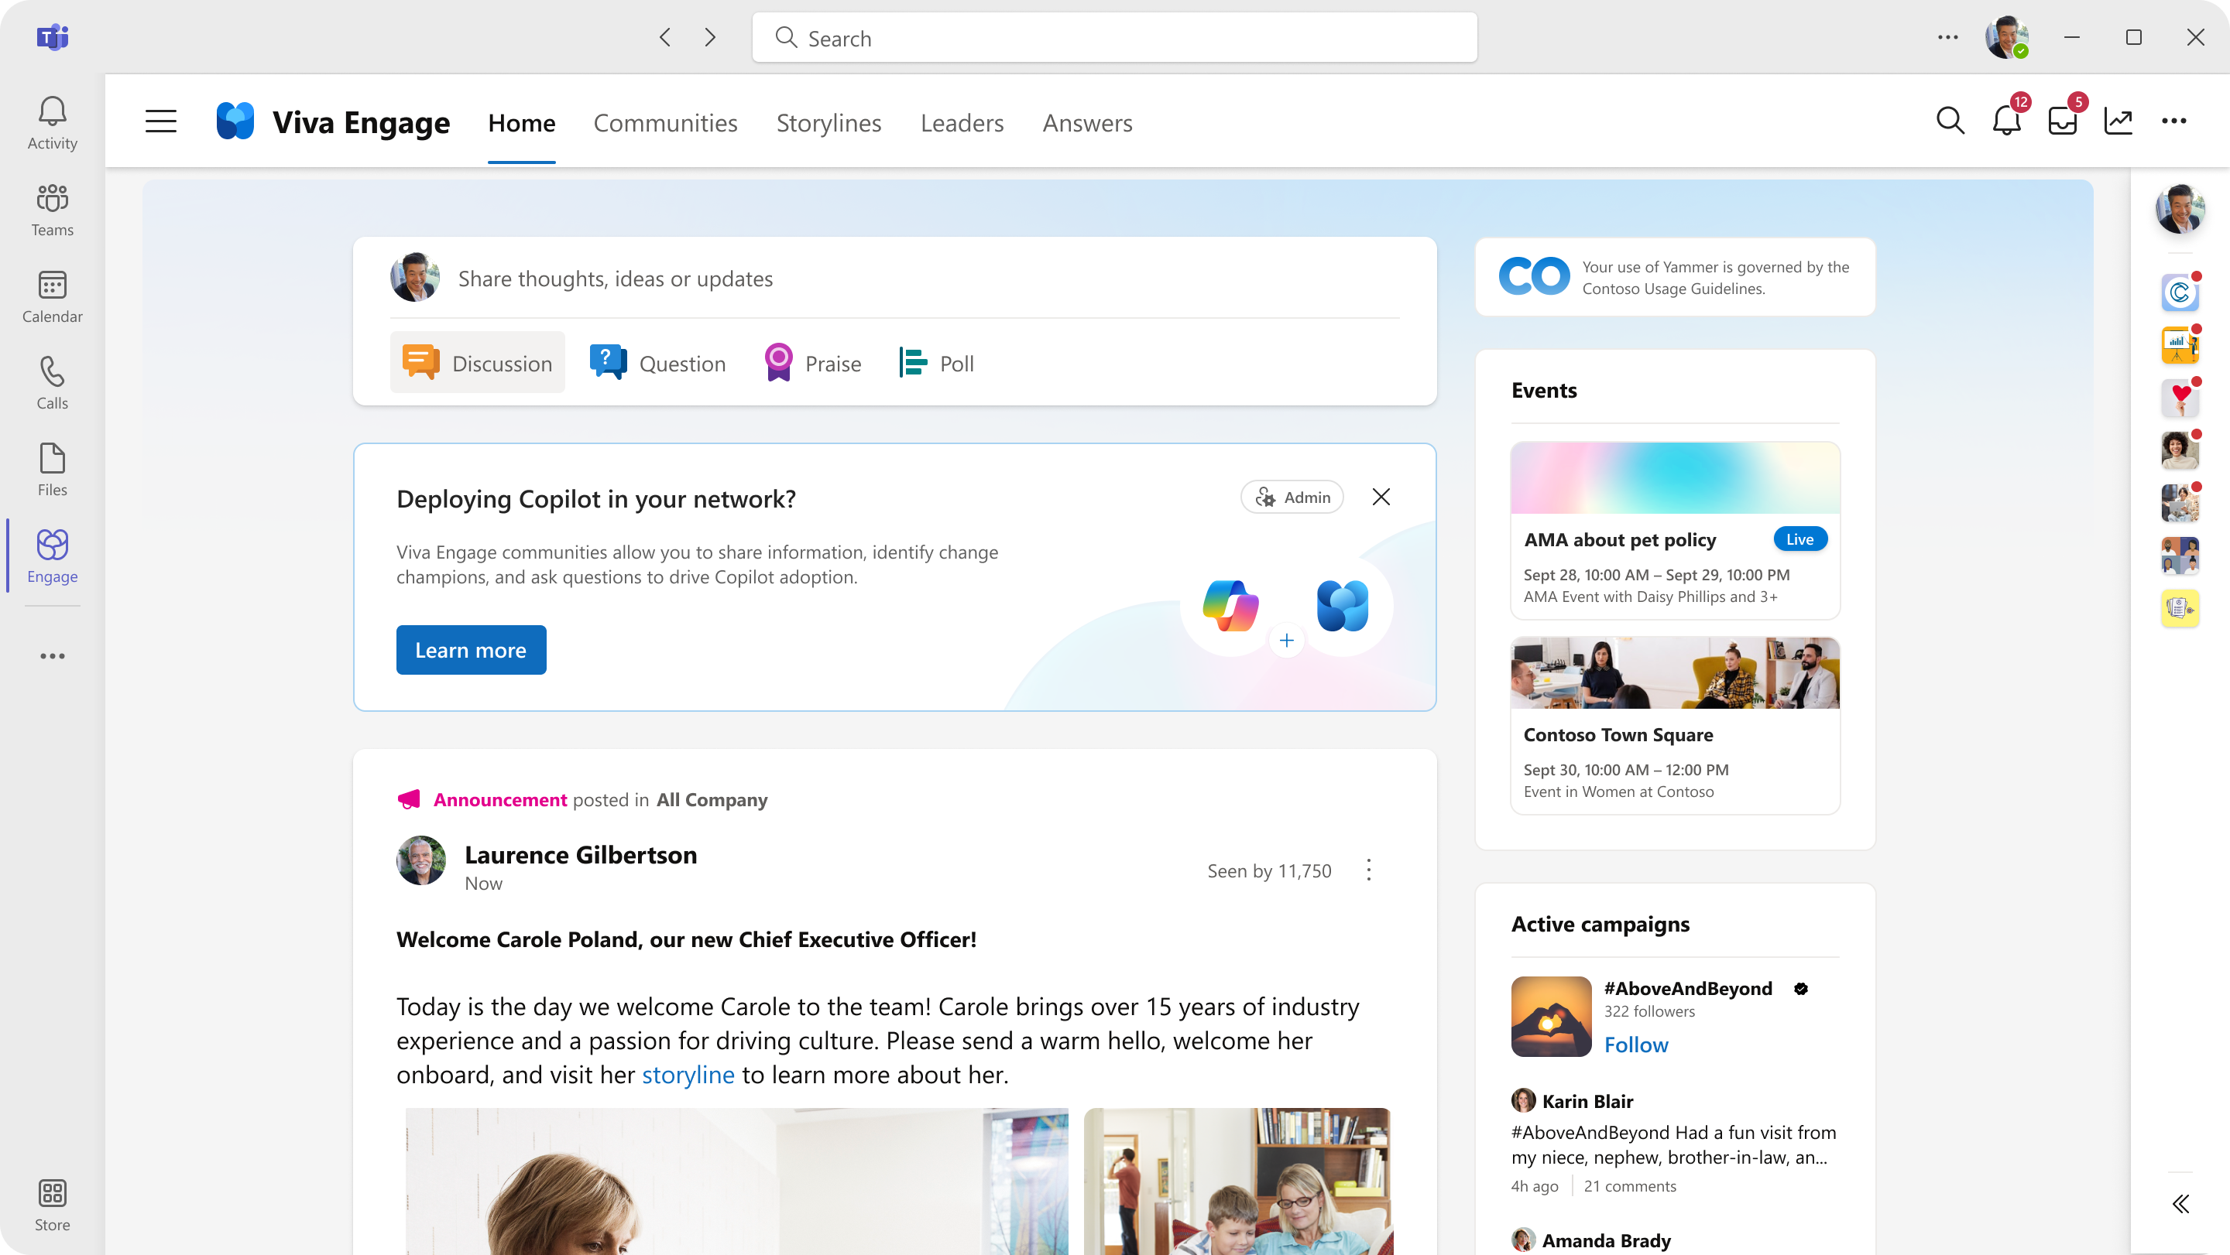
Using Engage to support M365 Copilot adoption
Notes:
Service community
Intended to help support people in your org who are learning about copilot
A place for people to share their experience, learn from one another, be inspired
Also a place to ask questions around things like integrations and types of data available
Educate and inspire employees on ways to use Copilot.
Share knowledge, tips and best practices.
Support one another by asking and answering questions.
Let’s make this all real by sharing how you can leverage all of these great AI capabilities in your own Copilot adoption community.
Such a community can be an incredibly valuable and effective way to crowdsource the support of the copilot adoption in your organization.
You can use copilot to help you write the engaging and informative posts to keep the community going
But in addition to that – there’s a ton of AI at the core of the knowledge aspects of communities which can help you simplify community management and reduce overhead
Beyond helping you write engaging and informative posts AI can also help you:
Simplify community management
Help employees get answers to their questions as quickly as possible
Reduce duplicate questions
Help get the right SME involved
Copilot can assist with:
Write engaging posts
Create excitement: Announce new capabilities, show leadership support.
Upskilling: Run campaigns such as a prompting masterclass, share tips and tricks to all.
Showcase best practices and stories: Post the very best success stories of Copilot use in your organization.
Crowdsource new practices and new stories: Learn all new practices and stories in your organization
Check your success with detailed analytics
Offer scaled support: Members can ask questions and get the best answers.

Slide 17
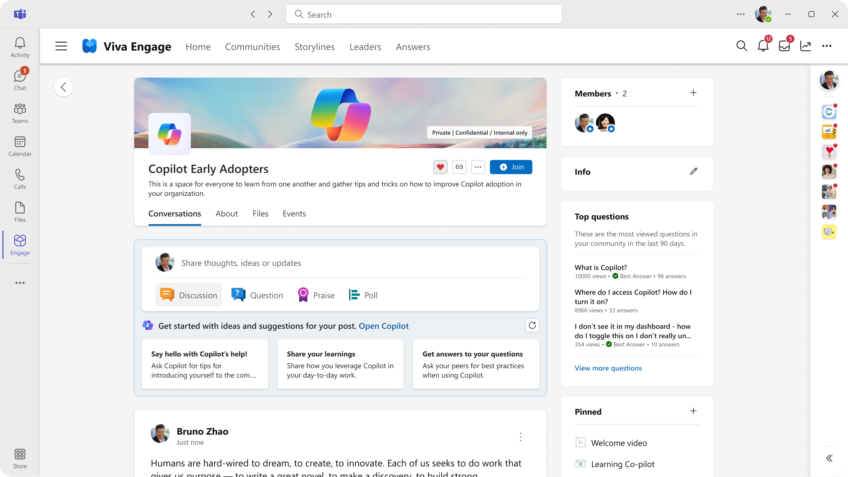
Community setup checklist
Private? Public later?
Admins, leads and SMEs
Cover photo, icon
Mark as official?
Info box: emojis, links
Pinned links & resources
Seed initial content
Pin an intro message
Notes:
Setting up a community can take as little as 5 min, but can take days
There are more fundamental questions like purpose and objectives, but we’re going into that with community leaders tomorrow
Principle here is “set out the food and put on the music before opening the door and starting the party”
See if you can get a leader or celebrity to kick off your activity

Slide 18














Building the team to manage the community
Community steering team
Community leads
(representing diverse perspectives from across the business)
Business sponsor(s)
Executive sponsor(s)
1 CPM per 10 communities is our target ratio
3-5 Leads per community
Community
program mgr.
Engagement leads
Avg 14 per community
SMEs
Notes:
KEY POINTS:
Each community is run by volunteers who do this above and beyond their role responsibilities
Leads are selected for passion, leadership skill, and representation for different parts of the business
Leads can recruit people to help run the community (BEST PRACTICE!)
Engagement Leads own strategy and execution of an aspect of the community (like communications)
SMEs contribute their knowledge (answering questions, sessions, articles, etc.)
Program managers on our team coach and guide the communities
Some communities have executive sponsors
Can appoint a business sponsor to work directly with the community

Slide 19
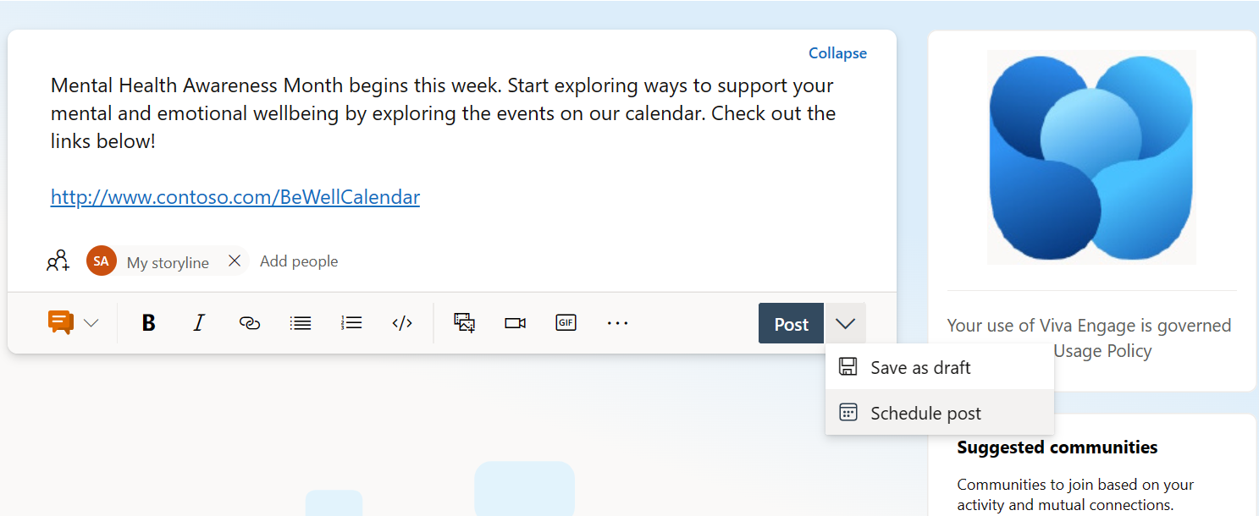
Map out your engagement plan
Daily
Review unanswered questions
Mark best answer
Move off-topic posts
Weekly
Post content (3-2-1)
Check on stats
Gather stories
Regularly
Events, video or chat
Notes:
While community managers shouldn’t be posting all the time, you should be driving a content plan
Even if the content is supplied by others most of the time
And checking regularly for unanswered questions, connecting queries with people that could answer with a @mention or private chat

Slide 20
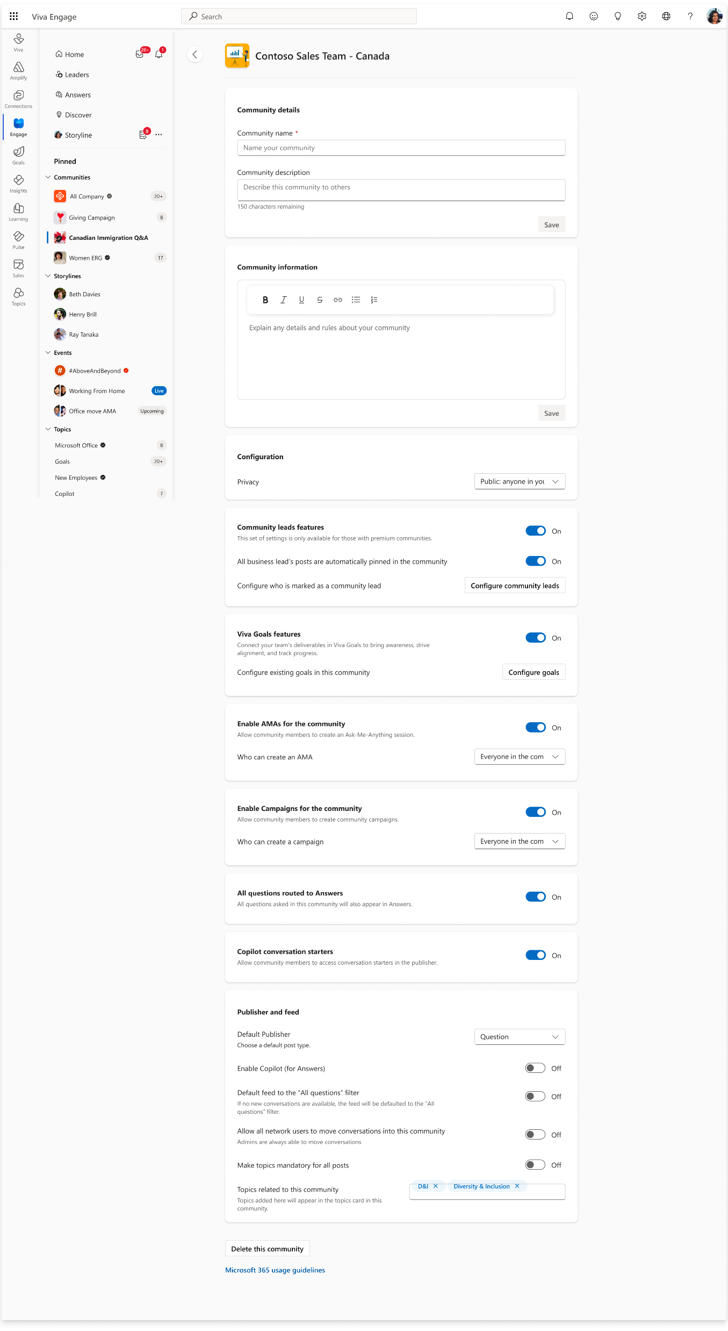
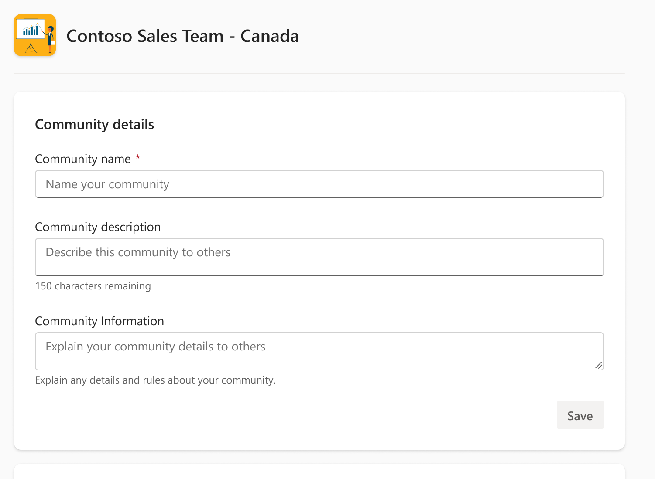
New customizable community settings
Coming Soon!
Community admins can customize settings to build each community based on the community’s purpose and objectives.
Leaders
Viva Goals
AMAs
Campaigns
Answers
Copilot

Slide 21
Driving engagement

Slide 22
Community manager secrets
Welcome and encourage new members to introduce themselves to the community.
Ask questions and mark best answer
Tag an expert to draw their opinion or insight into a conversation.
Share other relevant conversations happening in the network to the community.
Add topics to conversations. Create topics related to your community initiatives.
Post weekly roundups or related content to the community.
Praise community members for behaviour you'd like to see.
Don't leave a post to your community unanswered! If you're unsure of the answer, @mention someone who may know.

Slide 23
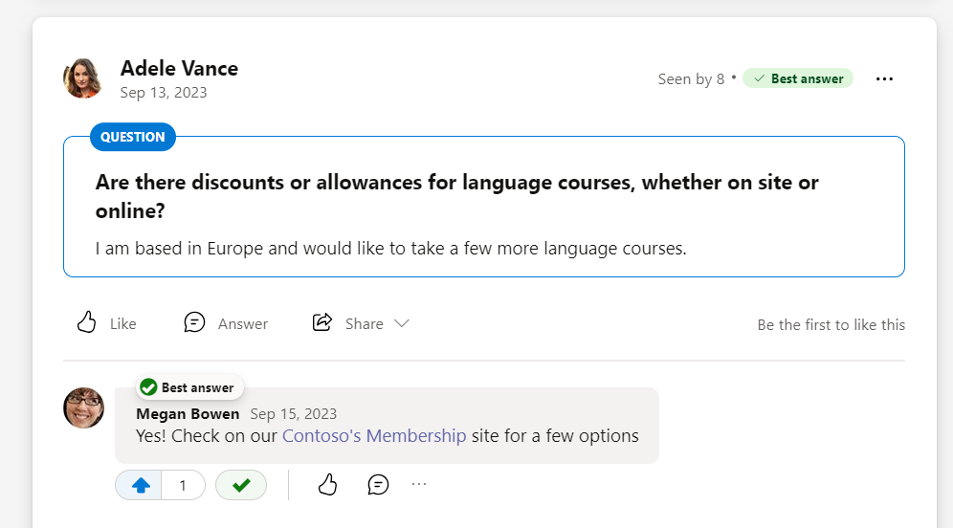
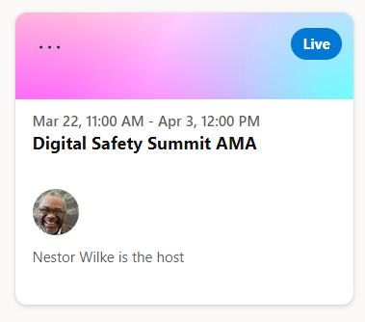
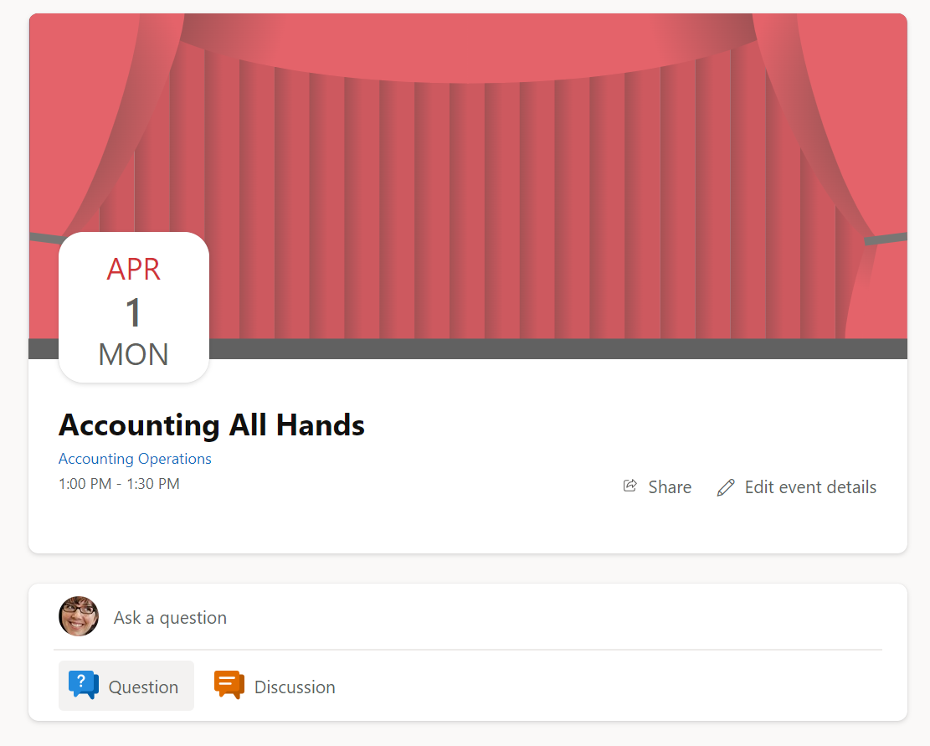
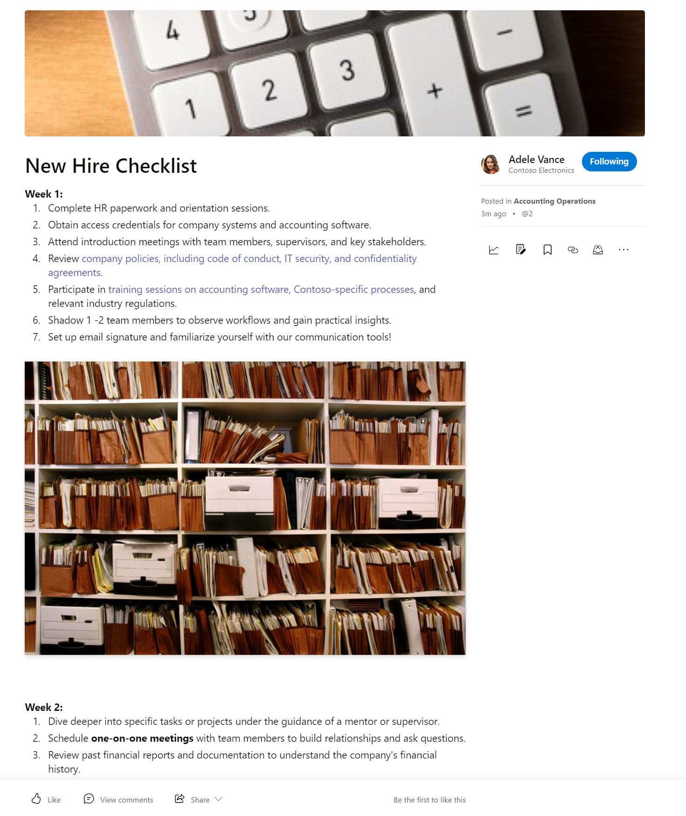
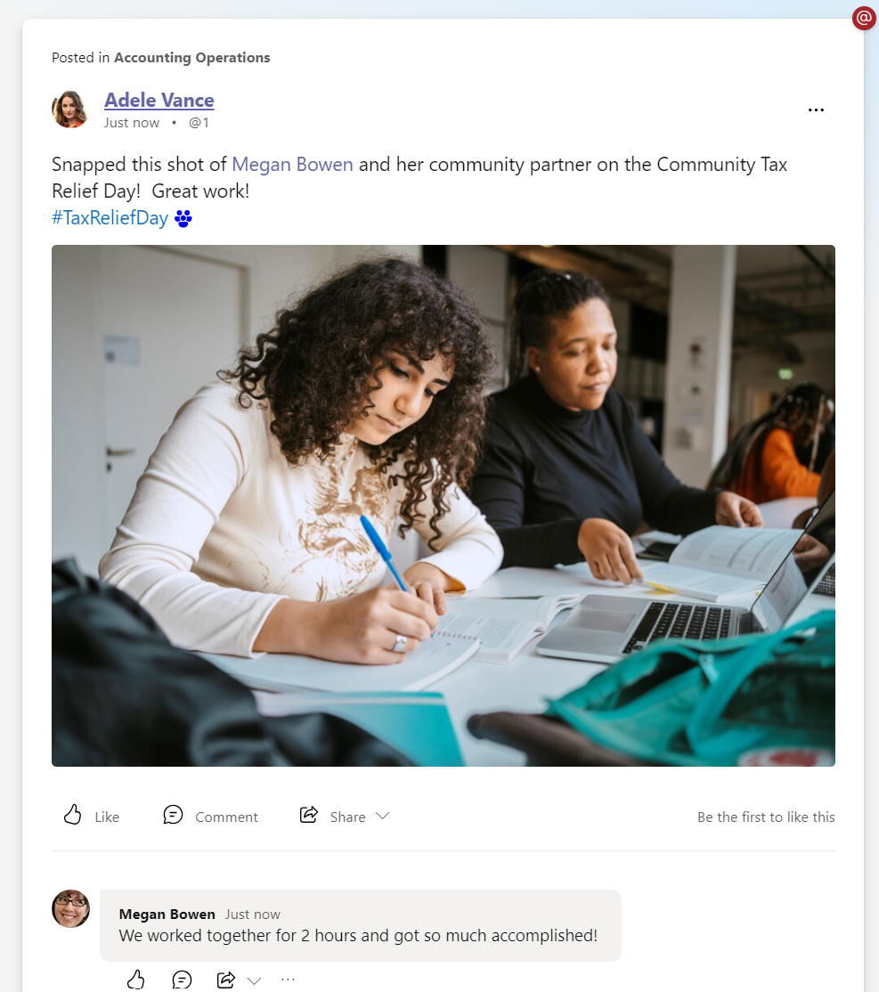
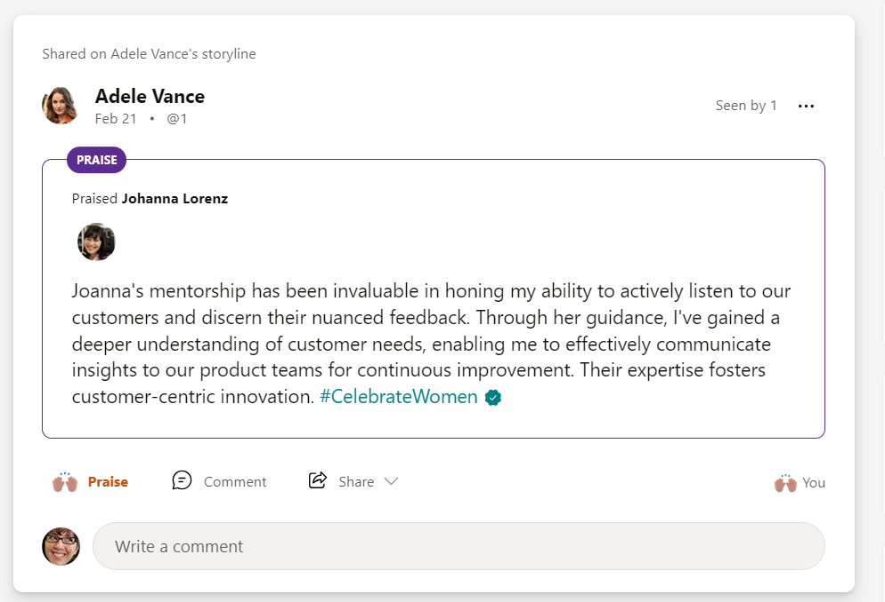
Conversations that support employees
Ask me Anything & Live Events
New
Questions & Answers
New
Community #Campaigns
Long form content
Praise & Recognition
Notes:
Employees and communicators can create a diverse set of conversations in communities
Create engaging content
Draft and schedule

Slide 24
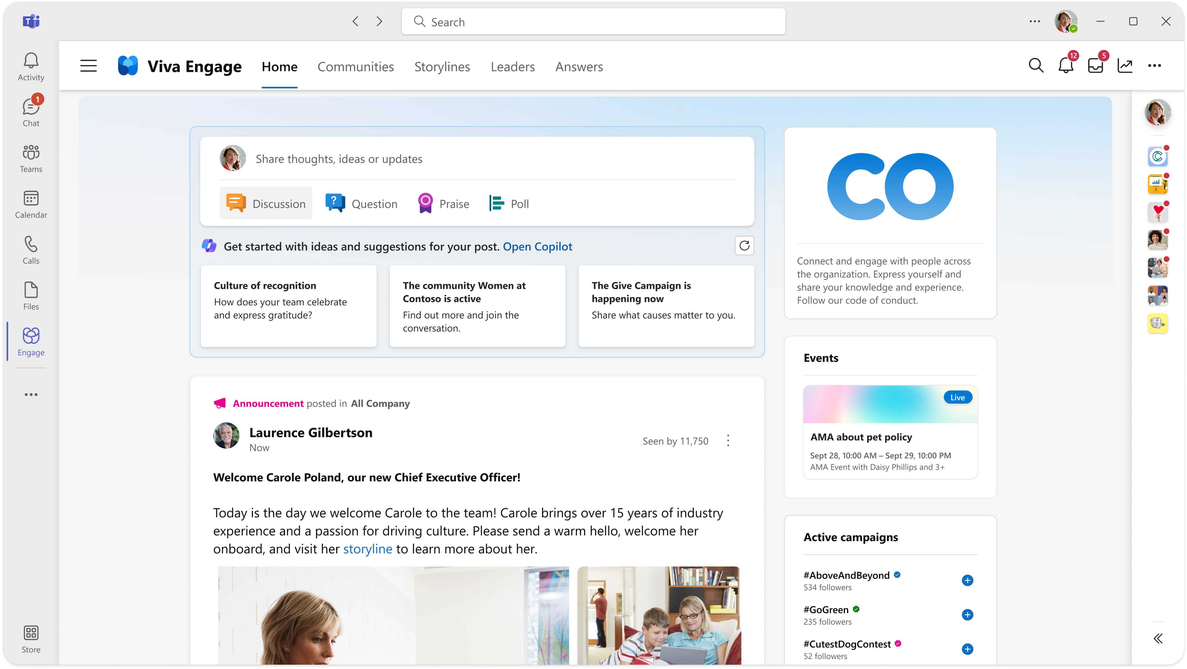
Copilot for Viva Engage inspires you to contribute
Copilot provides personalized suggestions for you to engage in communities, campaigns, and trending posts subjects based on your network and how you use Viva Engage to inspire employees to participate.
Copilot helps you brainstorm ideas of what to post and where with conversation starters.
Notes:
Figma demo:
https://www.figma.com/proto/89PxZQTGLOScUSysJ7rg2x/branch/nzN8mmiky279cw2pPIJoWy/Engage-Copilot-MVP-%26-V1?type=design&page-id=7147%3A506559&node-id=7189-581645&viewport=-1375%2C-159%2C0.11&t=6vRoq784ebco1vYU-1&scaling=min-zoom&starting-point-node-id=7189%3A581645&mode=design

Slide 25
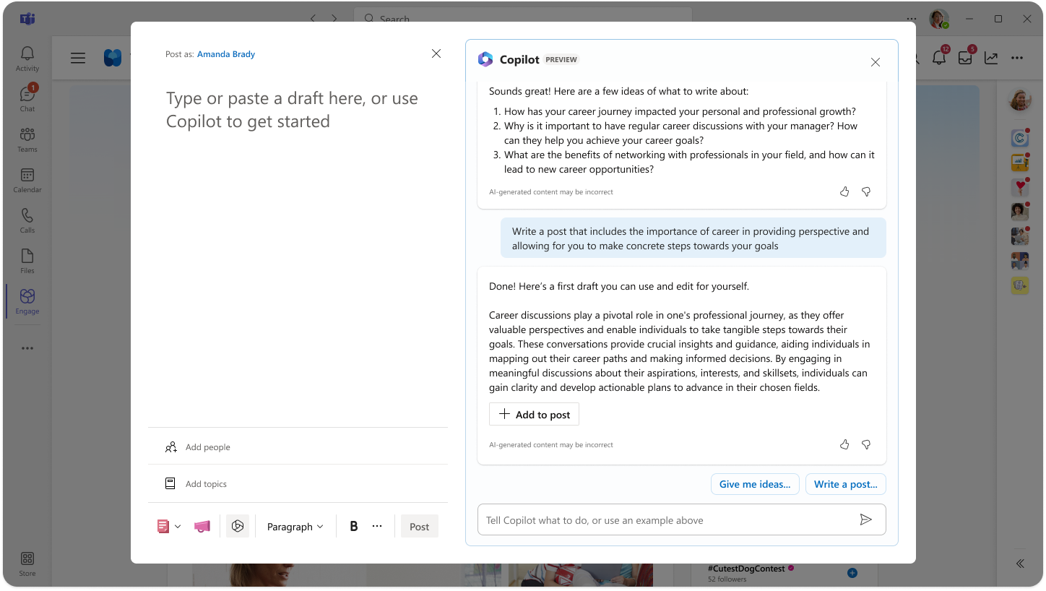
Craft your message with Copilot
Ask Copilot to help you with ideas, or to write a message or even add emojis.
Ask Copilot for feedback about the post, including questions that may come up.
Use Copilot suggestions for Viva Glint research-backed posts to strengthen employee experience and achievement.
Delegates can also use Copilot.

Slide 26
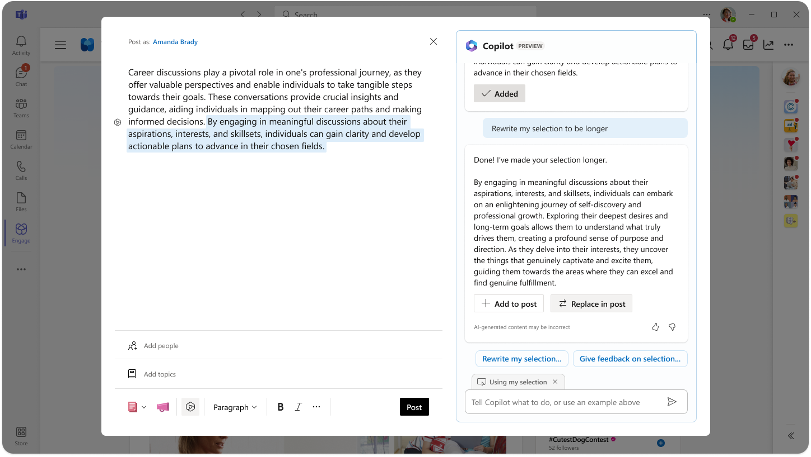
Refine pieces of your message
Highlight a part of the message that you need to help with and ask copilot for suggestions

Slide 27
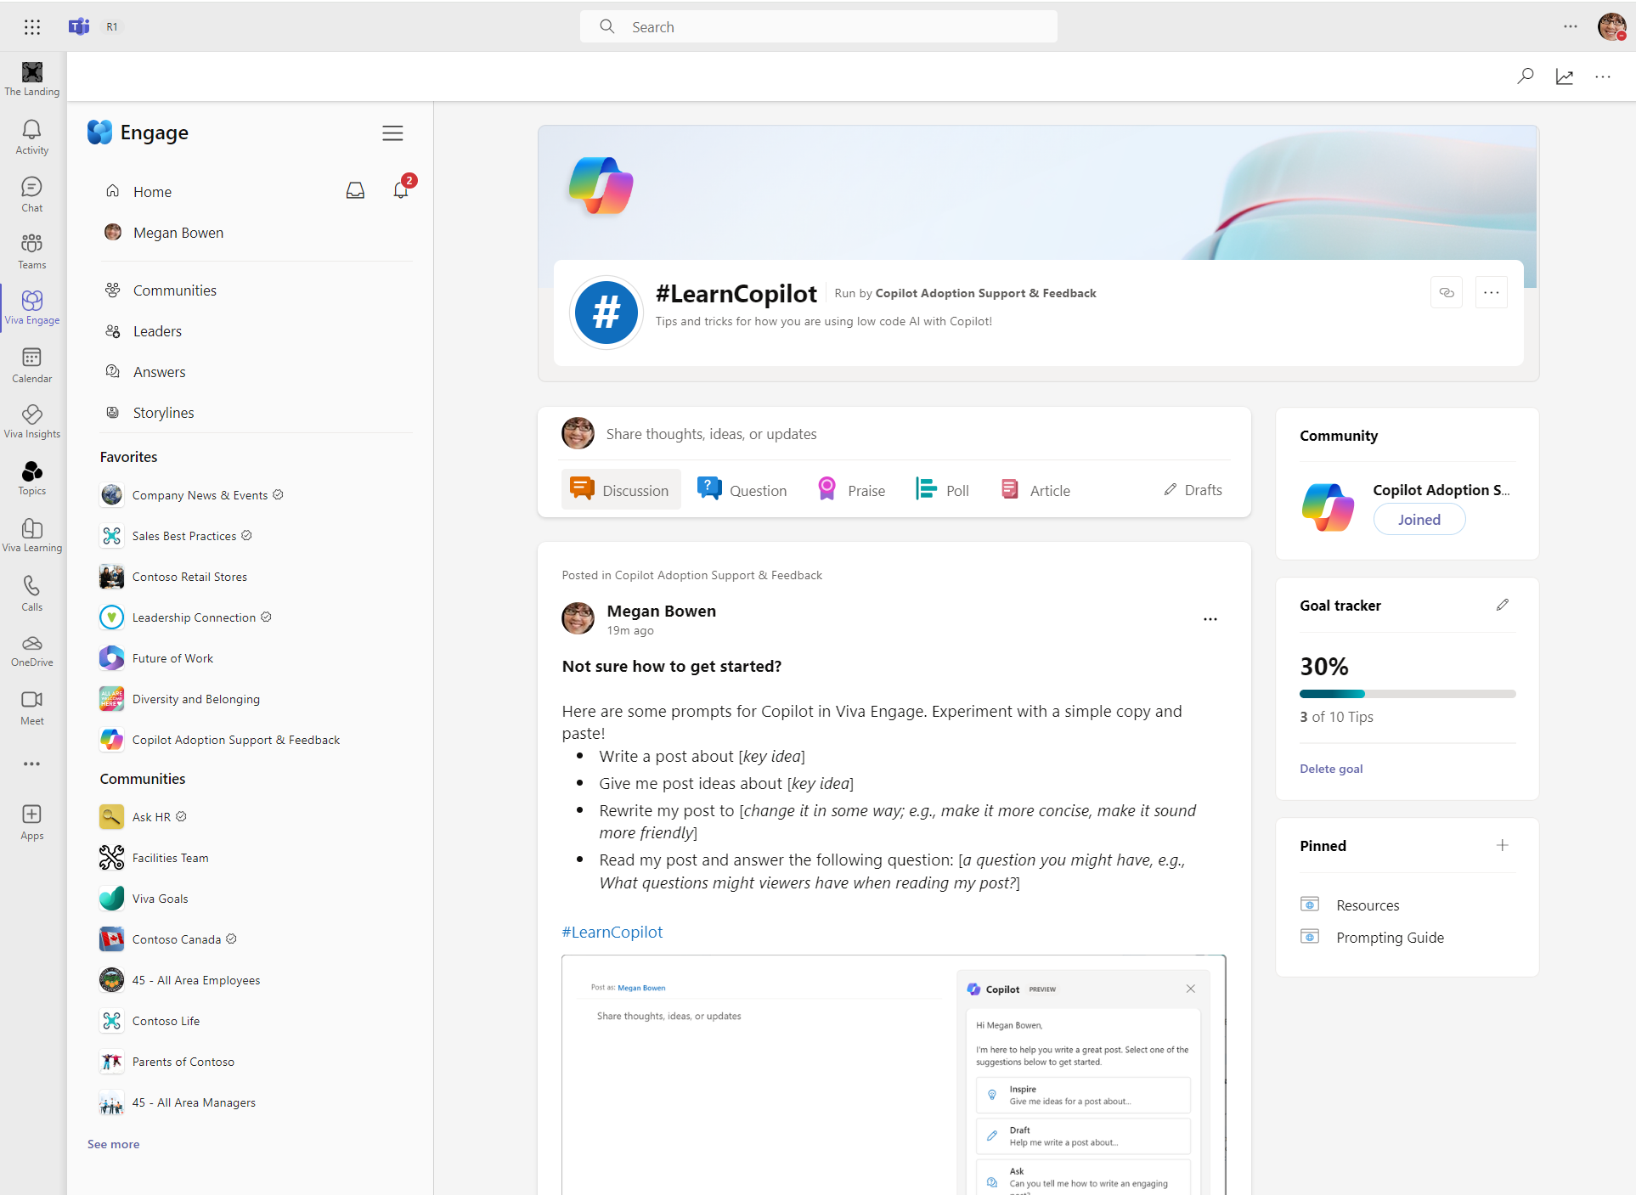
Community focused campaigns
Target social campaigns for public and private communities. ​
​
Community admins can create, manage, and track campaigns directly within their community.
​
Lite analytics available now and more coming as part of updated community analytics.
Notes:
Official campaign – network wide followership, executive sponsors, checkmark
Promoting official campaigns – promote it to targeted group of people (bell notification) – followership, executive sponsors, checkmark - any corporate communicator can create
Campaigns within community – an icon will be there but not “official’ – only admins can create – summary card available, and then will show up in the new community
Private campaign = scoped to a private community

Slide 28
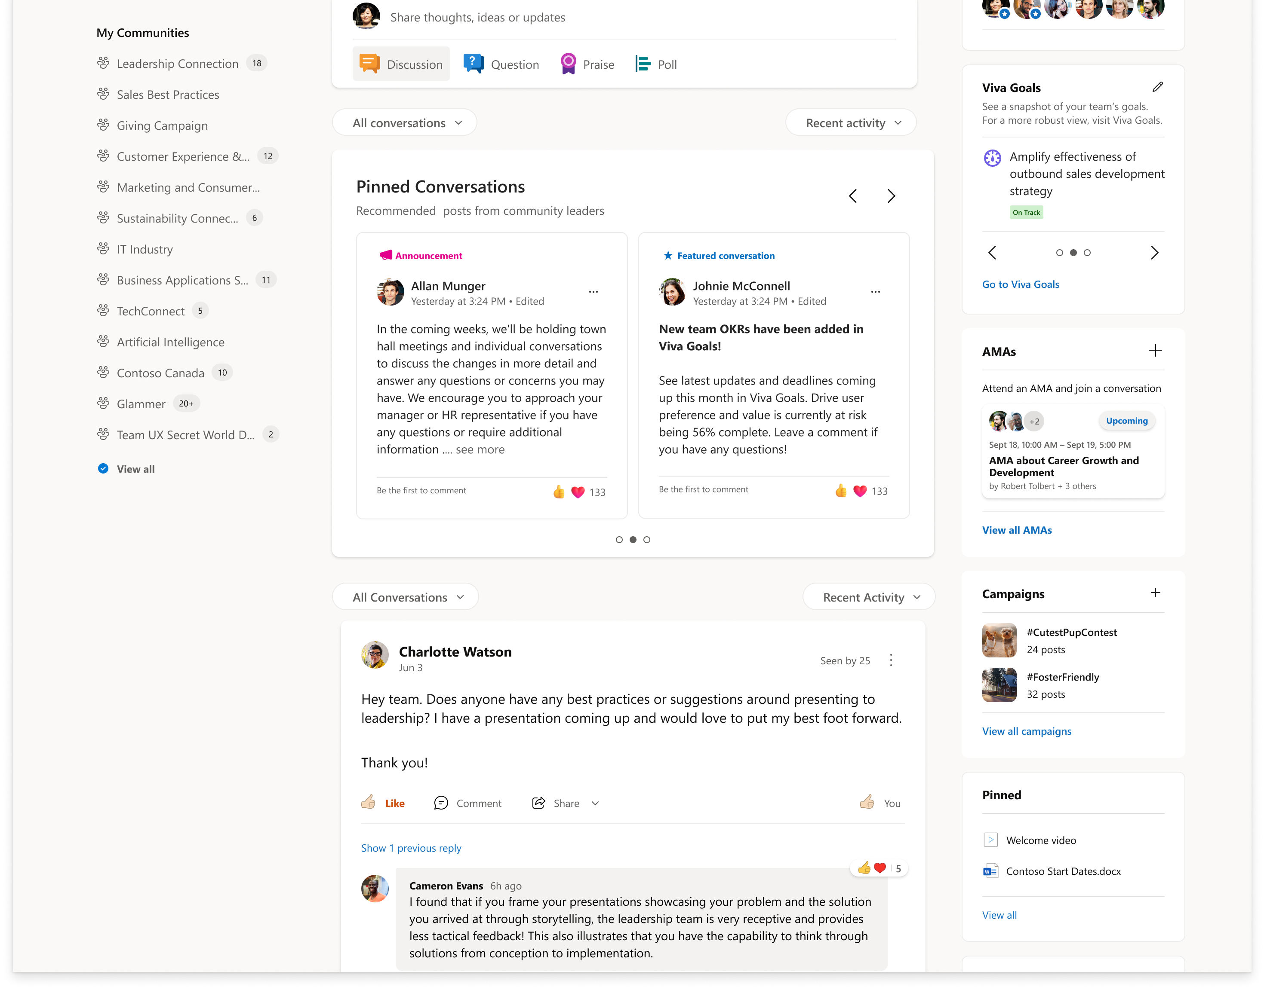
Pin multiple conversations
Community leaders posts are automatically pinned*
Up to 6 posts can be pinned at one time
Admins can pin/unpin posts
Posts will show in the order of the latest pins
*Community admin toggle available

Slide 29
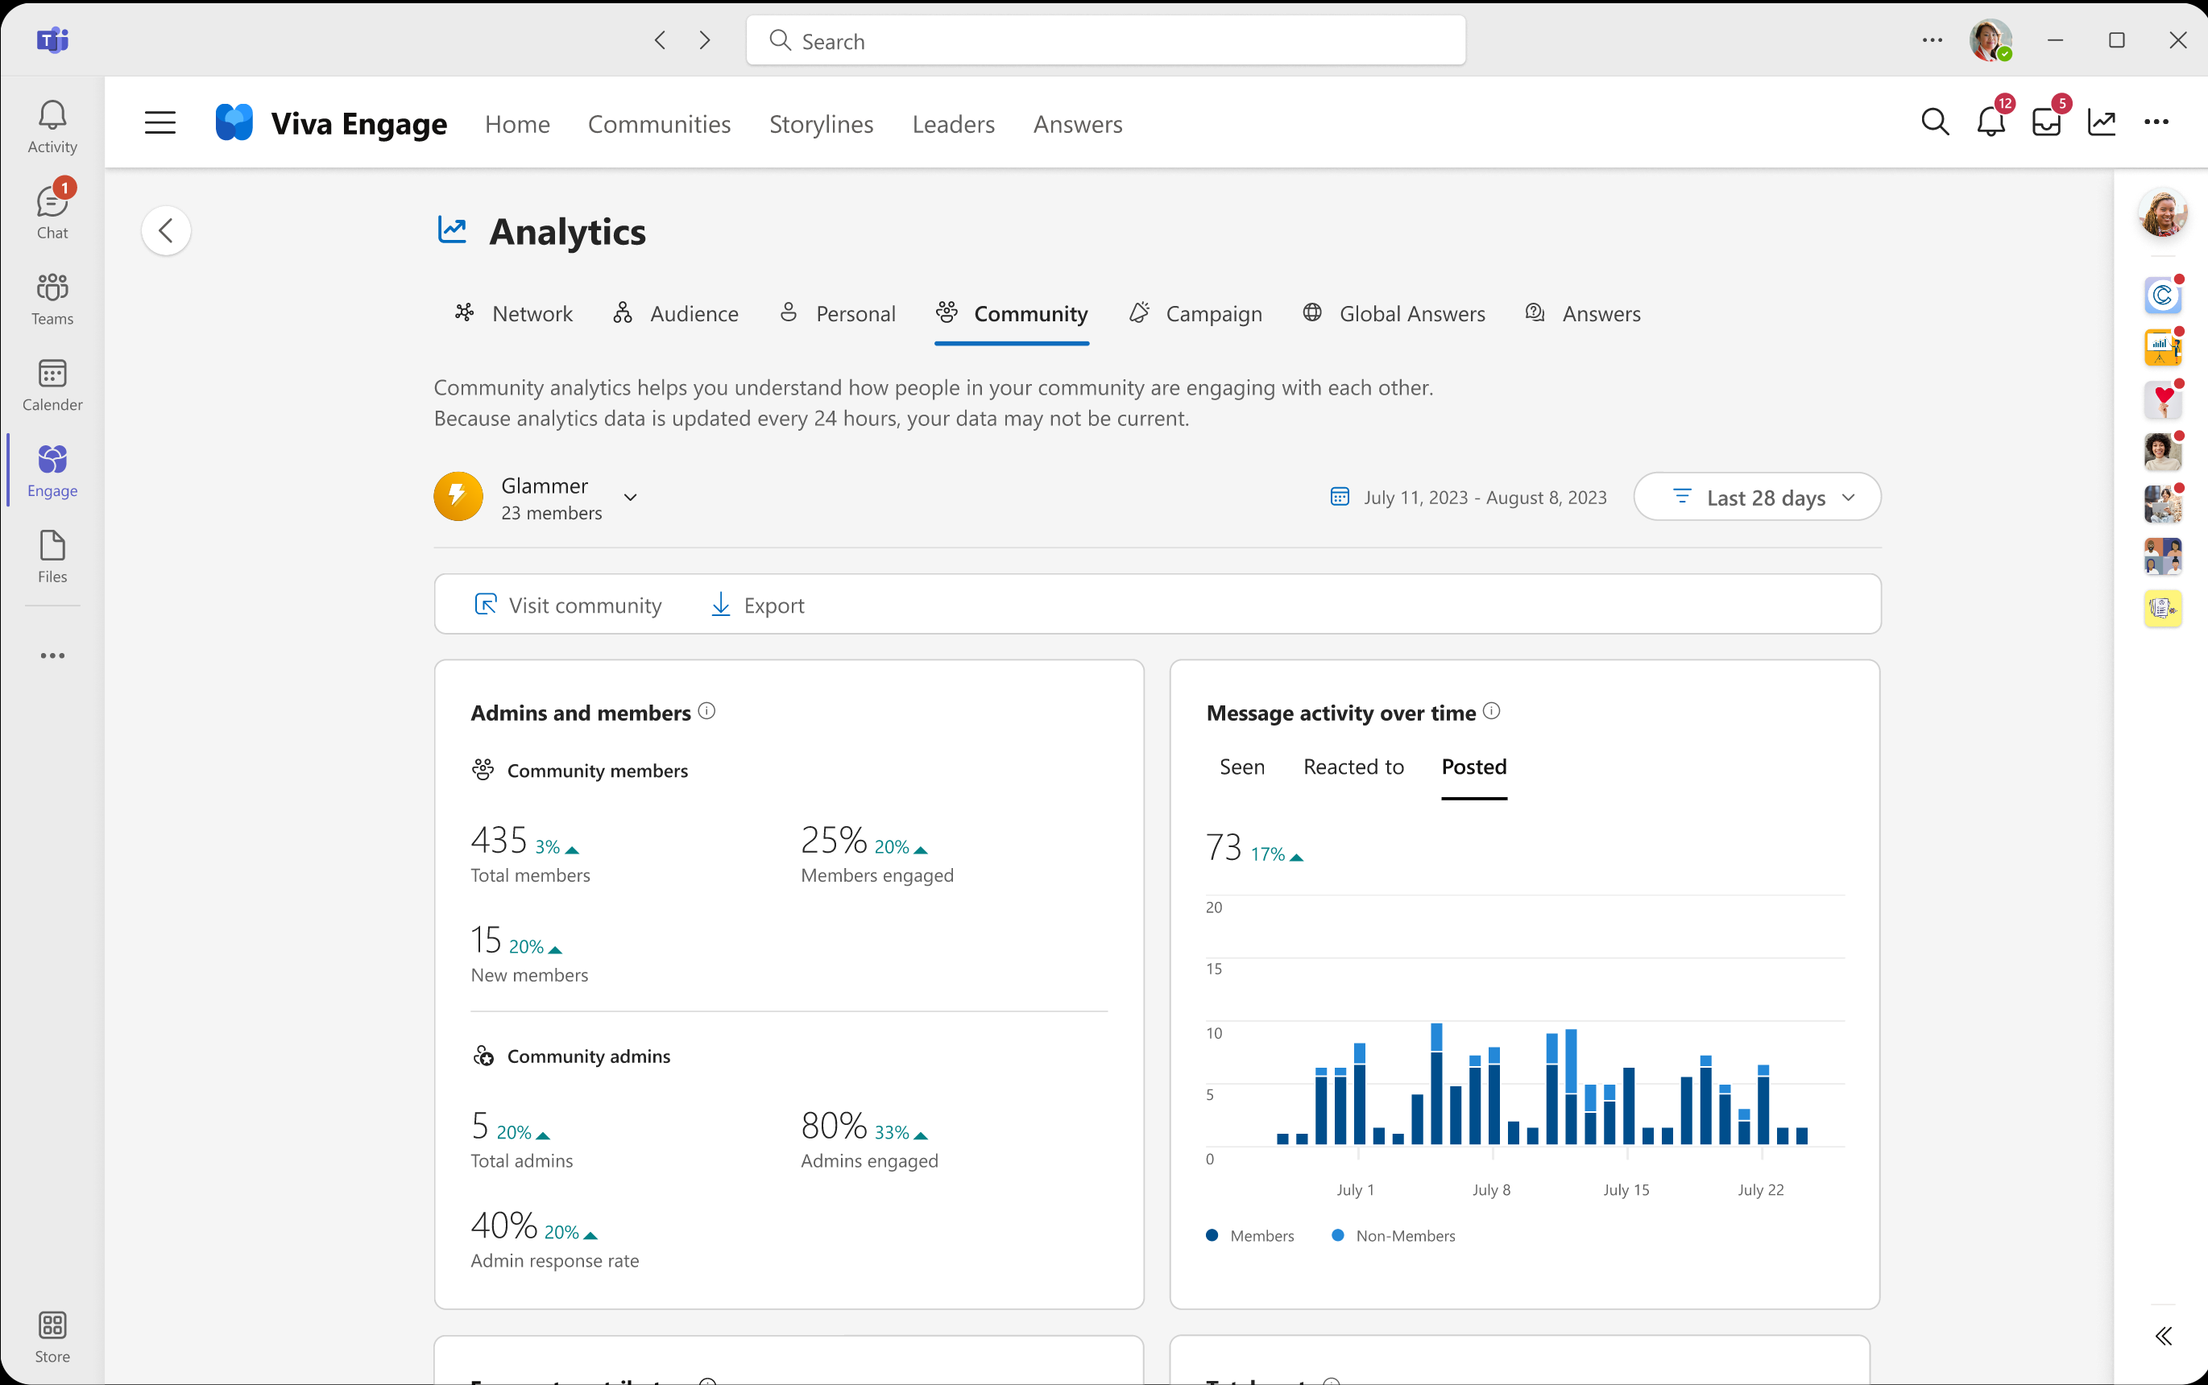
New community insights
Measure community growth including new member creation, active people, their location and department.
Analyze and foster engagement with insights into how people engaged with conversations, comments, reactions, questions, answers, campaigns, live events and more.
Recognize catalysts and trends including top conversations, questions, active contributors, champions and trends to measure event attendance, and knowledge dissemination.
Export data for deeper analysis.

Slide 30
Building knowledge

Slide 31




Building knowledge in communities
Services
Support
Learning
Practice
Facilitate employee support for company-wide services
Connect employees with answers and experts in specific domain areas
Ensure efficient sharing of information
Build a robust knowledge base and keep it up to date
Enable support for a specific product, program, or area
Provide access to support from experts and community members
Champion expertise and enthusiasts
Amplify important updates and announcements
Foster growth and learning through shared knowledge
Learn and grow with resources and content
Connect with teachers and peers to encourage progress and growth
Reward learning, progress, and expertise
Share expertise, mentorship, and best practices around a specific role
Connect professionals with peers to share best practices
Learn and upskill together
Foster networking, career growth, and mentorship opportunities
Notes:
Long before Microsoft Viva Answers, organizations have used communities to give their organization a place to ask questions and get them answered. From the time of Viva Answers, many customers have asked how they can connect the features of Answers with the existing knowledge base and habit that their users have built in communities. AiC brings the capabilities of Answers into communities.

Slide 32
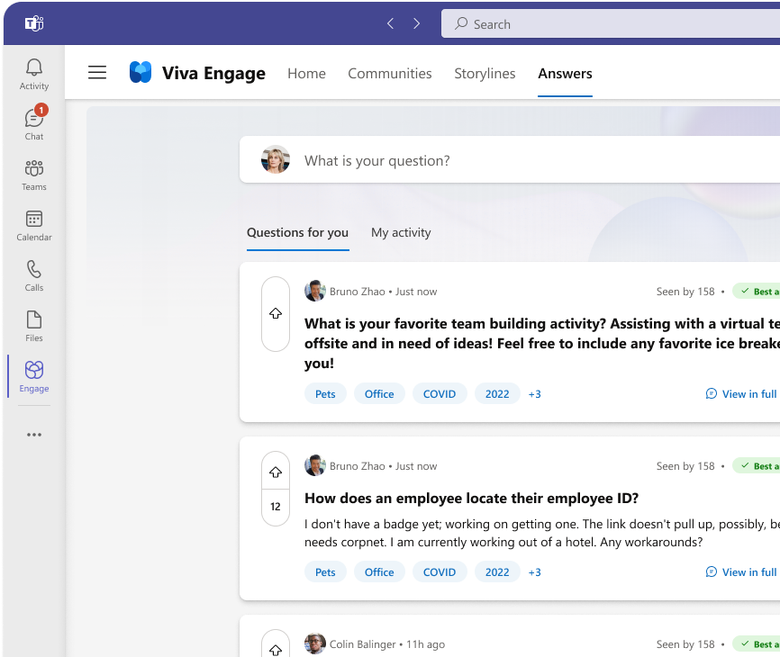
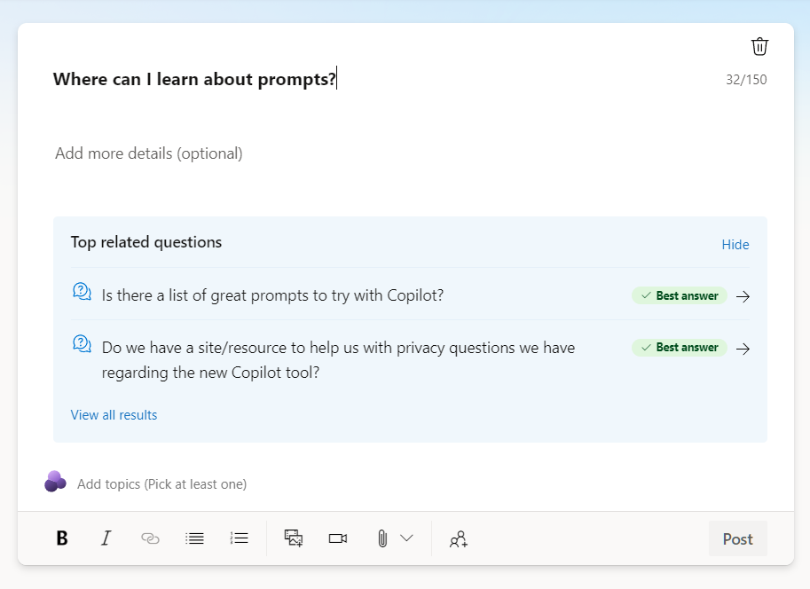
Get faster answers to questions
Reduce duplicate questions and get answers faster with Answers in Communities.
LLM based search finds similar questions.
Start off with a rich knowledge base from existing community questions.
Notes:
There is intelligence built into the new question publisher.
- Asking a question - you can see if a similar question has already been asked and hopefully answered
- 45% of the time people are getting a result here worth checking out - which helps people either get their answer immediately, or sometimes better frame the question they're actually wanting to ask so they can get to the specifics for their circumstances. And worst case, if it hasn't been answered, you can upvote that question increasing the signal that it's an important one to answer
- LLM based search - So it even finds questions which have been asked in a different language, and finds questions where people used slightly different words
- Indexes existing questions – We've done a lot of work behind the scenes to index the questions already asked in an existing community - infer the title from the description and show those here, even though they don't have a title specified
- Results are shown both from this community and from public communities as well as private communities you are a member of, so you don't have to worry about someone getting access to knowledge they shouldn't have
LLM-backed related questions include all existing community questions.
Question posts for all users across Engage now includes question field to make the question clear and easy to search for.
Unified topic picker across Engage and Answers includes AI suggested topics, making adding topics fast and easy.
New prompt guides employees to post a question when appropriate, to take full advantage of question capabilities.
Instantly upgrade your question posts in Viva Engage communities.
Tap into the habits your organization has built around knowledge communities.
Leverage the knowledge you already have in these communities.
No action required on your side to integrate this prior knowledge.
Works with both public and private communities
Reward community members with badges for sharing their knowledge

Slide 33
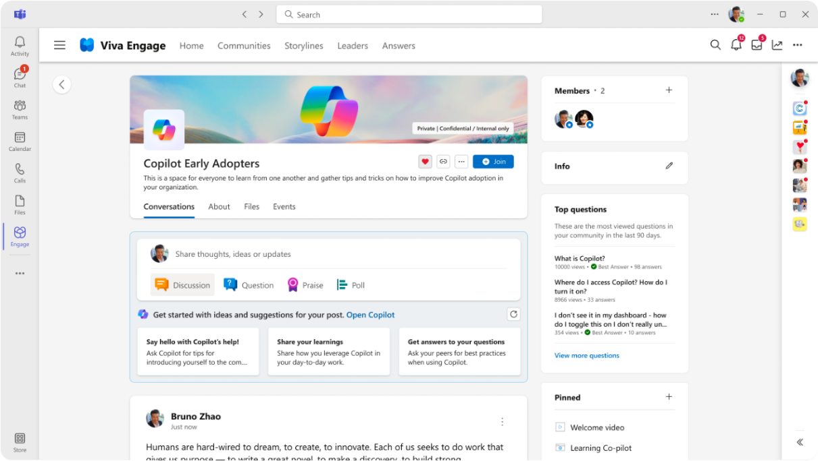
Copilot in Viva Engage helps you create engagement
Conversation Starters encourage valuable posts and Writing Assistant makes creation easier
Copilot helps members share
Questions
Learnings
Stories (e.g., of how you're using Copilot in your role)
Social learning
strengthens engagement.

Slide 34
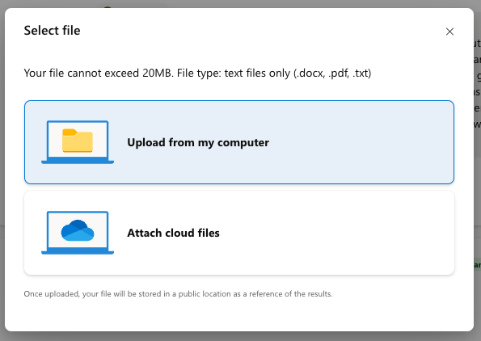
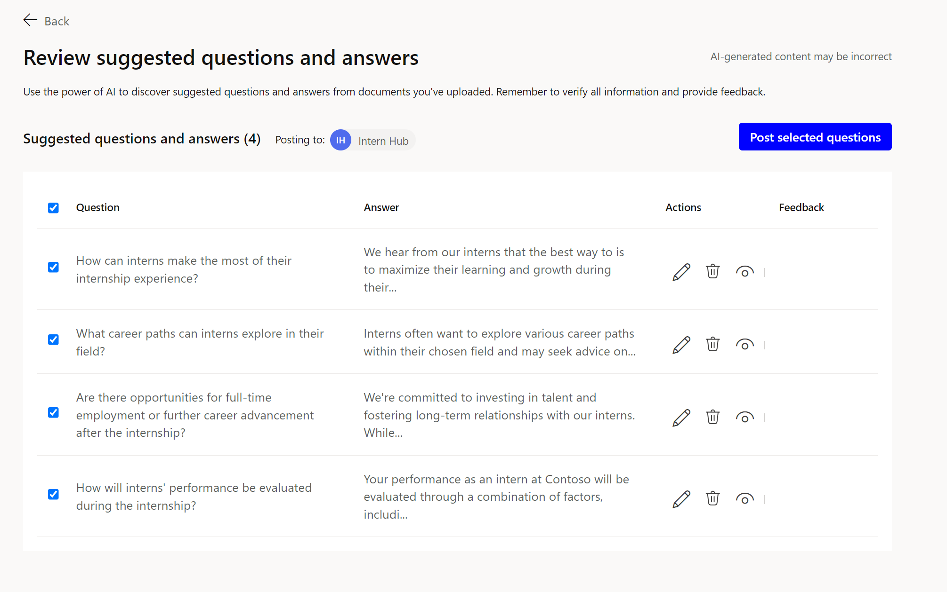
Intelligent Importer simplifies seeding Q&A in your community
Uses generative AI to create Questions and Answers based on the contents of documents including Word, PDFs, and text files.
Admins can edit, preview, delete and publish suggested questions to get your new community growing quickly.
Notes:
Another way that AI can help make your transformation / copilot adoption community more successful is a new feature we call Intelligent Importer
Intelligent Importer is a really cool generative AI tool which can save you tons of time in generating Q&A or a FAQ out of existing documents.
For example:
- You could have a copilot 101 document to help employees get past the basics of using copilot.
- You can feed this document into intelligent importer, and it will generate Q&A pairs to add to the community based on the content of the document
- From there you can review and edit, and keep the ones you think will be the most helpful and import them into your community
This saves tons of time in getting your community off the ground by pre-seeding it with relevant content tailored to your organization and your specific use cases.

Slide 35
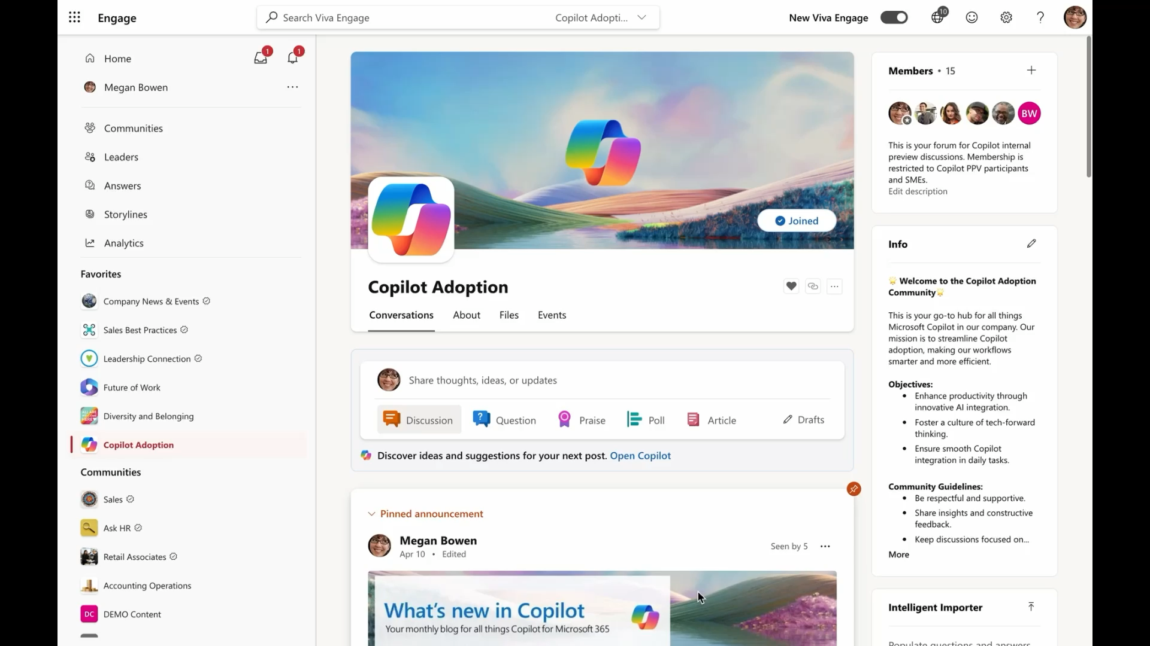
Intelligent importer
Notes:
Play this demo video of the intelligent importer.
Intelligent importer:
Choose file
Review Q&A
Edit, Review, Delete
Select posts
Save
Posts are imported with your name and posted to the community

Slide 36




What is the impact of employee's questions getting answered in Viva Engage?
Reduces question creation by 45% with related questions
Faster time to answer question by 13 hours
10% better Best Answer rate
2+ more hours saved per employee
Notes:
Reduces question creation by 45% with related questions
10% better Best Answer rate
Faster time to answer question by 13 hours
2+ more hours saved per employee
these people are getting immediate answer to their question
or they are getting closer to an answer and can formulate a better question by gaining adjacent knowledge along the way
And we are saving the time of those who find themselves answering the same question repeatedly

Slide 37
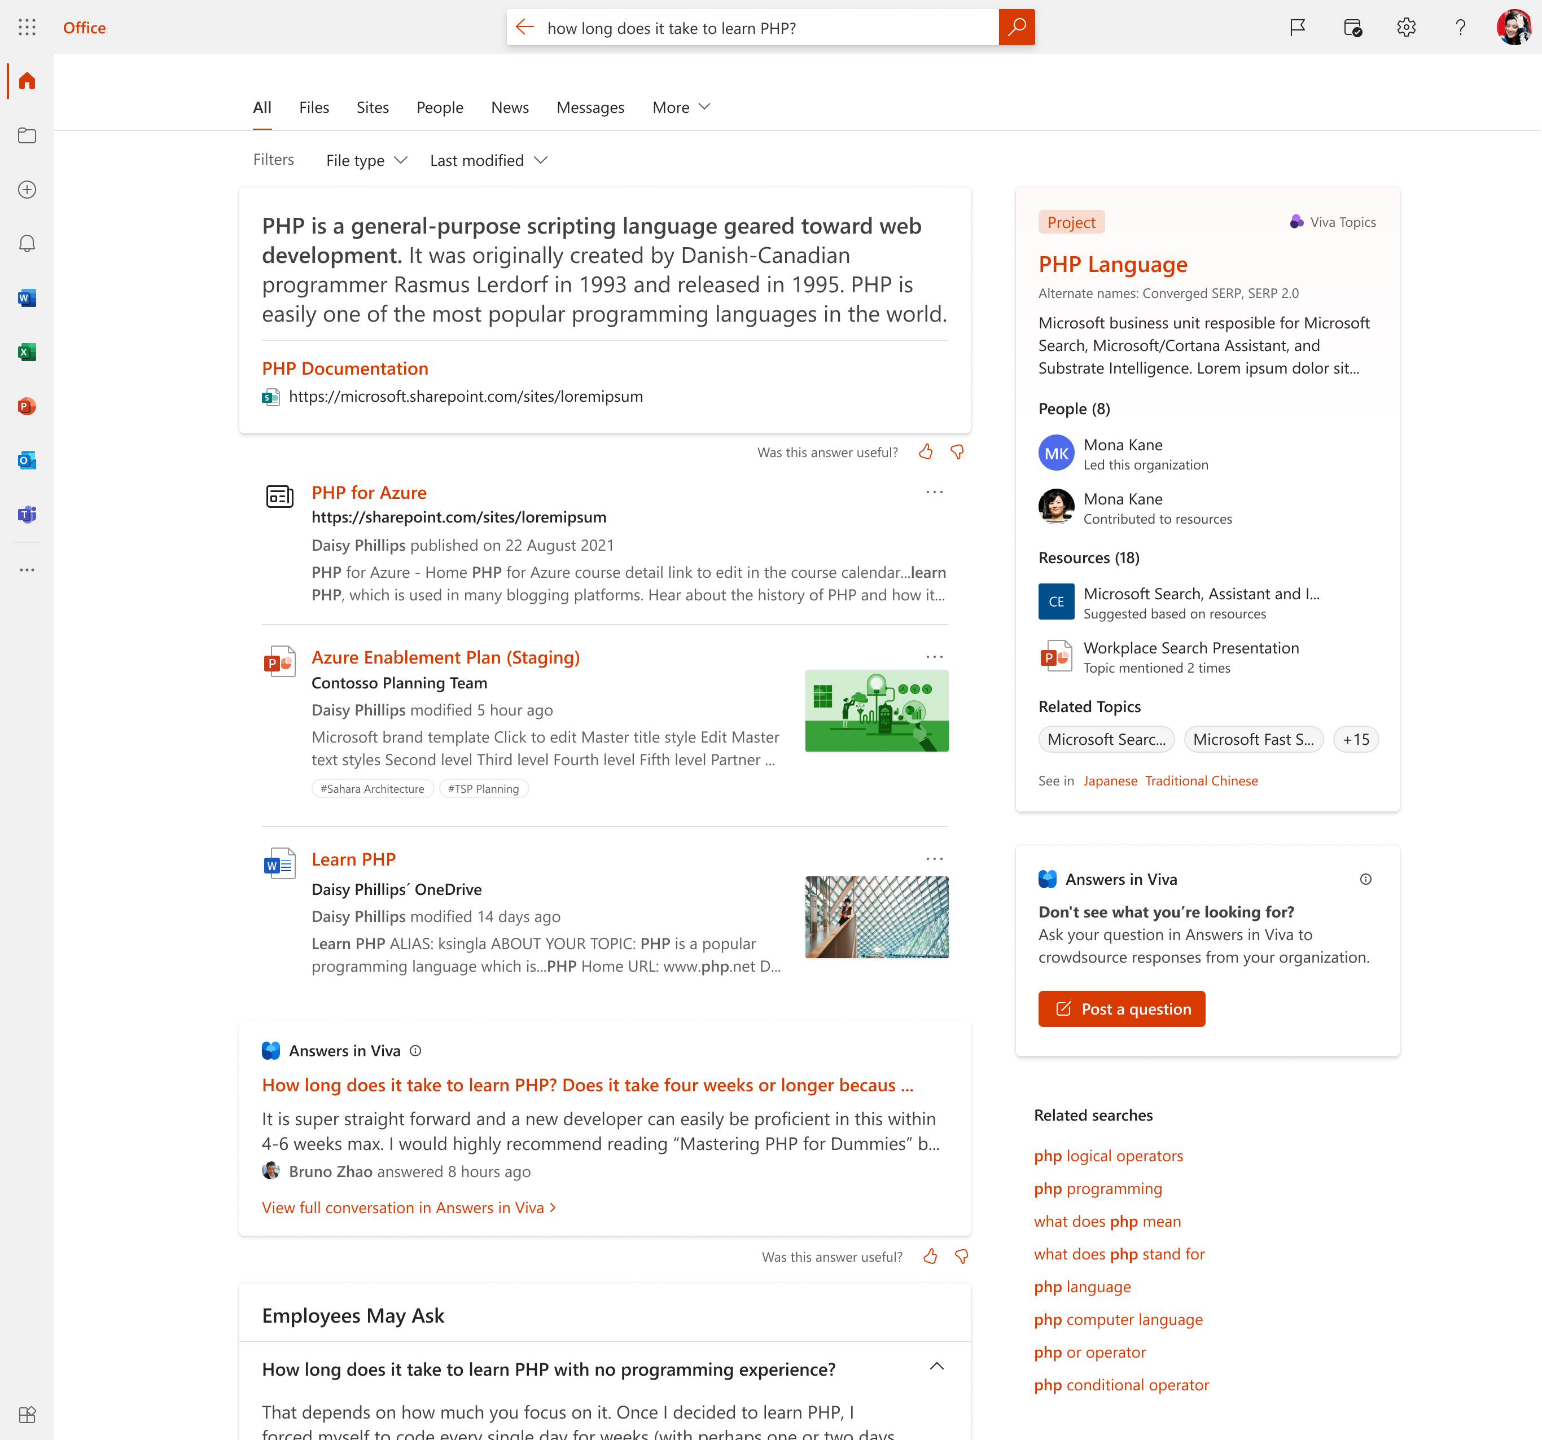
Accessing knowledge in the flow of work
Find existing answers in Search​
Bring Answers content into workplace search, enabling users to get the answers to their questions in the flow of work
Ask a new question from Search​
If users don’t get a satisfactory answer, help them ask the question in Answers.
Now Generally Available
Notes:
Answers in Microsoft Search:
In Sharepoint.com
Office.com
Bing at Work

Slide 38
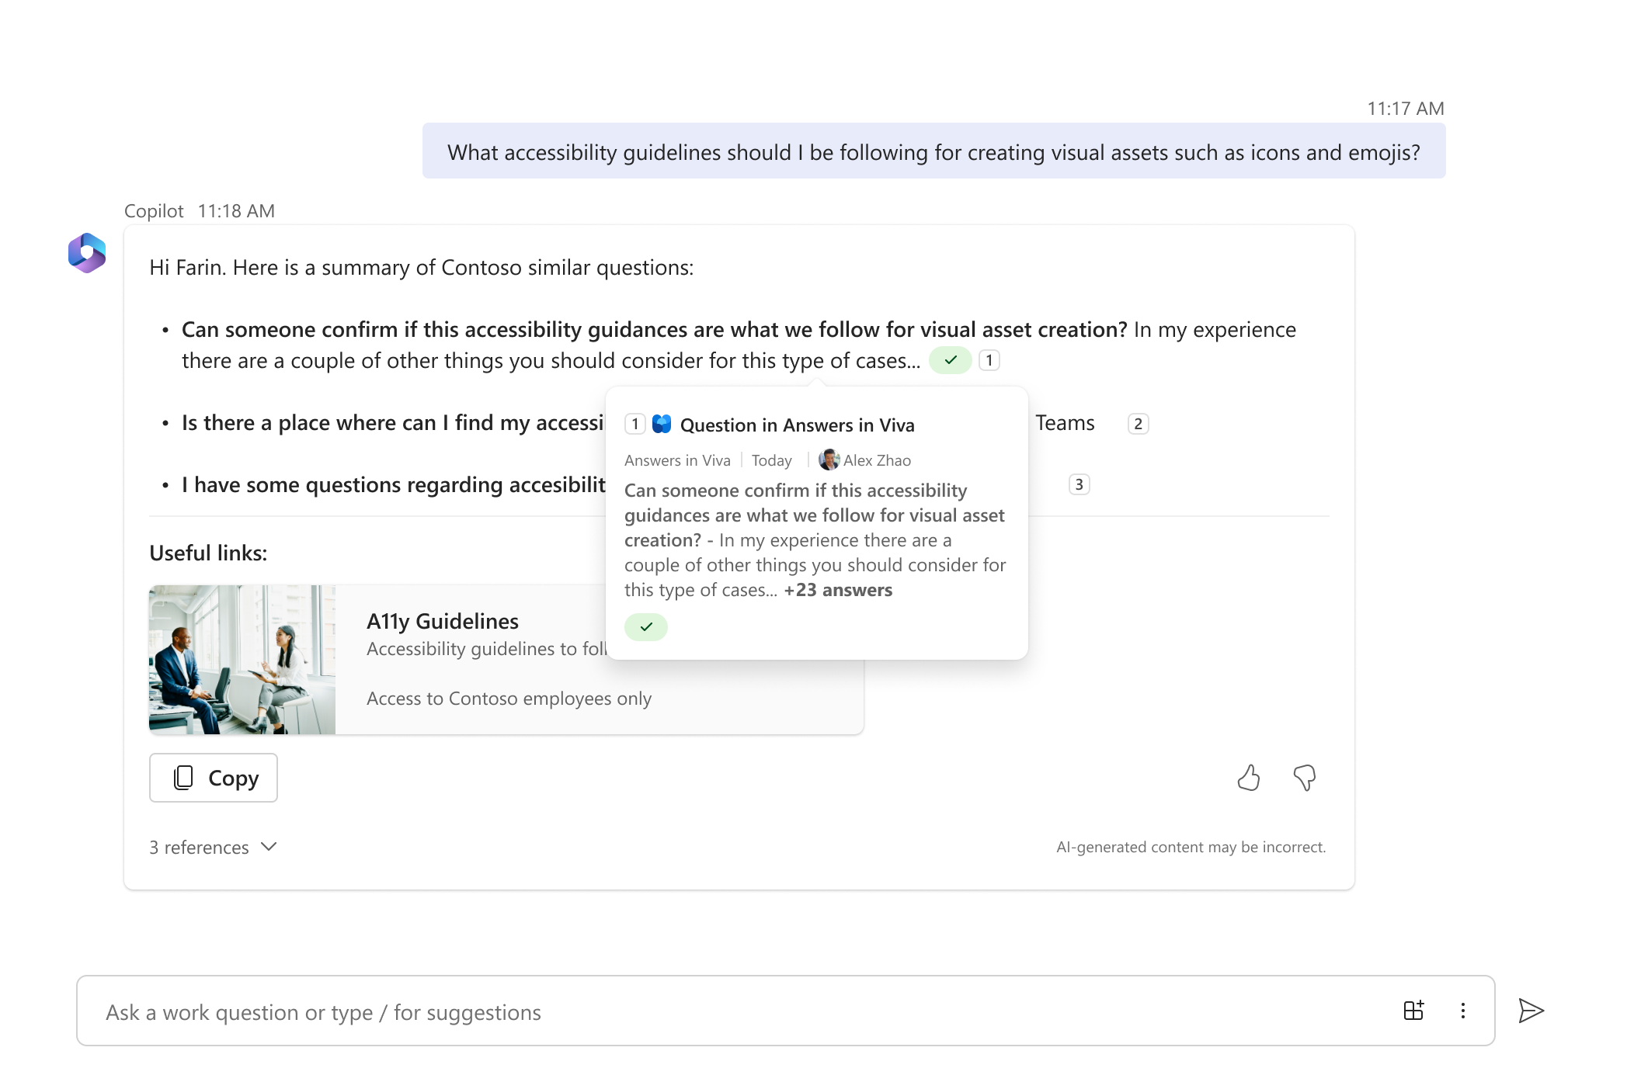
Answers as a content source for M365 Copilot
Answers content as a reference in Copilot generated responses.
Answers content shown directly when an exact match answer is available for a user's question.
Expected: 2024 H2
DESIGN MOCKS
Notes:
M365 Chat Copilot (formerly BizChat)
Most question posts from Engage: From Answers, Engage Communities and Storylines. Into Chat Copilot in June .

Slide 39
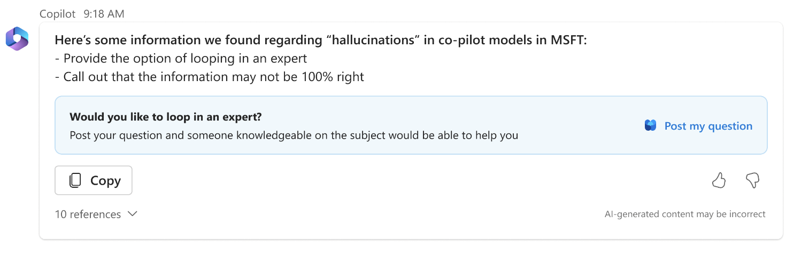
Asking questions from M365 Copilot
Expected: 2024 H2
DESIGN MOCKS

Slide 40
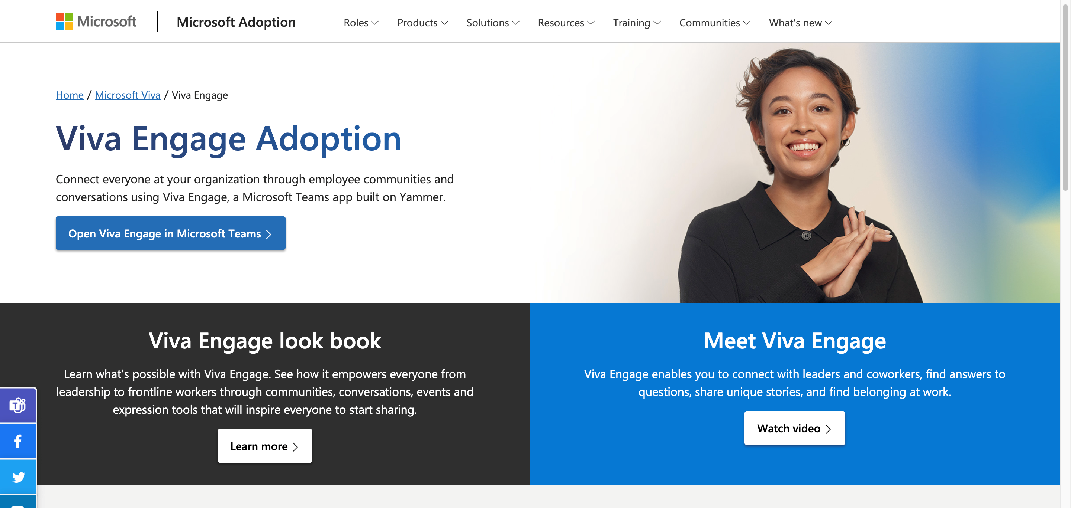
Learn more
  Viva Engage blog
  https://Aka.ms/VivaEngage/blog/
  Adoption resources
  https://adoption.microsoft.com/viva/engage/
  https://adoption.microsoft.com/viva/
  Engage with our customer community
  https://aka.ms/VivaEngage/JoinUs

Slide 41
Microsoft Viva

