Slide 1

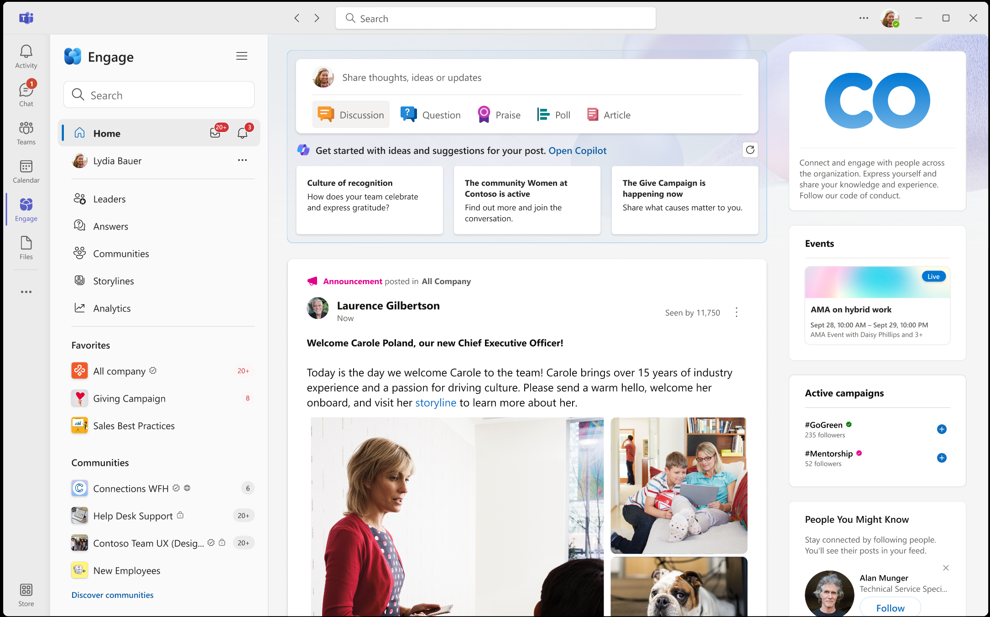
Viva Engage Training Overview
End User Guide
December 2025

Slide 2
Viva Engage Training Overview
End User Guide
December 2025

Slide 3



Communities and Conversations
Communities connect people based on interests, topics, roles, and experiences, and empower the organization to reach and engage employees.
Notes:
Generated by Copilot
Communities are central to connecting people based on shared interests, roles, and experiences. They empower the organization to effectively reach and engage employees by fostering meaningful conversations and collaboration.
______

Slide 4
Meet Viva Engage
Post updates to communities or to your storyline
Engage with your leaders and network!
Communities
View conversations from communities and people you follow
Notes:
Generated by Copilot
Introducing Viva Engage, which enables posting updates to communities or personal storylines, viewing conversations from followed communities and people, and engaging directly with leaders and networks. It’s a tool designed to enhance communication and connection within Danone.
______
Microsoft Viva Engage is the Communities app for Microsoft Teams which brings new capabilities to connect people, find and share knowledge, express yourself, and find belonging at work.

Slide 5
Home Feed: The front door of Engage
Notes:
Generated by Copilot
The Home Feed acts as the main entry point to Engage, providing a personalized stream of content tailored to each user. The screenshot illustrates the user interface where employees can access relevant updates and conversations.
______

Slide 6
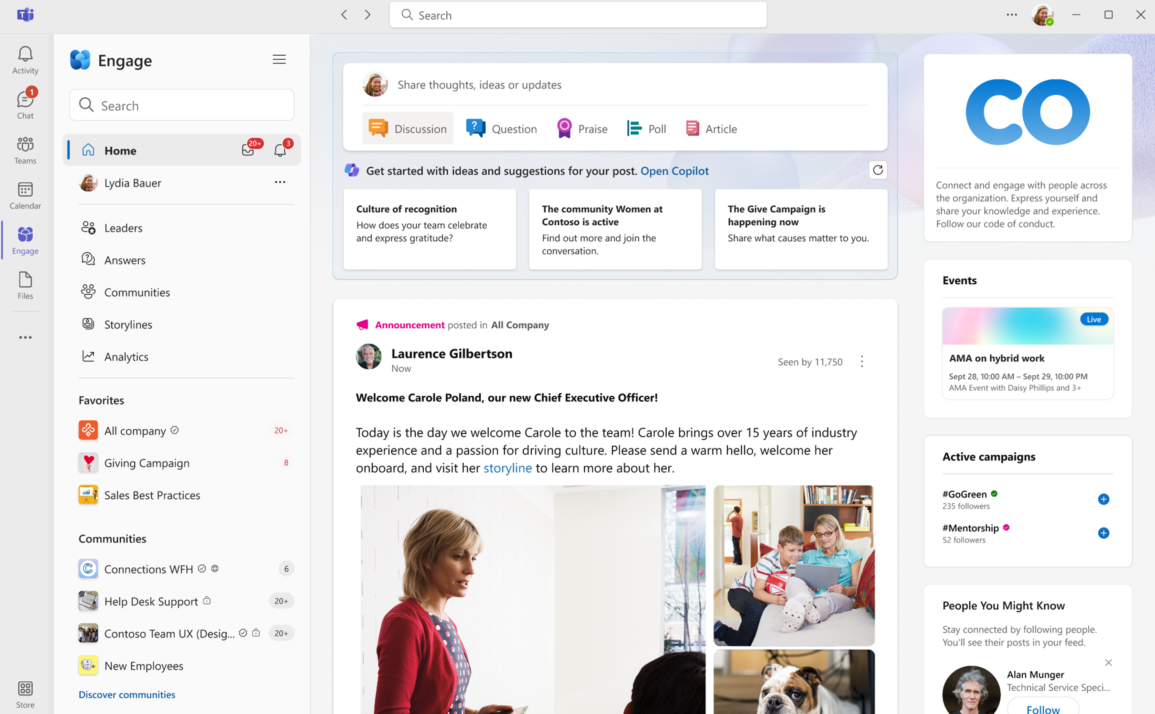
How the Home Feed works
Everyone’s feed is personalized
Content is ranked based on a range of factors, including:
Community membership
User relationships, recent interactions
Likelihood of engaging with specific conversations
Featured conversations, announcements, muting
Read more: Viva Engage Explained: The Feed | Microsoft Community Hub
Notes:
Generated by Copilot
The Home Feed personalizes content based on factors like community membership, user relationships, recent interactions, and engagement likelihood. It also features announcements and allows muting of less relevant content, ensuring users see what matters most to them.
______

Slide 7
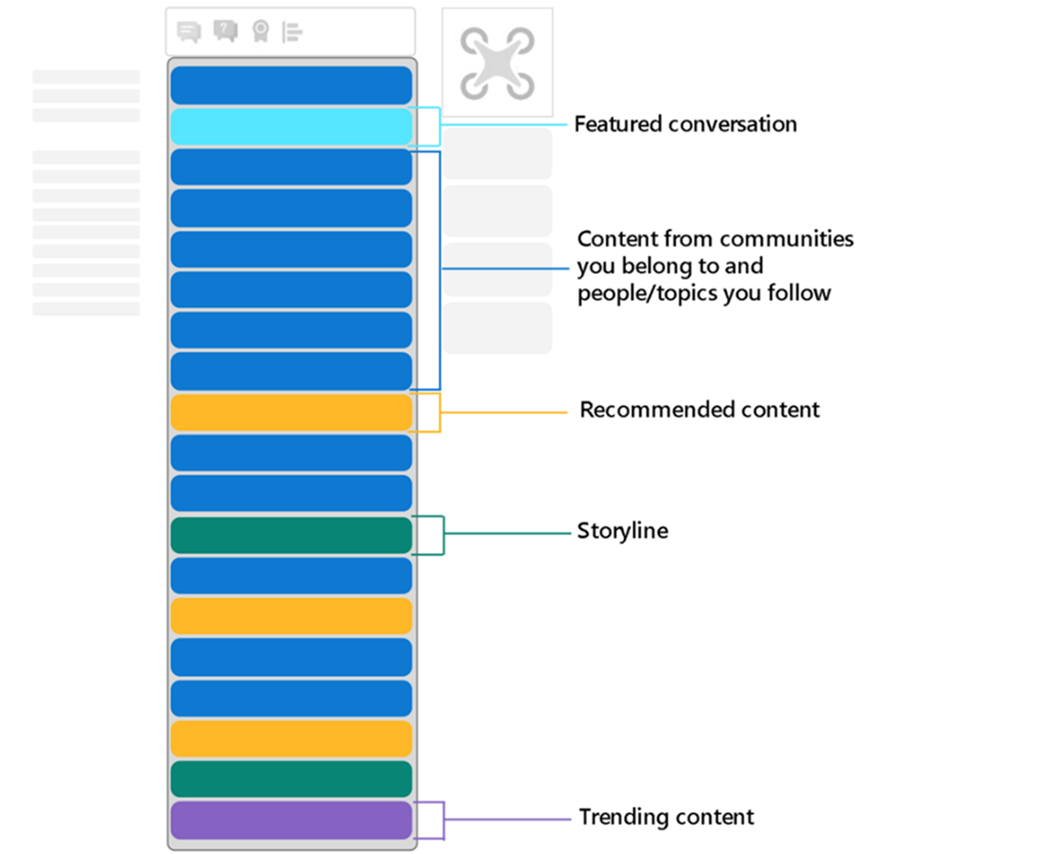
Why the Home Feed is so powerful
Engage suggests content, communities, and people based on relevance
Communicators can push content into the feed (announcements, featured conversations, and more)
Notes:
Generated by Copilot
The power of the Home Feed lies in its ability to suggest relevant content, communities, and people, enhancing user engagement. Communicators can also push important announcements and featured conversations directly into the feed to maximize visibility.
______

Slide 8
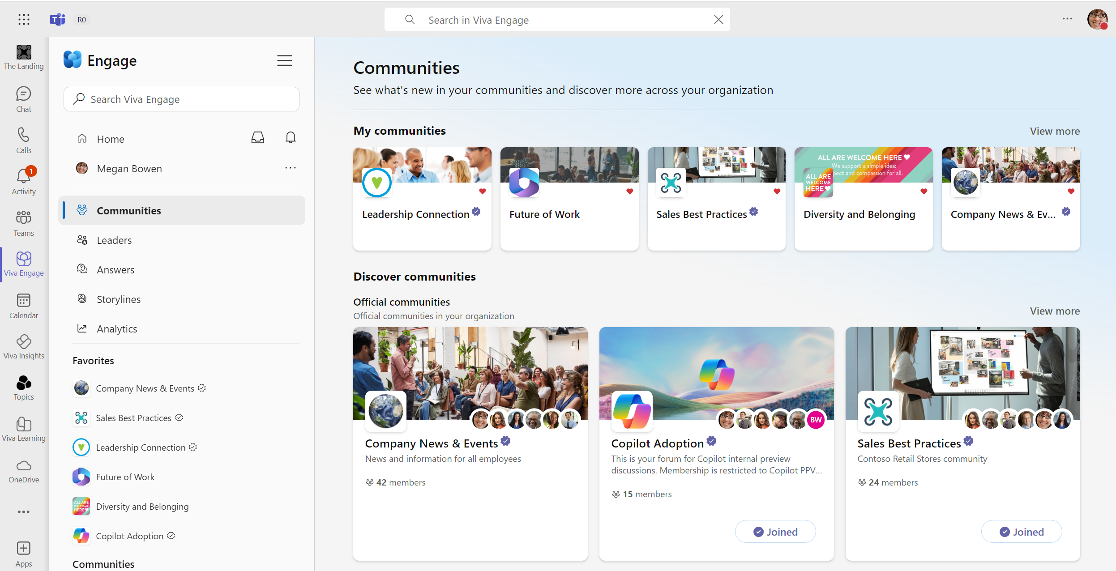
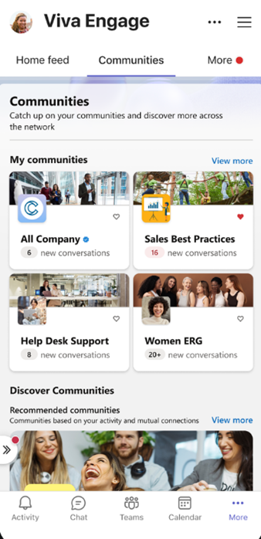
Connect & participate with your communities
Exchange ideas, insights, and news
Post messages in your community and upload a cover photo to welcome people.
Ask questions and mark answers
See what’s top of mind by filtering the community by questions or unanswered questions.
Ask for feedback
Crowdsource employee solutions to common problems and customer issues.
@mention subject matter experts
Pull knowledgeable employees into the conversation to respond to questions.
Communities with engaged admins gain 3x more monthly members compared to communities without
Notes:
Generated by Copilot
Active participation in communities is encouraged through sharing ideas, posting messages, and asking questions. Engaged community admins significantly increase member activity, highlighting the importance of leadership in fostering vibrant communities.
______

Slide 9

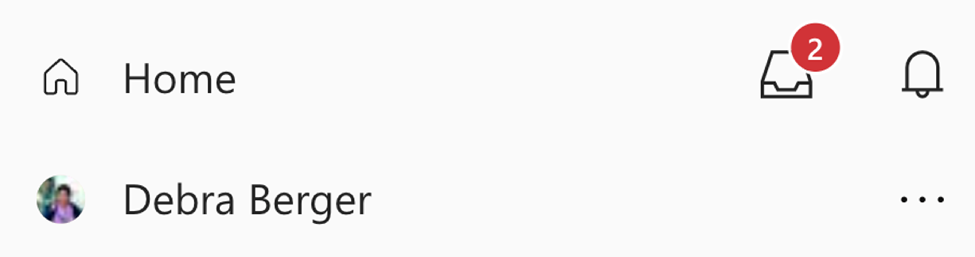

How notifications work
Inbox
Mentions, replies, private messages
Action required
Time-sensitive information that needs attention
Bell
Reactions, completed actions
No immediate action needed
Not time-sensitive updates for awareness
Notes:
Generated by Copilot
Notifications are categorized to help users prioritize. The Inbox delivers action-required, time-sensitive messages like mentions and private messages, while the Bell provides awareness updates such as reactions and completed actions that don’t require immediate attention.
______

Slide 10
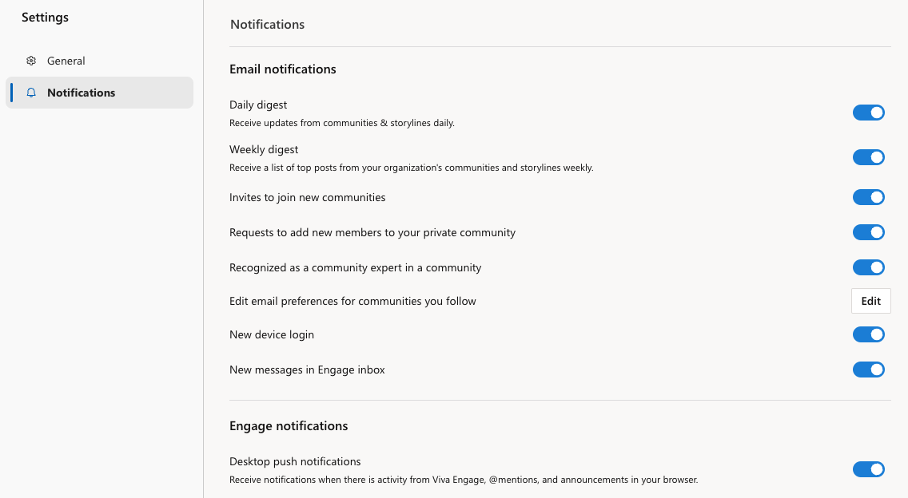
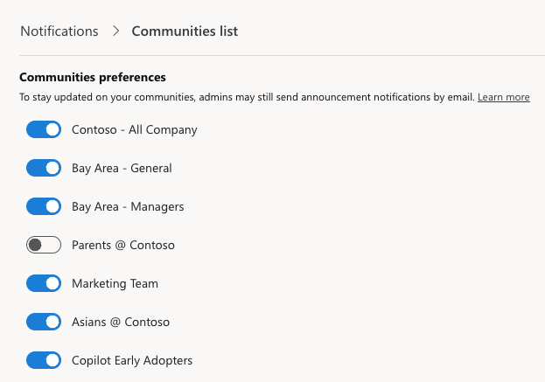
Personalizing Email Notifications
Personalize the specific actions or communities you’d like to receive updates for via email.
Personalize how and what you are notified for
Read more: Viva Engage Explained: Notifications | Microsoft Community Hub
Notes:
Generated by Copilot
Users can personalize email notifications to control which actions or community updates they receive. This customization helps manage information flow and ensures relevant updates are delivered in a preferred manner.
______

Slide 11
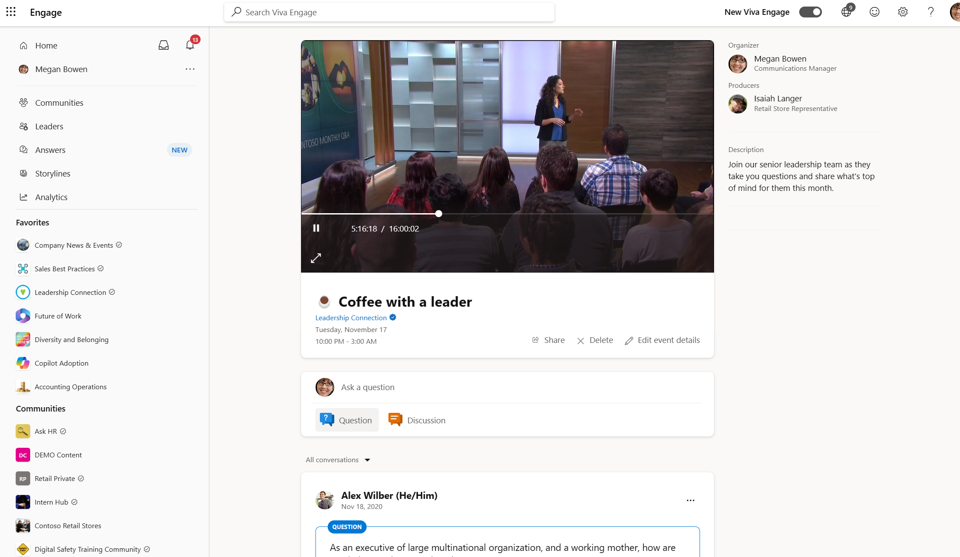
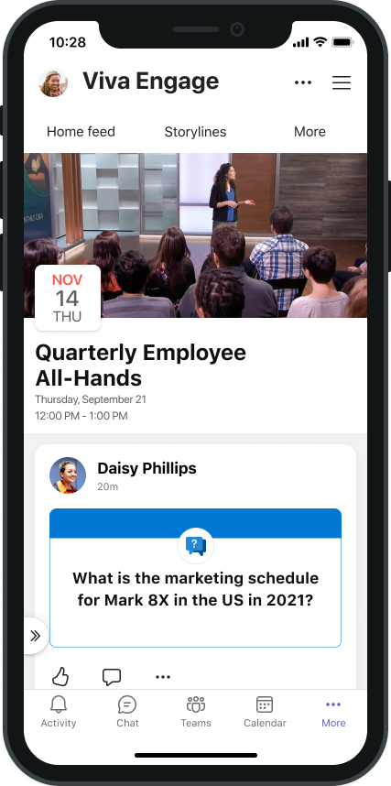
Broadcast virtual events and townhalls
Host virtual events with up to 20K attendees with a simple webcam and screen sharing or studio quality productions
Invite and pin questions and conversations before, during, and after the event.
Support every attendee with caption,
recordings, and assistive technologies.
View real-time metrics and insights to
understand reach and attendee engagement.

Slide 12
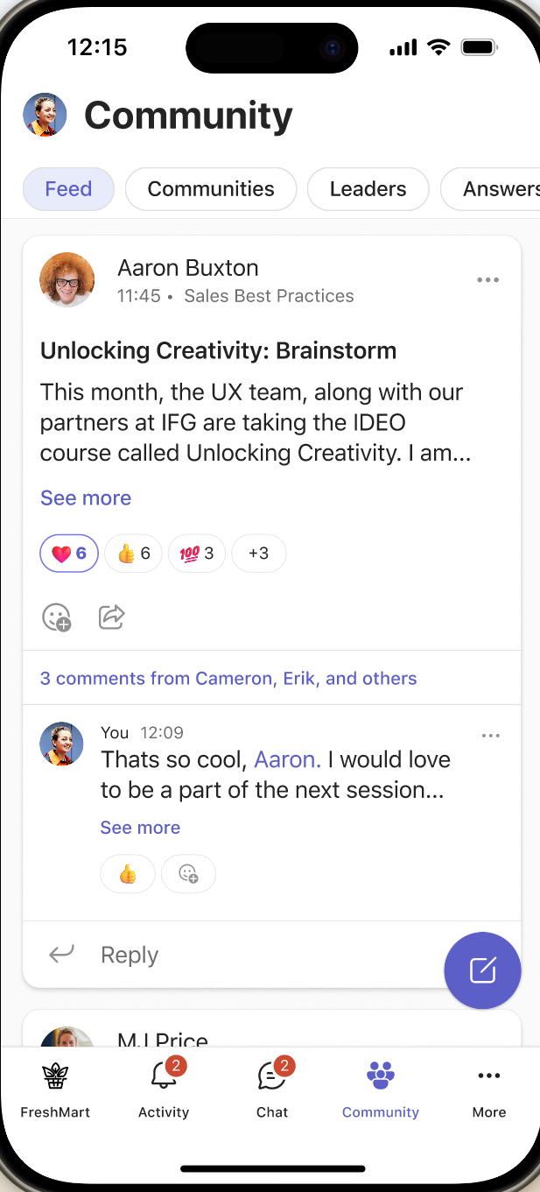
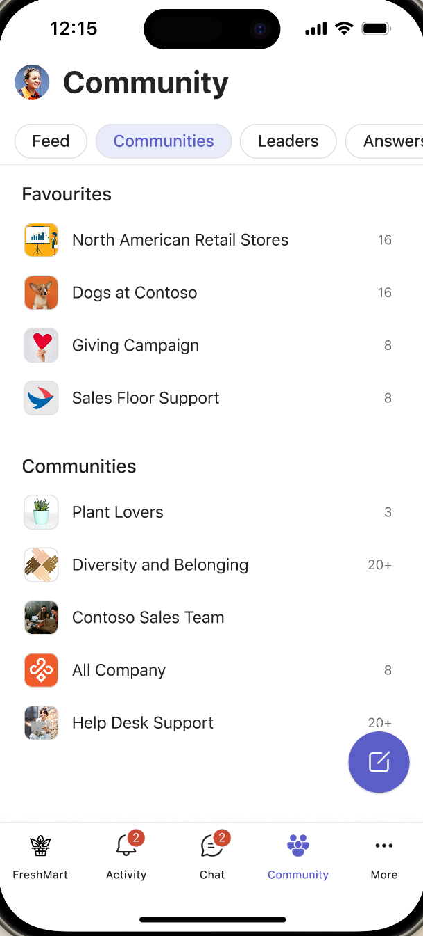
Find communities via the Teams Mobile App
In your phone’s app store, search and download Microsoft Teams.
Sign in using your work email and password.
Notes:
Generated by Copilot
Employees can access communities on the go via the Microsoft Teams mobile app. After downloading and signing in with work credentials, they can stay connected and engaged anytime, anywhere.
______
*Some experiences will open in web experiences or Viva Engage mobile app.

Slide 13
Storyline
Storyline in Engage empowers everyone to share personal experiences, learn from leaders, and build authentic connections.

Slide 14
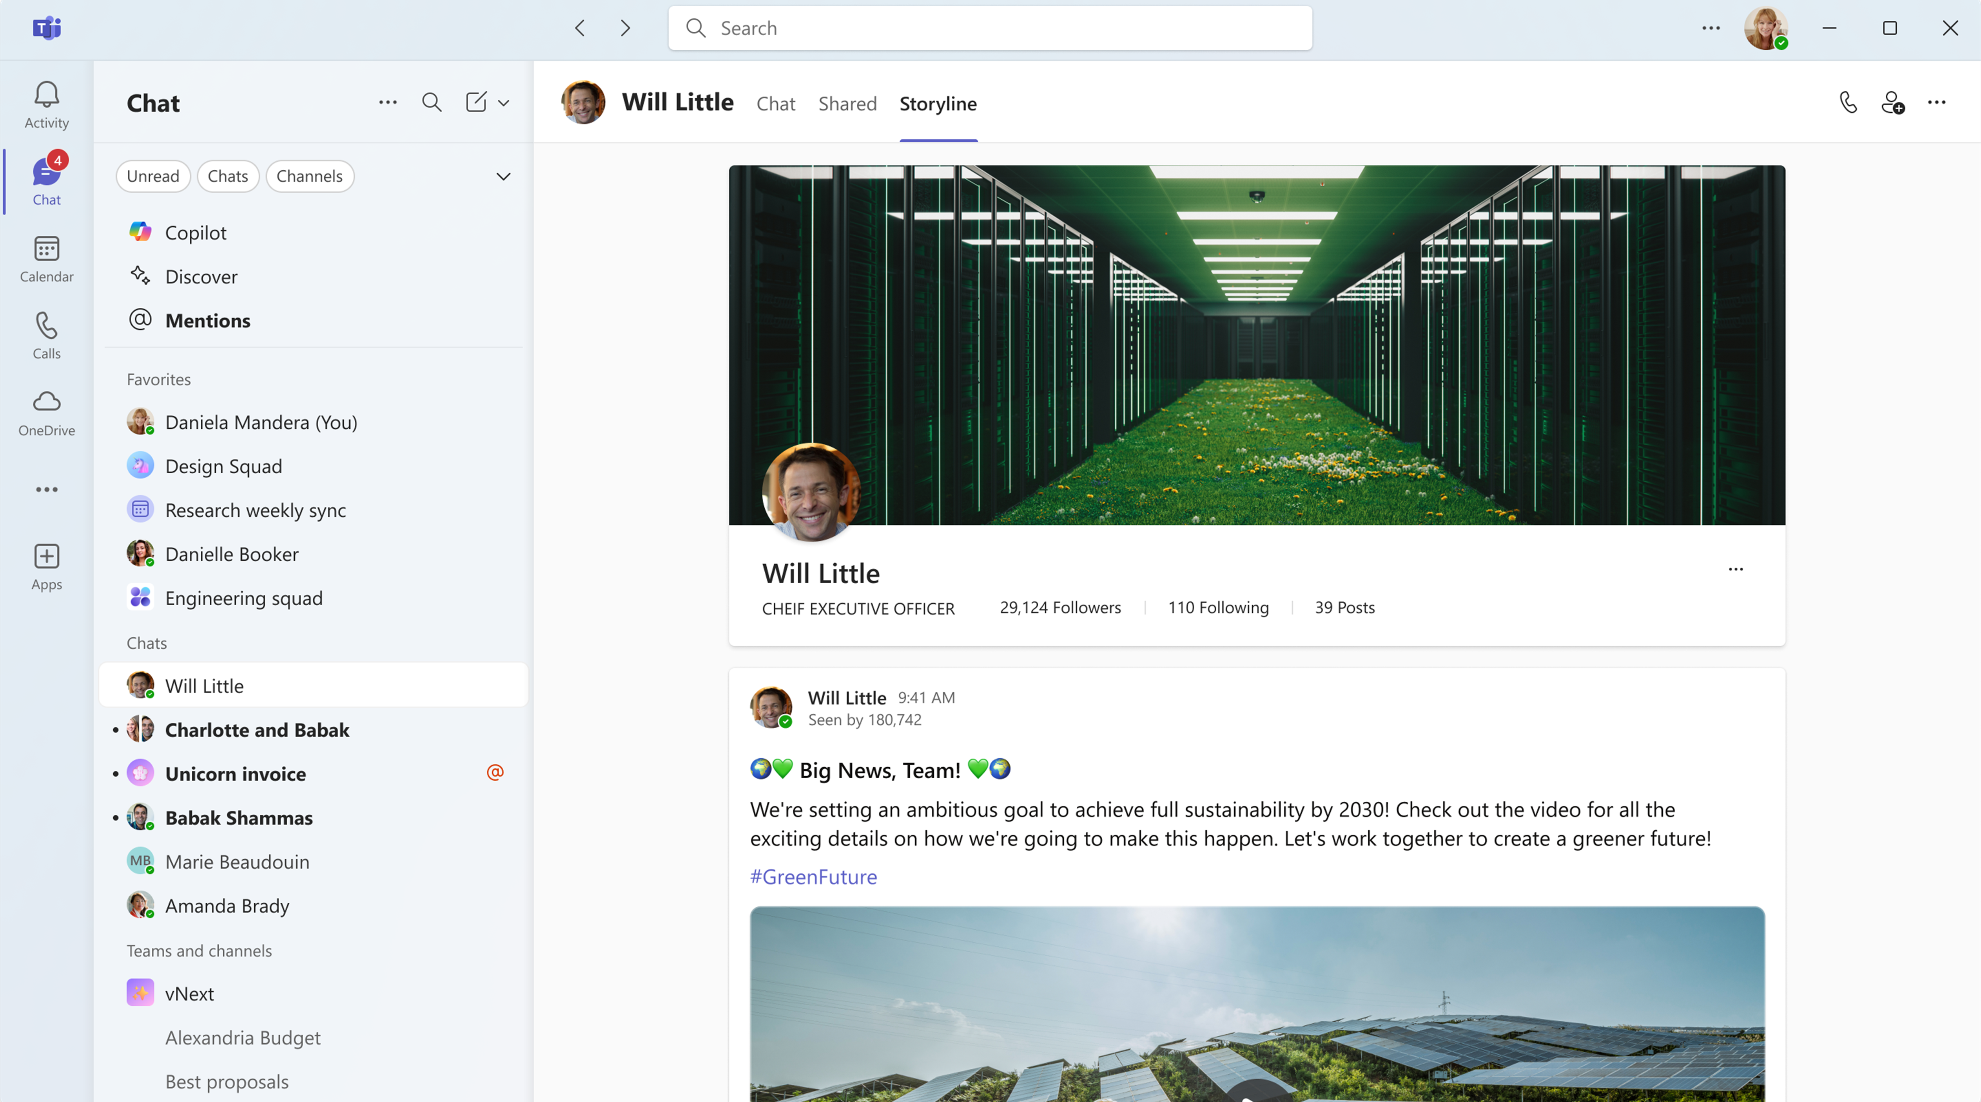
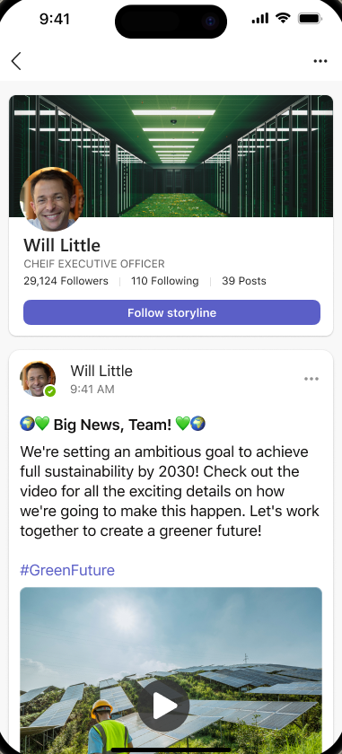
Today, you can tell your story at work
Share work experiences, build connections, and express yourself. ​
Use posts, video, and images to share perspectives & updates with people across the organization.​
Find, follow, and engage with leaders and experts. ​
Connect and build your personal network to grow professionally and amplify your impact.

Slide 15
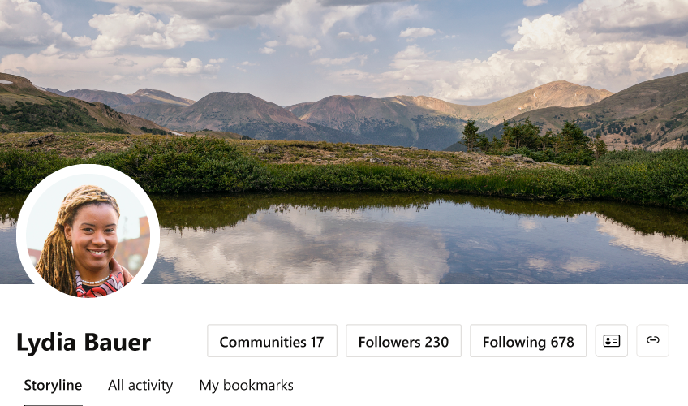
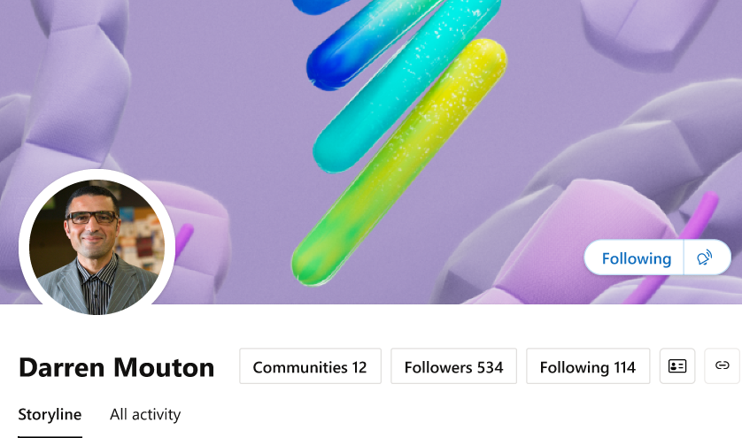
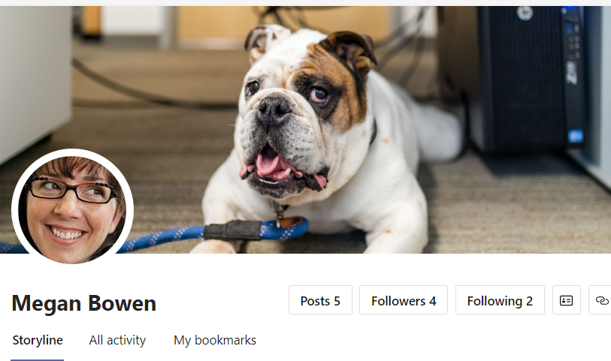
Add a Cover Photo
Personalize your cover photo to express yourself.
Pro Tip: The web cover photo dimensions are 680 px by 275 px. The file must be 20 MBs or less and either a .PNG, .JPEG, or a non-animated .GIF.
Notes:
Generated by Copilot
Personalizing your profile with a cover photo helps express individuality. Recommended dimensions and file types ensure optimal display. This visual personalization enhances community presence and engagement.
______

Slide 16
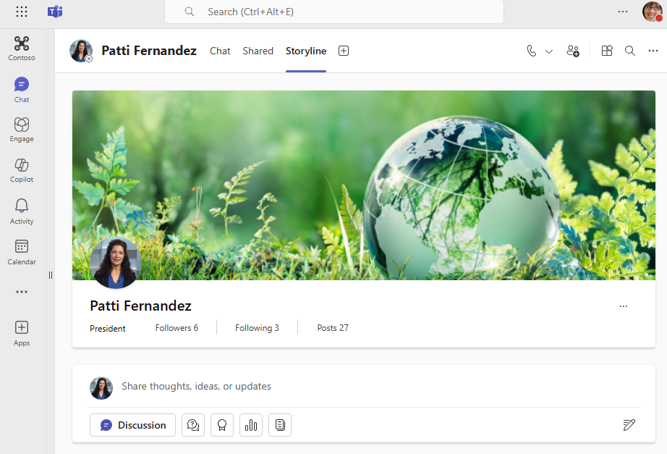
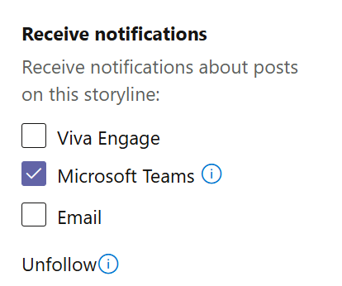
Follow people
Follow leaders and co-workers directly from their profile.​
Follow colleagues directly from the home feed or from their profile. ​
Opt-in to notifications when they share updates.​
View the feed or following feed for storyline content.

Slide 17
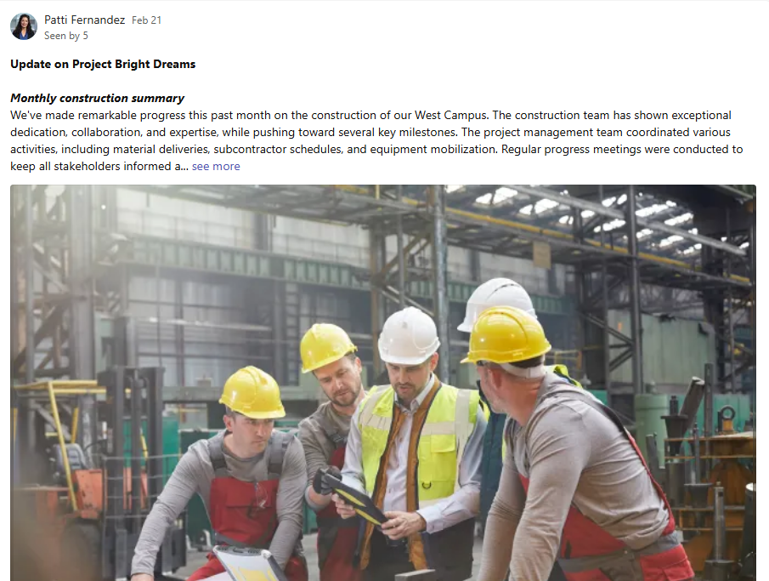
Share updates
Post meeting highlights: Capture the highlights of your last business trip, conference, and share on your storyline. Tag a few people who can help with any feedback you received.
Showcase customer wins and best practices. Post links to external customer stories and resources that helped secure the win.
Notes:
Establish Thought Leadership: Share insights, industry knowledge, and expertise to position yourself as a leader in your field.
Engage with Your Audience: Respond to comments, participate in discussions, and provide valuable feedback to build a strong reputational network.
Example: Write posts about recent trends in your industry, share case studies, or provide commentary on relevant news articles.

Slide 18
Participate in conversations
In communities or on your storyline, share learnings and ask questions and join the conversation.
Notes:
Generated by Copilot
Encouraging active participation, employees are invited to share learnings, ask questions, and engage in conversations both within communities and on their personal storylines, fostering a collaborative environment.
______

Slide 19


Engagement Tactics
Create a simple engagement plan, content plan or campaign idea for your community.
Host meet ups or live events with the community. Post recaps or learnings from the meetings to keep the community informed.
Engage a leader who is passionate about the topic or subject matter to host a chat, or to be active within the community. (1-2-3 rule)
If it’s been a while since any activity, send a note to the community members via email to share about upcoming programs and events.
Stuck? Ask Copilot for some ideas!

Slide 20

Community Admin checklist
Welcome new members to the community
Check new posts are in the correct community and are on-topic
Check for unanswered questions or unresolved conversations, @mention people who can help
Encourage people to share their experiences and learnings on Viva Engage
Post something new weekly to keep the conversation going, use a campaign or conversation starter to keep up the momentum

Slide 21
Sample conversation starters
Set the tone by asking questions and leading by example.
Connect
Career Related
Reflection
What do you need help with this week?
What are your favorite sources of information related to this community?
Who should be part of this community and isn’t yet?
Why are you part of this community?
What’s your favorite part about your job? What’s your least favorite?
How did you get into your current position?
What’s one thing that surprised you when you took your position?
Is there something that people consistently ask you for help with? What is it?
This is what I learned today/week…
This is how I spent my day…
This is how I decided…
What do I know now that I didn’t know when I started…
What are ways Copilot can help you?

Slide 22

Community Conversation starters via Copilot
Copilot
Sure! Here are some conversation starters tailored for your community of busy, tech-savvy professionals who support customers:
Technology Adoption:
  “What new technology have you recently adopted that has significantly improved your workflow?“
  “How do you stay updated with the latest tech trends and tools in our industry?“
Customer Support:
  “What strategies do you find most effective in providing exceptional
  customer support?“
  “Can you share a recent experience where you went above and beyond to help
  a customer?“
Productivity Tips:
  “What productivity tools or apps do you swear by to manage your
  busy schedule?“
  “How do you balance adopting new technology while maintaining high productivity levels?“
Challenges and Solutions:
  “What is the biggest challenge you face in your role, and how are you
  addressing it?“
  “Have you encountered any tech-related issues recently? How did you
  resolve them?“
Collaboration and Teamwork:
  “How do you ensure effective communication and collaboration within
  your team?“
  “What tools or practices do you use to keep your team aligned and motivated?“
Learning and Development:
  “What online courses or certifications have you found valuable for your professional growth?“
  “How do you prioritize continuous learning amidst your busy schedule?“
Feedback and Improvement:
  “How do you gather and implement feedback from customers to improve
  your services?“
  “What methods do you use to measure and enhance customer satisfaction?
Copilot
Draft some conversation starters for my community. People who are in this community are typically [X], [Y], [Z]. Include a clear call to action.

Slide 23
Content plan sample from Copilot
Copilot
Sure! Absolutely, Allison!
Here’s a weekly engagement plan for a community manager that aligns with each day of the week:
Monday: Motivation Monday
  Post an inspirational quote or story to kickstart the week on a positive note.
  Share a success story from the community or highlight a member’s achievement to motivate others.
Tuesday: Tip Tuesday
  Share a useful tip or best practice related to the community’s focus. This could be a productivity hack, a new feature in Viva Engage, or a relevant industry insight.
  Encourage members to share their own tips and tricks in the comments.
Wednesday: Wellness Wednesday
  Post content related to wellness, such as a short article on work-life balance, a mindfulness exercise, or a healthy recipe.
  Host a virtual wellness activity, like a short meditation session or a discussion on wellness topics.
Thursday: Throwback Thursday
  Share a “throwback“ post, such as a memorable event, a past success story, or an old photo from a community event.
  Invite members to share their own throwback memories related to the community or their professional journey.
Friday: Fun Friday
  Post a fun activity, such as a quiz, a poll, or a “Two Truths and a Lie“ game. This can be related to Viva Engage or just for fun.
  Share a light-hearted post, like a funny meme, a joke, or a feel-good story to end the week on a high note.
Copilot
Draft a weekly content plan for my community. Include some fun. And some alliterations.

Slide 24
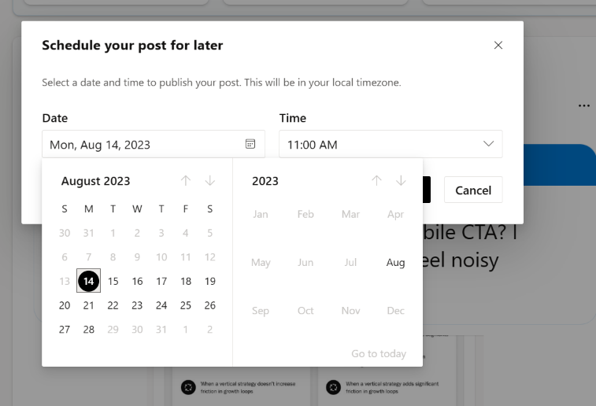
Schedule messages and plan ahead
Build consistency around conversations and optimize for your target audience.
Anticipate global reach and maximize likelihood of engagement.
Pro tip: Tuesdays are the best day to post for high engagement.

Slide 25
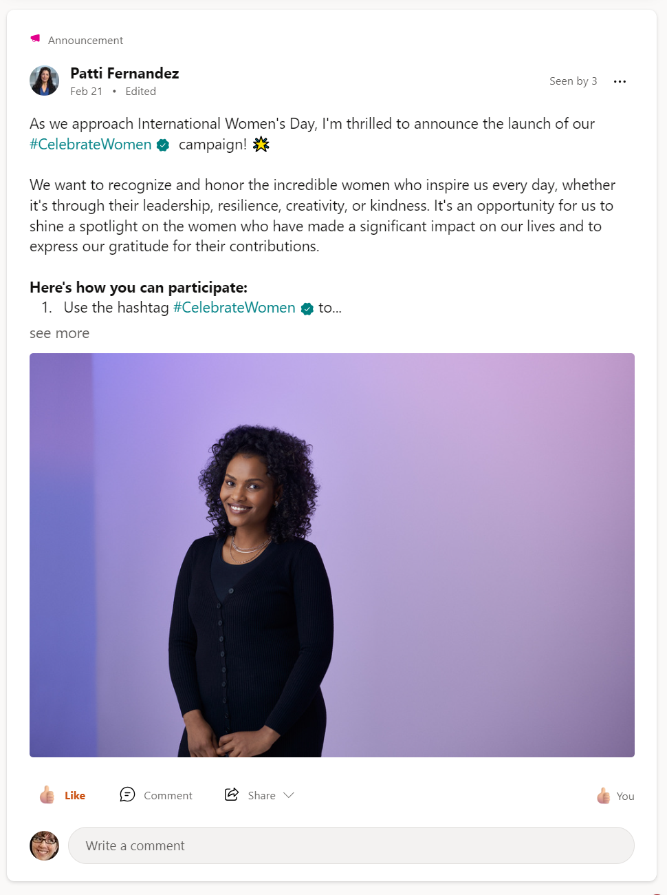
Send an announcement
View insights understand the impact and reach of the announcement.
Community admins can mark any post type (including questions and polls) as an announcement to share information with the entire community and maximize reach.
Members will see a notification about the announcement within Viva Engage, Outlook, and Microsoft Teams.
Pro tip: Admins can send Priority Announcements to override any user level notifications setting.

Slide 26
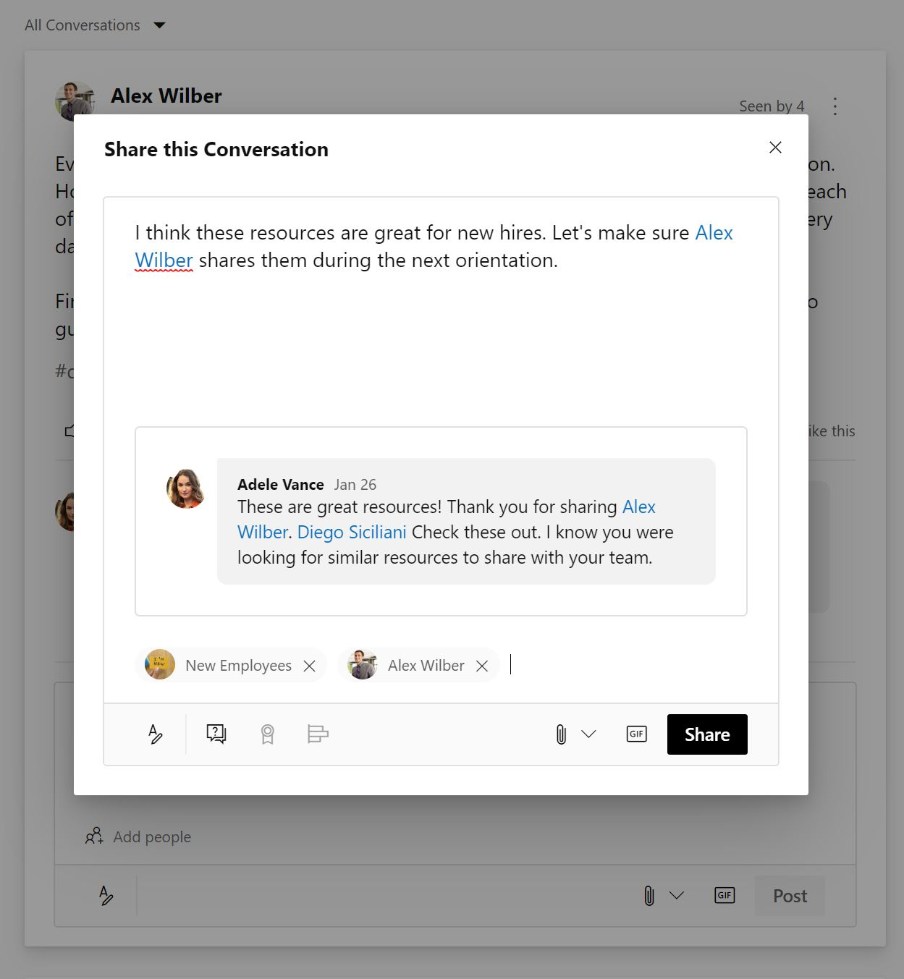
Share a conversation
Share conversation across communities or to your storyline to add even more voices to the conversation.
Sharing builds on existing conversations instead of fragmenting them around the same topic.
Select the community or your storyline.
Pro tip: The number of times that the conversation has been shared is displayed at the top of the thread.
Notes:
Generated by Copilot
Sharing conversations across communities or to your storyline helps consolidate discussions and amplify voices. The platform tracks how often conversations are shared, encouraging broader engagement without fragmenting topics.
______
On an existing post, click Share.
In the window, select Post in a Community or Send Private Message.
Enter a personalized message in the Say something about
this conversation box.
If you are sharing to a community, Select a community from the drop-down menu.
Notify specific people and Add files, if you like.
Click Share.

Slide 27
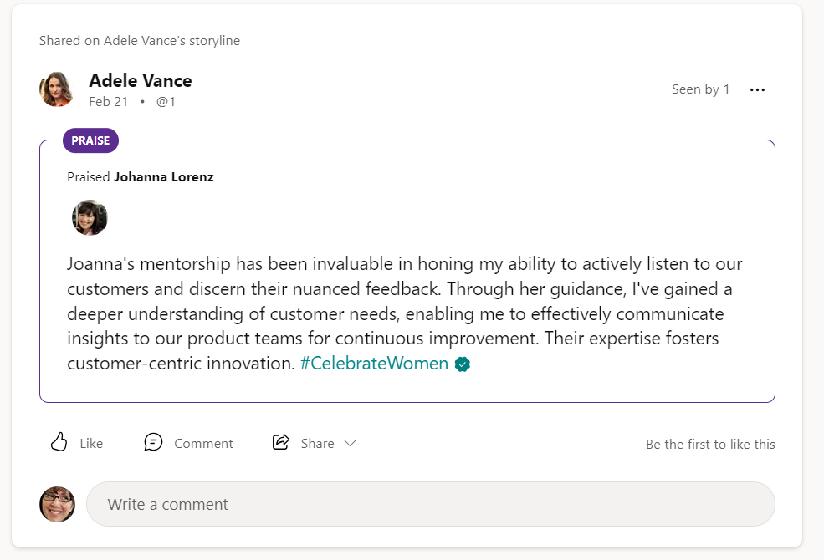
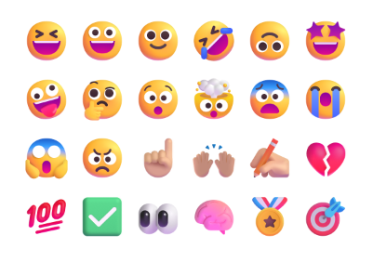
Praise a coworker
Good work should always be recognized.
Praise people in your community who have shared valuable business knowledge or skills or celebrate successes on your storyline.
Add reactions!
Pro tip: You can praise multiple people in the same post.
Notes:
Generated by Copilot
Recognizing good work publicly is vital. Praising coworkers in communities or on storylines celebrates valuable contributions and successes. Multiple people can be praised in one post, and reactions add an extra layer of appreciation.
______
At the top of the community page, select Praise to display the Praise dialog box.
Enter the name of the person you want to praise in the top box. You can enter more than one name.
Enter your message in the lower box, where it asks, What are you praising them for?
It’s a good idea to add the person’s supervisor to the Add people to notify box so they have visibility into a job well done.
Attach a file or Add Topics, if you like. When done, click Post.

Slide 28
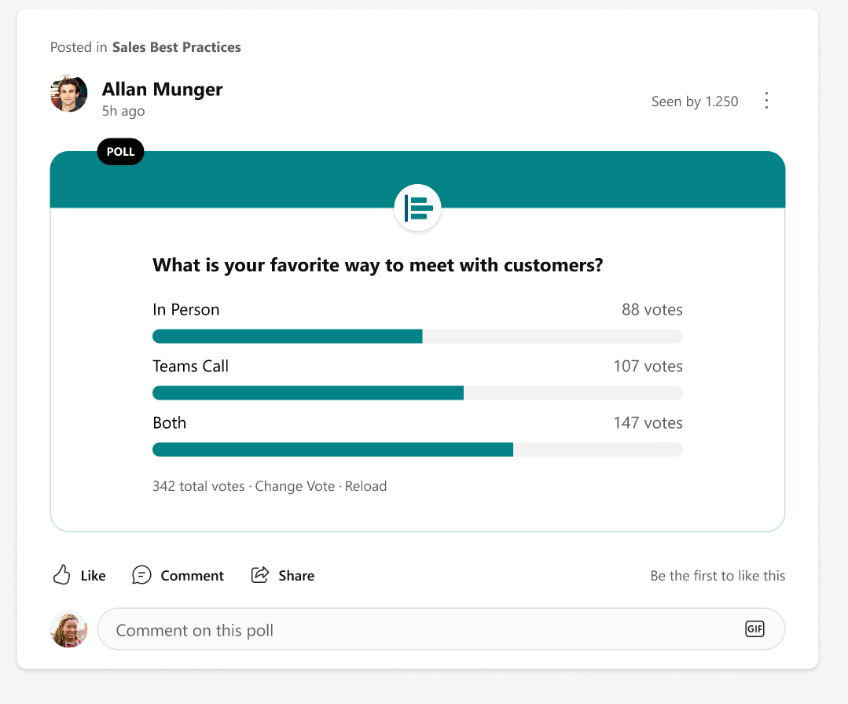
Create a poll
Need to quickly crowdsource feedback, or want to get a pulse on your company?
Use polls to create a quick survey and get answers fast.
See how many people voted.
Pro tip: You can have up to 10 responses to a poll.
Notes:
Generated by Copilot
Polls are a quick way to gather feedback or gauge sentiment across the company. They support up to 10 response options and provide visibility into participation, enabling fast and effective decision-making.
______
At the top of the community page, click Poll.
Type your question and options for answers. Click Post.
Your collaborators can vote on your poll by selecting an answer option and clicking Vote. You can always change your vote if needed.
Once posted, click Go to results, Change vote or Reload.

Slide 29
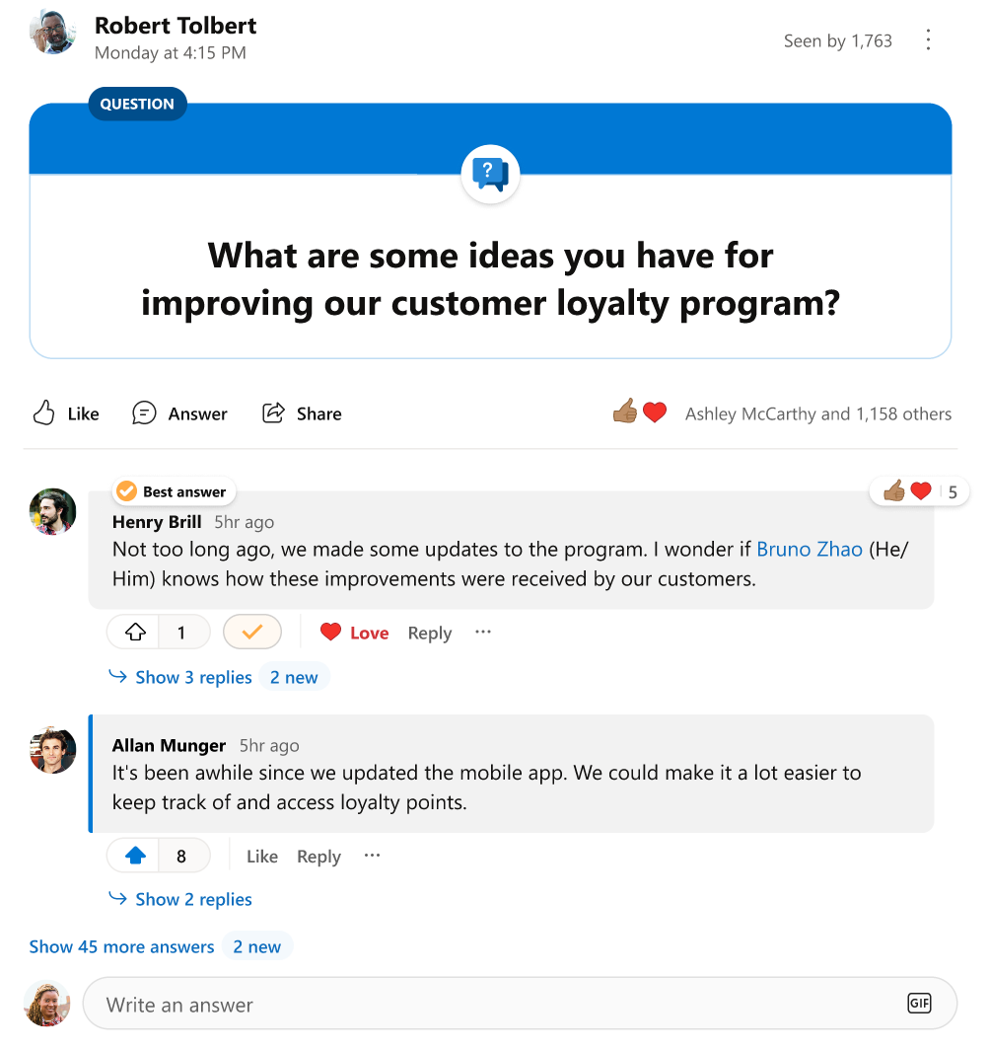
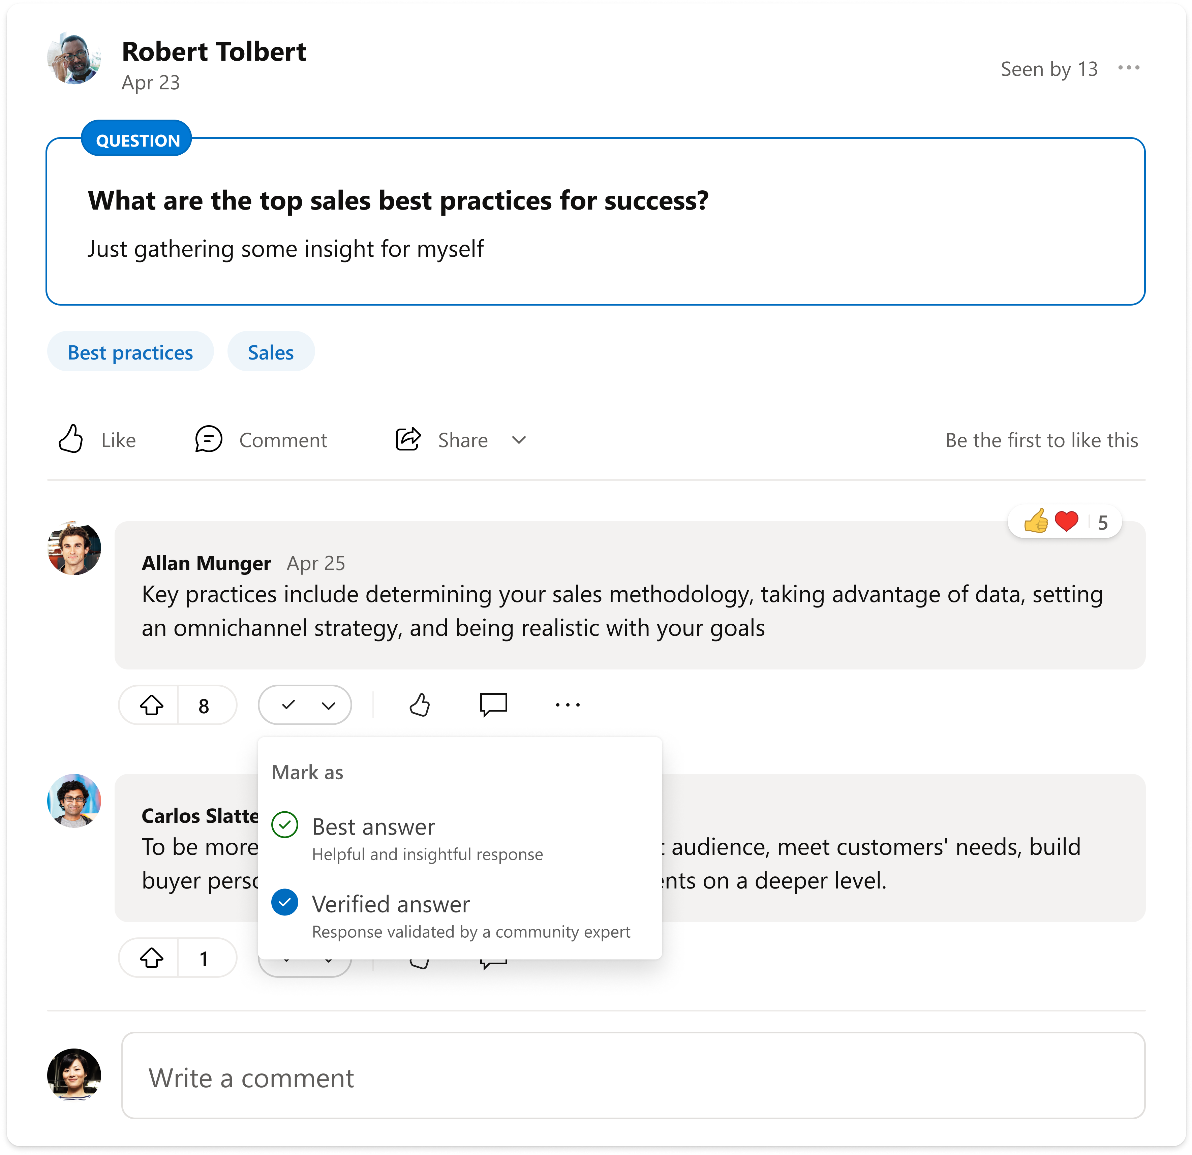
Ask a question
Use a question to ask to get answers fast. Upvote quality answers and mark Best Answer when you’ve received the correct answer.
Questions in a community can be filtered so you can see other questions that still need answers.
Mark Best answer on questions
Mark Verified answer on questions (NEW!)
One label displayed at a time
Endorsed answers are pinned to the top of the thread
The original poster or a community admin can mark as best answer.
Pro tip: You can covert a regular post to a question.
Notes:
Generated by Copilot
Questions facilitate fast answers by allowing users to upvote quality responses and mark the best answer. Posts can be converted into questions, and community admins or original posters can designate the best answer to ensure clarity.
______
At the top of the community page, click Question.
Type your question.
Click Post.
Your colleagues can reply or @mention someone who may have the right answer.
Once you’ve received the correct answer, mark Best Answer.

Slide 30
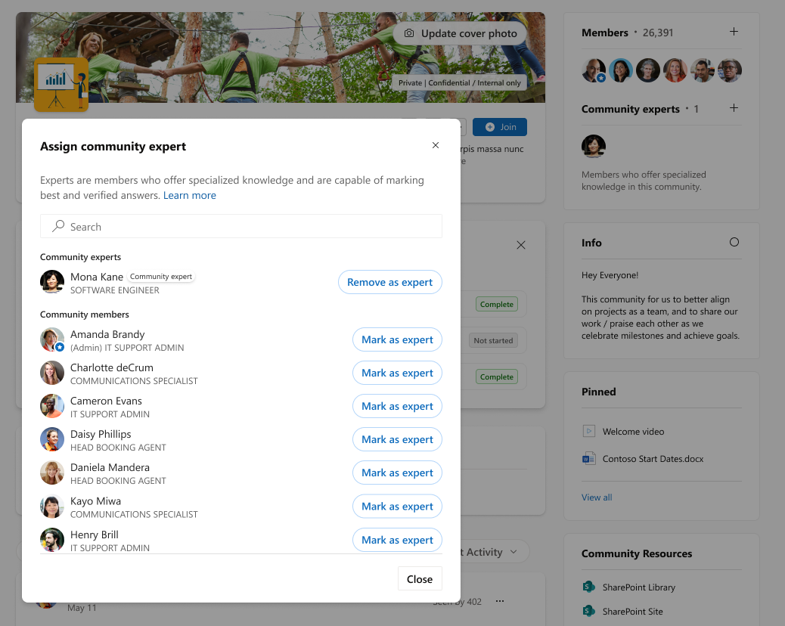
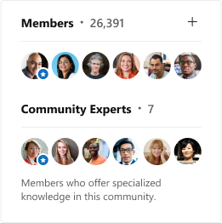
NEW! Assign experts in communities
Community admins can designate experts in their communities.
New expert abilities:
Mark best answer on questions
Mark an answer as Verified
(coming soon)
Get an expert tag next to their name
Be recognized in the expert section

Slide 31
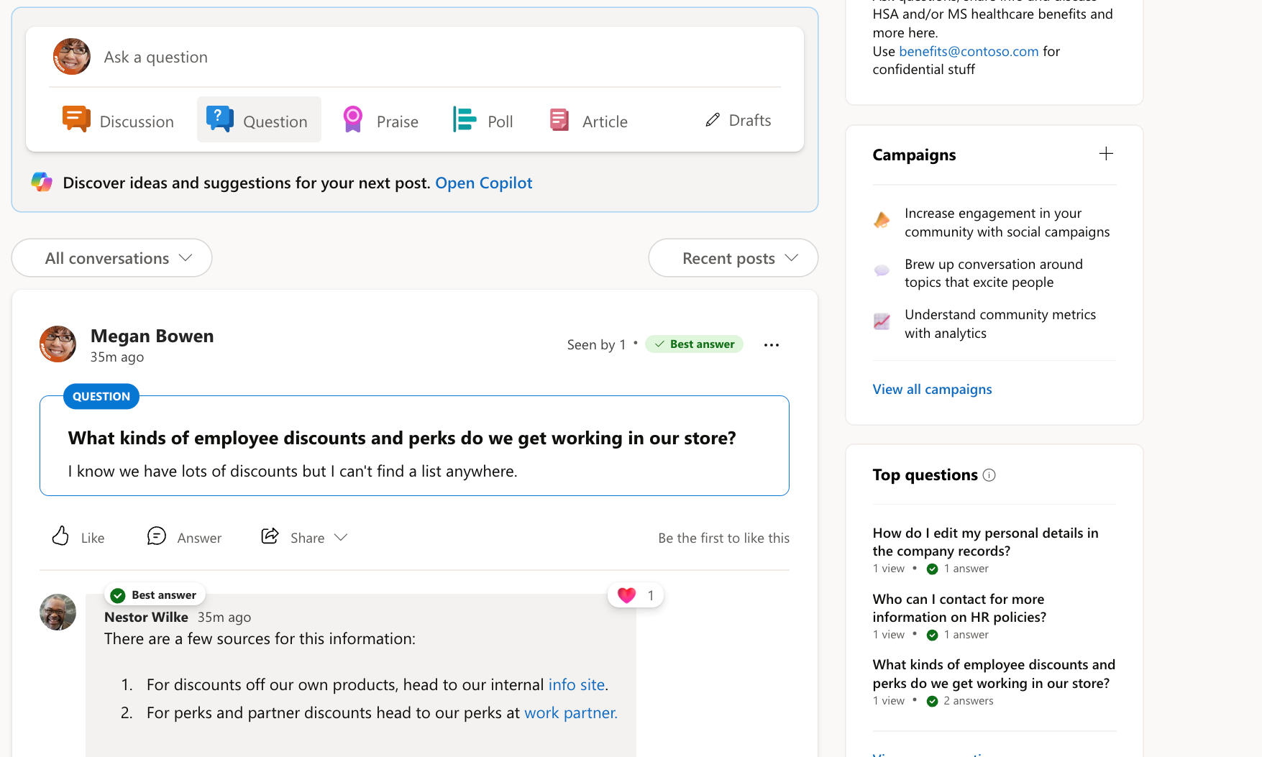
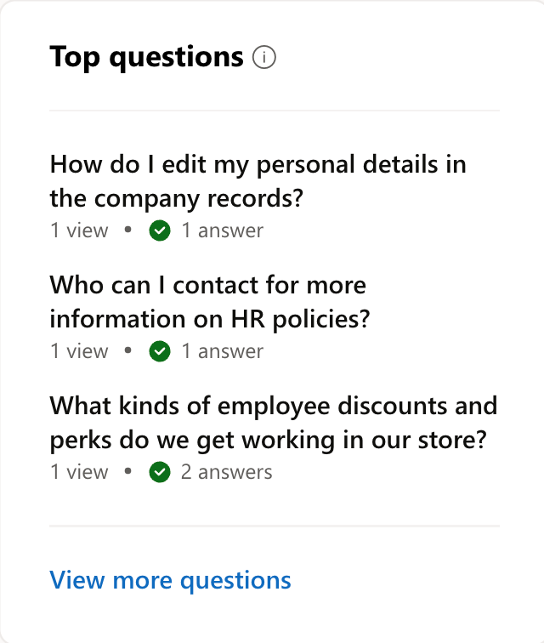
NEW! Top Questions
A dynamic FAQ for your community, top questions, looks at the questions asked in the community over the last 90 days and ranks them by the number of views received.
This means that the questions with the highest view counts are considered the top questions.

Slide 32



When should I use Teams, Engage, and Outlook?
Teams
Engage
Outlook
Conversation mode
Focused teamwork
Leadership/scaled communications, community, discovery
Targeted, direct and restricted (IRM) communications
Work with people regularly
on projects
Quickly iterate
Work on files
Collaborate
Connect across the organization
Create a community or audience from a distribution list
Reactions, replies, dialogue
Announcements & analytics
Ask-me-anything and Q&A
Share with specific people
or groups
Restricted (encrypted) comms
Broad comms, limited replies
Comms to ad hoc recipients:
No need for group
Move from DL to group
Nature of collaboration
Group size
and openness
Private group – Small to medium team or organization
Leader audience Public or private group: Community or large organization
Private or directed audience –Tracked, communications, offline teamwork
Notes:
Generated by Copilot
This slide compares Teams, Engage, and Outlook, outlining when to use each based on conversation mode, collaboration nature, and group size. Teams is for focused teamwork, Engage for leadership and community communication, and Outlook for targeted, direct messaging.
______

Slide 33
Sample Templates
Access Engage from Microsoft Teams and download the Microsoft Teams app.
Notes:
Generated by Copilot
Getting started with Engage is simple: access it through Microsoft Teams and download the Teams app if needed. This ensures employees can easily join and participate in the new engagement platform.
______

Slide 34
[Sample] Create community scorecard
Measurement | Status | Details
Effective community management | ● | Two community managers, need to recruit champions to build content calendar
Clear purpose | ● | Need to update description, info box with more details
Membership | ● | Steady growth
Leadership engagement | ● | CVP hosting monthly events, need more levels of leaders involved
Quality of conversations, questions | ● | 45% of questions have “best answer“ marked
Diversity of contributions | ● | Only members are reacting, responding, can do better sharing and request to feature a conversation next quarter to allow non-members to interact
Brings value to the business | ● | Search #communitywin for conversations that save time, money for our customers
Create your own or edit and add metrics that make sense for your community.
Highlight wins of connection and celebrate campaigns success.

Slide 35
Bonus Exercise: Community Canvas
1. Purpose Why does this community exist? | 2. Audience Who is this for and how do they find out? | 3. Values What 3 principles are important?
4. Goals What are 3 metrics we can measure in the next 12 months? 1. 2. 3. | 5. Experience What happens on a reoccurring basis? How are people onboarded? | 6. Roles What different roles can people play?
7. Rules What guidelines and boundaries help achieve the purpose and values? | 8. Governance How do we make decisions? Who gets to decide? | 9. Communication What are the channels for us to communicate? How frequent?
Source: https://community-canvas.org/

Slide 36


Thank you!
Notes:
Generated by Copilot
A closing slide to thank the audience, signaling the end of the presentation and inviting any final questions or discussions.
______

