Slide 1
Social campaigns with Viva Engage
A step-by-step playbook
Updated January 2023

Slide 2
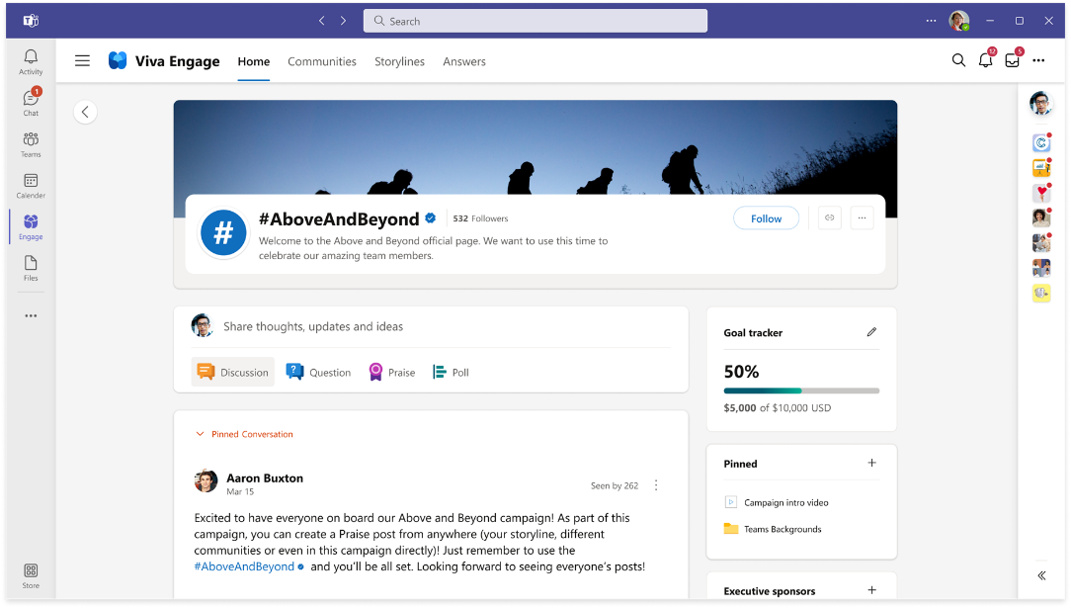
Strengthen social campaigns with Viva Engage
Create campaigns to drive important initiatives that support business goals and objectives.
Assign campaign sponsors and pin resources to get the campaign off the ground.
Hashtags allow people to find, follow, and participate in the campaign. These will have official checkmark and a color assigned to distinguish from other hashtags or campaigns.
The goal tracker allows for visible measure of progress towards the campaign's goals.
Gain insight about the campaign’s impact and reach with analytics from the last week, month or of all time
Find top creators and top conversations to highlight post-campaign success.
An announcement to broadcast the start of your campaign could result in 5x greater reach than a regular post.
Notes:
Leaders can also create campaigns to drive important initiatives that support business goals and objectives. These campaigns include a visual Goal Tracker to highlight progress and showcase key sponsors and contributors.

Slide 3
Benefits of social campaigns
With the flexibility of Viva Engage you are not limited to one type of campaign. Combine different types to help your campaign reach its full potential.
Targeted
Large Audience
Supportive
Engagement
You have a specific message and objective you want to address with a key audience
You want to address a broad audience with a general message.
Viva Engage is used to manage the digital conversation of the primary campaign.
You want to activate a conversation but don't want it to be a distraction from daily responsibilities.

Slide 4
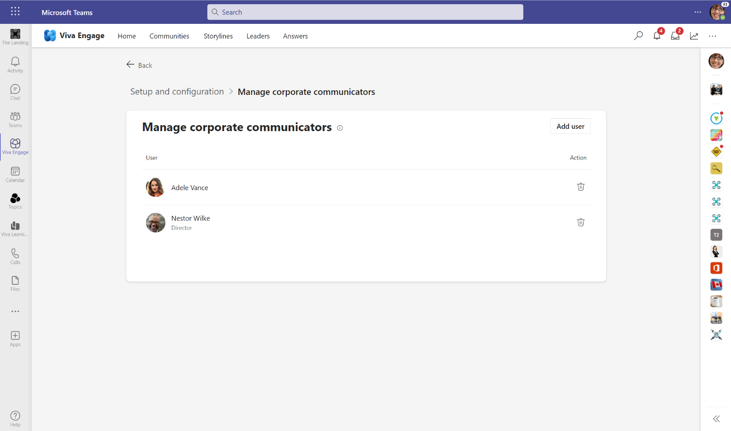
Corporate communicators can create campaigns
Using social campaigns within Viva Engage broadens conversations—it is a great companion to organization-wide initiatives. Viva Engage admins can add corporate communicators through the admin settings. Corp comms can add or remove other Corporate Communicators.

Slide 5
Build social campaigns that focus on employees
Drive Business Goals
Tap into the collective experiences
Create belonging at work
Rally distributed workforces around common goals in an interactive and engaging way
Involve employees in ideation
Include everyone and create initiatives that employees are passionate about
Customer Example:
Photo contests to showcase remote workspaces. #WhereIWork
Share about conversations that matter to your business and wins #retailWins
Customer Examples:
Crowdsourcing ideas for sustainability in the workplace #FutureUs
Encourage employees to share when they see your product/service in the real world #IntheWild
Customer Examples:
#MoveForwardTogether for employees to be connected during a time of change
As the year/quarter closes, encourage employees to share #reflections for that season.

Slide 6
Sample campaign ideas
Many organizations already have different campaigns running, and using Viva Engage can be an additional channel to engage employees. Different types of campaigns influence and determine desired engagement.
Company-wide initiative
Use Viva Engage to support a key initiative within your organization. Seek feedback and gain insights.
Top 5–sink or swim
Find out what's working and what's not at your company. Have your people weigh in on programs, tools, initiatives and more and spark an active conversation.
Win. Win. Win.
Use Viva Engage to manage the motivating and engaging conversation of wins. Share, congratulate, discuss, and learn.
Product launch or roll out
Use Viva Engage to announce a new product/tool/service roll out and include community support all in the same place.
30 days of ______
Pick a topic/idea and spend 30 days actively discussing in Viva Engage. Could be one question per day/week that employees answer, share response related to the campaign.
Innovation generation
What’s next for your organization? Encourage employees to share hacks, tips and tricks and more. Use Viva Engage to connect asynchronously to imagine tomorrow.
Leadership series
Use Viva Engage as a channel for employees to connect with leadership and have leaders go first. Encourage leaders to take turns sharing about what they are learning, reading, listening to and encourage employees to share the same.
Corporate-wide Giving efforts
Coordinate company efforts to give back to the communities in which you live. Share key messages, track progress, and seek participation.
Recognition & Gratitude
Who are the individuals and teams who are making it happen, going above and beyond? Who is making an impact? Showcase their efforts with Viva Engage praise campaign.
Problem solve out loud
Ask about a problem and openly think of solutions using the collective IQ of the employees.

Slide 7
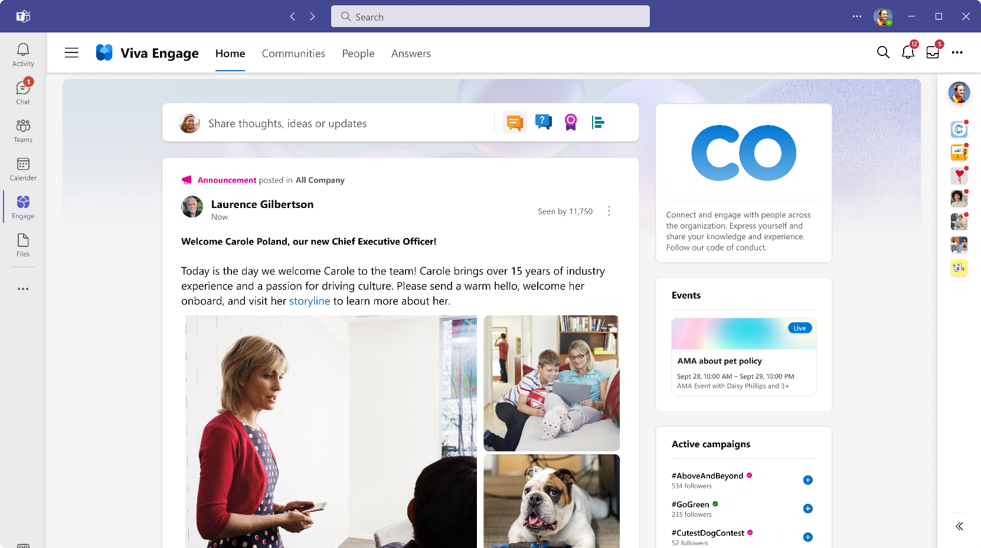
Employees find and participate in active campaigns
Active campaigns

Slide 8
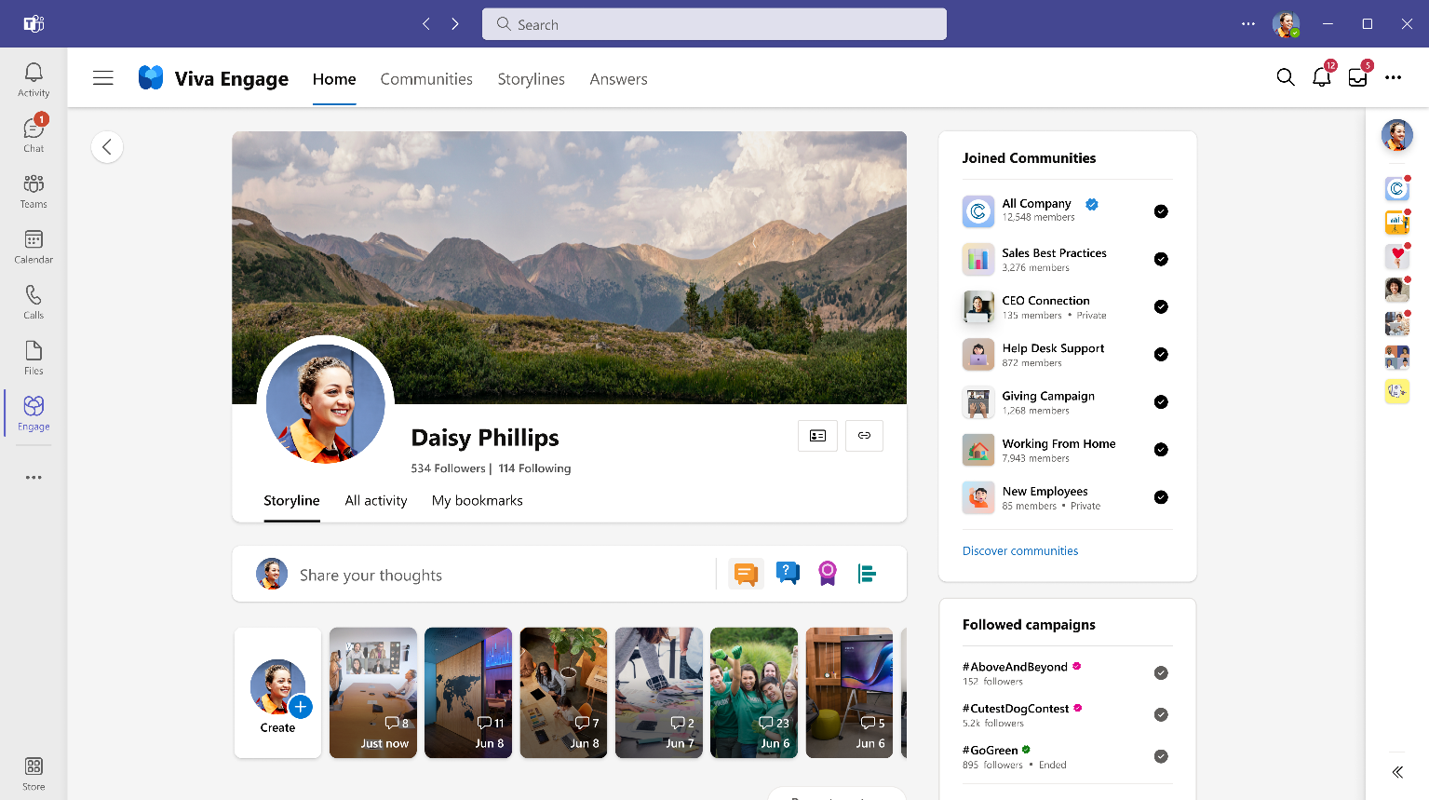
Employees can follow campaigns
Followed active campaigns

Slide 9
Step 1 - Preparation
The success of a social campaign can be determined by how well your team prepares and how relevant the subject is to your audience. Choosing a relevant topic that will connect with your audience, clearly defining the roles and responsibilities of the people who will participate and ensuring the logistics are carefully thought through helps to ensure success.

Slide 10

Build your campaign plan
Opportunity or problem?
Are you running this campaign because you see an opportunity or are you trying to solve a problem?
Once you have determined the reason you can start to focus on the details that will help drive the nuances of the campaign, such as: topic or theme, purpose and objectives, campaign type and supporting idea, and how Viva Engage can support these objectives.

Slide 11
Develop the social content and strategy
Social content for the campaign should have a clear and defined goal that educates, supports, and/or entertains. Additionally, the content should have an easy-to-understand main idea, strong supporting points, and a clear call to action for employees.
Examples that could support your strategy:
A messaging framework, including frequently asked questions
Technical support documents
Conversation starters
Pre-written and approved social posts for executives and influencers
Campaign marketing materials that can be shared on variety of channels

Slide 12
Campaign stakeholders and audience
It's important to know who will be supporting the corporate communicators in the execution of the campaign. They will need to know their roles and related responsibilities so be sure to provide clear guidelines and expectations.
Primary Audience
Stakeholders
Executive Sponsorship
This is the community or employees you primarily want to reach with a specific business purpose. While campaigns are global in nature and available to all, promotion and awareness can be targeted within specific communities or via specific leaders.
Those who make it happen -- your experts, community managers, and campaign managers.
Leaders who support the campaign, are engaged in the strategy, and care about the outcome. Campaigns will have the ability to have a visible executive sponsor. Encourage the executive to participate early and often.
Note: Only employees who have the corporate communications role assigned in Viva Engage will be able to create campaigns.

Slide 13
[TEMPLATE] Social campaign brief
Use this as a template for creating a brief that can be used to gain support or sponsorship from executive stakeholders.
Details
Opportunity/problem | What is the opportunity you want to take advantage of or the problem you are looking to solve?
Background | Why is this campaign happening?
Topic/theme | What is the topic or theme that will drive this campaign?
Purpose/objective | Outline the purpose or objective this campaign is being developed for
Campaign type | Focused, large community, passive, or supportive
Campaign idea | What idea will be the foundation of your campaign?
Viva Engage? | How can Viva Engage support this campaign?
People
Primary audience | Who are you targeting and why?
Executive sponsorship | Who is the executive and/or organization sponsoring this event and what responsibilities will they have?
Stakeholders | Who are the subject matter experts, community managers, and campaign managers and what responsibilities will they have?
Logistics
Primary communication channel(s) | Which communities will be used to host campaign communications?
Budget | Will any funding be needed to make this campaign happen? If yes, how much?
Schedule | What are the key dates for this campaign? Kick-off, launch, check-ins, close, report and review.
Analytics baseline | What are the key data points you will use to showcase progress and success?

Slide 14
Key milestones
Even though a Viva Engage social campaign is easy to set up, building and implementing it still requires planning. Each campaign is different and may require different prep work, have unique success criteria, and will vary as to what to expect in terms of outcomes.
Campaign kick-off
Days
before
Two+
weeks
before
One week
before
Determine schedules content and posts
Upload documents, photos or videos
Send out reminders
Clearly define KPIs
Finalize planning and messaging
Prepare & train stakeholders
What type of campaign do you want to run and what idea will determine the theme?
Fill out your campaign brief template
Put a meeting invite on stakeholders’ calendars

Slide 15
Campaign Readiness Checklist
 | Sample tasks
 | Determine the timing of the campaign. Will this be a reoccurring campaign?
 | Is your team trained and ready?
 | Do you know who are going to be your main voices and use @mentions to get them engaged early.
 | Determine the specific #hashtag to track campaign efforts. You cannot change this once the campaign as started.
 | Do you have a clear social content strategy? Define key messages and call to action for employees.
 | Determine the entry point for the campaign.
 | Find a few stakeholders to seed the campaign with a few posts to get the conversation started.
 | Create a short video to introduce the campaign to employees.

Slide 16
Step 2: Plan, Build, Execute
Besides being a fun, affordable, and engaging way to connect people, a Viva Engage social campaign should reflect your company's culture.

Slide 17
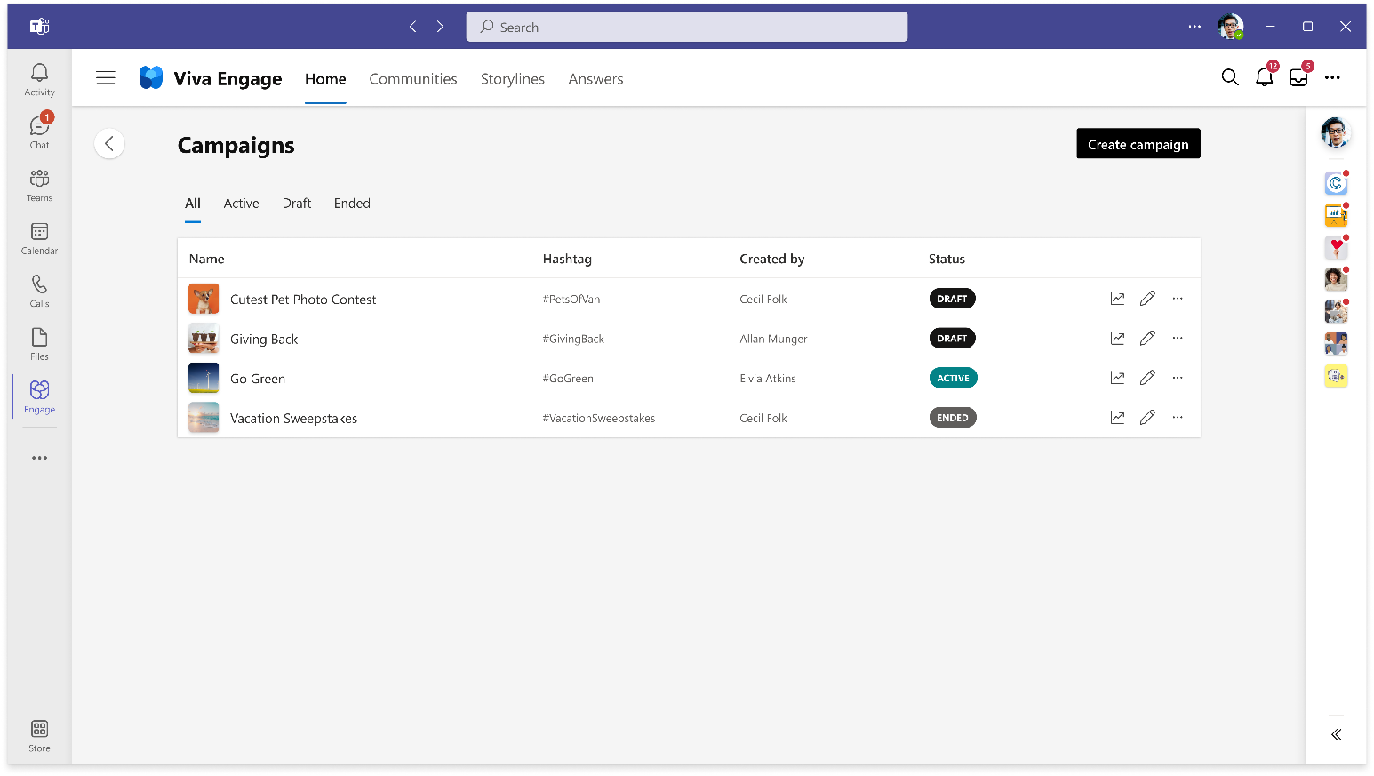
View campaigns across the network
Viva Engage and Corporate Communicators can view campaigns.
Create new campaigns
All campaigns

Slide 18
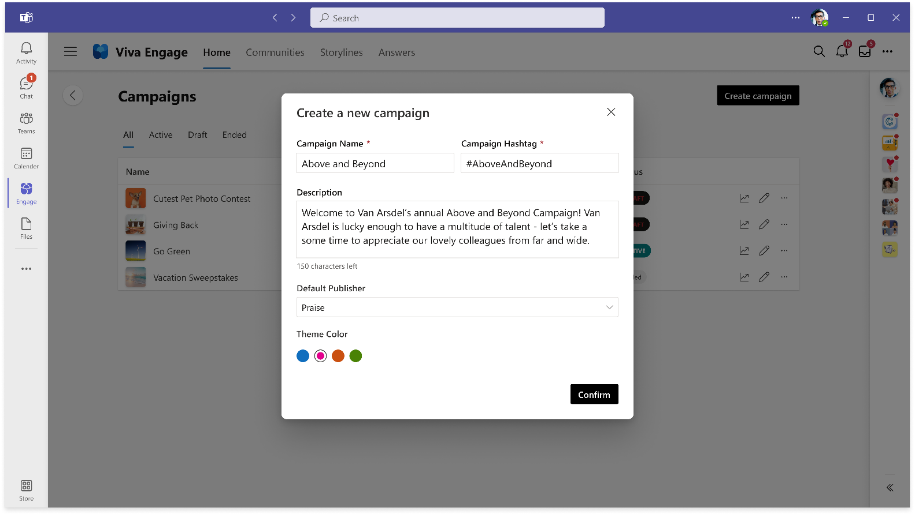
Set up the campaign
Add campaign hashtag.
Add call to action in description.
Change publisher to reflect campaign goals.
Select a color for the #hashtag.

Slide 19
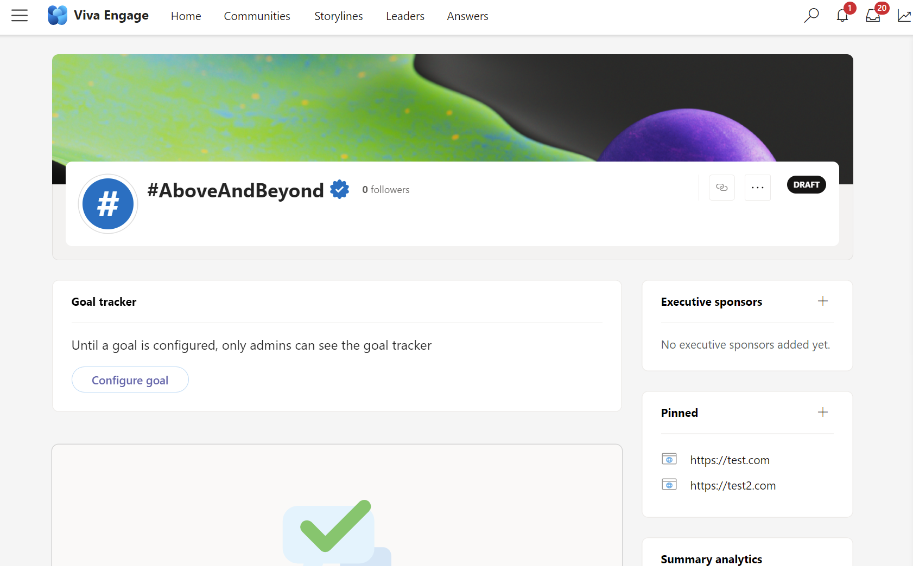
Customize and add additional details before it’s live
Update cover photo
Edit the goal tracker to match objectives.
Add relevant leaders
Related resources for the campaigns.

Slide 20
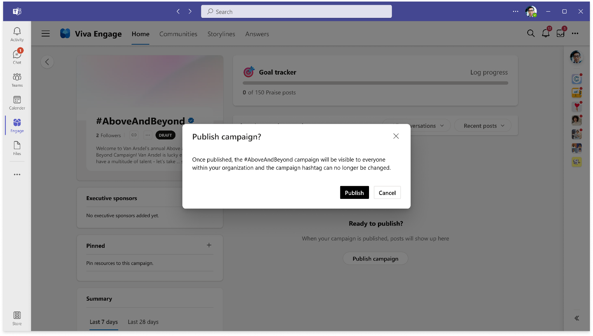
Publish the campaign when ready

Slide 21
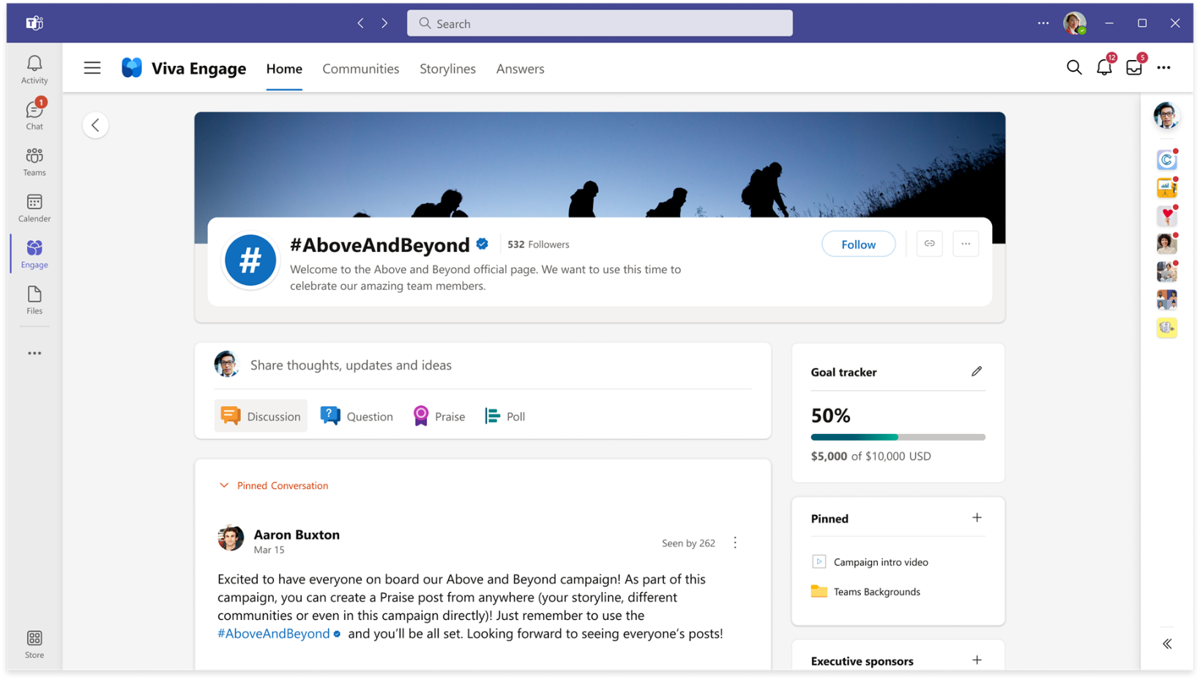
Identify resources to support the campaign
Add pinned resources

Slide 22
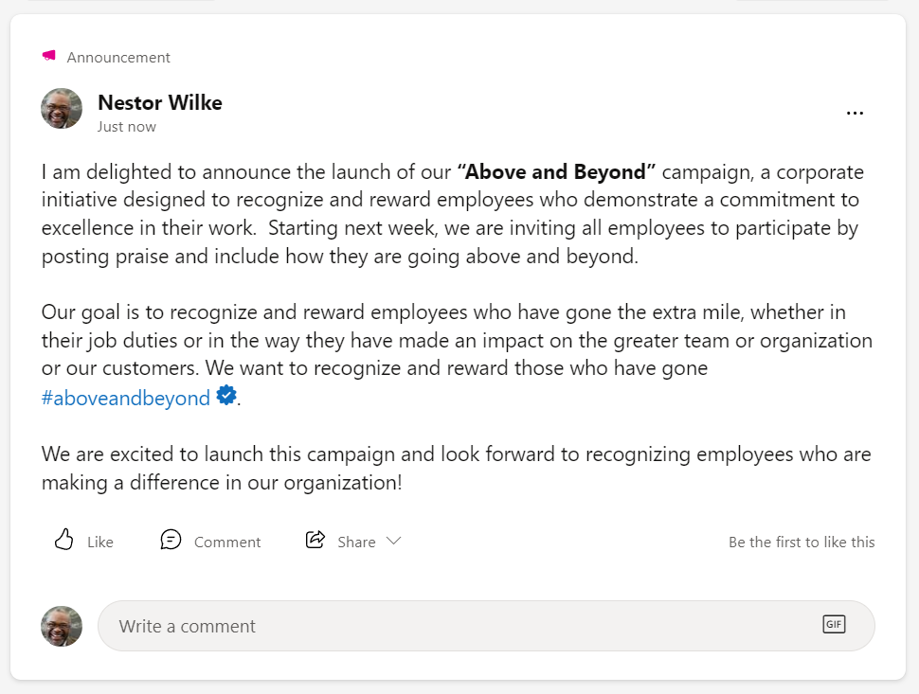
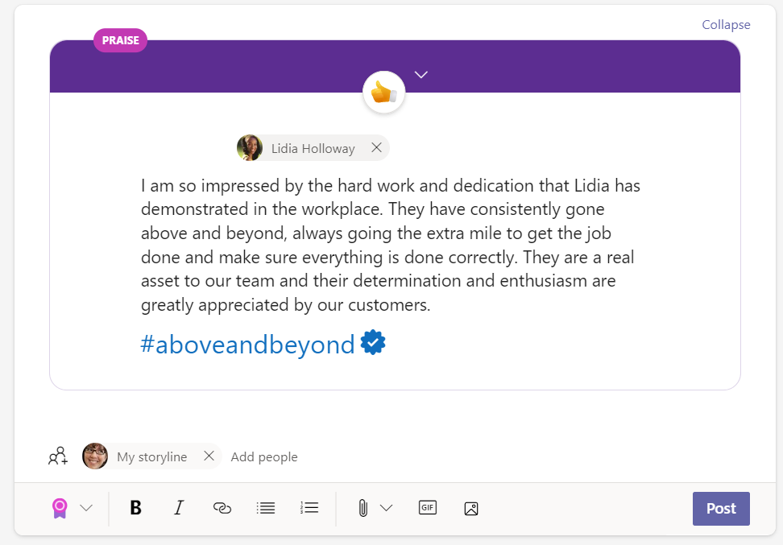
Communicate how to contribute to the campaign
Send an announcement from the executive sponsor with your campaign details and call to action for employees. You can pin this message in the campaign feed.
Encourage influential stakeholders to go first

Slide 23
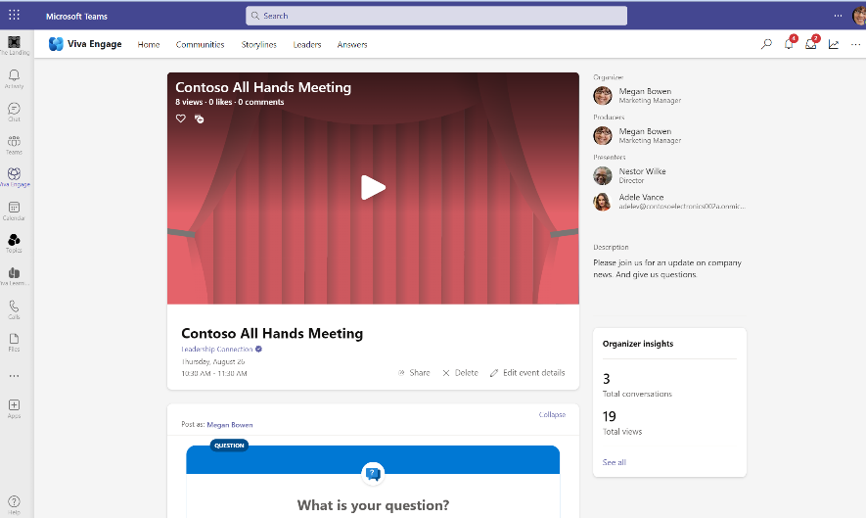
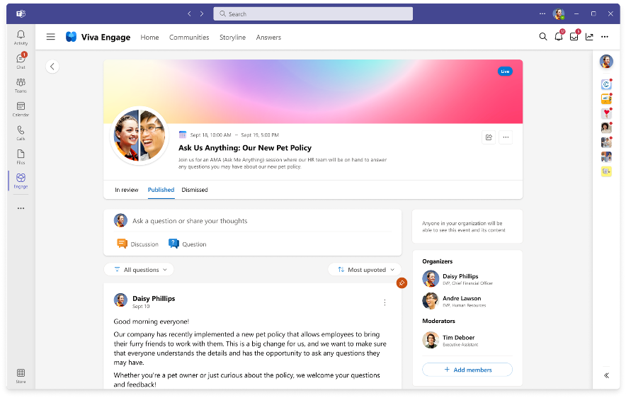
Get the word out about your campaign with events
Live events
Ask Me Anything (AMAs)
Live events use video and interactive discussion and attendees can participate in real-time from anywhere, on any device, and catch the event recording if they can't make the scheduled time. Learn more about live events here.
Kick off the campaign with an AMA style event to get the conversation started.

Slide 24
Step 3 – Measuring impact
Your campaign can contribute to the holistic view of how your company is evolving into a modern workplace.

Slide 25
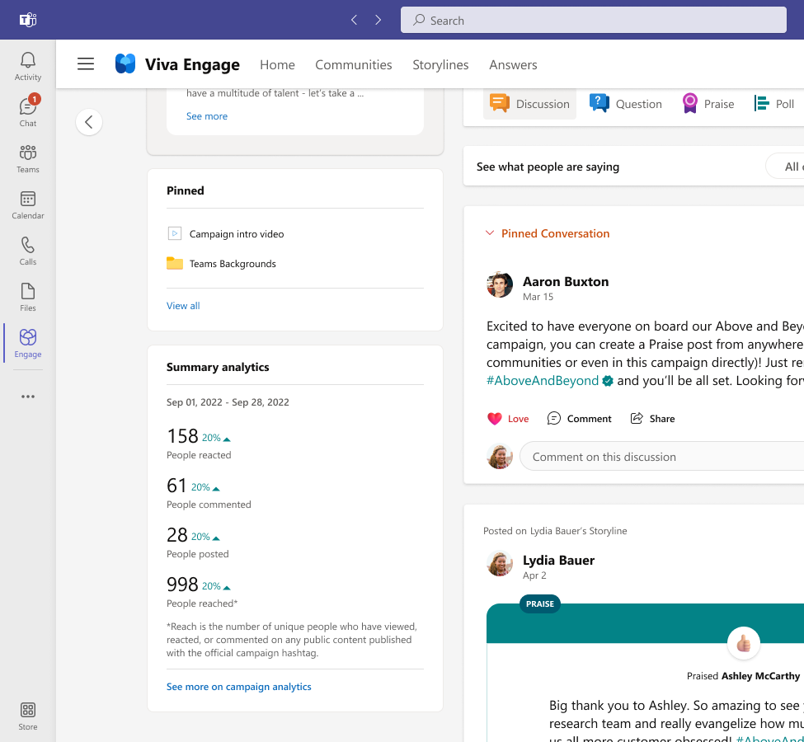
Campaign Analytics
Track and measure what happened during the campaign.
From the campaign page, campaign owners and admins can see a summary of the information collected and trends over time.
Reactions
Comments
People posting
Reach

Slide 26
[Template] Campaign Reporting
Campaign sponsor: [Leader, community, team, or organization]
Campaign background: [Add a brief sentence or two about why you created the campaign.]
People | Subject matter expert: Community manager: | [Key Takeaway]
Audience | Potential audience size Number of attendees (active and non-member) | [Key Takeaway]
Questions | Number of questions Number of comments per question | [Key Takeaway]
Engagement | Likes Shares Total comments | [Key Takeaway]
Anecdotal highlights and quotes | “quote” [highlight] | [Key Takeaway]

Slide 27
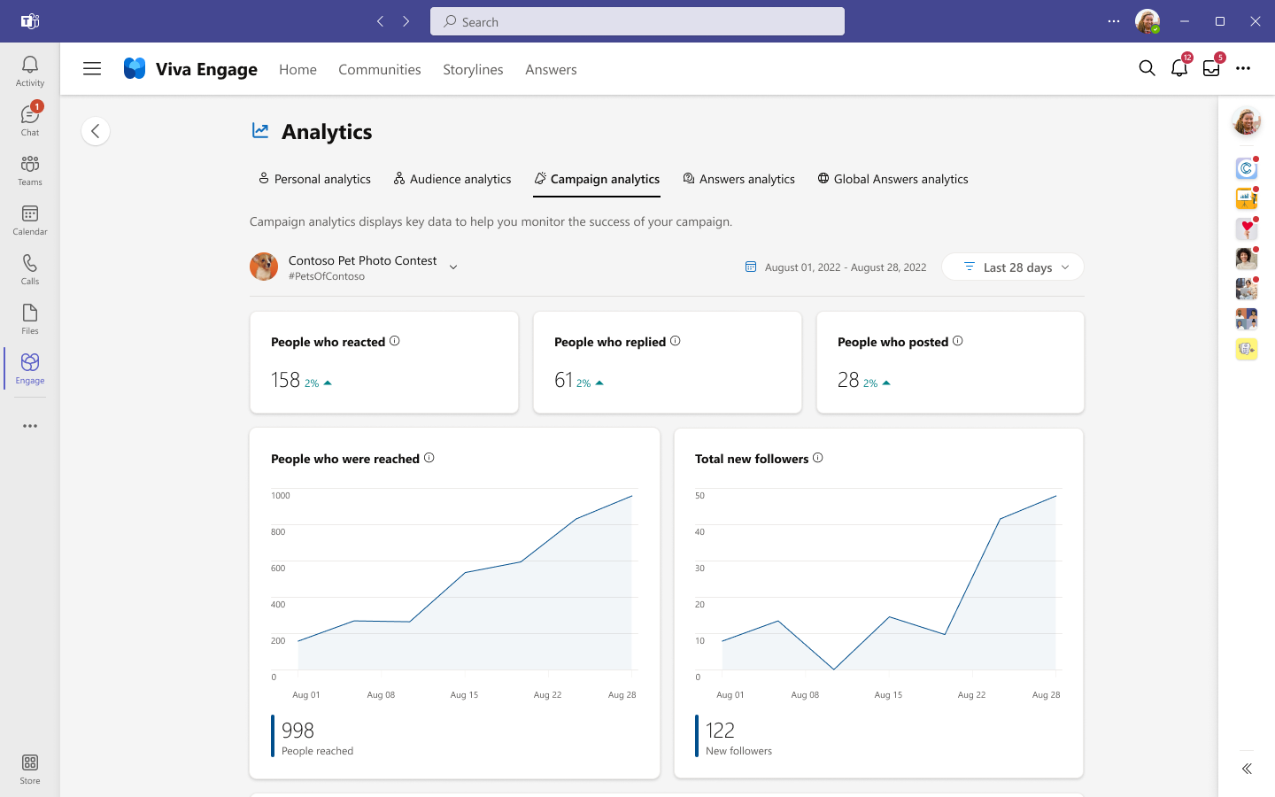
Measure the impact of your campaign
See who is actively contributing
Track success metrics and progress
Review trends in campaign participation and see how many people have viewed and engaged with content.
Switch between campaigns.
Determine date range.
Reach is the total number of ALL engagements including
(views, reactions, replies and posts).

Slide 28

Keeping the campaign going, after it’s over…
Persistence – The discussions related to the campaign has now been captured, it can be referenced and can continue to add value long after the campaign is over. This creates a reference for future learning and feedback.
Ongoing – Even if the timeframe for the campaign has ended, employees can still contribute the campaign using the official hashtag.
Engaged –Recognize engaged employees who contributed to the campaign, not only those who shared but also those who reacted and responded to others throughout the campaign. a resource for future learning.

Slide 29
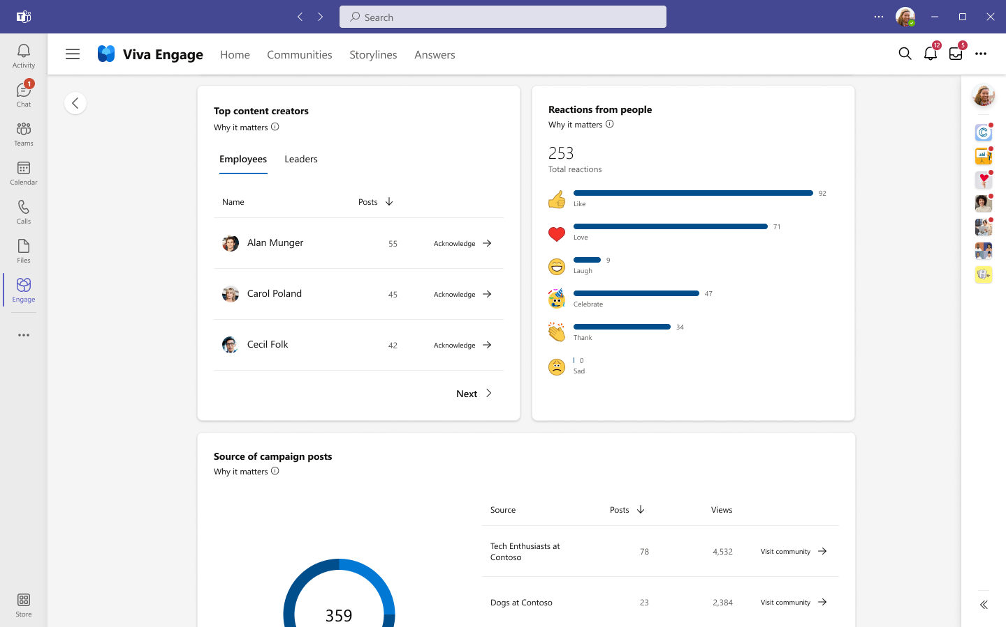
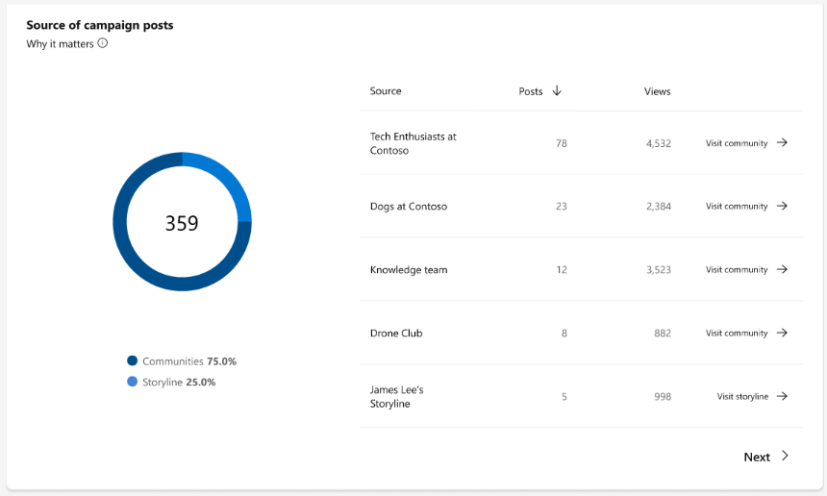
Recognize contributions and engagement
Share results of the campaign.
Acknowledge campaign contributions by giving praise post to top content creators.
Identify where the reach and sources of contribution for the campaign came from person, specific community or storyline.
Praise contributors.

Slide 30
Sample checklist for closing out the campaign
 | Suggested Tasks
 | Praise the contributors of your campaign.
 | Remind subject matter experts to track conversations and answer any follow up questions.
 | Send out follow up and thank you communications to key sponsors, stakeholders and participants.
 | Capture some of the anecdotal highlights and conversations.
 | Collect usage and engagement data.
 | Start planning your next campaign.
 | Capture insights that relate to your campaigns KPIs or OKRs.

Slide 31
FAQ
Q. Who can create or delete campaigns?
Corporate Communicators roles, Viva Engage Admins can create and delete campaigns.
Q. Can I change a hashtag after the campaign has been published?
You cannot edit a hashtag after the campaign has been published.
Q. Who can see my campaign in draft mode?
Only corporate communicators and Viva Engage admins can see all campaigns, including drafts from the dashboard.
Q. Can I limit who participates in a campaign?
Currently, campaigns are available to all users across the Viva Engage network. We cannot restrict them to a set audience.
Q. What if an employee participates in the campaign within a private community?
If any employees posts in a private community using the campaign hashtag, only the members of that private community will be able to see the post in the campaign landing page. Even the campaign manager won't be able to see it if they are not a member of that community.
More support and details can be found here.

Slide 32
Get started today!

