Slide 1
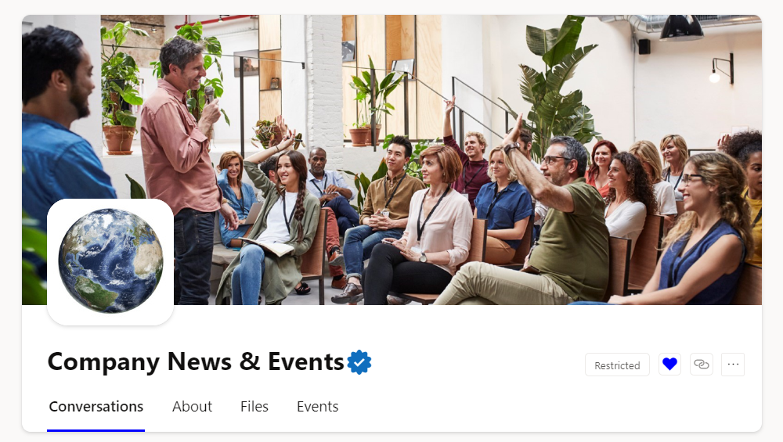
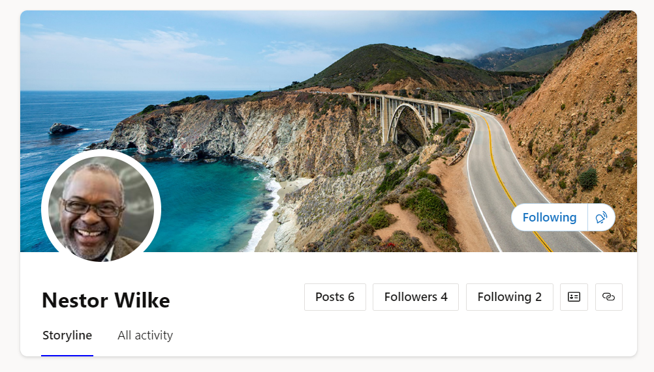
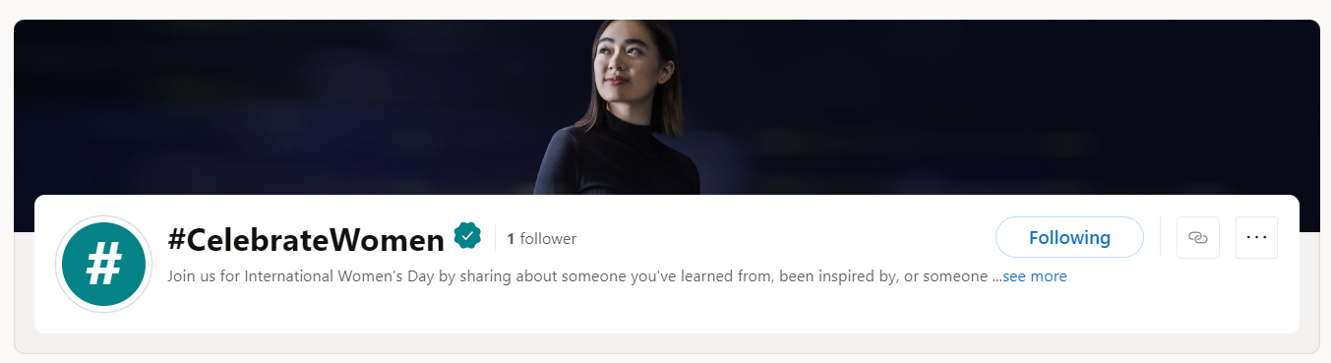
Viva Engage
Recommended images & sizing guide
Community cover photo and icon
Upload a cover photo to share your community’s identity, communicate a campaign, or publicize a community event. Only community admins can update the community cover photo.
The cover photo size is 1360 x 550
The icon image a square logo works best it will be resized to 85 x 85.
Best practice: Use something simple and recognizable because the community branding will be shown across the web and smaller on mobile devices.
Additional cover photos
Storyline
Storyline cover photo dimensions are 680 px by 275 px. The file must be 20 MBs or less and either a .png, .jpeg, or a non-animated .gif.
A delegate can edit a storyline cover photo.
Campaigns
Campaign cover photo dimensions are 984px by 160px.
The file must be 20 MBs or less and either a .png, .jpeg.
Corporate Communicators can update cover photos for the network level campaigns. Community Admins can update campaigns in the community.
Note: AMA cover photos cannot be edited at this time.
We try our best for recommendation for image sizes, however, the display of the image is highly dependent on the device and resolution.

Slide 2
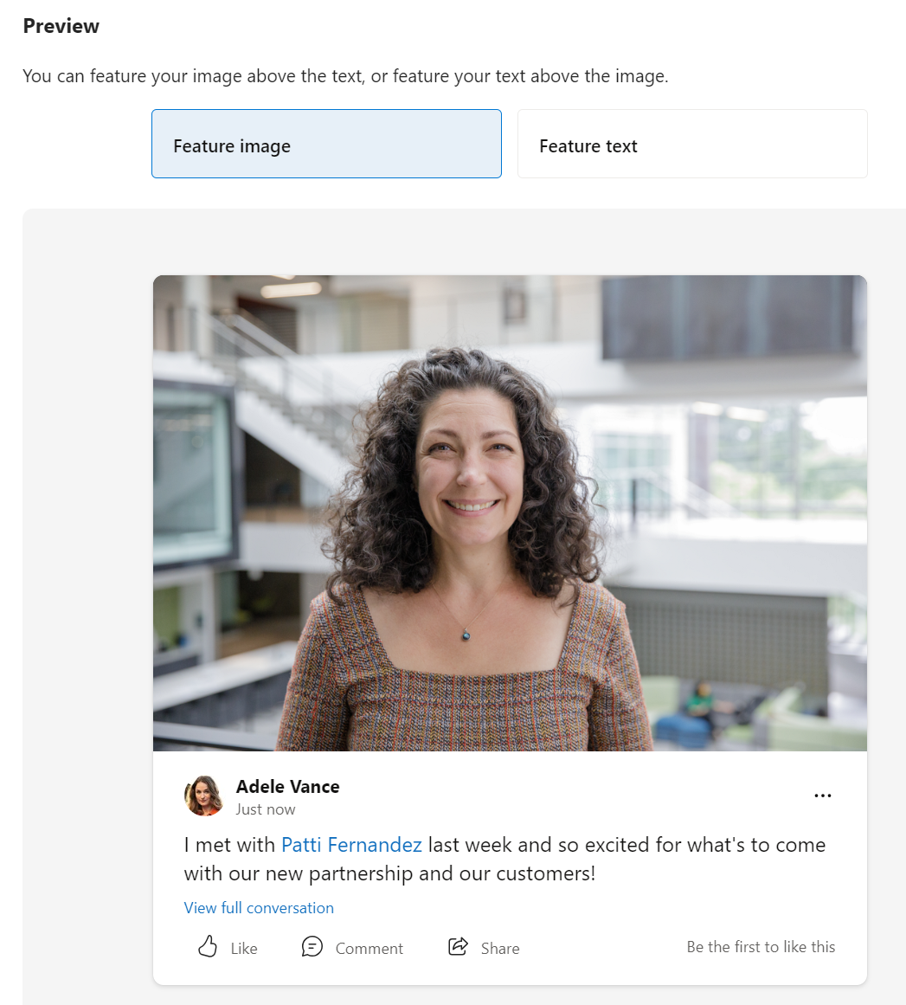
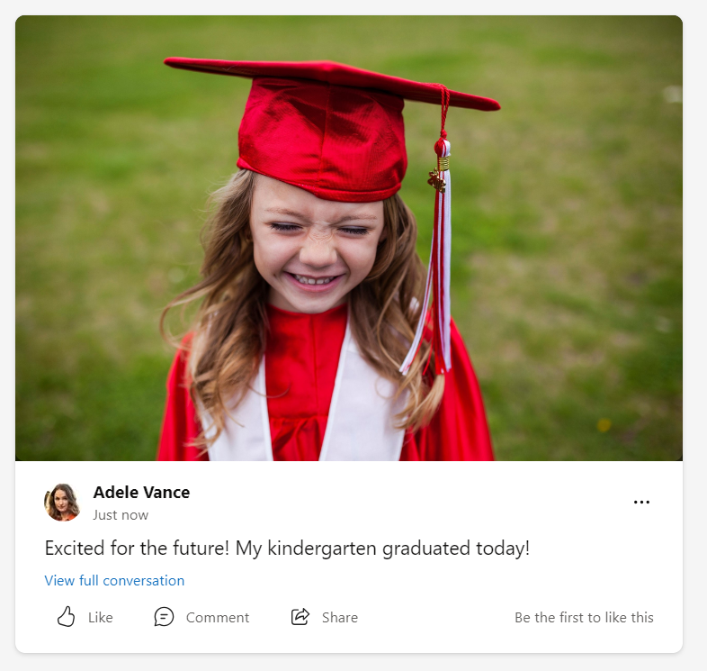
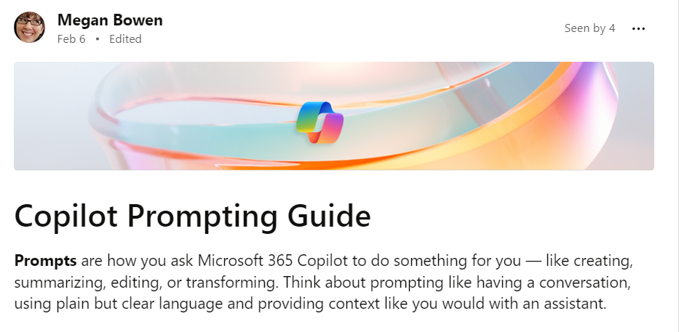
Viva Engage
Recommended images & sizing guide conversations
Conversations
​Try to keep posts short to medium length, 1–2 sentences per paragraph as post people tend to scan. Viva Engage posts have a 10,000-character limit.
For longer form posts, try using Articles!
Files - You can attach pdf files, image files, video files, Microsoft Office files, and more. Each post can have a maximum of 100 files.
Media centric posts (both images and videos) have a 452px height in web and 274px height in Android and iOS. When you upload an image or video, you'll be prompted for how you want it to display in the feed.
Images - You can upload 50+ photos at a time. The images you upload should be less than 5,000 x 5,000 pixels to maintain image quality.
⚠️The maximum image size is 10 MB
Videos - Supported file types for watching the video inline: .wmv, .avi, .mpeg, .3gp, .flv, .mov, .mp4, .mpg, .ogm, .mkv, .ogv, and .ogg, : .wmv, .avi, .mpeg, .3gp, .flv, .mov, .mp4, .mpg, .ogm, .mkv, .ogv, and .ogg.
⚠️The maximum video size is 10 MB.
Long form posts
Articles allow you to add a header image is recommended 1000 px by 200px.
Start using Copilot with Engage!

